Slide 1
Eastern Cape Province 21 July 2023
Educator Demand Projections
2021-2030

Slide 2
Introduction (1)
The proportion of educators that are 50 years or older has steadily risen between 2012 to 2021 in South Africa.
⇒ Nationally a wave of educator retirements is expected as older educators reach the standard retirement age of between 60 and 65.
Implications:
Many more appointments: The retirement wave will open up both teaching & school management & leadership positions & other office-based education specialists.
Total compensation of educators: Since older teachers earn more, when retiring they are replaced with younger (less costly) teachers.

Slide 3
Introduction (2)
As retirements increase, the required number of new appointments will need to increase to ensure that total educator numbers (at a minimum) stay at current levels and/or are sufficient to meet learner enrolment growth to prevent deterioration in learner-educator ratios.
Planning will be required to ensure that provinces are ready for the sustained increase in appointments.
If these positions are not filled, this could result in a further deterioration in the learner-educator ratio and lead to further increases in already large class sizes.

Slide 4
Introduction (3)
Educator age distribution in 2012 & 2021
Peak in age shifted from 46 years to 53 years
Source: Anonymised PERSAL data from 2021, only educators (Rank 60 000 – 69 999) are considered. ECD practitioners, TVET lecturers and ABET teachers were removed.

Slide 6
Objective
In each province there are some differences in the age profile of teachers, differences in the expected growth of the school-going population and differences in expected teacher attrition (resignations & retirements).
⇒ The year of the retirement wave peak will differ across provinces.
⇒ Also some provinces need to accommodate much more growth in
learners than others.
In this presentation, we highlight the situation in the
Eastern Cape to inform province-specific planning.

Slide 7
Overview
Age distributions
Projected retirements & resignations
Provincial population and enrolment trends
Public and independent school growth
Educator growth: Teachers and SMT positions
The implications for appointments and class sizes
Expected financial implications to 2030
Movement of educators: Between and within provinces
Gender imbalance in school management
Discussion
1
2
3
4
5
6
7
8
9
10

Slide 8
Eastern Cape educator demand summary
Age distribution: The age distribution in the EC had a peak at around 53 years of age in 2021
Projected resignations and retirements: From 2018 onwards, the majority of educators that exited PERSAL were age-related retirements (ages 56 to 65); the number of senior educators (SMT positions and other specialists) that are retiring is expected to increase (71% were 50+ years old in 2021)
Enrolment and population growth: Enrolment in the EC ordinary schools declined by -5% from 2012-2021 (~103K learners), and the school-aged population is forecast to decline by a further -15% (~235K learners) to 2030. School rationalization may need to continue in response to this decrease.
School and educator growth: Between 2012 and 2021, the educator number has fallen (-17%), and the number of ordinary schools has decreased (-7%), driving up the LE ratio and class sizes.
SMT position changes: In EC, there has been a decline in the number of Principals between 2012 and 2021 (-10%). Teacher numbers have also declined over this period (-20%), while there has been an increase in the number of HODs(6%) and Deputy Principals (8%)
Appointments and LE Ratio: The LE ratio increased from 26.6 to 30.9 between 2012 and 2021
Projected educator cost trends: The unit cost of educators is predicted to remain constant. Due to the change in age distribution.
Educator movements: There is low movement out of EC (~2%), and few educators move to EC (~1%). About 5% of educators move between schools within the province

Slide 9
Age distributions and projected retirements and resignations
1
2

Slide 10
Educator age distribution (2021)
1
A higher proportion of educators are over 50 years old in the Eastern Cape than in the rest of the country
Source: Anonymised PERSAL data from 2021, only educators (Rank 60 000 – 69 999) are considered. ECD practitioners, TVET lecturers and ABET teachers were removed.

Slide 11
Older teacher proportions for senior educator and primary schools educators
1
 |  | Percentage of educators aged 50+ in 2021
Province |  | All educators |  | Senior educators (HOD, Dep.- principals, Principals & Other) |  | Primary school educators
EC |  | 51% |  | 71% |  | 58%
FS |  | 43% |  | 65% |  | 49%
GP |  | 41% |  | 65% |  | 42%
KN |  | 39% |  | 65% |  | 44%
LP |  | 58% |  | 81% |  | 63%
MP |  | 50% |  | 73% |  | 55%
NC |  | 43% |  | 69% |  | 44%
NW |  | 47% |  | 70% |  | 52%
WC |  | 42% |  | 73% |  | 40%
SA |  | 46% |  | 69% |  | 49%
Source: Anonymised PERSAL data from 2021, only educators (Rank 60 000 – 69 999) are considered. ECD practitioners, TVET lecturers and ABET teachers were removed. The 2021 rankclass file was expanded to include ranks found only in years prior to 2021, used to classify educators by rank. Primary school only includes all educators that are in a component that is classified as a Primary school.

Slide 12
Older teacher proportions for senior educator and primary schools educators
1
 |  | Percentage of educators aged 50+ in 2021
Province |  | All educators |  | Senior educators (HOD, Dep.- principals, Principals & Other) |  | Primary school educators
EC |  | 51% |  | 71% |  | 58%
FS |  | 43% |  | 65% |  | 49%
GP |  | 41% |  | 65% |  | 42%
KN |  | 39% |  | 65% |  | 44%
LP |  | 58% |  | 81% |  | 63%
MP |  | 50% |  | 73% |  | 55%
NC |  | 43% |  | 69% |  | 44%
NW |  | 47% |  | 70% |  | 52%
WC |  | 42% |  | 73% |  | 40%
SA |  | 46% |  | 69% |  | 49%
zvc
Large numbers of SMT positions and education specialists (71%) were aged 50 years and older in 2021 in the EC
Source: Anonymised PERSAL data from 2021, only educators (Rank 60 000 – 69 999) are considered. ECD practitioners, TVET lecturers and ABET teachers were removed. The 2021 rankclass file was expanded to include ranks found only in years prior to 2021, used to classify educators by rank. Primary school only includes all educators that are in a component that is classified as a Primary school.

Slide 13
Educator age distribution in 2021 & 2030
1
Assume constant 2021 educator numbers
Age: 53
2021
2030
Source: Anonymised PERSAL data from 2021, only educators (Rank 60 000 – 69 999) are considered. ECD practitioners, TVET lecturers and ABET teachers were removed.

Slide 14
Projected resignation & retirements (EC)
2
Assume constant 2021 educator numbers
Proportion of Educators
The majority of educators that exit PERSAL in the Eastern Cape are retirees (ages 56 to 65)
The resignation rate in the Eastern Cape is low. Fewer educators opt to leave teaching before retirement
The number of young teachers (ages 21-30) resigning is projected to increase as the number of newly hired young teachers increases.
All educators that leave PERSAL (from that province) or change to something that is not an educator are classified as having either:
Resigned: Ages 21-55
Retired: Ages 56+
Projected
% of educators resigning or retiring
Source: Anonymised PERSAL data from 2021, only educators (Rank 60 000 – 69 999) are considered. ECD practitioners, TVET lecturers and ABET teachers were removed. Estimates to 2035 derived from the National and provincial teacher supply and demand models – assumption of no growth in educator numbers. Note: Retirements refer to all educators, aged 56 to 65, that leave PERSAL, whilst resignations refer to all educators aged 55 and below that leave PERSAL (as educators) for any reason.

Slide 15
Projected resignation & retirements (EC)
2
Assume constant 2021 educator numbers
Retirement headcount
The number of retirements is projected to increase, peaking in ~2029 and then declining again
The number of retirements is projected to increase from about 1,750 in 2022 to about 2,700 in 2029, an increase of about 950 retirements annually
Projected
Number of retirements
Source: Anonymised PERSAL data from 2021, only educators (Rank 60 000 – 69 999) are considered. ECD practitioners, TVET lecturers and ABET teachers were removed. Estimates to 2035 derived from the National and provincial teacher supply and demand models – assumption of no growth in educator numbers. Note: Retirements refer to all educators, aged 56 to 65, that leave PERSAL, whilst resignations refer to all educators aged 55 and below that leave PERSAL (as educators) for any reason.

Slide 16
Older leaver trend estimates to 2035
2
Assume constant 2021 educator numbers
About 32,000
educators estimated to retire by 2035 in the EC
(60% of total educators in 2021)
By 2032, about half of EC educators from 2021 will have retired
Source: Anonymised 2021 PERSAL data, only educators (Rank 60 000 – 69 999) are considered. ECD practitioners, TVET lecturers and ABET teachers were removed. Estimates to 2035 derived from the National and provincial models – assumption of no growth in educator numbers.

Slide 17
Projected educators leaving
2
Assume constant 2021 educator numbers
Teachers
(School based teachers)
Senior educators
(HODs, Deputy’s, Principals & Other)
% of teacher resigning & retiring
% of senior educators resigning & retiring
Careful succession planning is needed during this period as high numbers of HODs, deputies and principals will be retiring by 2035
A lower proportion of teachers are expected to resign and retire in EC relative to SA-proportions of teachers leaving are lower overall because so few teacher leave before retirement in the EC
Source: Anonymised 2021 PERSAL data, only educators (Rank 60 000 – 69 999) are considered. ECD practitioners, TVET lecturers and ABET teachers were removed. Estimates to 2035 derived from the National and provincial models – assumption of no growth in educator numbers.

Slide 18
Provincial population and enrolment trends
3

Slide 19
Provincial enrolment trends (2012-2021)
3
High growth
Moderate growth
Stable
Decline
Source: Enrolment numbers taken from School Realities-EMIS (2012 – 2021) released by the DBE, using total numbers for ordinary public and independent schools.

Slide 20
Provincial enrolment trends (2012-2021)
3
Enrolment in Eastern Cape ordinary schools
decreased by 5%
from 2012 to 2021
Source: Enrolment numbers taken from School Realities-EMIS (2012 – 2021) released by the DBE, using total numbers for ordinary public and independent schools.

Slide 21
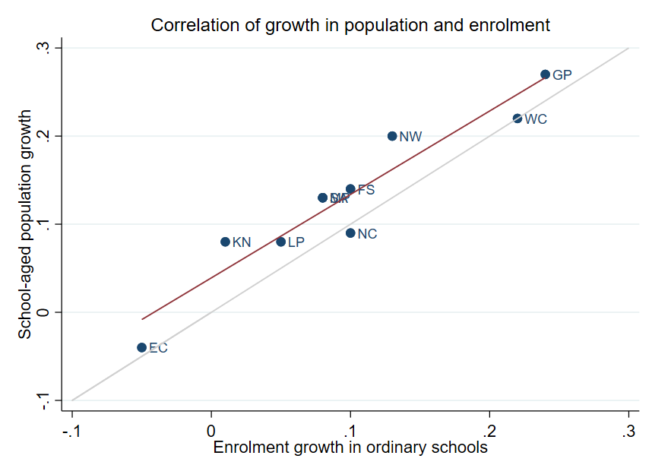
Correlation between population and enrolment growth (2012-2021)
3
R² = 0.9025
Strong positive correlation between population and enrolment growth between 2012 and 2021
45˚
Source: Thembisa age specific data V4.5 for school-aged population (Ages 7-18) estimates and enrolment taken from School Realities-EMIS (2012 – 2021) released by the DBE, for numbers on ordinary public and independent schools (Statistical Publications (education.gov.za))

Slide 22
Projected growth in school-aged population
3
Population of children aged 7-18 in the Eastern Cape, is expected to decrease by
~235K children (-15%)
from 2021 to 2030
Note: Period 2021 – 2030 is the same timeframe, nine years, as 2012 – 2021.
Source: Thembisa age-specific estimates from the model V4.5 for children aged 7-18 by province

Slide 23
School aged-population estimates to 2030
3
 | Number of children Aged 7-18 |  |  |  | Growth '12-21 | Growth '21-30
Province | 2012 | 2021 | 2030E |  | Growth '12-21 | Growth '21-30
EC | 1 657 202 | 1 598 475 | 1 361 637 |  | -4% | -15%
FS | 592 445 | 676 489 | 650 820 |  | 14% | -4%
GP | 1 962 793 | 2 498 533 | 3 180 884 |  | 27% | 27%
KN | 2 485 822 | 2 690 378 | 2 657 716 |  | 8% | -1%
LP | 1 395 864 | 1 507 386 | 1 612 125 |  | 8% | 7%
MP | 977 749 | 1 100 594 | 1 165 728 |  | 13% | 6%
NC | 254 075 | 277 560 | 281 208 |  | 9% | 1%
NW | 742 943 | 893 530 | 930 323 |  | 20% | 4%
WC | 1 068 009 | 1 298 801 | 1 496 731 |  | 22% | 15%
Total | 11 136 902 | 12 541 746 | 13 337 172 |  | 13% | 6%
1,60M
1,66M
1,36M
Note: Period 2021 – 2030 is the same timeframe, nine years, as 2012 – 2021.
Source: Thembisa age-specific estimates from the model V4.5 for children aged 7-18 by province

Slide 24
Public and independent school growth
4

Slide 25
Educator, school and enrolment growth
4
 | % growth from 2012 - 2021
Province | Number of educators | Number of teachers |  | Number of public ordinary schools | Enrolment in public ordinary schools | Enrolment in ordinary schools |  | Est. school-aged population
EC | -17% | -20% |  | -8% | -6% | -5% |  | -4%
FS | -13% | -13% |  | -27% | 9% | 10% |  | 14%
GP | 21% | 28% |  | 1% | 20% | 24% |  | 27%
KN | -5% | -3% |  | -3% | 1% | 1% |  | 8%
LP | -8% | -2% |  | -7% | 4% | 5% |  | 8%
MP | 3% | 7% |  | -8% | 7% | 8% |  | 13%
NC | 6% | 9% |  | -3% | 9% | 10% |  | 9%
NW | 2% | 4% |  | -9% | 12% | 13% |  | 20%
WC | 12% | 22% |  | 0% | 21% | 22% |  | 22%
SA | -1% | 2% |  | -6% | 7% | 8% |  | 13%
Source: Educator numbers from anonymised PERSAL data from 2012 and 2021, only educators (Rank 60 000 – 69 999) are considered. Thembisa age specific data V4.5 for school-aged population (Ages 7-18) estimates and enrolment and school numbers taken from School Realities-EMIS (2012 – 2021) released by the DBE, for numbers on ordinary public and independent schools (Statistical Publications (education.gov.za))

Slide 26
Educator, school and enrolment growth
4
 | % growth from 2012 - 2021
Province | Number of educators | Number of teachers |  | Number of public ordinary schools | Enrolment in public ordinary schools | Enrolment in ordinary schools |  | Est. school-aged population
EC | -17% | -20% |  | -8% | -6% | -5% |  | -4%
FS | -13% | -13% |  | -27% | 9% | 10% |  | 14%
GP | 21% | 28% |  | 1% | 20% | 24% |  | 27%
KN | -5% | -3% |  | -3% | 1% | 1% |  | 8%
LP | -8% | -2% |  | -7% | 4% | 5% |  | 8%
MP | 3% | 7% |  | -8% | 7% | 8% |  | 13%
NC | 6% | 9% |  | -3% | 9% | 10% |  | 9%
NW | 2% | 4% |  | -9% | 12% | 13% |  | 20%
WC | 12% | 22% |  | 0% | 21% | 22% |  | 22%
SA | -1% | 2% |  | -6% | 7% | 8% |  | 13%
z
Enrolment and educator numbers declined in the Eastern Cape. The number of public ordinary schools also declined
Source: Educator numbers from anonymised PERSAL data from 2012 and 2021, only educators (Rank 60 000 – 69 999) are considered. Thembisa age specific data V4.5 for school-aged population (Ages 7-18) estimates and enrolment and school numbers taken from School Realities-EMIS (2012 – 2021) released by the DBE, for numbers on ordinary public and independent schools (Statistical Publications (education.gov.za))

Slide 27
School growth from 2012 to 2021
4
School growth was driven by independent school growth (+37%) from 2012 to 2021. In contrast, the number of public schools in SA decreased (-6%)
EC | FS | GP | KN | LP | MP | NC | NW | WC | SA
% independent schools (2021)
4%
8%
30%
4%
5%
7%
7%
6%
17%
9%
Source: School numbers taken from School Realities-EMIS (2012 – 2021) released by the DBE, for numbers on ordinary public and independent schools (Statistical Publications (education.gov.za))

Slide 28
School growth from 2012 to 2021
4
Higher growth in the number of independent schools in the EC (+18%) vs. public schools (-8%), with enrolment growing from about 65K to 75K children (+16%)
EC | FS | GP | KN | LP | MP | NC | NW | WC | SA
% independent schools (2021)
4%
8%
30%
4%
5%
7%
7%
6%
17%
9%
Source: School numbers taken from School Realities-EMIS (2012 – 2021) released by the DBE, for numbers on ordinary public and independent schools (Statistical Publications (education.gov.za))

Slide 29
Educator growth by teachers and senior educators
5

Slide 30
Changes in teacher and SMT numbers
5
 |  | Teacher |  |  |  |  | HOD |  |  |  |  | Deputy-Principal |  |  |  |  | Principal
Province |  | 2012 | 2021 | Diff | % change |  | 2012 | 2021 | Diff | % change |  | 2012 | 2021 | Diff | % change |  | 2012 | 2021 | Diff | % change
EC |  | 50 295 | 40 115 | -10 180 | -20% |  | 5 870 | 6 196 | 326 | 6% |  | 1 342 | 1 453 | 111 | 8% |  | 5 294 | 4 755 | - 539 | -10%
FS |  | 20 148 | 17 561 | -2 587 | -13% |  | 2 685 | 2 470 | - 215 | -8% |  | 852 | 768 | - 84 | -10% |  | 1 224 | 892 | - 332 | -27%
GP |  | 47 233 | 60 677 | 13 444 | 28% |  | 8 708 | 9 209 | 501 | 6% |  | 2 565 | 2 850 | 285 | 11% |  | 2 162 | 1 959 | - 203 | -9%
KN |  | 73 050 | 71 000 | -2 050 | -3% |  | 11 289 | 10 330 | - 959 | -8% |  | 2 642 | 2 342 | - 300 | -11% |  | 5 584 | 5 055 | - 529 | -9%
LP |  | 44 998 | 44 317 | - 681 | -2% |  | 6 090 | 3 762 | -2 328 | -38% |  | 1 562 | 778 | - 784 | -50% |  | 3 510 | 3 316 | - 194 | -6%
MP |  | 26 127 | 27 857 | 1 730 | 7% |  | 4 047 | 4 055 | 8 | 0% |  | 1 108 | 1 114 | 6 | 1% |  | 1 790 | 1 450 | - 340 | -19%
NC |  | 7 257 | 7 929 | 672 | 9% |  | 1 034 | 1 094 | 60 | 6% |  | 294 | 365 | 71 | 24% |  | 587 | 488 | - 99 | -17%
NW |  | 21 305 | 22 261 | 956 | 4% |  | 2 994 | 3 023 | 29 | 1% |  | 902 | 1 041 | 139 | 15% |  | 1 698 | 1 338 | - 360 | -21%
WC |  | 23 579 | 28 665 | 5 086 | 22% |  | 4 065 | 3 700 | - 365 | -9% |  | 1 334 | 1 297 | - 37 | -3% |  | 1 531 | 1 339 | - 192 | -13%
SA |  | 313 992 | 320 382 | 6 390 | 2% |  | 46 782 | 43 839 | -2 943 | -6% |  | 12 601 | 12 008 | - 593 | -5% |  | 23 380 | 20 592 | -2 788 | -12%
Source: Anonymised PERSAL data from 2012 and 2021, only educators (Rank 60 000 – 69 999) are considered. ECD practitioners, TVET lecturers, and ABET teachers were removed. The 2021 rankclass file was expanded to include ranks found only in years prior to 2021.

Slide 31
Changes in teacher and SMT numbers
5
 |  | Teacher |  |  |  |  | HOD |  |  |  |  | Deputy-Principal |  |  |  |  | Principal
Province |  | 2012 | 2021 | Diff | % change |  | 2012 | 2021 | Diff | % change |  | 2012 | 2021 | Diff | % change |  | 2012 | 2021 | Diff | % change
EC |  | 50 295 | 40 115 | -10 180 | -20% |  | 5 870 | 6 196 | 326 | 6% |  | 1 342 | 1 453 | 111 | 8% |  | 5 294 | 4 755 | - 539 | -10%
FS |  | 20 148 | 17 561 | -2 587 | -13% |  | 2 685 | 2 470 | - 215 | -8% |  | 852 | 768 | - 84 | -10% |  | 1 224 | 892 | - 332 | -27%
GP |  | 47 233 | 60 677 | 13 444 | 28% |  | 8 708 | 9 209 | 501 | 6% |  | 2 565 | 2 850 | 285 | 11% |  | 2 162 | 1 959 | - 203 | -9%
KN |  | 73 050 | 71 000 | -2 050 | -3% |  | 11 289 | 10 330 | - 959 | -8% |  | 2 642 | 2 342 | - 300 | -11% |  | 5 584 | 5 055 | - 529 | -9%
LP |  | 44 998 | 44 317 | - 681 | -2% |  | 6 090 | 3 762 | -2 328 | -38% |  | 1 562 | 778 | - 784 | -50% |  | 3 510 | 3 316 | - 194 | -6%
MP |  | 26 127 | 27 857 | 1 730 | 7% |  | 4 047 | 4 055 | 8 | 0% |  | 1 108 | 1 114 | 6 | 1% |  | 1 790 | 1 450 | - 340 | -19%
NC |  | 7 257 | 7 929 | 672 | 9% |  | 1 034 | 1 094 | 60 | 6% |  | 294 | 365 | 71 | 24% |  | 587 | 488 | - 99 | -17%
NW |  | 21 305 | 22 261 | 956 | 4% |  | 2 994 | 3 023 | 29 | 1% |  | 902 | 1 041 | 139 | 15% |  | 1 698 | 1 338 | - 360 | -21%
WC |  | 23 579 | 28 665 | 5 086 | 22% |  | 4 065 | 3 700 | - 365 | -9% |  | 1 334 | 1 297 | - 37 | -3% |  | 1 531 | 1 339 | - 192 | -13%
SA |  | 313 992 | 320 382 | 6 390 | 2% |  | 46 782 | 43 839 | -2 943 | -6% |  | 12 601 | 12 008 | - 593 | -5% |  | 23 380 | 20 592 | -2 788 | -12%
zvc
Teacher numbers (-20%) declined more than enrolment growth (-6%) in public ordinary schools
Decrease in principal numbers between 2012 and 2021
Source: Anonymised PERSAL data from 2012 and 2021, only educators (Rank 60 000 – 69 999) are considered. ECD practitioners, TVET lecturers, and ABET teachers were removed. The 2021 rankclass file was expanded to include ranks found only in years prior to 2021.

Slide 32
Changes in teacher and SMT numbers
5
 |  | Teacher |  |  |  |  | HOD |  |  |  |  | Deputy-Principal |  |  |  |  | Principal
Province |  | 2012 | 2021 | Diff | % change |  | 2012 | 2021 | Diff | % change |  | 2012 | 2021 | Diff | % change |  | 2012 | 2021 | Diff | % change
EC |  | 50 295 | 40 115 | -10 180 | -20% |  | 5 870 | 6 196 | 326 | 6% |  | 1 342 | 1 453 | 111 | 8% |  | 5 294 | 4 755 | - 539 | -10%
FS |  | 20 148 | 17 561 | -2 587 | -13% |  | 2 685 | 2 470 | - 215 | -8% |  | 852 | 768 | - 84 | -10% |  | 1 224 | 892 | - 332 | -27%
GP |  | 47 233 | 60 677 | 13 444 | 28% |  | 8 708 | 9 209 | 501 | 6% |  | 2 565 | 2 850 | 285 | 11% |  | 2 162 | 1 959 | - 203 | -9%
KN |  | 73 050 | 71 000 | -2 050 | -3% |  | 11 289 | 10 330 | - 959 | -8% |  | 2 642 | 2 342 | - 300 | -11% |  | 5 584 | 5 055 | - 529 | -9%
LP |  | 44 998 | 44 317 | - 681 | -2% |  | 6 090 | 3 762 | -2 328 | -38% |  | 1 562 | 778 | - 784 | -50% |  | 3 510 | 3 316 | - 194 | -6%
MP |  | 26 127 | 27 857 | 1 730 | 7% |  | 4 047 | 4 055 | 8 | 0% |  | 1 108 | 1 114 | 6 | 1% |  | 1 790 | 1 450 | - 340 | -19%
NC |  | 7 257 | 7 929 | 672 | 9% |  | 1 034 | 1 094 | 60 | 6% |  | 294 | 365 | 71 | 24% |  | 587 | 488 | - 99 | -17%
NW |  | 21 305 | 22 261 | 956 | 4% |  | 2 994 | 3 023 | 29 | 1% |  | 902 | 1 041 | 139 | 15% |  | 1 698 | 1 338 | - 360 | -21%
WC |  | 23 579 | 28 665 | 5 086 | 22% |  | 4 065 | 3 700 | - 365 | -9% |  | 1 334 | 1 297 | - 37 | -3% |  | 1 531 | 1 339 | - 192 | -13%
SA |  | 313 992 | 320 382 | 6 390 | 2% |  | 46 782 | 43 839 | -2 943 | -6% |  | 12 601 | 12 008 | - 593 | -5% |  | 23 380 | 20 592 | -2 788 | -12%
zvc
Increase in HOD and deputy principal numbers between 2012 and 2021, unexpectedly
Source: Anonymised PERSAL data from 2012 and 2021, only educators (Rank 60 000 – 69 999) are considered. ECD practitioners, TVET lecturers, and ABET teachers were removed. The 2021 rankclass file was expanded to include ranks found only in years prior to 2021.

Slide 33
Proportional split by educator rank
5
 | All Educators |  |  | Teacher |  |  | HOD |  |  | Dep.-Principal |  |  | Principal |  |  | Other
 | 2012 | 2021 |  | 2012 | 2021 |  | 2012 | 2021 |  | 2012 | 2021 |  | 2012 | 2021 |  | 2012 | 2021
EC | 100% | 100% |  | 78% | 75% |  | 9% | 12% |  | 2.1% | 2.7% |  | 8.2% | 8.8% |  | 2.5% | 2.4%
FS | 100% | 100% |  | 78% | 78% |  | 10% | 11% |  | 3.3% | 3.4% |  | 4.7% | 4.0% |  | 3.7% | 3.3%
GP | 100% | 100% |  | 74% | 79% |  | 14% | 12% |  | 4.0% | 3.7% |  | 3.4% | 2.6% |  | 4.4% | 2.7%
KN | 100% | 100% |  | 77% | 79% |  | 12% | 11% |  | 2.8% | 2.6% |  | 5.9% | 5.6% |  | 2.1% | 1.3%
LP | 100% | 100% |  | 78% | 84% |  | 11% | 7% |  | 2.7% | 1.5% |  | 6.1% | 6.3% |  | 2.1% | 1.5%
MP | 100% | 100% |  | 76% | 79% |  | 12% | 12% |  | 3.2% | 3.2% |  | 5.2% | 4.1% |  | 3.2% | 1.8%
NC | 100% | 100% |  | 75% | 77% |  | 11% | 11% |  | 3.0% | 3.6% |  | 6.1% | 4.8% |  | 5.1% | 3.9%
NW | 100% | 100% |  | 76% | 78% |  | 11% | 11% |  | 3.2% | 3.7% |  | 6.1% | 4.7% |  | 3.7% | 2.6%
WC | 100% | 100% |  | 74% | 80% |  | 13% | 10% |  | 4.2% | 3.6% |  | 4.8% | 3.7% |  | 4.1% | 2.1%
SA | 100% | 100% |  | 77% | 79% |  | 11% | 11% |  | 3.1% | 3.0% |  | 5.7% | 5.1% |  | 3.1% | 2.1%
Source: Anonymised PERSAL data from 2012 and 2021. Only educators are considered. ECD practitioners, examination reviewers, ABET teachers and TVET lecturers were removed. Arrow shown for teachers and HODs if difference is at least 3 percentage points, for deputy principals if the difference is at least 0.6 percentage points and for principals a difference of at least 0.8 percentage points.

Slide 34
Proportional split by educator rank
5
 | All Educators |  |  | Teacher |  |  | HOD |  |  | Dep.-Principal |  |  | Principal |  |  | Other
 | 2012 | 2021 |  | 2012 | 2021 |  | 2012 | 2021 |  | 2012 | 2021 |  | 2012 | 2021 |  | 2012 | 2021
EC | 100% | 100% |  | 78% | 75% |  | 9% | 12% |  | 2.1% | 2.7% |  | 8.2% | 8.8% |  | 2.5% | 2.4%
FS | 100% | 100% |  | 78% | 78% |  | 10% | 11% |  | 3.3% | 3.4% |  | 4.7% | 4.0% |  | 3.7% | 3.3%
GP | 100% | 100% |  | 74% | 79% |  | 14% | 12% |  | 4.0% | 3.7% |  | 3.4% | 2.6% |  | 4.4% | 2.7%
KN | 100% | 100% |  | 77% | 79% |  | 12% | 11% |  | 2.8% | 2.6% |  | 5.9% | 5.6% |  | 2.1% | 1.3%
LP | 100% | 100% |  | 78% | 84% |  | 11% | 7% |  | 2.7% | 1.5% |  | 6.1% | 6.3% |  | 2.1% | 1.5%
MP | 100% | 100% |  | 76% | 79% |  | 12% | 12% |  | 3.2% | 3.2% |  | 5.2% | 4.1% |  | 3.2% | 1.8%
NC | 100% | 100% |  | 75% | 77% |  | 11% | 11% |  | 3.0% | 3.6% |  | 6.1% | 4.8% |  | 5.1% | 3.9%
NW | 100% | 100% |  | 76% | 78% |  | 11% | 11% |  | 3.2% | 3.7% |  | 6.1% | 4.7% |  | 3.7% | 2.6%
WC | 100% | 100% |  | 74% | 80% |  | 13% | 10% |  | 4.2% | 3.6% |  | 4.8% | 3.7% |  | 4.1% | 2.1%
SA | 100% | 100% |  | 77% | 79% |  | 11% | 11% |  | 3.1% | 3.0% |  | 5.7% | 5.1% |  | 3.1% | 2.1%
zvc
The Eastern Cape has a higher proportion of senior educators than what we observe in the rest of the country. The proportion of principals is particularly high at 8.8%, due to the large number of small schools in the EC.
Additionally, over time in the Eastern Cape, the proportion of teachers has declined, while the proportion of educators in more senior roles has grown.
Source: Anonymised PERSAL data from 2012 and 2021. Only educators are considered. ECD practitioners, examination reviewers, ABET teachers and TVET lecturers were removed. Arrow shown for teachers and HODs if difference is at least 3 percentage points, for deputy principals if the difference is at least 0.6 percentage points and for principals a difference of at least 0.8 percentage points.

Slide 35
Implications on appointments, class sizes and small schools
6

Slide 36
Projected increase in appointments
6
Increase in expected annual appointments over the period of ~2026 – 2030, despite shrinking workforce (~600 per year).
This increase is mostly due to retirement (the province has a large proportion of older educators)
Given possible further school rationalisation, there needs to be careful management of appointments
~1 000
Additional educators will
need to be appointed
annually
~3 200
educators
2 235
educators
Mean number of annual joiners over the period 2012 - 2021
Projected mean number of annual joiners needed from 2026 – 2030 and assuming -10% growth*
*Assumes that total educator numbers decrease by ~600 educators annually between 2022 - 2030

Slide 37
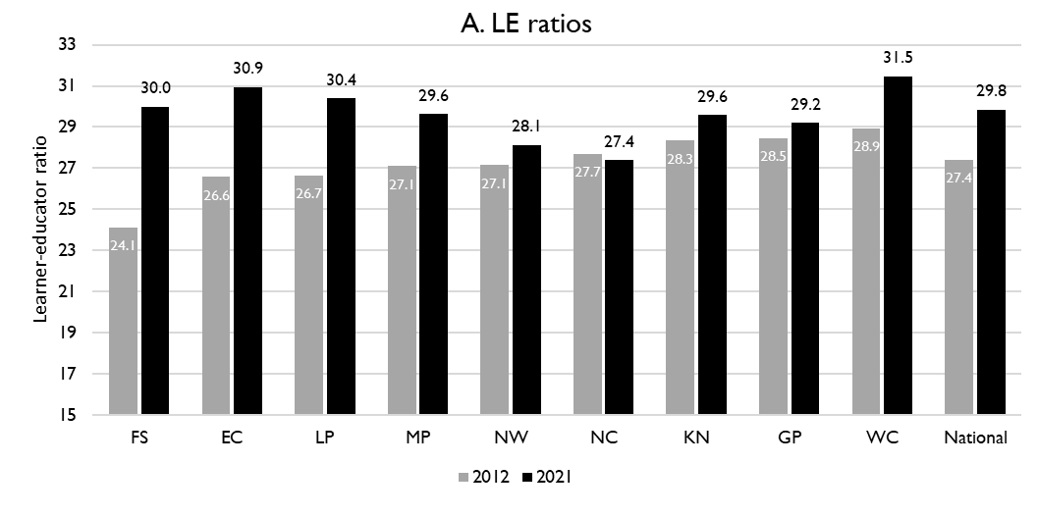
Learner-public educator ratios (‘12 & ’21)
6
National and provincial learner-to-public-educator ratios in 2012 and 2021, grades 1 to 12 in public ordinary schools in South Africa
z
LE ratio rose from 26.6 learners per educator to 30.9 learners per educator in the Eastern Cape between 2012 and 2021, which is more than the national average
Excl. SGB teachers
Source: Figure 1 in South African teacher shortages as revealed through class sizes and learner-educator ratios: An exploratory analysis by Gabrielle Wills (2023)

Slide 38
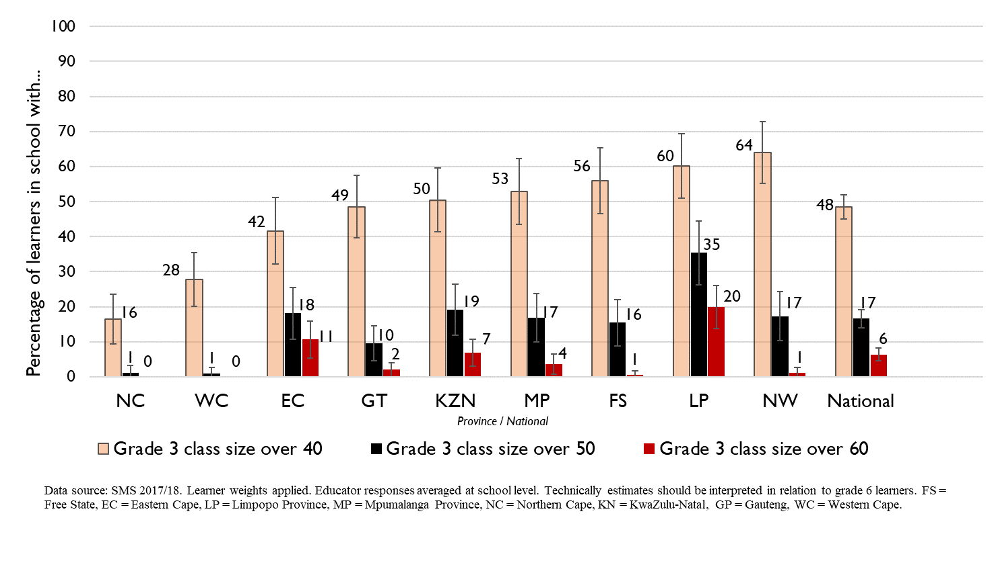
Grade 3 class sizes
(2017/18 School Monitoring Survey)
Post-provisioning guidelines - Class sizes should not exceed 35 in Grade 3.
% of learners in grade 3 classes > 40:
48% in SA, 42% in EC
% of learners in grade 3 classes > 50:
17% in SA, ~18% in EC
% of learners in grade 3 classes > 60:
6% in SA, ~11% in EC
Note: Nationally, grade 3 enrolment numbers had been rising from about 2011 and peaked in 2017 before starting to decline slightly, stabilising at about 1,1 million in 2021 (Gustafsson 2022a, p10-11). Holding other things constant, grade 3 class sizes will be similar or slightly smaller in 2022 than what is seen in these 2017/18 SMS estimates.

Slide 39
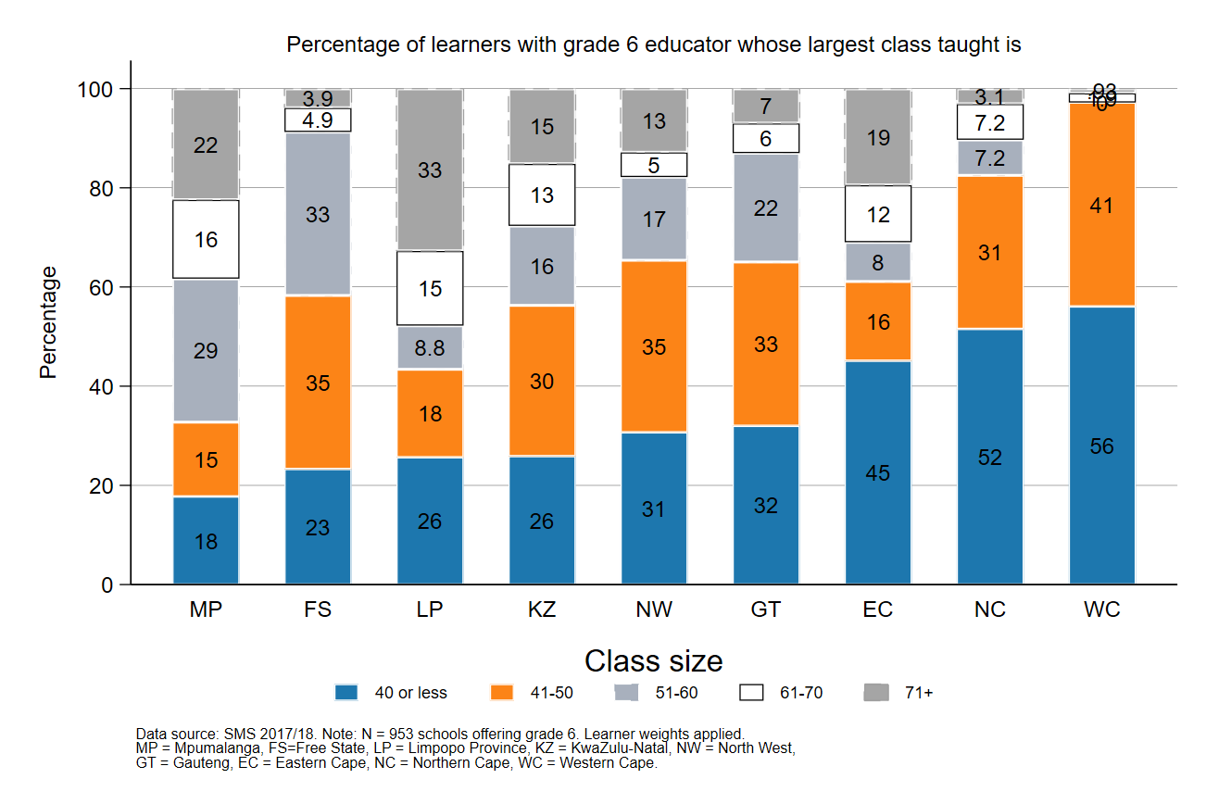
Largest classes - School Monitoring Survey 2017/18
6
6
In 2017/18, the Eastern Cape had more than 30% of Gr6 learners in schools with very large classes (>60 learners)
A further deterioration of the LE ratio will drive up class size and the number of excessively large classes, negatively impacting quality and teacher motivation
Percentage of grade 6 learners in schools with an educator reporting that their largest class is in the following class size category, disaggregated by province (SMS 2017/18)
Source: Figure 1 in South African teacher shortages as revealed through class sizes and learner-educator ratios: An exploratory analysis by Gabrielle Wills (2023) using School Monitoring Survey 2017/18 (953 schools, learner weighted).

Slide 40
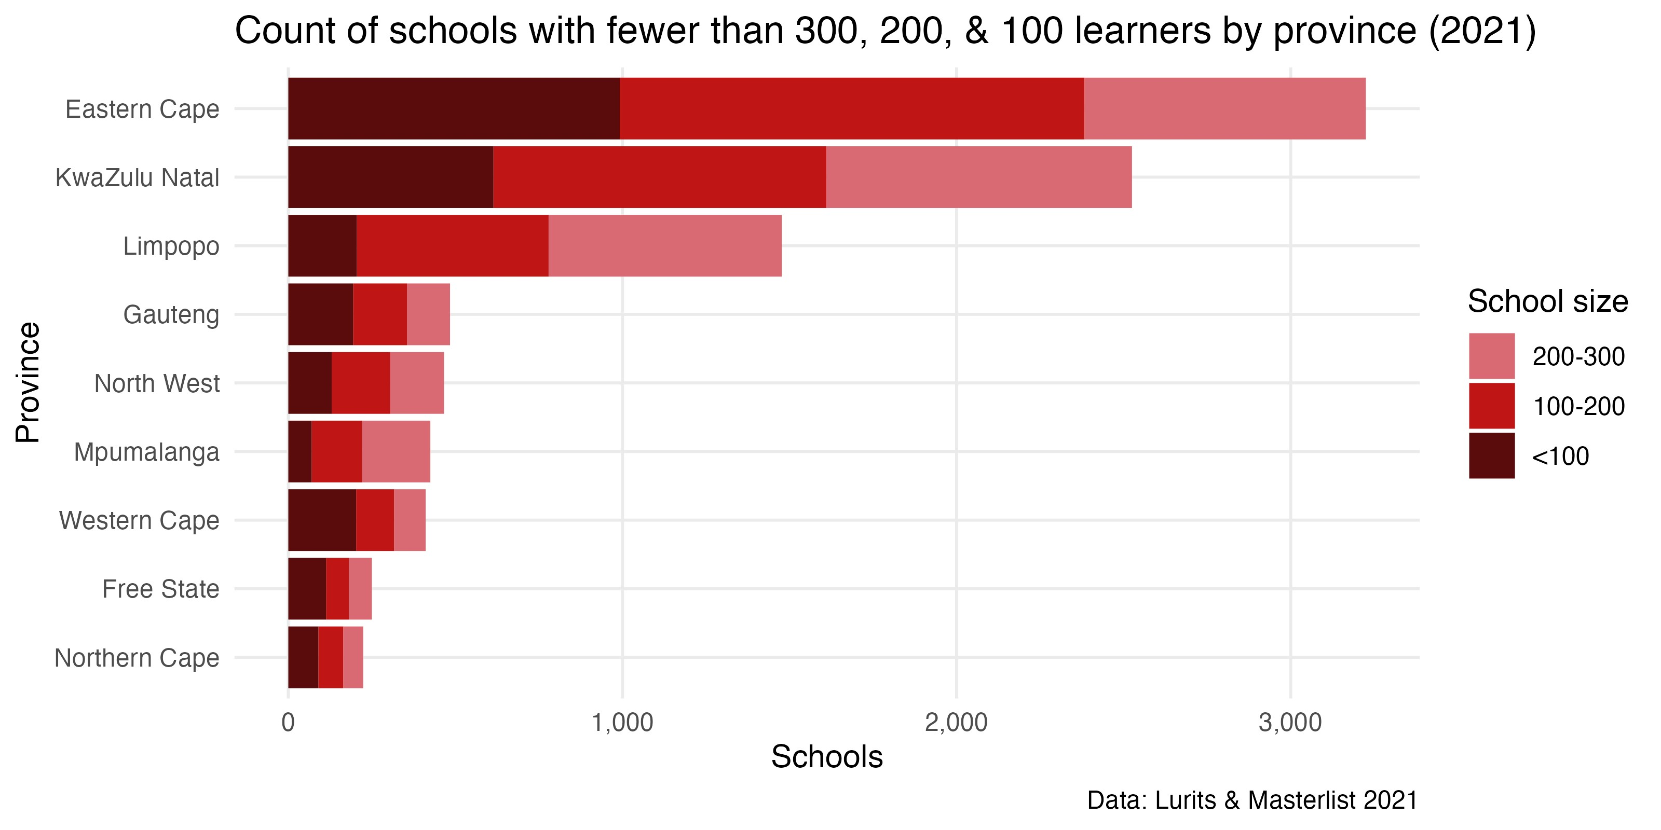
Small school count by province
6
The Eastern Cape is the province with the highest number of small and very small schools in the country
Source: LURITS and EMIS school Masterlist data from 2021.

Slide 41
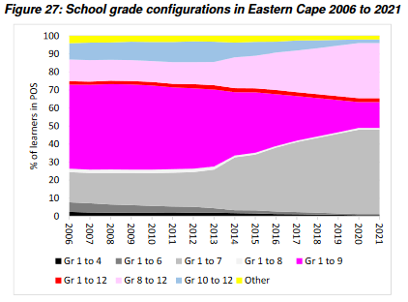
Past school reconfiguring & rationalisation
6
School grade configuration in the Eastern Cape, 2006 to 2021
Significant changes to school grade configuration from 2013 onwards, shift towards schools with Gr 1-7 and Gr 8-12
Source: DBE report, Key patterns in the 1994 to 2021 ordinary school enrolment statistics , 30 June 20221 (p. 19) [Unpublished]

Slide 42
Expected financial implications to 2030
7

Slide 43
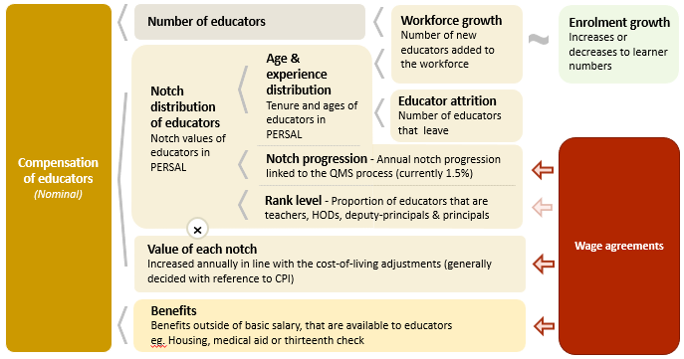
Unit cost drivers
7

Slide 44
Real and nominal costs
7
Examples:
In 2022 CPI was 7.2%
If nominal wages increase by 7.2%, then real wages increase by 0%
If nominal wages increase by 9%, then real wages increase by 1.8%
If nominal wages increase by 5%, then real wages decrease by 2.2%
A real increase in wages takes place when wages increase above the rate of inflation
Changes to real wages are an indicator of purchasing power

Slide 45
Projected unit costs trends| All educators
7
In constant 2021 rands
EC has much higher unit costs per educator than other provinces and the national average because EC has a large share of older teachers and senior educators (principals, deputies, HODs)
Note: Scale not from zero
Source: Own calculations, using the anonymised PERSAL data from 2021, only educators are considered. ECD practitioners and examination reviewers removed. Estimates to 2030 derived from the national and provincial TSD models. Assumption of no growth in educator numbers.

Slide 46
Projected unit costs trends| All educators
7
In constant 2021 rands
the real unit cost of educators is expected to remain constant in the EC from 2022 to 2030
Note: Scale not from zero
Adjusted the expected growth in educator numbers
Assume 10% decrease in educators from 2021 to 2030 in EC
EC growth adjusted: -10%
Source: Own calculations, using the anonymised PERSAL data from 2021, only educators are considered. ECD practitioners and examination reviewers removed. Estimates to 2030 derived from the national and provincial TSD models. Assumption of no growth in educator numbers for FS, KN, LP, MP, NC, NW and SA. Assume 20% educator growth for GP, 10% for WC and a decline in 10% of educators in the EC. In LP assume that the proportion of senior educators grows from 16% in 2021 to 21% in 2030.

Slide 47
Indexed unit costs trends| All educators
7
In constant 2021 rands
GP: 1% increase
Educator unit cost
(Index in 2022 = 100%)
WC: <1.5% decrease
Note: Scale not from zero
EC growth adjusted: -10%
Source: Own calculations, using the anonymised PERSAL data from 2021, only educators are considered. ECD practitioners and examination reviewers removed. Estimates to 2030 derived from the national and provincial TSD models. Assumption of no growth in educator numbers for FS, KN, LP, MP, NC, NW and SA. Assume 20% educator growth for GP, 10% for WC and a decline in 10% of educators in the EC. In LP assume that the proportion of senior educators grows from 16% in 2021 to 21% in 2030.

Slide 48
Indexed unit costs trends| All educators
7
In constant 2021 rands
EC: No change in real cost from
2022 - 2030
Educator unit cost
(Index in 2022 = 100%)
Note: Scale not from zero
EC growth adjusted: -10%
Source: Own calculations, using the anonymised PERSAL data from 2021, only educators are considered. ECD practitioners and examination reviewers removed. Estimates to 2030 derived from the national and provincial TSD models. Assumption of no growth in educator numbers for FS, KN, LP, MP, NC, NW and SA. Assume 20% educator growth for GP, 10% for WC and a decline in 10% of educators in the EC. In LP assume that the proportion of senior educators grows from 16% in 2021 to 21% in 2030.

Slide 49
Projected unit costs trends| All educators
7
In constant 2021 rands
Teachers
(School based teachers)
Senior educators
(HODs, Deputy’s, Principals & Other)
-3%
+1%
Average annual unit cost
(In 2021 Rands)
Note: Scale not from zero
EC growth adjusted: -10%
Source: Own calculations, using the anonymised PERSAL data from 2021, only educators are considered. ECD practitioners and examination reviewers removed. Estimates to 2030 derived from the national and provincial TSD models. Assumption of no growth in educator numbers for FS, KN, LP, MP, NC, NW and SA. Assume 20% educator growth for GP, 10% for WC and a decline in 10% of educators in the EC. In LP assume that the proportion of senior educators grows from 16% in 2021 to 21% in 2030.

Slide 50
Between and within province movement
8

Slide 51
Inter-provincial educator movement (7-yr)
8
 |  | Province in 2019 |  |  |  |  |  |  |  |  |  |  | Movement out of province
 |  | EC | FS | GP | KN | LP | MP | NC | NW | WC | Total
Province in 2012 | EC | 97.79 | 0.10 | 0.86 | 0.22 | 0.01 | 0.04 | 0.11 | 0.19 | 0.70 | 100 |  | 2.23%
 | FS | 0.35 | 94.25 | 2.76 | 0.10 | 0.07 | 0.23 | 0.41 | 1.56 | 0.26 | 100 |  | 5.74%
 | GP | 0.15 | 0.26 | 96.86 | 0.27 | 0.81 | 0.42 | 0.05 | 0.93 | 0.24 | 100 |  | 3.13%
 | KN | 0.22 | 0.10 | 1.14 | 97.95 | 0.10 | 0.37 | 0.01 | 0.06 | 0.04 | 100 |  | 2.04%
 | LP | 0.02 | 0.02 | 1.72 | 0.02 | 96.80 | 0.80 | 0.05 | 0.56 | 0.02 | 100 |  | 3.21%
 | MP | 0.03 | 0.14 | 2.48 | 0.37 | 1.54 | 94.86 | 0.03 | 0.49 | 0.07 | 100 |  | 5.15%
 | NC | 0.47 | 0.50 | 0.47 | 0.06 | 0.59 | 0.03 | 94.35 | 2.37 | 1.15 | 100 |  | 5.64%
 | NW | 0.06 | 0.59 | 3.84 | 0.03 | 0.65 | 0.34 | 0.75 | 93.60 | 0.14 | 100 |  | 6.40%
 | WC | 0.72 | 0.03 | 0.17 | 0.05 | 0.00 | 0.02 | 0.35 | 0.03 | 98.61 | 100 |  | 1.37%
Source: PERSAL 10-year anonymised dataset, only educators that were in the dataset for 2018 and 2019 are considered here

Slide 52
Inter-provincial educator movement (7-yr)
8
 |  | Province in 2019 |  |  |  |  |  |  |  |  |  |  | Movement out of province
 |  | EC | FS | GP | KN | LP | MP | NC | NW | WC | Total
Province in 2012 | EC | 97.79 | 0.10 | 0.86 | 0.22 | 0.01 | 0.04 | 0.11 | 0.19 | 0.70 | 100 |  | 2.23%
 | FS | 0.35 | 94.25 | 2.76 | 0.10 | 0.07 | 0.23 | 0.41 | 1.56 | 0.26 | 100 |  | 5.74%
 | GP | 0.15 | 0.26 | 96.86 | 0.27 | 0.81 | 0.42 | 0.05 | 0.93 | 0.24 | 100 |  | 3.13%
 | KN | 0.22 | 0.10 | 1.14 | 97.95 | 0.10 | 0.37 | 0.01 | 0.06 | 0.04 | 100 |  | 2.04%
 | LP | 0.02 | 0.02 | 1.72 | 0.02 | 96.80 | 0.80 | 0.05 | 0.56 | 0.02 | 100 |  | 3.21%
 | MP | 0.03 | 0.14 | 2.48 | 0.37 | 1.54 | 94.86 | 0.03 | 0.49 | 0.07 | 100 |  | 5.15%
 | NC | 0.47 | 0.50 | 0.47 | 0.06 | 0.59 | 0.03 | 94.35 | 2.37 | 1.15 | 100 |  | 5.64%
 | NW | 0.06 | 0.59 | 3.84 | 0.03 | 0.65 | 0.34 | 0.75 | 93.60 | 0.14 | 100 |  | 6.40%
 | WC | 0.72 | 0.03 | 0.17 | 0.05 | 0.00 | 0.02 | 0.35 | 0.03 | 98.61 | 100 |  | 1.37%
Low level of movement between provinces – about 2.2% of Eastern Cape teachers in 2012 are teaching in a different province in 2019
Educators are most likely to move to the Gauteng and the Western Cape
zvc
Source: PERSAL 10-year anonymised dataset, only educators that were in the dataset for 2018 and 2019 are considered here

Slide 53
Inter-provincial educator movement (7-yr)
8
 |  | Province in 2019
 |  | EC | FS | GP | KN | LP | MP | NC | NW | WC
Province in 2012 | EC | 42 645 | 42 | 373 | 95 | 5 | 16 | 46 | 82 | 304
 | FS | 57 | 15 267 | 447 | 17 | 11 | 38 | 67 | 252 | 42
 | GP | 67 | 117 | 42 770 | 121 | 356 | 187 | 20 | 409 | 108
 | KN | 146 | 67 | 755 | 64 723 | 64 | 247 | 9 | 37 | 26
 | LP | 10 | 10 | 709 | 7 | 39 899 | 328 | 20 | 230 | 7
 | MP | 7 | 34 | 618 | 94 | 385 | 23 644 | 7 | 121 | 17
 | NC | 31 | 33 | 31 | 4 | 39 | 2 | 6 214 | 156 | 76
 | NW | 12 | 111 | 726 | 5 | 123 | 65 | 141 | 17 690 | 27
 | WC | 152 | 7 | 37 | 11 | 0 | 5 | 75 | 6 | 20 858
 | Total 2019 | 43 127 | 15 688 | 46 466 | 65 077 | 40 882 | 24 532 | 6 599 | 18 983 | 21 465
 | Movement into province | 482 | 421 | 3 696 | 354 | 983 | 888 | 385 | 1 293 | 607
 | % movement into province | 1.1% | 2.7% | 8.0% | 0.5% | 2.4% | 3.6% | 5.8% | 6.8% | 2.8%
Source: PERSAL 10-year anonymised dataset, only educators that were in the dataset for 2012 and 2019 are considered here

Slide 54
Inter-provincial educator movement (7-yr)
8
 |  | Province in 2019
 |  | EC | FS | GP | KN | LP | MP | NC | NW | WC
Province in 2012 | EC | 42 645 | 42 | 373 | 95 | 5 | 16 | 46 | 82 | 304
 | FS | 57 | 15 267 | 447 | 17 | 11 | 38 | 67 | 252 | 42
 | GP | 67 | 117 | 42 770 | 121 | 356 | 187 | 20 | 409 | 108
 | KN | 146 | 67 | 755 | 64 723 | 64 | 247 | 9 | 37 | 26
 | LP | 10 | 10 | 709 | 7 | 39 899 | 328 | 20 | 230 | 7
 | MP | 7 | 34 | 618 | 94 | 385 | 23 644 | 7 | 121 | 17
 | NC | 31 | 33 | 31 | 4 | 39 | 2 | 6 214 | 156 | 76
 | NW | 12 | 111 | 726 | 5 | 123 | 65 | 141 | 17 690 | 27
 | WC | 152 | 7 | 37 | 11 | 0 | 5 | 75 | 6 | 20 858
 | Total 2019 | 43 127 | 15 688 | 46 466 | 65 077 | 40 882 | 24 532 | 6 599 | 18 983 | 21 465
 | Movement into province | 482 | 421 | 3 696 | 354 | 983 | 888 | 385 | 1 293 | 607
 | % movement into province | 1.1% | 2.7% | 8.0% | 0.5% | 2.4% | 3.6% | 5.8% | 6.8% | 2.8%
Very few educators moved to EC, only 1.1% of educators in 2019 had come from another province since 2012
The provinces that sent the highest number of educators to EC were the WC and KN
zvc
Source: PERSAL 10-year anonymised dataset, only educators that were in the dataset for 2012 and 2019 are considered here

Slide 55
Educator movement between schools
8
Fair amount of movement between schools, about 4.6% of EC educators (5% nationally) move to a different pay point but stay within PERSAL from 2018-2019
Rate at which EC educators aged 50 and below (2.1%) leave the system is lower than the national average (3.8%)
 | Pay point in 2019 (Ordinary schools only)
Province | Same as in 2018 (%) | Different to 2018 (%) | None - left system (%) | Total (%)
EC | 93.25 | 4.61 | 2.14 | 100
FS | 90.54 | 5.54 | 3.93 | 100
GP | 91.08 | 3.95 | 4.97 | 100
KN | 91.99 | 4.31 | 3.70 | 100
LP | 91.04 | 6.95 | 2.00 | 100
MP | 92.02 | 4.66 | 3.32 | 100
NC | 85.44 | 8.39 | 6.18 | 100
NW | 89.42 | 6.30 | 4.28 | 100
WC | 87.27 | 6.09 | 6.64 | 100
Total | 91.11 | 5.05 | 3.83 | 100
Source: PERSAL 10-year anonymised dataset. Only included educators aged 50 years and below, that were in ordinary schools in 2018 (Primary, Secondary, Combined and Intermediate)—excluded all paypoints that did not appear in both years after identifying 103 paypoints where the paypoint number changed.

Slide 56
Gender imbalances in management
9

Slide 57
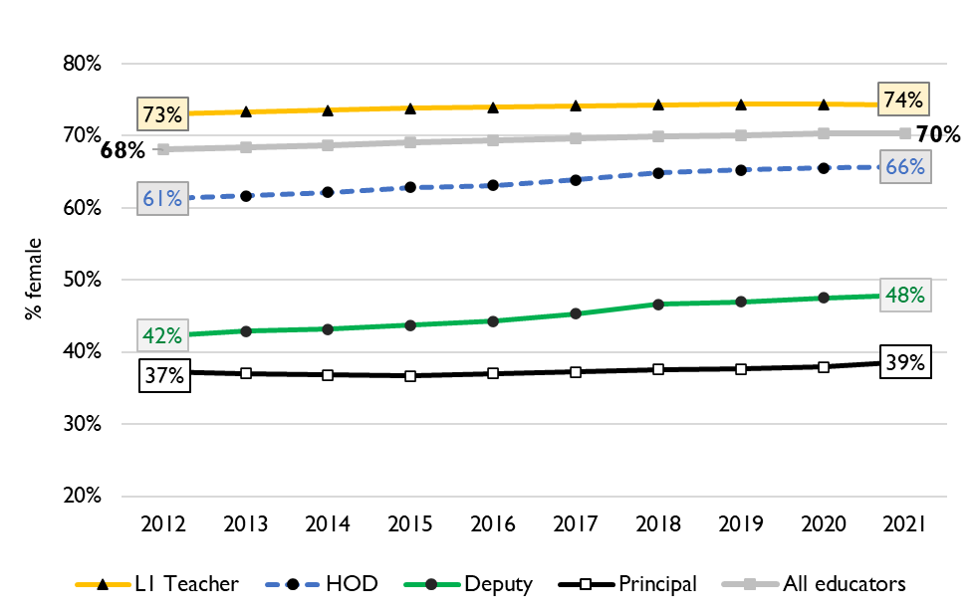
Percentage of educators that are female
9
Percentage of public educators in South Africa that are female, PERSAL (2012-2021)
Nationally, there has been very little transformation in senior school leadership in terms of gender since 2012 and even since 2004 (just 34% of principals were female).
There is better representation at middle-management (HOD) level.
Source: Using anonymised 10-year PERSAL data from 2012 to 2021, only educators of the ranks: level 1 teacher, HOD, deputy principal and principal are considered.

Slide 58
Percentage of educators that are female
9
In the Eastern Cape in 2021, 72% of all educators were women. Women were well represented at the HOD level at 71% of HODs.
Yet only 47% of deputy principals and 39% of principals were women.
Source: Using anonymised 10-year PERSAL data from 2012 to 2021, only educators of the ranks: level 1 teacher, HOD, deputy principal and principal are considered.

Slide 59
Conclusion
10
In EC, higher levels of retirements are expected to about 2035, more than half of educators were 50 years or older in 2021, with a high proportion of SMT (Principals, Deputies and HODs) and other education specialists (71%) being over 50.
School-aged population and enrolment are projected to decline
Will need to decrease workforce overall whilst still appointing and promoting enough staff for those leaving, in the right schools and positions
With average school sizes likely to decrease further, ongoing school rationalisation efforts will likely need to continue
The unit cost of educators is predicted to stay roughly constant. This should give the province ample room to engage in targeted school rationalisation if decreases in enrolment make this a priority

Slide 60
?

