Slide 1
Free State Province 14 August 2023
Educator Demand Projections
2021-2030

Slide 2
Introduction (1)
The proportion of educators that are 50 years or older has steadily risen between 2012 to 2021 in South Africa.
⇒ Nationally a wave of educator retirements is expected as older educators reach the standard retirement age of between 60 and 65.
Implications:
Many more appointments: The retirement wave will open up both teaching & school management & leadership positions & other office-based education specialists.
Total compensation of educators: Since older teachers earn more, when retiring they are replaced with younger (less costly) teachers.

Slide 3
Introduction (2)
As retirements increase, the required number of new appointments will need to increase to ensure that total educator numbers (at a minimum) stay at current levels and/or are sufficient to meet learner enrolment growth to prevent deterioration in learner-educator ratios.
Planning will be required to ensure that provinces are ready for the sustained increase in appointments.
If these positions are not filled, this could result in a further deterioration in the learner-educator ratio and lead to further increases in already large class sizes.

Slide 4
Introduction (3)
Educator age distribution in 2012 & 2021 in SA
Peak in age shifted from 46 years to 53 years
Source: Anonymised PERSAL data from 2021, only educators (Rank 60 000 – 69 999) are considered. ECD practitioners, TVET lecturers and ABET teachers were removed.

Slide 5
Objective
In each province there are some differences in the age profile of teachers, differences in the expected growth of the school-going population and differences in expected teacher attrition (resignations & retirements).
⇒ The year of the retirement wave peak will differ across provinces.
⇒ Also some provinces need to accommodate much more growth in
learners than others.
In this presentation, we highlight the situation in the
Free State to inform province-specific planning.

Slide 6
Overview
Age distributions
Projected retirements & resignations
Provincial population and enrolment trends
Public and independent school growth
Educator growth: Teachers and SMT positions
The implications for appointments and class sizes
Expected financial implications to 2030
Movement of educators: Between and within provinces
Gender imbalance in school management
Discussion
1
2
3
4
5
6
7
8
9
10

Slide 7
Free State educator demand summary
Age distribution: The age distribution in the FS had a peak at around 51 years of age in 2021
Projected resignations and retirements: About half of the educators that exit PERSAL are age-related retirements (ages 56 to 65); the number of senior educators (SMT positions and other specialists) that are retiring is expected to increase (65% were 50+ years old in 2021)
Enrolment and population growth: Enrolment in the FS ordinary schools increased by 10% from 2012-2021 (~65K learners), and the school-aged population is forecast to decline by -4% (~26K learners) to 2030, which will likely result in lower enrolments. School rationalisation may need to continue as a result of the decrease.
School and educator growth: Between 2012 and 2021, the educator number has fallen (-13%), and the number of public ordinary schools has decreased (-27%), driving up the LE ratio and class sizes.
SMT position changes: In the FS, there has been a large decline in the number of Principals between 2012 and 2021 (-27%), largely as a result of school rationalisation. The number of HODs (-8%), Deputy Principals (-10%) and teachers (-13%) have also declined over this period.
Appointments and LE Ratio: The LE ratio increased from 24.1 to 30.0 between 2012 and 2021
Projected educator cost trends: The unit cost of educators is predicted to remain constant. Due to the change in age distribution.
Educator movements: There is high movement out of the FS (~6%), and few educators move to the FS (<3%). About ~6% educators move between schools within the province.

Slide 8
Age distributions and projected retirements and resignations
1
2

Slide 9
Educator age distribution (2021)
1
A lower proportion of educators are over 50 years old in the Free State than in the rest of the country
A slightly higher proportion of young educators under 35 years in the Free State than in the rest of the country
Source: Anonymised PERSAL data from 2021, only educators (Rank 60 000 – 69 999) are considered. ECD practitioners, TVET lecturers and ABET teachers were removed.

Slide 10
Older teacher proportions for senior educator and primary schools educators
1
 |  | Percentage of educators aged 50+ in 2021
Province |  | All educators |  | Senior educators (HOD, Dep.- principals, Principals & Other) |  | Primary school educators
EC |  | 51% |  | 71% |  | 58%
FS |  | 43% |  | 65% |  | 49%
GP |  | 41% |  | 65% |  | 42%
KN |  | 39% |  | 65% |  | 44%
LP |  | 58% |  | 81% |  | 63%
MP |  | 50% |  | 73% |  | 55%
NC |  | 43% |  | 69% |  | 44%
NW |  | 47% |  | 70% |  | 52%
WC |  | 42% |  | 73% |  | 40%
SA |  | 46% |  | 69% |  | 49%
Source: Anonymised PERSAL data from 2021, only educators (Rank 60 000 – 69 999) are considered. ECD practitioners, TVET lecturers and ABET teachers were removed. The 2021 rankclass file was expanded to include ranks found only in years prior to 2021, used to classify educators by rank. Primary school only includes all educators that are in a component that is classified as a Primary school.

Slide 11
Older teacher proportions for senior educator and primary schools educators
1
 |  | Percentage of educators aged 50+ in 2021
Province |  | All educators |  | Senior educators (HOD, Dep.- principals, Principals & Other) |  | Primary school educators
EC |  | 51% |  | 71% |  | 58%
FS |  | 43% |  | 65% |  | 49%
GP |  | 41% |  | 65% |  | 42%
KN |  | 39% |  | 65% |  | 44%
LP |  | 58% |  | 81% |  | 63%
MP |  | 50% |  | 73% |  | 55%
NC |  | 43% |  | 69% |  | 44%
NW |  | 47% |  | 70% |  | 52%
WC |  | 42% |  | 73% |  | 40%
SA |  | 46% |  | 69% |  | 49%
zvc
zvc
zvc
FS has 43% of educators aged 50 years and older in 2021 with a higher proportion in primary schools (49%)
Source: Anonymised PERSAL data from 2021, only educators (Rank 60 000 – 69 999) are considered. ECD practitioners, TVET lecturers and ABET teachers were removed. The 2021 rankclass file was expanded to include ranks found only in years prior to 2021, used to classify educators by rank. Primary school only includes all educators that are in a component that is classified as a Primary school.

Slide 12
Educator age distribution in 2021 & 2030
1
Assume constant 2021 educator numbers
Age: 51
2021
2030
Source: Anonymised PERSAL data from 2021, only educators (Rank 60 000 – 69 999) are considered. ECD practitioners, TVET lecturers and ABET teachers were removed.

Slide 13
Projected resignation & retirements (FS)
2
Assume constant 2021 educator numbers
Proportion of Educators
About half of the educators that exit PERSAL in the FS are retiring (ages 56 or above)
Large spike in resignations due to the pension reform rumours in 2015
The number of young teachers (ages 21-30) resigning is projected to increase as the number of newly hired young teachers increases.
Projected
% of educators resigning or retiring
Source: Anonymised PERSAL data from 2021, only educators (Rank 60 000 – 69 999) are considered. ECD practitioners, TVET lecturers and ABET teachers were removed. Estimates to 2035 derived from the National and provincial teacher supply and demand models – assumption of no growth in educator numbers. Note: Retirements refer to all educators, aged 56 to 65, that leave PERSAL, whilst resignations refer to all educators aged 55 and below that leave PERSAL (as educators) for any reason.

Slide 14
Projected resignation & retirements (FS)
2
Assume constant 2021 educator numbers
Retirement headcount
The number of retirements is projected to increase, peaking in ~2030 & 2031 and then declining
The number of retirements is projected to increase from just over 700 in 2022 to just under 900 in 2030, an increase of about 200 retirements annually
Projected
Number of retirements
Source: Anonymised PERSAL data from 2021, only educators (Rank 60 000 – 69 999) are considered. ECD practitioners, TVET lecturers and ABET teachers were removed. Estimates to 2035 derived from the National and provincial teacher supply and demand models – assumption of no growth in educator numbers. Note: Retirements refer to all educators, aged 56 to 65, that leave PERSAL, whilst resignations refer to all educators aged 55 and below that leave PERSAL (as educators) for any reason.

Slide 15
Older leaver trend estimates to 2035
2
Assume constant 2021 educator numbers
About 11,300
educators estimated to retire by 2035 in the FS
(50% of total educators in 2021)
Source: Anonymised 2021 PERSAL data, only educators (Rank 60 000 – 69 999) are considered. ECD practitioners, TVET lecturers and ABET teachers were removed. Estimates to 2035 derived from the National and provincial models – assumption of no growth in educator numbers.

Slide 16
Projected educators leaving
2
Assume constant 2021 educator numbers
Teachers
(School based teachers)
Senior educators
(HODs, Deputy’s, Principals & Other)
% of teacher resigning & retiring
% of senior educators resigning & retiring
A high proportion of teachers are expected to resign and retire in the FS
While a lower proportion of senior educators are expected to leave relative to the SA average (from about 2025 onwards), careful succession planning is still needed during this period as high numbers of HODs, deputies and principals will be retiring by 2035
Source: Anonymised 2021 PERSAL data, only educators (Rank 60 000 – 69 999) are considered. ECD practitioners, TVET lecturers and ABET teachers were removed. Estimates to 2035 derived from the National and provincial models – assumption of no growth in educator numbers.

Slide 17
Provincial population and enrolment trends
3

Slide 18
Provincial enrolment trends (2012-2021)
3
High growth
Moderate growth
Stable
Decline
Source: Enrolment numbers taken from School Realities-EMIS (2012 – 2021) released by the DBE, using total numbers for ordinary public and independent schools.

Slide 19
Provincial enrolment trends (2012-2021)
3
Enrolment in Free State ordinary schools
increased by 10%
from 2012 to 2021
Source: Enrolment numbers taken from School Realities-EMIS (2012 – 2021) released by the DBE, using total numbers for ordinary public and independent schools.

Slide 20
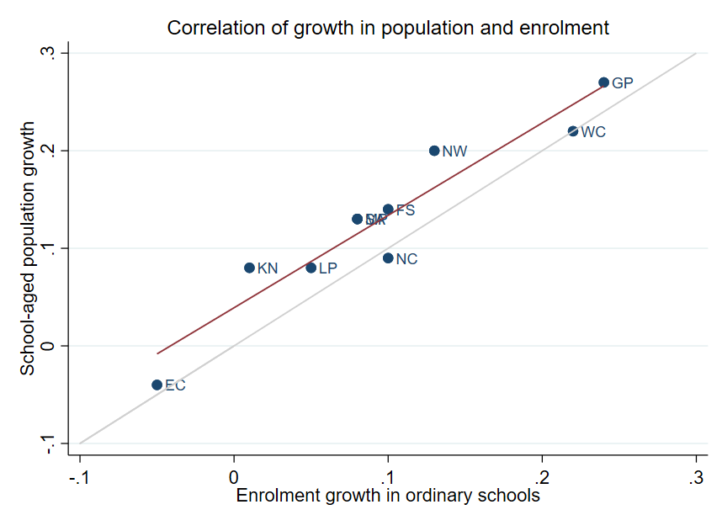
Correlation between population and enrolment growth (2012-2021)
3
R² = 0.9025
Strong positive correlation between population and enrolment growth between 2012 and 2021
45˚
Source: Thembisa age specific data V4.5 for school-aged population (Ages 7-18) estimates and enrolment taken from School Realities-EMIS (2012 – 2021) released by the DBE, for numbers on ordinary public and independent schools (Statistical Publications (education.gov.za))

Slide 21
Projected growth in school-aged population
3
Population of children aged 7-18 in the Free State, is expected to decrease by
~26K children (-4%)
from 2021 to 2030
Note: Period 2021 – 2030 is the same timeframe, nine years, as 2012 – 2021.
Source: Thembisa age-specific estimates from the model V4.5 for children aged 7-18 by province

Slide 22
School aged-population estimates to 2030
3
 | Number of children Aged 7-18 |  |  |  | Growth '12-21 | Growth '21-30
Province | 2012 | 2021 | 2030E
EC | 1 657 202 | 1 598 475 | 1 361 637 |  | -4% | -15%
FS | 592 445 | 676 489 | 650 820 |  | 14% | -4%
GP | 1 962 793 | 2 498 533 | 3 180 884 |  | 27% | 27%
KN | 2 485 822 | 2 690 378 | 2 657 716 |  | 8% | -1%
LP | 1 395 864 | 1 507 386 | 1 612 125 |  | 8% | 7%
MP | 977 749 | 1 100 594 | 1 165 728 |  | 13% | 6%
NC | 254 075 | 277 560 | 281 208 |  | 9% | 1%
NW | 742 943 | 893 530 | 930 323 |  | 20% | 4%
WC | 1 068 009 | 1 298 801 | 1 496 731 |  | 22% | 15%
Total | 11 136 902 | 12 541 746 | 13 337 172 |  | 13% | 6%
676K
592K
651K
Note: Period 2021 – 2030 is the same timeframe, nine years, as 2012 – 2021.
Source: Thembisa age-specific estimates from the model V4.5 for children aged 7-18 by province

Slide 23
Public and independent school growth
4

Slide 24
Educator, school and enrolment growth
4
 | % growth from 2012 - 2021
Province | Number of educators | Number of teachers |  | Number of public ordinary schools | Enrolment in public ordinary schools | Enrolment in ordinary schools |  | Est. school-aged population
EC | -17% | -20% |  | -8% | -6% | -5% |  | -4%
FS | -13% | -13% |  | -27% | 9% | 10% |  | 14%
GP | 21% | 28% |  | 1% | 20% | 24% |  | 27%
KN | -5% | -3% |  | -3% | 1% | 1% |  | 8%
LP | -8% | -2% |  | -7% | 4% | 5% |  | 8%
MP | 3% | 7% |  | -8% | 7% | 8% |  | 13%
NC | 6% | 9% |  | -3% | 9% | 10% |  | 9%
NW | 2% | 4% |  | -9% | 12% | 13% |  | 20%
WC | 12% | 22% |  | 0% | 21% | 22% |  | 22%
SA | -1% | 2% |  | -6% | 7% | 8% |  | 13%
Source: Educator numbers from anonymised PERSAL data from 2012 and 2021, only educators (Rank 60 000 – 69 999) are considered. Thembisa age specific data V4.5 for school-aged population (Ages 7-18) estimates and enrolment and school numbers taken from School Realities-EMIS (2012 – 2021) released by the DBE, for numbers on ordinary public and independent schools (Statistical Publications (education.gov.za))

Slide 25
Educator, school and enrolment growth
4
 | % growth from 2012 - 2021
Province | Number of educators | Number of teachers |  | Number of public ordinary schools | Enrolment in public ordinary schools | Enrolment in ordinary schools |  | Est. school-aged population
EC | -17% | -20% |  | -8% | -6% | -5% |  | -4%
FS | -13% | -13% |  | -27% | 9% | 10% |  | 14%
GP | 21% | 28% |  | 1% | 20% | 24% |  | 27%
KN | -5% | -3% |  | -3% | 1% | 1% |  | 8%
LP | -8% | -2% |  | -7% | 4% | 5% |  | 8%
MP | 3% | 7% |  | -8% | 7% | 8% |  | 13%
NC | 6% | 9% |  | -3% | 9% | 10% |  | 9%
NW | 2% | 4% |  | -9% | 12% | 13% |  | 20%
WC | 12% | 22% |  | 0% | 21% | 22% |  | 22%
SA | -1% | 2% |  | -6% | 7% | 8% |  | 13%
z
z
The number of public ordinary schools declined in the Free State largely as a result of school rationalisation
Source: Educator numbers from anonymised PERSAL data from 2012 and 2021, only educators (Rank 60 000 – 69 999) are considered. Thembisa age specific data V4.5 for school-aged population (Ages 7-18) estimates and enrolment and school numbers taken from School Realities-EMIS (2012 – 2021) released by the DBE, for numbers on ordinary public and independent schools (Statistical Publications (education.gov.za))

Slide 26
Educator, school and enrolment growth
4
 | % growth from 2012 - 2021
Province | Number of educators | Number of teachers |  | Number of public ordinary schools | Enrolment in public ordinary schools | Enrolment in ordinary schools |  | Est. school-aged population
EC | -17% | -20% |  | -8% | -6% | -5% |  | -4%
FS | -13% | -13% |  | -27% | 9% | 10% |  | 14%
GP | 21% | 28% |  | 1% | 20% | 24% |  | 27%
KN | -5% | -3% |  | -3% | 1% | 1% |  | 8%
LP | -8% | -2% |  | -7% | 4% | 5% |  | 8%
MP | 3% | 7% |  | -8% | 7% | 8% |  | 13%
NC | 6% | 9% |  | -3% | 9% | 10% |  | 9%
NW | 2% | 4% |  | -9% | 12% | 13% |  | 20%
WC | 12% | 22% |  | 0% | 21% | 22% |  | 22%
SA | -1% | 2% |  | -6% | 7% | 8% |  | 13%
z
z
The number of school-aged children and enrolment in public ordinary schools grew in the Free State between 2012 and 2021
Source: Educator numbers from anonymised PERSAL data from 2012 and 2021, only educators (Rank 60 000 – 69 999) are considered. Thembisa age specific data V4.5 for school-aged population (Ages 7-18) estimates and enrolment and school numbers taken from School Realities-EMIS (2012 – 2021) released by the DBE, for numbers on ordinary public and independent schools (Statistical Publications (education.gov.za))

Slide 27
Educator, school and enrolment growth
4
 | % growth from 2012 - 2021
Province | Number of educators | Number of teachers |  | Number of public ordinary schools | Enrolment in public ordinary schools | Enrolment in ordinary schools |  | Est. school-aged population
EC | -17% | -20% |  | -8% | -6% | -5% |  | -4%
FS | -13% | -13% |  | -27% | 9% | 10% |  | 14%
GP | 21% | 28% |  | 1% | 20% | 24% |  | 27%
KN | -5% | -3% |  | -3% | 1% | 1% |  | 8%
LP | -8% | -2% |  | -7% | 4% | 5% |  | 8%
MP | 3% | 7% |  | -8% | 7% | 8% |  | 13%
NC | 6% | 9% |  | -3% | 9% | 10% |  | 9%
NW | 2% | 4% |  | -9% | 12% | 13% |  | 20%
WC | 12% | 22% |  | 0% | 21% | 22% |  | 22%
SA | -1% | 2% |  | -6% | 7% | 8% |  | 13%
z
z
Alongside growing enrolment numbers and a decline in the number of public ordinary schools, the number of educators and teachers declined potentially as a result of school rationalisation
Source: Educator numbers from anonymised PERSAL data from 2012 and 2021, only educators (Rank 60 000 – 69 999) are considered. Thembisa age specific data V4.5 for school-aged population (Ages 7-18) estimates and enrolment and school numbers taken from School Realities-EMIS (2012 – 2021) released by the DBE, for numbers on ordinary public and independent schools (Statistical Publications (education.gov.za))

Slide 28
School growth from 2012 to 2021
4
School growth was driven by independent school growth (+37%) from 2012 to 2021. In contrast, the number of public schools in SA decreased (-6%)
EC | FS | GP | KN | LP | MP | NC | NW | WC | SA
% independent schools (2021)
4%
8%
30%
4%
5%
7%
7%
6%
17%
9%
Source: School numbers taken from School Realities-EMIS (2012 – 2021) released by the DBE, for numbers on ordinary public and independent schools (Statistical Publications (education.gov.za))

Slide 29
School growth from 2012 to 2021
4
Strong growth in the number of independent schools in the FS (+19%) relative to the large decline in the number of public schools (-27%). Enrolment grew from 16K to 20K children (+29%)
EC | FS | GP | KN | LP | MP | NC | NW | WC | SA
% independent schools (2021)
4%
8%
30%
4%
5%
7%
7%
6%
17%
9%
Source: School numbers taken from School Realities-EMIS (2012 – 2021) released by the DBE, for numbers on ordinary public and independent schools (Statistical Publications (education.gov.za))

Slide 30
Educator growth by teachers and senior educators
5

Slide 31
Changes in teacher and SMT numbers
5
 |  | Teacher |  |  |  |  | HOD |  |  |  |  | Deputy-Principal |  |  |  |  | Principal
Province |  | 2012 | 2021 | Diff | % change |  | 2012 | 2021 | Diff | % change |  | 2012 | 2021 | Diff | % change |  | 2012 | 2021 | Diff | % change
EC |  | 50 295 | 40 115 | -10 180 | -20% |  | 5 870 | 6 196 | 326 | 6% |  | 1 342 | 1 453 | 111 | 8% |  | 5 294 | 4 755 | - 539 | -10%
FS |  | 20 148 | 17 561 | -2 587 | -13% |  | 2 685 | 2 470 | - 215 | -8% |  | 852 | 768 | - 84 | -10% |  | 1 224 | 892 | - 332 | -27%
GP |  | 47 233 | 60 677 | 13 444 | 28% |  | 8 708 | 9 209 | 501 | 6% |  | 2 565 | 2 850 | 285 | 11% |  | 2 162 | 1 959 | - 203 | -9%
KN |  | 73 050 | 71 000 | -2 050 | -3% |  | 11 289 | 10 330 | - 959 | -8% |  | 2 642 | 2 342 | - 300 | -11% |  | 5 584 | 5 055 | - 529 | -9%
LP |  | 44 998 | 44 317 | - 681 | -2% |  | 6 090 | 3 762 | -2 328 | -38% |  | 1 562 | 778 | - 784 | -50% |  | 3 510 | 3 316 | - 194 | -6%
MP |  | 26 127 | 27 857 | 1 730 | 7% |  | 4 047 | 4 055 | 8 | 0% |  | 1 108 | 1 114 | 6 | 1% |  | 1 790 | 1 450 | - 340 | -19%
NC |  | 7 257 | 7 929 | 672 | 9% |  | 1 034 | 1 094 | 60 | 6% |  | 294 | 365 | 71 | 24% |  | 587 | 488 | - 99 | -17%
NW |  | 21 305 | 22 261 | 956 | 4% |  | 2 994 | 3 023 | 29 | 1% |  | 902 | 1 041 | 139 | 15% |  | 1 698 | 1 338 | - 360 | -21%
WC |  | 23 579 | 28 665 | 5 086 | 22% |  | 4 065 | 3 700 | - 365 | -9% |  | 1 334 | 1 297 | - 37 | -3% |  | 1 531 | 1 339 | - 192 | -13%
SA |  | 313 992 | 320 382 | 6 390 | 2% |  | 46 782 | 43 839 | -2 943 | -6% |  | 12 601 | 12 008 | - 593 | -5% |  | 23 380 | 20 592 | -2 788 | -12%
Source: Anonymised PERSAL data from 2012 and 2021, only educators (Rank 60 000 – 69 999) are considered. ECD practitioners, TVET lecturers, and ABET teachers were removed. The 2021 rankclass file was expanded to include ranks found only in years prior to 2021.

Slide 32
Changes in teacher and SMT numbers
5
 |  | Teacher |  |  |  |  | HOD |  |  |  |  | Deputy-Principal |  |  |  |  | Principal
Province |  | 2012 | 2021 | Diff | % change |  | 2012 | 2021 | Diff | % change |  | 2012 | 2021 | Diff | % change |  | 2012 | 2021 | Diff | % change
EC |  | 50 295 | 40 115 | -10 180 | -20% |  | 5 870 | 6 196 | 326 | 6% |  | 1 342 | 1 453 | 111 | 8% |  | 5 294 | 4 755 | - 539 | -10%
FS |  | 20 148 | 17 561 | -2 587 | -13% |  | 2 685 | 2 470 | - 215 | -8% |  | 852 | 768 | - 84 | -10% |  | 1 224 | 892 | - 332 | -27%
GP |  | 47 233 | 60 677 | 13 444 | 28% |  | 8 708 | 9 209 | 501 | 6% |  | 2 565 | 2 850 | 285 | 11% |  | 2 162 | 1 959 | - 203 | -9%
KN |  | 73 050 | 71 000 | -2 050 | -3% |  | 11 289 | 10 330 | - 959 | -8% |  | 2 642 | 2 342 | - 300 | -11% |  | 5 584 | 5 055 | - 529 | -9%
LP |  | 44 998 | 44 317 | - 681 | -2% |  | 6 090 | 3 762 | -2 328 | -38% |  | 1 562 | 778 | - 784 | -50% |  | 3 510 | 3 316 | - 194 | -6%
MP |  | 26 127 | 27 857 | 1 730 | 7% |  | 4 047 | 4 055 | 8 | 0% |  | 1 108 | 1 114 | 6 | 1% |  | 1 790 | 1 450 | - 340 | -19%
NC |  | 7 257 | 7 929 | 672 | 9% |  | 1 034 | 1 094 | 60 | 6% |  | 294 | 365 | 71 | 24% |  | 587 | 488 | - 99 | -17%
NW |  | 21 305 | 22 261 | 956 | 4% |  | 2 994 | 3 023 | 29 | 1% |  | 902 | 1 041 | 139 | 15% |  | 1 698 | 1 338 | - 360 | -21%
WC |  | 23 579 | 28 665 | 5 086 | 22% |  | 4 065 | 3 700 | - 365 | -9% |  | 1 334 | 1 297 | - 37 | -3% |  | 1 531 | 1 339 | - 192 | -13%
SA |  | 313 992 | 320 382 | 6 390 | 2% |  | 46 782 | 43 839 | -2 943 | -6% |  | 12 601 | 12 008 | - 593 | -5% |  | 23 380 | 20 592 | -2 788 | -12%
zvcd
zvcd
Large decrease in principal numbers, but by the same proportion as the decrease in number of ordinary schools between 2012 and 2021
Source: Anonymised PERSAL data from 2012 and 2021, only educators (Rank 60 000 – 69 999) are considered. ECD practitioners, TVET lecturers, and ABET teachers were removed. The 2021 rankclass file was expanded to include ranks found only in years prior to 2021.

Slide 33
Changes in teacher and SMT numbers
5
 |  | Teacher |  |  |  |  | HOD |  |  |  |  | Deputy-Principal |  |  |  |  | Principal
Province |  | 2012 | 2021 | Diff | % change |  | 2012 | 2021 | Diff | % change |  | 2012 | 2021 | Diff | % change |  | 2012 | 2021 | Diff | % change
EC |  | 50 295 | 40 115 | -10 180 | -20% |  | 5 870 | 6 196 | 326 | 6% |  | 1 342 | 1 453 | 111 | 8% |  | 5 294 | 4 755 | - 539 | -10%
FS |  | 20 148 | 17 561 | -2 587 | -13% |  | 2 685 | 2 470 | - 215 | -8% |  | 852 | 768 | - 84 | -10% |  | 1 224 | 892 | - 332 | -27%
GP |  | 47 233 | 60 677 | 13 444 | 28% |  | 8 708 | 9 209 | 501 | 6% |  | 2 565 | 2 850 | 285 | 11% |  | 2 162 | 1 959 | - 203 | -9%
KN |  | 73 050 | 71 000 | -2 050 | -3% |  | 11 289 | 10 330 | - 959 | -8% |  | 2 642 | 2 342 | - 300 | -11% |  | 5 584 | 5 055 | - 529 | -9%
LP |  | 44 998 | 44 317 | - 681 | -2% |  | 6 090 | 3 762 | -2 328 | -38% |  | 1 562 | 778 | - 784 | -50% |  | 3 510 | 3 316 | - 194 | -6%
MP |  | 26 127 | 27 857 | 1 730 | 7% |  | 4 047 | 4 055 | 8 | 0% |  | 1 108 | 1 114 | 6 | 1% |  | 1 790 | 1 450 | - 340 | -19%
NC |  | 7 257 | 7 929 | 672 | 9% |  | 1 034 | 1 094 | 60 | 6% |  | 294 | 365 | 71 | 24% |  | 587 | 488 | - 99 | -17%
NW |  | 21 305 | 22 261 | 956 | 4% |  | 2 994 | 3 023 | 29 | 1% |  | 902 | 1 041 | 139 | 15% |  | 1 698 | 1 338 | - 360 | -21%
WC |  | 23 579 | 28 665 | 5 086 | 22% |  | 4 065 | 3 700 | - 365 | -9% |  | 1 334 | 1 297 | - 37 | -3% |  | 1 531 | 1 339 | - 192 | -13%
SA |  | 313 992 | 320 382 | 6 390 | 2% |  | 46 782 | 43 839 | -2 943 | -6% |  | 12 601 | 12 008 | - 593 | -5% |  | 23 380 | 20 592 | -2 788 | -12%
zvcd
zvcd
Decrease in HOD and deputy principal numbers are large but lower than the decrease in number of principals and teachers between 2012 and 2021
Source: Anonymised PERSAL data from 2012 and 2021, only educators (Rank 60 000 – 69 999) are considered. ECD practitioners, TVET lecturers, and ABET teachers were removed. The 2021 rankclass file was expanded to include ranks found only in years prior to 2021.

Slide 34
Proportional split by educator rank
5
 | All Educators |  |  | Teacher |  |  | HOD |  |  | Dep.-Principal |  |  | Principal |  |  | Other
 | 2012 | 2021 |  | 2012 | 2021 |  | 2012 | 2021 |  | 2012 | 2021 |  | 2012 | 2021 |  | 2012 | 2021
EC | 100% | 100% |  | 78% | 75% |  | 9% | 12% |  | 2.1% | 2.7% |  | 8.2% | 8.8% |  | 2.5% | 2.4%
FS | 100% | 100% |  | 78% | 78% |  | 10% | 11% |  | 3.3% | 3.4% |  | 4.7% | 4.0% |  | 3.7% | 3.3%
GP | 100% | 100% |  | 74% | 79% |  | 14% | 12% |  | 4.0% | 3.7% |  | 3.4% | 2.6% |  | 4.4% | 2.7%
KN | 100% | 100% |  | 77% | 79% |  | 12% | 11% |  | 2.8% | 2.6% |  | 5.9% | 5.6% |  | 2.1% | 1.3%
LP | 100% | 100% |  | 78% | 84% |  | 11% | 7% |  | 2.7% | 1.5% |  | 6.1% | 6.3% |  | 2.1% | 1.5%
MP | 100% | 100% |  | 76% | 79% |  | 12% | 12% |  | 3.2% | 3.2% |  | 5.2% | 4.1% |  | 3.2% | 1.8%
NC | 100% | 100% |  | 75% | 77% |  | 11% | 11% |  | 3.0% | 3.6% |  | 6.1% | 4.8% |  | 5.1% | 3.9%
NW | 100% | 100% |  | 76% | 78% |  | 11% | 11% |  | 3.2% | 3.7% |  | 6.1% | 4.7% |  | 3.7% | 2.6%
WC | 100% | 100% |  | 74% | 80% |  | 13% | 10% |  | 4.2% | 3.6% |  | 4.8% | 3.7% |  | 4.1% | 2.1%
SA | 100% | 100% |  | 77% | 79% |  | 11% | 11% |  | 3.1% | 3.0% |  | 5.7% | 5.1% |  | 3.1% | 2.1%
Source: Anonymised PERSAL data from 2012 and 2021. Only educators are considered. ECD practitioners, examination reviewers, ABET teachers and TVET lecturers were removed. Arrow shown for teachers and HODs if difference is at least 3 percentage points, for deputy principals if the difference is at least 0.6 percentage points and for principals a difference of at least 0.8 percentage points.

Slide 35
Proportional split by educator rank
5
 | All Educators |  |  | Teacher |  |  | HOD |  |  | Dep.-Principal |  |  | Principal |  |  | Other
 | 2012 | 2021 |  | 2012 | 2021 |  | 2012 | 2021 |  | 2012 | 2021 |  | 2012 | 2021 |  | 2012 | 2021
EC | 100% | 100% |  | 78% | 75% |  | 9% | 12% |  | 2.1% | 2.7% |  | 8.2% | 8.8% |  | 2.5% | 2.4%
FS | 100% | 100% |  | 78% | 78% |  | 10% | 11% |  | 3.3% | 3.4% |  | 4.7% | 4.0% |  | 3.7% | 3.3%
GP | 100% | 100% |  | 74% | 79% |  | 14% | 12% |  | 4.0% | 3.7% |  | 3.4% | 2.6% |  | 4.4% | 2.7%
KN | 100% | 100% |  | 77% | 79% |  | 12% | 11% |  | 2.8% | 2.6% |  | 5.9% | 5.6% |  | 2.1% | 1.3%
LP | 100% | 100% |  | 78% | 84% |  | 11% | 7% |  | 2.7% | 1.5% |  | 6.1% | 6.3% |  | 2.1% | 1.5%
MP | 100% | 100% |  | 76% | 79% |  | 12% | 12% |  | 3.2% | 3.2% |  | 5.2% | 4.1% |  | 3.2% | 1.8%
NC | 100% | 100% |  | 75% | 77% |  | 11% | 11% |  | 3.0% | 3.6% |  | 6.1% | 4.8% |  | 5.1% | 3.9%
NW | 100% | 100% |  | 76% | 78% |  | 11% | 11% |  | 3.2% | 3.7% |  | 6.1% | 4.7% |  | 3.7% | 2.6%
WC | 100% | 100% |  | 74% | 80% |  | 13% | 10% |  | 4.2% | 3.6% |  | 4.8% | 3.7% |  | 4.1% | 2.1%
SA | 100% | 100% |  | 77% | 79% |  | 11% | 11% |  | 3.1% | 3.0% |  | 5.7% | 5.1% |  | 3.1% | 2.1%
zvc
zvc
There was a decline in the proportion of principals, as expected after school closures. There were no other major changes to the proportions of educators at different levels of management.
Source: Anonymised PERSAL data from 2012 and 2021. Only educators are considered. ECD practitioners, examination reviewers, ABET teachers and TVET lecturers were removed. Arrow shown for teachers and HODs if difference is at least 3 percentage points, for deputy principals if the difference is at least 0.6 percentage points and for principals a difference of at least 0.8 percentage points.

Slide 36
Implications on appointments, class sizes and small schools
6

Slide 37
Projected increase in appointments
6
Increase in expected annual appointments over the period of ~2026– 2030. This is mostly due to retirement (the province has a large proportion of older educators)
Given possible further school rationalisation, there needs to be careful management of appointments
~300
Additional educators will
need to be appointed
annually
~1 800
educators
1 513
educators
Mean number of annual joiners over the period 2012 - 2021
Projected mean number of annual joiners needed from 2026 – 2030 assuming a constant workforce

Slide 38
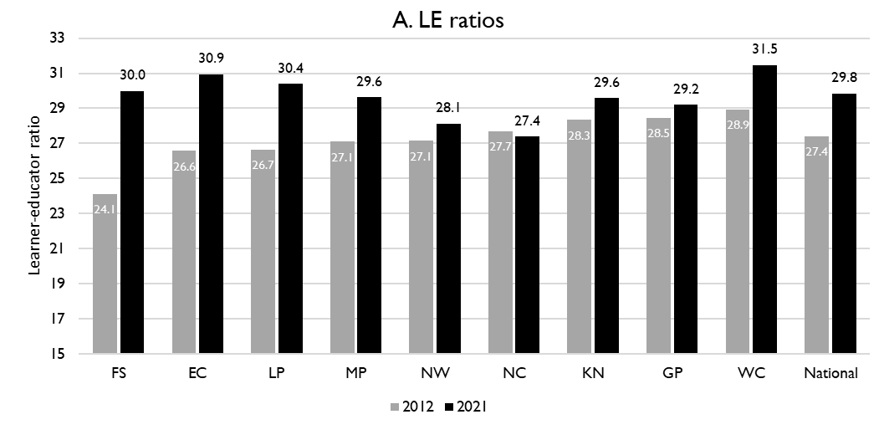
Learner-public educator ratios (‘12 & ’21)
6
National and provincial learner-to-public-educator ratios in 2012 and 2021, grades 1 to 12 in public ordinary schools in South Africa
LE ratio rose steeply from 24.1 to 30.0 learners per educator in the FS between 2012 and 2021; more than the national average
This increase was as a result of school rationalisation, where many of the schools that closed were small schools
z
Excl. SGB teachers
Source: Figure 1 in South African teacher shortages as revealed through class sizes and learner-educator ratios: An exploratory analysis by Gabrielle Wills (2023)

Slide 39
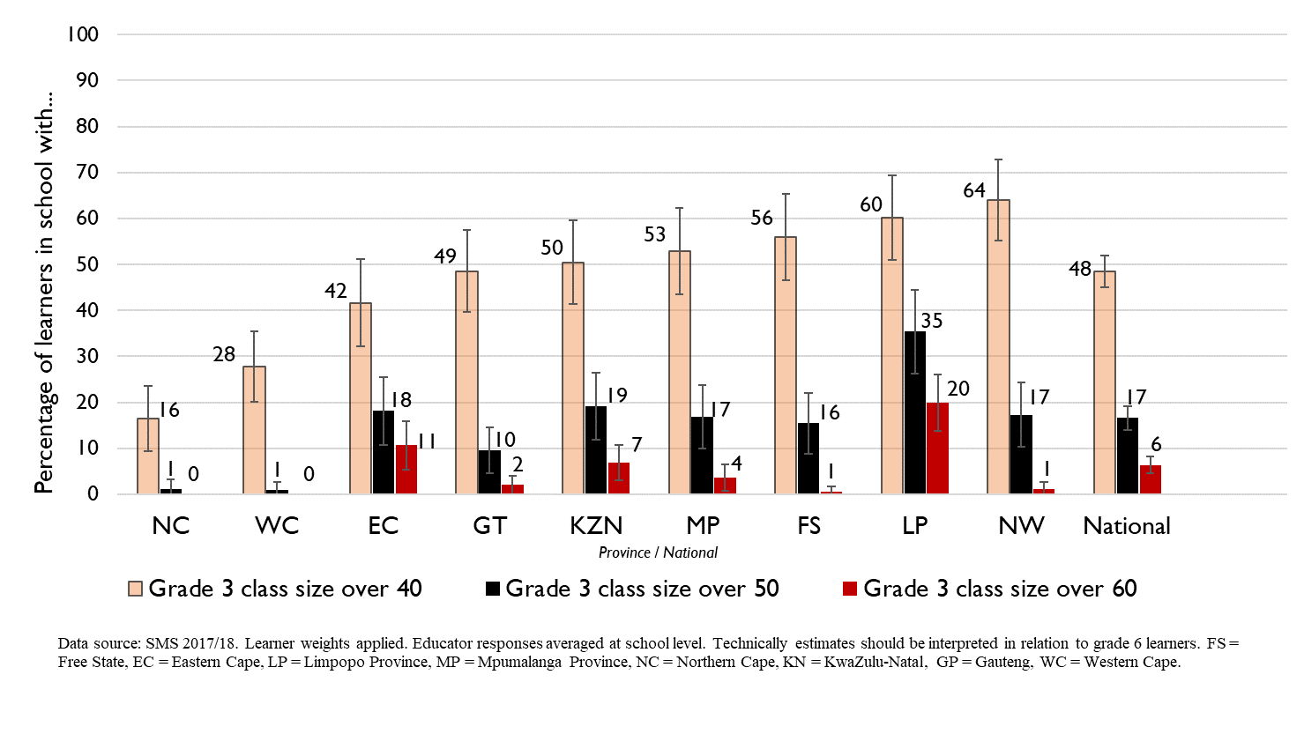
Grade 3 class sizes
(2017/18 School Monitoring Survey)
6
Post-provisioning guidelines - Class sizes should not exceed 35 in Grade 3.
% of learners in grade 3 classes > 40:
48% in SA, 56% in FS
% of learners in grade 3 classes > 50:
17% in SA, ~16% in FS
% of learners in grade 3 classes > 60:
6% in SA, ~1% in FS
Note: Nationally, grade 3 enrolment numbers had been rising since about 2011 and peaked in 2017 before starting to decline slightly, stabilising at about 1,1 million in 2021 (Gustafsson 2022a, p10-11). Holding other things constant, grade 3 class sizes will be similar or slightly smaller in 2022 than what is seen in these 2017/18 SMS estimates.

Slide 40
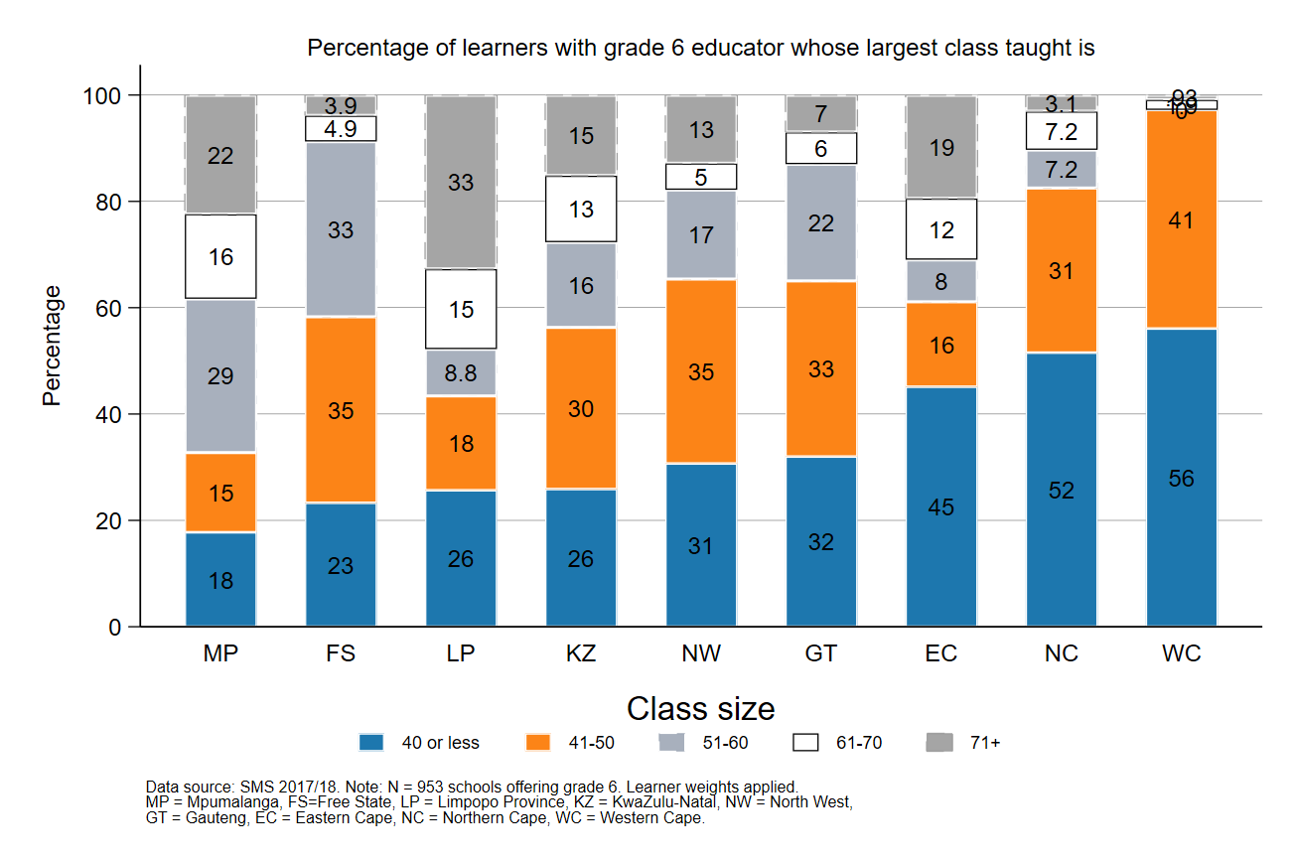
Largest classes - School Monitoring Survey 2017/18
6
In 2017/18, the FS was one of four provinces where the proportion of Gr6 learners in schools with large classes (>50 learners) was above 40%
A further deterioration of the LE ratio will drive up class size and the number of large classes, negatively impacting quality and teacher motivation
Percentage of grade 6 learners in schools with an educator reporting that their largest class is in the following class size category, disaggregated by province (SMS 2017/18)
Source: Figure 1 in South African teacher shortages as revealed through class sizes and learner-educator ratios: An exploratory analysis by Gabrielle Wills (2023) using School Monitoring Survey 2017/18 (953 schools, learner weighted).

Slide 41
Expected financial implications to 2030
7

Slide 42
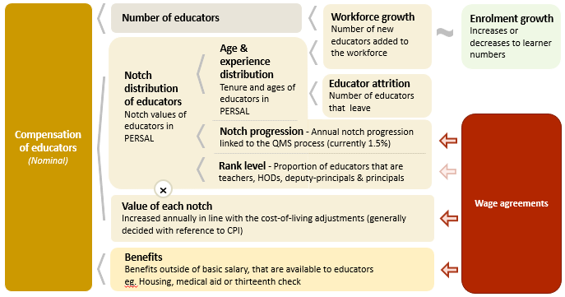
Unit cost drivers
7

Slide 43
Real and nominal costs
7
Examples:
In 2022 CPI was 7.2%
If nominal wages increase by 7.2%, then real wages increase by 0%
If nominal wages increase by 9%, then real wages increase by 1.8%
If nominal wages increase by 5%, then real wages decrease by 2.2%
A real increase in wages takes place when wages increase above the rate of inflation
Changes to real wages are an indicator of purchasing power

Slide 44
Projected unit costs trends| All educators
7
In constant 2021 rands
The real unit cost of educators in the FS is expected to remain constant (+0.3%) from 2022 to 2030
Note: Scale not from zero
Source: Own calculations, using the anonymised PERSAL data from 2021, only educators are considered. ECD practitioners and examination reviewers removed. Estimates to 2030 derived from the national and provincial TSD models. Assumption of no growth in educator numbers.

Slide 45
Indexed unit costs trends| All educators
7
In constant 2021 rands
GP: ~1% increase
Educator unit cost
(Index in 2022 = 100%)
WC: ~1.5% decrease
Note: Scale not from zero
Source: Own calculations, using the anonymised PERSAL data from 2021, only educators are considered. ECD practitioners and examination reviewers removed. Estimates to 2030 derived from the national and provincial TSD models. Assumption of no growth in educator numbers for FS, KN, LP, MP, NC, NW and SA. Assume 20% educator growth for GP, 10% for WC and a decline in 10% of educators in the EC. In LP assume that the proportion of senior educators grows from 16% in 2021 to 21% in 2030.

Slide 46
Indexed unit costs trends| All educators
7
In constant 2021 rands
FS: No change in real cost from
2022 - 2030
Educator unit cost
(Index in 2022 = 100%)
Note: Scale not from zero
Source: Own calculations, using the anonymised PERSAL data from 2021, only educators are considered. ECD practitioners and examination reviewers removed. Estimates to 2030 derived from the national and provincial TSD models. Assumption of no growth in educator numbers for FS, KN, LP, MP, NC, NW and SA. Assume 20% educator growth for GP, 10% for WC and a decline in 10% of educators in the EC. In LP assume that the proportion of senior educators grows from 16% in 2021 to 21% in 2030.

Slide 47
Projected unit costs trends| All educators
7
In constant 2021 rands
Teachers
(School based teachers)
Senior educators
(HODs, Deputy’s, Principals & Other)
-5%
Average annual unit cost
(In 2021 Rands)
+2%
Note: Scale not from zero
Source: Own calculations, using the anonymised PERSAL data from 2021, only educators are considered. ECD practitioners and examination reviewers removed. Estimates to 2030 derived from the national and provincial TSD models. Assumption of no growth in educator numbers for FS, KN, LP, MP, NC, NW and SA. Assume 20% educator growth for GP, 10% for WC and a decline in 10% of educators in the EC. In LP assume that the proportion of senior educators grows from 16% in 2021 to 21% in 2030.

Slide 48
Between and within province movement
8

Slide 49
Inter-provincial educator movement (7-yr)
8
 |  | Province in 2019 |  |  |  |  |  |  |  |  |  |  | Movement out of province
 |  | EC | FS | GP | KN | LP | MP | NC | NW | WC | Total
Province in 2012 | EC | 97.79 | 0.10 | 0.86 | 0.22 | 0.01 | 0.04 | 0.11 | 0.19 | 0.70 | 100 |  | 2.23%
 | FS | 0.35 | 94.25 | 2.76 | 0.10 | 0.07 | 0.23 | 0.41 | 1.56 | 0.26 | 100 |  | 5.74%
 | GP | 0.15 | 0.26 | 96.86 | 0.27 | 0.81 | 0.42 | 0.05 | 0.93 | 0.24 | 100 |  | 3.13%
 | KN | 0.22 | 0.10 | 1.14 | 97.95 | 0.10 | 0.37 | 0.01 | 0.06 | 0.04 | 100 |  | 2.04%
 | LP | 0.02 | 0.02 | 1.72 | 0.02 | 96.80 | 0.80 | 0.05 | 0.56 | 0.02 | 100 |  | 3.21%
 | MP | 0.03 | 0.14 | 2.48 | 0.37 | 1.54 | 94.86 | 0.03 | 0.49 | 0.07 | 100 |  | 5.15%
 | NC | 0.47 | 0.50 | 0.47 | 0.06 | 0.59 | 0.03 | 94.35 | 2.37 | 1.15 | 100 |  | 5.64%
 | NW | 0.06 | 0.59 | 3.84 | 0.03 | 0.65 | 0.34 | 0.75 | 93.60 | 0.14 | 100 |  | 6.40%
 | WC | 0.72 | 0.03 | 0.17 | 0.05 | 0.00 | 0.02 | 0.35 | 0.03 | 98.61 | 100 |  | 1.37%
Source: PERSAL 10-year anonymised dataset, only educators that were in the dataset for 2018 and 2019 are considered here

Slide 50
Inter-provincial educator movement (7-yr)
8
 |  | Province in 2019 |  |  |  |  |  |  |  |  |  |  | Movement out of province
 |  | EC | FS | GP | KN | LP | MP | NC | NW | WC | Total
Province in 2012 | EC | 97.79 | 0.10 | 0.86 | 0.22 | 0.01 | 0.04 | 0.11 | 0.19 | 0.70 | 100 |  | 2.23%
 | FS | 0.35 | 94.25 | 2.76 | 0.10 | 0.07 | 0.23 | 0.41 | 1.56 | 0.26 | 100 |  | 5.74%
 | GP | 0.15 | 0.26 | 96.86 | 0.27 | 0.81 | 0.42 | 0.05 | 0.93 | 0.24 | 100 |  | 3.13%
 | KN | 0.22 | 0.10 | 1.14 | 97.95 | 0.10 | 0.37 | 0.01 | 0.06 | 0.04 | 100 |  | 2.04%
 | LP | 0.02 | 0.02 | 1.72 | 0.02 | 96.80 | 0.80 | 0.05 | 0.56 | 0.02 | 100 |  | 3.21%
 | MP | 0.03 | 0.14 | 2.48 | 0.37 | 1.54 | 94.86 | 0.03 | 0.49 | 0.07 | 100 |  | 5.15%
 | NC | 0.47 | 0.50 | 0.47 | 0.06 | 0.59 | 0.03 | 94.35 | 2.37 | 1.15 | 100 |  | 5.64%
 | NW | 0.06 | 0.59 | 3.84 | 0.03 | 0.65 | 0.34 | 0.75 | 93.60 | 0.14 | 100 |  | 6.40%
 | WC | 0.72 | 0.03 | 0.17 | 0.05 | 0.00 | 0.02 | 0.35 | 0.03 | 98.61 | 100 |  | 1.37%
High level of movement between provinces – about 5.7% of Free State teachers in 2012 are teaching in a different province in 2019
Educators are most likely to move to the Gauteng and the North West
zvc
zvc
Source: PERSAL 10-year anonymised dataset, only educators that were in the dataset for 2018 and 2019 are considered here

Slide 51
Inter-provincial educator movement (7-yr)
8
 |  | Province in 2019
 |  | EC | FS | GP | KN | LP | MP | NC | NW | WC
Province in 2012 | EC | 42 645 | 42 | 373 | 95 | 5 | 16 | 46 | 82 | 304
 | FS | 57 | 15 267 | 447 | 17 | 11 | 38 | 67 | 252 | 42
 | GP | 67 | 117 | 42 770 | 121 | 356 | 187 | 20 | 409 | 108
 | KN | 146 | 67 | 755 | 64 723 | 64 | 247 | 9 | 37 | 26
 | LP | 10 | 10 | 709 | 7 | 39 899 | 328 | 20 | 230 | 7
 | MP | 7 | 34 | 618 | 94 | 385 | 23 644 | 7 | 121 | 17
 | NC | 31 | 33 | 31 | 4 | 39 | 2 | 6 214 | 156 | 76
 | NW | 12 | 111 | 726 | 5 | 123 | 65 | 141 | 17 690 | 27
 | WC | 152 | 7 | 37 | 11 | 0 | 5 | 75 | 6 | 20 858
 | Total 2019 | 43 127 | 15 688 | 46 466 | 65 077 | 40 882 | 24 532 | 6 599 | 18 983 | 21 465
 | Movement into province | 482 | 421 | 3 696 | 354 | 983 | 888 | 385 | 1 293 | 607
 | % movement into province | 1.1% | 2.7% | 8.0% | 0.5% | 2.4% | 3.6% | 5.8% | 6.8% | 2.8%
Source: PERSAL 10-year anonymised dataset, only educators that were in the dataset for 2012 and 2019 are considered here

Slide 52
Inter-provincial educator movement (7-yr)
8
 |  | Province in 2019
 |  | EC | FS | GP | KN | LP | MP | NC | NW | WC
Province in 2012 | EC | 42 645 | 42 | 373 | 95 | 5 | 16 | 46 | 82 | 304
 | FS | 57 | 15 267 | 447 | 17 | 11 | 38 | 67 | 252 | 42
 | GP | 67 | 117 | 42 770 | 121 | 356 | 187 | 20 | 409 | 108
 | KN | 146 | 67 | 755 | 64 723 | 64 | 247 | 9 | 37 | 26
 | LP | 10 | 10 | 709 | 7 | 39 899 | 328 | 20 | 230 | 7
 | MP | 7 | 34 | 618 | 94 | 385 | 23 644 | 7 | 121 | 17
 | NC | 31 | 33 | 31 | 4 | 39 | 2 | 6 214 | 156 | 76
 | NW | 12 | 111 | 726 | 5 | 123 | 65 | 141 | 17 690 | 27
 | WC | 152 | 7 | 37 | 11 | 0 | 5 | 75 | 6 | 20 858
 | Total 2019 | 43 127 | 15 688 | 46 466 | 65 077 | 40 882 | 24 532 | 6 599 | 18 983 | 21 465
 | Movement into province | 482 | 421 | 3 696 | 354 | 983 | 888 | 385 | 1 293 | 607
 | % movement into province | 1.1% | 2.7% | 8.0% | 0.5% | 2.4% | 3.6% | 5.8% | 6.8% | 2.8%
Few educators moved to FS, about 2.7% of educators in 2019 had come from another province since 2012
The provinces that sent the highest number of educators to FS were the GP and NW
zvc
zvc
Source: PERSAL 10-year anonymised dataset, only educators that were in the dataset for 2012 and 2019 are considered here

Slide 53
Educator movement between schools
8
High levels of movement between schools, about 5.5% of FS educators (5.1% nationally) move to a different pay point but stay within PERSAL from 2018-2019
Rate at which FS educators aged 50 and below (3.9%) leave the system is comparable with the national average (3.8%)
 | Pay point in 2019 (Ordinary schools only)
Province | Same as in 2018 (%) | Different to 2018 (%) | None - left system (%) | Total (%)
EC | 93.25 | 4.61 | 2.14 | 100
FS | 90.54 | 5.54 | 3.93 | 100
GP | 91.08 | 3.95 | 4.97 | 100
KN | 91.99 | 4.31 | 3.70 | 100
LP | 91.04 | 6.95 | 2.00 | 100
MP | 92.02 | 4.66 | 3.32 | 100
NC | 85.44 | 8.39 | 6.18 | 100
NW | 89.42 | 6.30 | 4.28 | 100
WC | 87.27 | 6.09 | 6.64 | 100
Total | 91.11 | 5.05 | 3.83 | 100
Source: PERSAL 10-year anonymised dataset. Only included educators aged 50 years and below, that were in ordinary schools in 2018 (Primary, Secondary, Combined and Intermediate)—excluded all paypoints that did not appear in both years after identifying 103 paypoints where the paypoint number changed.

Slide 54
Gender imbalances in management
9

Slide 55
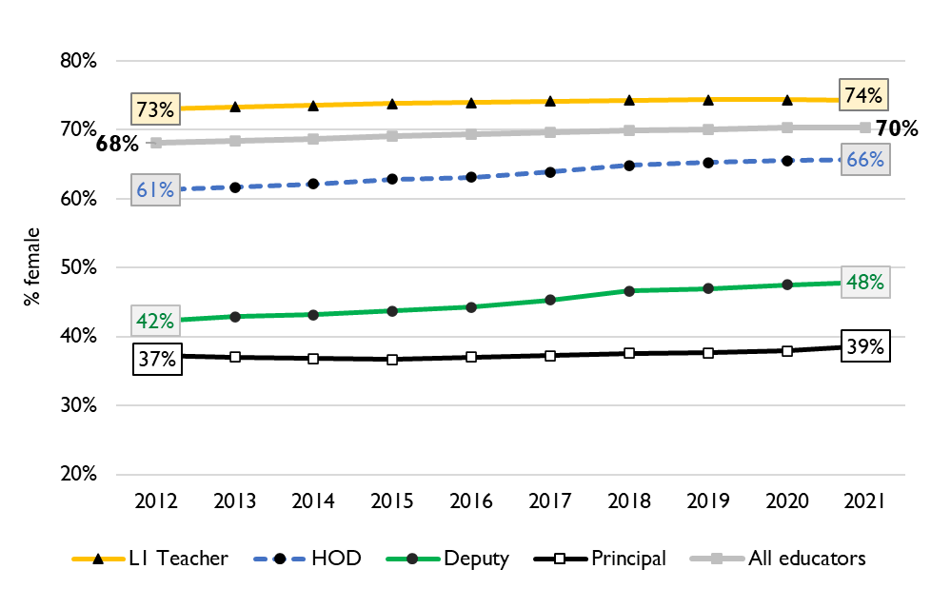
Percentage of educators that are female
9
Percentage of public educators in South Africa that are female, PERSAL (2012-2021)
Nationally, there has been very little transformation in senior school leadership in terms of gender since 2012 and even since 2004 (just 34% of principals were female).
There is better representation at middle-management (HOD) level.
Source: Using anonymised 10-year PERSAL data from 2012 to 2021, only educators of the ranks: level 1 teacher, HOD, deputy principal and principal are considered.

Slide 56
Percentage of educators that are female
9
In the Free State in 2021, 69% of all educators were women.
Women were underrepresented at all levels of management with 57% of HODs being women. And, only 48% of deputy principals and 33% of principals.
Source: Using anonymised 10-year PERSAL data from 2012 to 2021, only educators of the ranks: level 1 teacher, HOD, deputy principal and principal are considered.

Slide 57
Conclusion
10
In the FS, about 43% of educators were 50 years or older in 2021, with a high proportion of senior educators (65%) being over 50
Careful succession planning, efficient promotion processes, and good onboarding practices will be required to manage this transition as they retire
School-aged population is projected to decline from 2021 to 2030
With average school sizes likely to decrease further, ongoing school rationalisation efforts will likely need to continue
Upward pressure on class sizes due to increases in LE ratio, if the workforce continues to decline more than enrolment.
The unit cost of educators is predicted to stay roughly constant. This should give the province room to engage in targeted school rationalisation if decreases in enrolment make this a priority

