Slide 1
Gauteng Province
24 October 2023
Educator Demand Projections
2021-2030

Slide 2
Introduction (1)
The proportion of educators that are 50 years or older has steadily risen between 2012 to 2021 in South Africa.
⇒ Nationally a wave of educator retirements is expected as older educators reach the standard retirement age of between 60 and 65.
Implications:
Many more appointments: The retirement wave will open up both teaching & school management & leadership positions & other office-based education specialists.
Total compensation of educators: Since older teachers earn more, when retiring they are replaced with younger (less costly) teachers.

Slide 3
Introduction (2)
As retirements increase, the required number of new appointments will need to increase to ensure that total educator numbers (at a minimum) stay at current levels and/or are sufficient to meet learner enrolment growth to prevent deterioration in learner-educator ratios.
Planning will be required to ensure that provinces are ready for the sustained increase in appointments.
If these positions are not filled, this could result in a further deterioration in the learner-educator ratio and lead to further increases in already large class sizes.

Slide 4
Objective
In this presentation, we will….
Outline the
National picture
Highlight aspects of
the situation in Gauteng
Present some insights for Gauteng from SA-SAMS
In each province, there are differences in the age profile of teachers, the expected growth of the school-going population and expected teacher attrition (resignations and retirements).

Slide 5
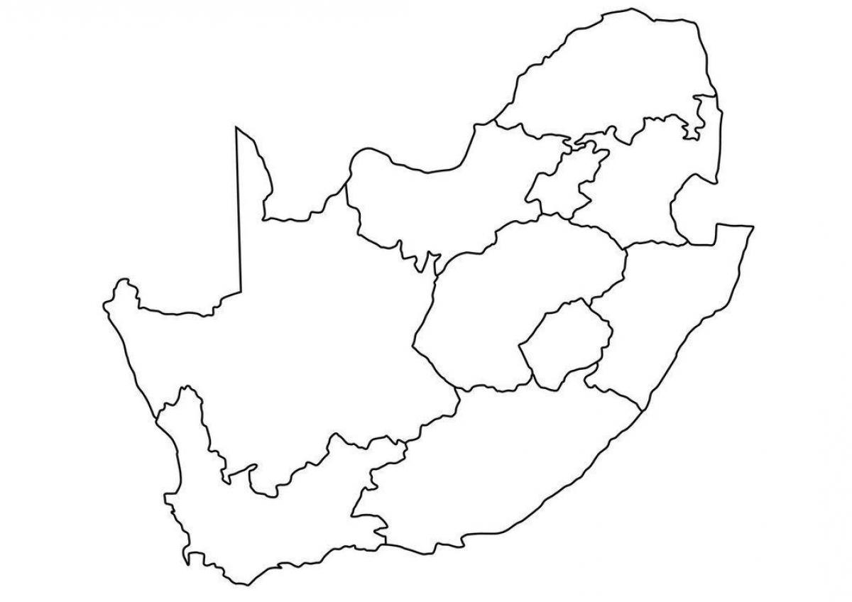
National Background

Slide 6
The ‘main graph’: Focus on the LE ratio
Newly graduated teachers
First-time joiners

Slide 7
The ‘main graph’: Focus on the LE ratio
Newly graduated teachers
20%
First-time joiners
27.4
29.8

Slide 8
The ‘main graph’: Focus on the LE ratio
403 000
467 000
Newly graduated teachers
First-time joiners

Slide 9
The ‘main graph’: Focus on the LE ratio
Newly graduated teachers
20%
First-time joiners
27.4
29.8
27.4

Slide 10
More educators retiring in the coming years
1
Educators aged 56 to 65 leaving
By 2030, 35% would have left due to age
By 2035, 53%

Slide 11
Many more school-age children than we expected
2
Population of children in millions (ages 7-18)
From 2006 projections of UN World Population Prospects (WPP)

Slide 12
Many more school-age children than we expected
2
2022 UN WPP projections
Population of children in millions (ages 7-18)
From 2006 projections of UN World Population Prospects (WPP)

Slide 13
Many more school-age children than we expected
2
2022 UN WPP projections
Stats SA
DBE grades 1 to 12 enrolments
Population of children in millions (ages 7-18)
Thembisa
From 2006 projections of UN World Population Prospects (WPP)

Slide 14
How much will we be able to spend on educators in future?
Schooling provides skills needed to grow the economy
Schooling
Economy
A growing economy means more to spend on schooling, and teachers

Slide 15
Spending on educators, GDP and government non-interest spending
Spending on educators over GDP
Spending on educators over government non-interest spending

Slide 16
Spending on educators, GDP and government non-interest spending
191bn
139bn
Spending on educators over GDP
Spending on educators over government non-interest spending

Slide 17
Spending on educators, GDP and government non-interest spending
38%
(2.1% pa)
191bn
139bn
Spending on educators over GDP
Spending on educators over government non-interest spending

Slide 18
Spending on educators, GDP and government non-interest spending
221bn
38%
(2.1% pa)
191bn
139bn
Spending on educators over GDP
Spending on educators over government non-interest spending

Slide 19
Spending on educators, GDP and government non-interest spending
Older educators (42.8 to 45.1)
Grey part: improvements in purchasing power
Workforce growth
Spending on educators over GDP
Spending on educators over government non-interest spending

Slide 20
Spending on educators, GDP and government non-interest spending
Demographic dividend
(Average age decreases)
Workforce growth
(Around
60 000 additional educators)
Spending on educators over GDP
Spending on educators over government non-interest spending

Slide 21
What an LE ratio increase of 1.0 means
Based on analysis of 2015 to 2018 grades 1 to 3 trends
Average class size | Goes up by 1.2
% of learners in classes over 40 | Rises e.g. from 49% to 55%, so 6 percentage points, pushing some 200,000 grades 1 to 3 learners over the threshold
% of learners in classes over 50 | Rises from e.g. 20% to 23%, so 3 percentage points

Slide 22
Future demand, Workforce size and the Economy
 | Now |  | 2030
 |  | Focus on LE (of 2011) | Keep LE at present levels | Constant educators
LE ratio (was 27.4 in 2011) | 29.8 | 27.4 | 29.8 | 31.6
Total educators | 403 000 | 467 000 | 428 000 | 403 000
Newly graduated teachers | 31 000 | 40 000 | 33 000 | 28 000
Above-CPI annual CoL increase | 1.8 2015-2019, -2.5 2019-2023 | 0.0 | 0.0 | 0.0
Annual real % increase in unit cost 2022-2030 | 0.4% 2011-2022 | 0.0 | 0.0 | 0.1
Annual real % increase in total cost 2022-2030 | 0.8% 2011-2022 | 1.8 | 0.8 | 0.1
➔
➔
➔
Notes:
LE ratio:  POS 1 to 12 over eds in Persal (with a few exclusions).  Historical worsening, has pushed some 400,000 across 40-threshold.  Move from 29.8 to 31.6 pushes 360,000 grades 1 to 3 learners beyond the 40 limit.
Newly graduated teachers:  The 31,000 is a dramatic increase, was half this in 2014. This rise is arguably a second time we’ve misunderstood demand.  Number rises by around 10% for all scenarios if reserve pool effects removed.  Annual real % increase in total cost 2022-2030: 1.8% is IMF projection for 2024.
To conclude: All this in important i.t.o. (1) understanding unit cost trend (provincial planners will look beyond Treasury manuals); (2) bringing about a more long-term demand-focused debate around education service delivery (central bargaining will consider trade-offs).

Slide 23
Overview
Age distributions
Projected retirements & resignations
Provincial population and enrolment trends
Public and independent school growth
Implications for infrastructure, appointments & class sizes
Educator growth: Teachers and SMT positions
Expected financial implications to 2030
Movement of educators: Between and within provinces
Gender imbalance in school management
Discussion
1
2
3
4
5
6
7
8
9
10

Slide 24
Gauteng educator demand summary
Age distribution: The age distribution in GP had a peak at around 51 years of age in 2021
Projected resignations and retirements: GP will see lower rates of retirements, but high rates of resignations can be expected for younger educators (aged 55 and below)-this is mainly driven by younger educators resigning as the proportion of newly hired younger educators increases
Enrolment and population growth: Enrolment in GP ordinary schools grew by 24% from 2012-2021 (~489K learners), the school-aged population is forecast to grow by 27% (~680K learners) to 2030
School and educator growth: From 2012 to 2021, the educator number in public schools increased but less than enrolment (+21%); school numbers remained almost constant, increasing the LE ratio (excl. SGB)
Appointments and LE Ratio: Increases in appointments are needed in response to enrolment growth; otherwise, the LE ratio will increase further (inc. from 28.5 to 29.2 from 2012 to 2021)
Teacher and senior educator changes: In GP, there has been an increase in the number of teachers (+28%), HODs (+6%), and deputy principals (+11%) from 2012 to 2021, but principal numbers decreased (-10%)
Projected educator cost trends: GP will experience a slight increase in the real average cost of educators (~1%); the real unit cost of teachers will increase by (+2%), and the real unit cost of senior educator educators will decrease by (-3%)
Educator movements: Low movements out of GP (~3%) but high movement into the province (~8%) over 7 year period. The annual attrition rate of younger educators (ages ≤ 50) of about 5% is higher than SA

Slide 25
Age distributions and projected retirements and resignations
1
2

Slide 26
Educator age distribution (2021)
1
Source: Anonymised PERSAL data from 2021, only educators (Rank 60 000 – 69 999) are considered. ECD practitioners, TVET lecturers and ABET teachers were removed.

Slide 27
Educator age distribution (2021)
1
A lower proportion of educators are over 50 years old in Gauteng than in the rest of the country.
Age: 51
A slightly higher proportion of young educators under 35 years in GP
Source: Anonymised PERSAL data from 2021, only educators (Rank 60 000 – 69 999) are considered. ECD practitioners, TVET lecturers and ABET teachers were removed.

Slide 28
Older teacher proportions for senior educators and primary schools educators
1
 |  | Percentage of educators aged 50+ in 2021
Province |  | All educators |  | Senior educators (HOD, Dep.- principals, Principals & Other) |  | Primary school educators
EC |  | 51% |  | 71% |  | 58%
FS |  | 43% |  | 65% |  | 49%
GP |  | 41% |  | 65% |  | 42%
KN |  | 39% |  | 65% |  | 44%
LP |  | 58% |  | 81% |  | 63%
MP |  | 50% |  | 73% |  | 55%
NC |  | 43% |  | 69% |  | 44%
NW |  | 47% |  | 70% |  | 52%
WC |  | 42% |  | 73% |  | 40%
Source: Anonymised PERSAL data from 2021, only educators (Rank 60 000 – 69 999) are considered. ECD practitioners, TVET lecturers and ABET teachers were removed. The 2021 rankclass file was expanded to include ranks found only in years prior to 2021, used to classify educators by rank. Primary school only includes all educators that are in a component that is classified as a Primary school.

Slide 29
Older teacher proportions for senior educators and primary schools educators
1
 |  | Percentage of educators aged 50+ in 2021
Province |  | All educators |  | Senior educators (HOD, Dep.- principals, Principals & Other) |  | Primary school educators
EC |  | 51% |  | 71% |  | 58%
FS |  | 43% |  | 65% |  | 49%
GP |  | 41% |  | 65% |  | 42%
KN |  | 39% |  | 65% |  | 44%
LP |  | 58% |  | 81% |  | 63%
MP |  | 50% |  | 73% |  | 55%
NC |  | 43% |  | 69% |  | 44%
NW |  | 47% |  | 70% |  | 52%
WC |  | 42% |  | 73% |  | 40%
zvc
Lower proportions (but still high) of educators are 50+ in GP than in SA, this is also true for primary schools and for SMT positions and education specialists
zvc
Source: Anonymised PERSAL data from 2021, only educators (Rank 60 000 – 69 999) are considered. ECD practitioners, TVET lecturers and ABET teachers were removed. The 2021 rankclass file was expanded to include ranks found only in years prior to 2021, used to classify educators by rank. Primary school only includes all educators that are in a component that is classified as a Primary school.

Slide 30
Educator age distribution in 2021 & 2030
1
Assume constant 2021 educator numbers
Age: 51
2021
2030
Source: Anonymised PERSAL data from 2021, only educators (Rank 60 000 – 69 999) are considered. ECD practitioners, TVET lecturers and ABET teachers were removed.

Slide 31
Educator age distribution in 2021 & 2030
1
Assume constant 2021 educator numbers
Age: 51
2021
2030
Source: Anonymised PERSAL data from 2021, only educators (Rank 60 000 – 69 999) are considered. ECD practitioners, TVET lecturers and ABET teachers were removed.

Slide 32
Projected resignation & retirements (GP)
2
Assume constant 2021 educator numbers
Proportion of Educators
The majority of educators that exit PERSAL in Gauteng are resigning (ages 55 or below)
The retirement number rises and peaks in 2030 and 2031 but remains smaller than resignations
The number of young teachers (ages 21-30) resigning is projected to increase as the number of newly hired young teachers increases.
Projected
% of educators resigning or retiring
Source: Anonymised PERSAL data from 2021, only educators (Rank 60 000 – 69 999) are considered. ECD practitioners, TVET lecturers and ABET teachers were removed. Estimates to 2035 derived from the National and provincial teacher supply and demand models – assumption of no growth in educator numbers. Note: Retirements refer to all educators, aged 56 to 65, that leave PERSAL, whilst resignations refer to all educators aged 55 and below that leave PERSAL (as educators) for any reason.

Slide 33
Projected resignation & retirements (GP)
2
Assume constant 2021 educator numbers
Retirement headcount
The number of retirements is projected to increase, peaking in ~2030 & 2031 and then declining again
The number of retirements is projected to increase from just under 2,000 in 2022 to just under 3,000 in 2031, an increase of about 1,000 retirements annually
Projected
Number of retirements
Source: Anonymised PERSAL data from 2021, only educators (Rank 60 000 – 69 999) are considered. ECD practitioners, TVET lecturers and ABET teachers were removed. Estimates to 2035 derived from the National and provincial teacher supply and demand models – assumption of no growth in educator numbers. Note: Retirements refer to all educators, aged 56 to 65, that leave PERSAL, whilst resignations refer to all educators aged 55 and below that leave PERSAL (as educators) for any reason.

Slide 34
Older leaver trend estimates to 2035
2
Assume constant 2021 educator numbers
About 36,000
educators estimated to retire by 2035 in the GP
(47% of total educators in 2021)
Source: Anonymised 2021 PERSAL data, only educators (Rank 60 000 – 69 999) are considered. ECD practitioners, TVET lecturers and ABET teachers were removed. Estimates to 2035 derived from the National and provincial models – assumption of no growth in educator numbers.

Slide 35
Projected educators leaving
2
Assume constant 2021 educator numbers
Teachers
(Level 1 teachers)
Senior educators
(HODs, Deputy’s, Principals & Other)
% of teacher resigning & retiring
% of senior educators resigning & retiring
A higher proportion of teachers are expected to resign and retire in GP; many of them are younger educators
Careful succession planning is needed over the next ten years as high numbers of HODs, deputies and principals are projected to retire and resign
Source: Anonymised 2021 PERSAL data, only educators (Rank 60 000 – 69 999) are considered. ECD practitioners, TVET lecturers and ABET teachers were removed. Estimates to 2035 derived from the National and provincial models – assumption of no growth in educator numbers.

Slide 36
Provincial population and enrolment trends
3

Slide 37
Provincial enrolment trends (2012-2021)
3
High growth
Moderate growth
Stable
Decline
Source: Enrolment numbers taken from School Realities-EMIS (2012 – 2021) released by the DBE, using total numbers for ordinary public and independent schools.

Slide 38
Provincial enrolment trends (2012-2021)
3
Enrolment in Gauteng ordinary schools
grew by 24%
from 2012 to 2021
Source: Enrolment numbers taken from School Realities-EMIS (2012 – 2021) released by the DBE, using total numbers for ordinary public and independent schools.

Slide 39
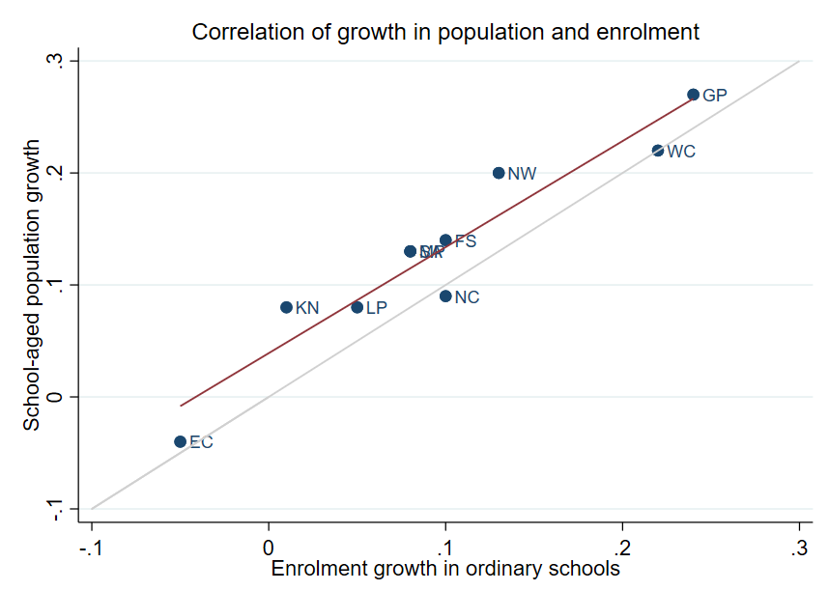
Correlation between population and enrolment growth
(2012-2021)
3
R² = 0.9025
Strong positive correlation between population and enrolment growth between 2012 and 2021
45˚
Source: Thembisa age specific data V4.5 for school-aged population (Ages 7-18) estimates and enrolment taken from School Realities-EMIS (2012 – 2021) released by the DBE, for numbers on ordinary public and independent schools (Statistical Publications (education.gov.za))

Slide 40
Projected growth in school-aged population
3
Population of children aged 7-18 in Gauteng is expected to grow by
27% from 2021 to 2030
Note: Period 2021 – 2030 is the same timeframe, nine years, as 2012 – 2021.
Source: Thembisa age-specific estimates from the model V4.5 for children aged 7-18 by province

Slide 41
School aged-population estimates to 2030
3
 | Number of children Aged 7-18 |  |  |  | Growth '12-21 | Growth '21-30
Province | 2012 | 2021 | 2030E |  | Growth '12-21 | Growth '21-30
EC | 1 657 202 | 1 598 475 | 1 361 637 |  | -4% | -15%
FS | 592 445 | 676 489 | 650 820 |  | 14% | -4%
GP | 1 962 793 | 2 498 533 | 3 180 884 |  | 27% | 27%
KN | 2 485 822 | 2 690 378 | 2 657 716 |  | 8% | -1%
LP | 1 395 864 | 1 507 386 | 1 612 125 |  | 8% | 7%
MP | 977 749 | 1 100 594 | 1 165 728 |  | 13% | 6%
NC | 254 075 | 277 560 | 281 208 |  | 9% | 1%
NW | 742 943 | 893 530 | 930 323 |  | 20% | 4%
WC | 1 068 009 | 1 298 801 | 1 496 731 |  | 22% | 15%
Total | 11 136 902 | 12 541 746 | 13 337 172 |  | 13% | 6%
3.18M
2,50M
1.96M
Note: Period 2021 – 2030 is the same timeframe, nine years, as 2012 – 2021.
Source: Thembisa age-specific estimates from the model V4.5 for children aged 7-18 by province

Slide 42
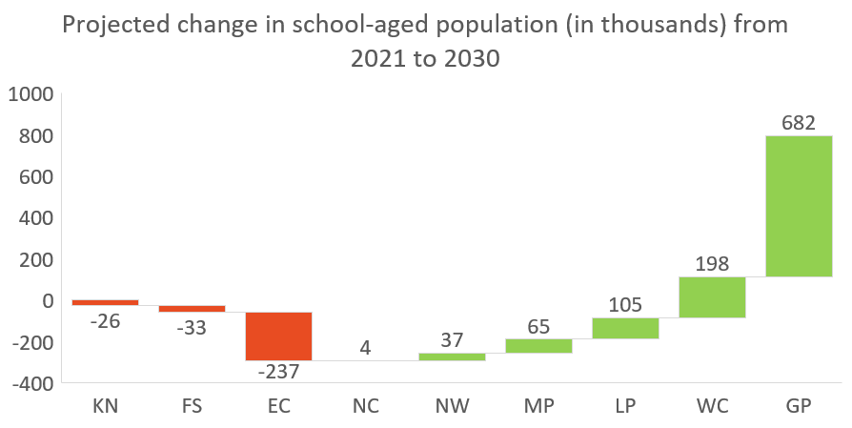
School-aged population estimates to 2030
3
63%
of all provincial population headcount growth is projected to take place in Gauteng
(in-migration)
Change in number of school-aged children
(in thousands of children)
Note: Period 2021 – 2030 is the same timeframe, nine years, as 2012 – 2021.
Source: Thembisa age-specific estimates from the model V4.5 for children aged 7-18 by province

Slide 43
Public and independent school growth
4

Slide 44
Educator, school and enrolment growth
4
 | % growth from 2012 - 2021
Province | Number of educators | Number of teachers |  | Number of public ordinary schools | Enrolment in public ordinary schools | Enrolment in ordinary schools |  | Est. school-aged population
EC | -17% | -20% |  | -8% | -6% | -5% |  | -4%
FS | -13% | -13% |  | -27% | 9% | 10% |  | 14%
GP | 21% | 28% |  | 1% | 20% | 24% |  | 27%
KN | -5% | -3% |  | -3% | 1% | 1% |  | 8%
LP | -8% | -2% |  | -7% | 4% | 5% |  | 8%
MP | 3% | 7% |  | -8% | 7% | 8% |  | 13%
NC | 6% | 9% |  | -3% | 9% | 10% |  | 9%
NW | 2% | 4% |  | -9% | 12% | 13% |  | 20%
WC | 12% | 22% |  | 0% | 21% | 22% |  | 22%
SA | -1% | 2% |  | -6% | 7% | 8% |  | 13%
Source: Educator numbers from anonymised PERSAL data from 2012 and 2021, only educators (Rank 60 000 – 69 999) are considered. Thembisa age specific data V4.5 for school-aged population (Ages 7-18) estimates and enrolment and school numbers taken from School Realities-EMIS (2012 – 2021) released by the DBE, for numbers on ordinary public and independent schools (Statistical Publications (education.gov.za))

Slide 45
Educator, school and enrolment growth
4
 | % growth from 2012 - 2021
Province | Number of educators | Number of teachers |  | Number of public ordinary schools | Enrolment in public ordinary schools | Enrolment in ordinary schools |  | Est. school-aged population
EC | -17% | -20% |  | -8% | -6% | -5% |  | -4%
FS | -13% | -13% |  | -27% | 9% | 10% |  | 14%
GP | 21% | 28% |  | 1% | 20% | 24% |  | 27%
KN | -5% | -3% |  | -3% | 1% | 1% |  | 8%
LP | -8% | -2% |  | -7% | 4% | 5% |  | 8%
MP | 3% | 7% |  | -8% | 7% | 8% |  | 13%
NC | 6% | 9% |  | -3% | 9% | 10% |  | 9%
NW | 2% | 4% |  | -9% | 12% | 13% |  | 20%
WC | 12% | 22% |  | 0% | 21% | 22% |  | 22%
SA | -1% | 2% |  | -6% | 7% | 8% |  | 13%
z
z
Enrolment and educator numbers grew in Gauteng, whilst the number of public ordinary schools remained almost constant....
Source: Educator numbers from anonymised PERSAL data from 2012 and 2021, only educators (Rank 60 000 – 69 999) are considered. Thembisa age specific data V4.5 for school-aged population (Ages 7-18) estimates and enrolment and school numbers taken from School Realities-EMIS (2012 – 2021) released by the DBE, for numbers on ordinary public and independent schools (Statistical Publications (education.gov.za))

Slide 46
Educator, school and enrolment growth
4
 | % growth from 2012 - 2021
Province | Number of educators | Number of teachers |  | Number of public ordinary schools | Enrolment in public ordinary schools | Enrolment in ordinary schools |  | Est. school-aged population
EC | -17% | -20% |  | -8% | -6% | -5% |  | -4%
FS | -13% | -13% |  | -27% | 9% | 10% |  | 14%
GP | 21% | 28% |  | 1% | 20% | 24% |  | 27%
KN | -5% | -3% |  | -3% | 1% | 1% |  | 8%
LP | -8% | -2% |  | -7% | 4% | 5% |  | 8%
MP | 3% | 7% |  | -8% | 7% | 8% |  | 13%
NC | 6% | 9% |  | -3% | 9% | 10% |  | 9%
NW | 2% | 4% |  | -9% | 12% | 13% |  | 20%
WC | 12% | 22% |  | 0% | 21% | 22% |  | 22%
SA | -1% | 2% |  | -6% | 7% | 8% |  | 13%
z
z
The increase in the number of educators in Gauteng appears to be responsive to growth in enrolment….
Source: Educator numbers from anonymised PERSAL data from 2012 and 2021, only educators (Rank 60 000 – 69 999) are considered. Thembisa age specific data V4.5 for school-aged population (Ages 7-18) estimates and enrolment and school numbers taken from School Realities-EMIS (2012 – 2021) released by the DBE, for numbers on ordinary public and independent schools (Statistical Publications (education.gov.za))

Slide 47
School growth from 2012 to 2021
4
School growth was driven by independent school growth (+37%) from 2012 to 2021. In contrast, the number of public schools in SA decreased (-6%)
EC | FS | GP | KN | LP | MP | NC | NW | WC | SA
% independent schools (2021)
4%
8%
30%
4%
5%
7%
7%
6%
17%
9%
Source: School numbers taken from School Realities-EMIS (2012 – 2021) released by the DBE, for numbers on ordinary public and independent schools (Statistical Publications (education.gov.za))

Slide 48
School growth from 2012 to 2021
4
High growth in the number of independent schools in GP (+54%), with enrolment growing from about 217K to 337K learners (+56%) between 2012 and 2021
EC | FS | GP | KN | LP | MP | NC | NW | WC | SA
% independent schools (2021)
4%
8%
30%
4%
5%
7%
7%
6%
17%
30%
17%
9%
Source: School numbers taken from School Realities-EMIS (2012 – 2021) released by the DBE, for numbers on ordinary public and independent schools (Statistical Publications (education.gov.za))

Slide 49
Implications on appointments, infrastructure & class sizes
5

Slide 50
Projected increase in appointments
5
Large and sustained increase in expected annual appointments over the period 2026 -30 relative to 2012-21
Increase is due to expected growth in the workforce and higher rates of replacement due to retirement and high churn among younger educators
Sourcing and appointment processes will need to be strengthened
Almost 3 000
additional educators will
need to be appointed
annually
~9 300
educators
6 358
educators
Mean number of annual joiners over the period 2012 - 2021
Projected mean number of annual leavers from 2026 - 2030 plus educators needed to grow by 20%* to 2030
*Assumes total educator numbers increase by ~1 700 educators annually between 2022 - 2030

Slide 51
Ongoing GP school infrastructure projects
5
New demand and backlog
Replacement Schools
  29 Schools built from Asbestos (Inappropriate Material)
  87 Whole Mobile Schools
Classroom Shortages at existing schools to reduce overcrowding
  723 schools have a shortage of 5 554 classrooms of which 3 166 are primary schools while 2 388 are secondary schools.
New Schools
  The immediate shortage/ backlog in new townships are 132 new schools are required, i.e. 75 primary schools and 57 secondary schools.
  88 schools are required in areas where there are new high-density middle-income housing developments.
  Data related to admissions indicate that a total of 27 new schools are required on an annual basis.
The 2023/24 conditional grant amounts to R3.2 billion
R 1,7billion has been allocated to the Education infrastructure Grant
From 2023/24 from GED Budget speech, 28 May 2023
From a presentation delivered by Albert Chanee on 06 Sep 2023 at STIAS
Sources: https://www.gtac.gov.za/wp-content/uploads/2022/07/Gauteng-Schools-Friday-webinar.pdf ; https://www.iol.co.za/education/gauteng-department-of-education-announces-202324-budget-plans-72d4ebca-2624-49dc-96db-e63f8173cf04

Slide 52
Ongoing GP school infrastructure projects
5
Budget Facility for Infrastructure
R1,5 billion to build 18 schools over the next three years
Many are addressing backlog
Provincial Public Works
35 new schools in the planning phase
17 schools are planned for delivery in the next three
DBSA
8 schools being built over the next three years
The 2023/24 conditional grant amounts to R3.2 billion
R 1,7billion has been allocated to the Education infrastructure Grant
From 2023/24 from GED Budget speech, 28 May 2023
From a presentation delivered by Albert Chanee on 06 Sep 2023 at STIAS
Sources: https://www.gtac.gov.za/wp-content/uploads/2022/07/Gauteng-Schools-Friday-webinar.pdf ; https://www.iol.co.za/education/gauteng-department-of-education-announces-202324-budget-plans-72d4ebca-2624-49dc-96db-e63f8173cf04

Slide 53
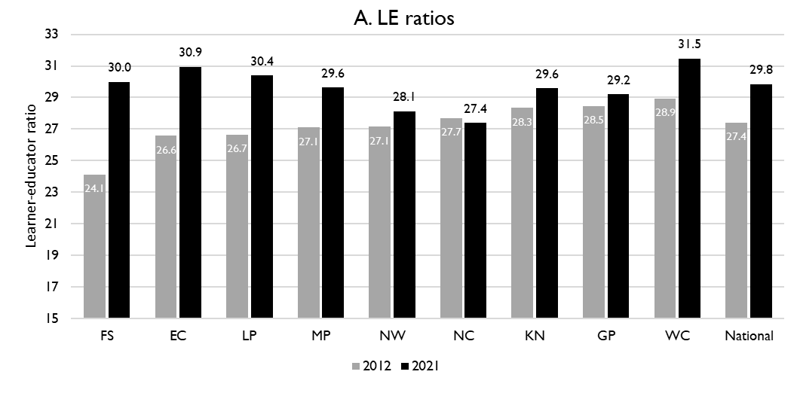
Learner-public educator ratios (‘12 & ‘21)
5
National and provincial learner-to-public-educator ratios in 2012 and 2021, grades 1 to 12 in public ordinary schools in South Africa
z
z
LE ratio rose from 28.5 learners per educator to 29.2 learners per educator in GP
However, some of this is offset by SGB positions.
Source: Figure 1 in South African teacher shortages as revealed through class sizes and learner-educator ratios: An exploratory analysis by Gabrielle Wills (2023)

Slide 54
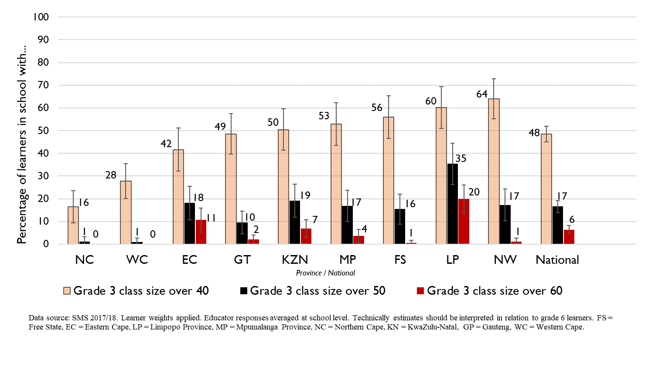
Grade 3 class sizes
(2017/18 School Monitoring Survey)
Post provisioning guidelines - Class sizes should not exceed 35 in Grade 3.
% of learners in grade 3 classes > 40:
48% in SA, 49% in GP
% of learners in grade 3 classes > 50:
17% in SA, 10% in GP
% of learners in grade 3 classes > 60:
6% in SA, 2% in GP
Note: Nationally, grade 3 enrolment numbers had been rising from about 2011 and peaked in 2017 before starting to decline slightly, stabilising at about 1,1 million in 2021 (Gustafsson 2022a, p10-11). Holding other things constant, grade 3 class sizes will be similar or slightly smaller in 2022 than what is seen in these 2017/18 SMS estimates.

Slide 55
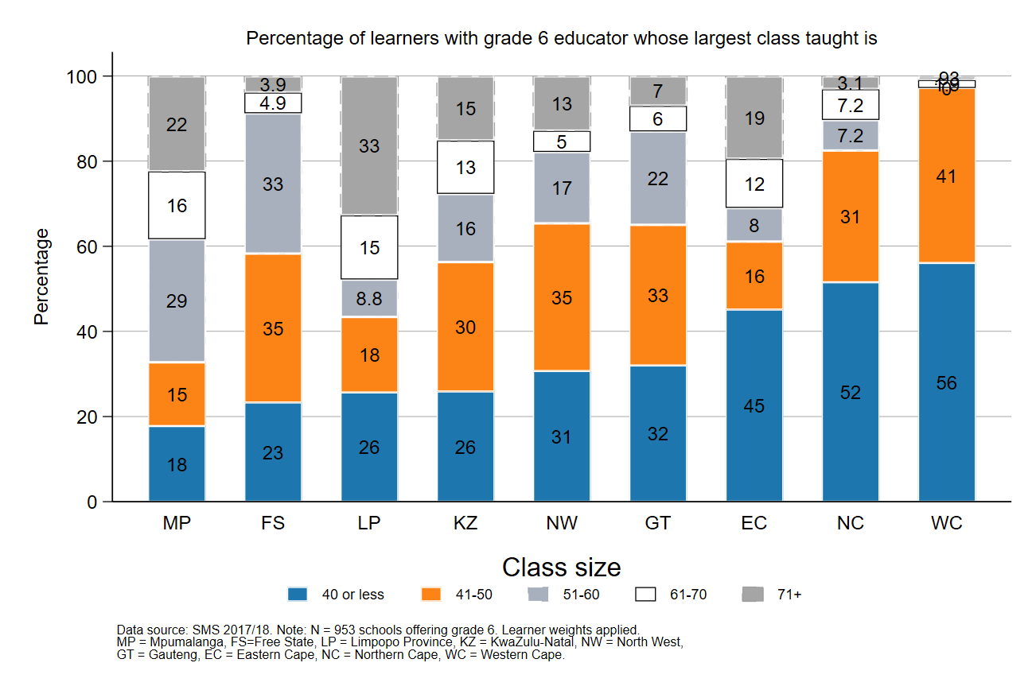
Largest classes - School Monitoring Survey 2017/18
5
In 2017/18, Gauteng was one of the top four provinces with the lowest percentage of large classes with more than 50 learners
A further deterioration of the LE ratio will drive up class size and the number of excessively large classes, negatively impacting quality and teacher motivation
Percentage of grade 6 learners in schools with an educator reporting that their largest class is in the following class size category, disaggregated by province (SMS 2017/18)
Source: Figure 1 in South African teacher shortages as revealed through class sizes and learner-educator ratios: An exploratory analysis by Gabrielle Wills (2023) using School Monitoring Survey 2017/18 (953 schools, learner weighted).

Slide 56
Educator growth by teachers and senior educator positions
6

Slide 57
Changes in teacher and SMT numbers
6
 |  | Teacher |  |  |  |  | HOD |  |  |  |  | Deputy-Principal |  |  |  |  | Principal
Province |  | 2012 | 2021 | Diff | % change |  | 2012 | 2021 | Diff | % change |  | 2012 | 2021 | Diff | % change |  | 2012 | 2021 | Diff | % change
EC |  | 50 295 | 40 115 | -10 180 | -20% |  | 5 870 | 6 196 | 326 | 6% |  | 1 342 | 1 453 | 111 | 8% |  | 5 294 | 4 755 | - 539 | -10%
FS |  | 20 148 | 17 561 | -2 587 | -13% |  | 2 685 | 2 470 | - 215 | -8% |  | 852 | 768 | - 84 | -10% |  | 1 224 | 892 | - 332 | -27%
GP |  | 47 233 | 60 677 | 13 444 | 28% |  | 8 708 | 9 209 | 501 | 6% |  | 2 565 | 2 850 | 285 | 11% |  | 2 162 | 1 959 | - 203 | -9%
KN |  | 73 050 | 71 000 | -2 050 | -3% |  | 11 289 | 10 330 | - 959 | -8% |  | 2 642 | 2 342 | - 300 | -11% |  | 5 584 | 5 055 | - 529 | -9%
LP |  | 44 998 | 44 317 | - 681 | -2% |  | 6 090 | 3 762 | -2 328 | -38% |  | 1 562 | 778 | - 784 | -50% |  | 3 510 | 3 316 | - 194 | -6%
MP |  | 26 127 | 27 857 | 1 730 | 7% |  | 4 047 | 4 055 | 8 | 0% |  | 1 108 | 1 114 | 6 | 1% |  | 1 790 | 1 450 | - 340 | -19%
NC |  | 7 257 | 7 929 | 672 | 9% |  | 1 034 | 1 094 | 60 | 6% |  | 294 | 365 | 71 | 24% |  | 587 | 488 | - 99 | -17%
NW |  | 21 305 | 22 261 | 956 | 4% |  | 2 994 | 3 023 | 29 | 1% |  | 902 | 1 041 | 139 | 15% |  | 1 698 | 1 338 | - 360 | -21%
WC |  | 23 579 | 28 665 | 5 086 | 22% |  | 4 065 | 3 700 | - 365 | -9% |  | 1 334 | 1 297 | - 37 | -3% |  | 1 531 | 1 339 | - 192 | -13%
SA |  | 313 992 | 320 382 | 6 390 | 2% |  | 46 782 | 43 839 | -2 943 | -6% |  | 12 601 | 12 008 | - 593 | -5% |  | 23 380 | 20 592 | -2 788 | -12%
Source: Anonymised PERSAL data from 2012 and 2021, only educators (Rank 60 000 – 69 999) are considered. ECD practitioners, TVET lecturers, and ABET teachers were removed. The 2021 rankclass file was expanded to include ranks found only in years prior to 2021.

Slide 58
Changes in teacher and SMT numbers
6
 |  | Teacher |  |  |  |  | HOD |  |  |  |  | Deputy-Principal |  |  |  |  | Principal
Province |  | 2012 | 2021 | Diff | % change |  | 2012 | 2021 | Diff | % change |  | 2012 | 2021 | Diff | % change |  | 2012 | 2021 | Diff | % change
EC |  | 50 295 | 40 115 | -10 180 | -20% |  | 5 870 | 6 196 | 326 | 6% |  | 1 342 | 1 453 | 111 | 8% |  | 5 294 | 4 755 | - 539 | -10%
FS |  | 20 148 | 17 561 | -2 587 | -13% |  | 2 685 | 2 470 | - 215 | -8% |  | 852 | 768 | - 84 | -10% |  | 1 224 | 892 | - 332 | -27%
GP |  | 47 233 | 60 677 | 13 444 | 28% |  | 8 708 | 9 209 | 501 | 6% |  | 2 565 | 2 850 | 285 | 11% |  | 2 162 | 1 959 | - 203 | -9%
KN |  | 73 050 | 71 000 | -2 050 | -3% |  | 11 289 | 10 330 | - 959 | -8% |  | 2 642 | 2 342 | - 300 | -11% |  | 5 584 | 5 055 | - 529 | -9%
LP |  | 44 998 | 44 317 | - 681 | -2% |  | 6 090 | 3 762 | -2 328 | -38% |  | 1 562 | 778 | - 784 | -50% |  | 3 510 | 3 316 | - 194 | -6%
MP |  | 26 127 | 27 857 | 1 730 | 7% |  | 4 047 | 4 055 | 8 | 0% |  | 1 108 | 1 114 | 6 | 1% |  | 1 790 | 1 450 | - 340 | -19%
NC |  | 7 257 | 7 929 | 672 | 9% |  | 1 034 | 1 094 | 60 | 6% |  | 294 | 365 | 71 | 24% |  | 587 | 488 | - 99 | -17%
NW |  | 21 305 | 22 261 | 956 | 4% |  | 2 994 | 3 023 | 29 | 1% |  | 902 | 1 041 | 139 | 15% |  | 1 698 | 1 338 | - 360 | -21%
WC |  | 23 579 | 28 665 | 5 086 | 22% |  | 4 065 | 3 700 | - 365 | -9% |  | 1 334 | 1 297 | - 37 | -3% |  | 1 531 | 1 339 | - 192 | -13%
SA |  | 313 992 | 320 382 | 6 390 | 2% |  | 46 782 | 43 839 | -2 943 | -6% |  | 12 601 | 12 008 | - 593 | -5% |  | 23 380 | 20 592 | -2 788 | -12%
zvc
zvc
Decline in principal numbers between 2012 and 2021
(principal appointments potentially delayed by COVID)
Source: Anonymised PERSAL data from 2012 and 2021, only educators (Rank 60 000 – 69 999) are considered. ECD practitioners, TVET lecturers, and ABET teachers were removed. The 2021 rankclass file was expanded to include ranks found only in years prior to 2021.

Slide 59
Proportional split by educator rank
6
 | All Educators |  |  | Teacher |  |  | HOD |  |  | Dep.-Principal |  |  | Principal |  |  | Other
 | 2012 | 2021 |  | 2012 | 2021 |  | 2012 | 2021 |  | 2012 | 2021 |  | 2012 | 2021 |  | 2012 | 2021
EC | 100% | 100% |  | 78% | 75% |  | 9% | 12% |  | 2.1% | 2.7% |  | 8.2% | 8.8% |  | 2.5% | 2.4%
FS | 100% | 100% |  | 78% | 78% |  | 10% | 11% |  | 3.3% | 3.4% |  | 4.7% | 4.0% |  | 3.7% | 3.3%
GP | 100% | 100% |  | 74% | 79% |  | 14% | 12% |  | 4.0% | 3.7% |  | 3.4% | 2.6% |  | 4.4% | 2.7%
KN | 100% | 100% |  | 77% | 79% |  | 12% | 11% |  | 2.8% | 2.6% |  | 5.9% | 5.6% |  | 2.1% | 1.3%
LP | 100% | 100% |  | 78% | 84% |  | 11% | 7% |  | 2.7% | 1.5% |  | 6.1% | 6.3% |  | 2.1% | 1.5%
MP | 100% | 100% |  | 76% | 79% |  | 12% | 12% |  | 3.2% | 3.2% |  | 5.2% | 4.1% |  | 3.2% | 1.8%
NC | 100% | 100% |  | 75% | 77% |  | 11% | 11% |  | 3.0% | 3.6% |  | 6.1% | 4.8% |  | 5.1% | 3.9%
NW | 100% | 100% |  | 76% | 78% |  | 11% | 11% |  | 3.2% | 3.7% |  | 6.1% | 4.7% |  | 3.7% | 2.6%
WC | 100% | 100% |  | 74% | 80% |  | 13% | 10% |  | 4.2% | 3.6% |  | 4.8% | 3.7% |  | 4.1% | 2.1%
SA | 100% | 100% |  | 77% | 79% |  | 11% | 11% |  | 3.1% | 3.0% |  | 5.7% | 5.1% |  | 3.1% | 2.1%
Source: Anonymised PERSAL data from 2012 and 2021, only educators (Rank 60 000 – 69 999) are considered. ECD practitioners TVET lecturers and ABET teachers were removed. The 2021 rankclass file was expanded to include ranks found only in years prior to 2021. The percentage within each rank is calculated taking the total number of educator in that year for that rank over the total number of educators in that year.

Slide 60
Proportional split by educator rank
6
 | All Educators |  |  | Teacher |  |  | HOD |  |  | Dep.-Principal |  |  | Principal |  |  | Other
 | 2012 | 2021 |  | 2012 | 2021 |  | 2012 | 2021 |  | 2012 | 2021 |  | 2012 | 2021 |  | 2012 | 2021
EC | 100% | 100% |  | 78% | 75% |  | 9% | 12% |  | 2.1% | 2.7% |  | 8.2% | 8.8% |  | 2.5% | 2.4%
FS | 100% | 100% |  | 78% | 78% |  | 10% | 11% |  | 3.3% | 3.4% |  | 4.7% | 4.0% |  | 3.7% | 3.3%
GP | 100% | 100% |  | 74% | 79% |  | 14% | 12% |  | 4.0% | 3.7% |  | 3.4% | 2.6% |  | 4.4% | 2.7%
KN | 100% | 100% |  | 77% | 79% |  | 12% | 11% |  | 2.8% | 2.6% |  | 5.9% | 5.6% |  | 2.1% | 1.3%
LP | 100% | 100% |  | 78% | 84% |  | 11% | 7% |  | 2.7% | 1.5% |  | 6.1% | 6.3% |  | 2.1% | 1.5%
MP | 100% | 100% |  | 76% | 79% |  | 12% | 12% |  | 3.2% | 3.2% |  | 5.2% | 4.1% |  | 3.2% | 1.8%
NC | 100% | 100% |  | 75% | 77% |  | 11% | 11% |  | 3.0% | 3.6% |  | 6.1% | 4.8% |  | 5.1% | 3.9%
NW | 100% | 100% |  | 76% | 78% |  | 11% | 11% |  | 3.2% | 3.7% |  | 6.1% | 4.7% |  | 3.7% | 2.6%
WC | 100% | 100% |  | 74% | 80% |  | 13% | 10% |  | 4.2% | 3.6% |  | 4.8% | 3.7% |  | 4.1% | 2.1%
SA | 100% | 100% |  | 77% | 79% |  | 11% | 11% |  | 3.1% | 3.0% |  | 5.7% | 5.1% |  | 3.1% | 2.1%
zvc
zvc
The proportions of the different educator ranks in Gauteng appear to be roughly in line with the national average in 2021, although proportion of principals is lower. The proportion of teachers has grown, while the proportion of senior educators has declined
Source: Anonymised PERSAL data from 2012 and 2021, only educators (Rank 60 000 – 69 999) are considered. ECD practitioners TVET lecturers and ABET teachers were removed. The 2021 rankclass file was expanded to include ranks found only in years prior to 2021. The percentage within each rank is calculated taking the total number of educator in that year for that rank over the total number of educators in that year.

Slide 61
Expected financial implications to 2030
7

Slide 62
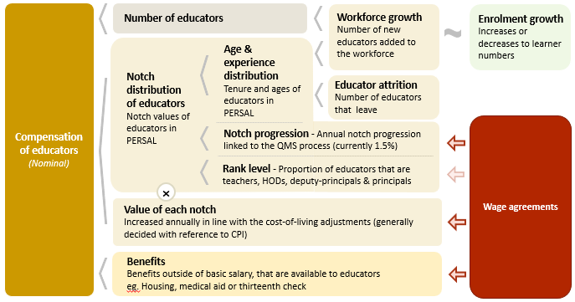
Unit cost drivers
7

Slide 63
Real and nominal costs
7
Examples:
In 2022 CPI was 7.2%
If nominal wages increase by 7.2%, then real wages increase by 0%
If nominal wages increase by 9%, then real wages increase by 1.8%
If nominal wages increase by 5%, then real wages decrease by 2.2%
A real increase in wages takes place when wages increase above the rate of inflation
Changes to real wages are an indicator of purchasing power

Slide 64
Projected unit costs trends| All educators
7
In constant 2021 rands
Note: Scale not from zero
Source: Own calculations, using the anonymised PERSAL data from 2021, only educators are considered. ECD practitioners and examination reviewers removed. Estimates to 2030 derived from the national and provincial TSD models. Assumption of no growth in educator numbers.

Slide 65
Projected unit costs trends| All educators
7
In constant 2021 rands
A slight increase in the real unit cost of educators is expected in the GP (~1%) from 2022 to 2030
Note: Scale not from zero
Adjusted the expected growth in educator numbers
Assume 20% growth in educators from 2021 to 2030 in GP
GP growth adjusted
Source: Own calculations, using the anonymised PERSAL data from 2021, only educators are considered. ECD practitioners and examination reviewers removed. Estimates to 2030 derived from the national and provincial TSD models. Assumption of no growth in educator numbers for FS, KN, LP, MP, NC, NW and SA. Assume 20% educator growth for GP, 10% for WC and a decline in 10% of educators in the EC. In LP assume that the proportion of senior educators grows from 16% in 2021 to 21% in 2030.

Slide 66
Indexed unit costs trends| All educators
7
In constant 2021 rands
GP: 1% increase
Educator unit cost
(Index in 2022 = 100%)
LP: ~1.5% decrease
Note: Scale not from zero
WC growth adjusted
Source: Own calculations, using the anonymised PERSAL data from 2021, only educators are considered. ECD practitioners and examination reviewers removed. Estimates to 2030 derived from the national and provincial TSD models. Assumption of no growth in educator numbers for FS, KN, LP, MP, NC, NW and SA. Assume 20% educator growth for GP, 10% for WC and a decline in 10% of educators in the EC. In LP assume that the proportion of senior educators grows from 16% in 2021 to 21% in 2030.

Slide 67
Projected unit costs trends| All educators
7
In constant 2021 rands
Teachers
(School based teachers)
Senior educators
(HODs, Deputy’s, Principals & Other)
-3%
Average annual unit cost
(In 2021 Rands)
+2%
Note: Scale not from zero
GP growth adjusted
Source: Own calculations, using the anonymised PERSAL data from 2021, only educators are considered. ECD practitioners and examination reviewers removed. Estimates to 2030 derived from the national and provincial TSD models. Assumption of no growth in educator numbers for FS, KN, LP, MP, NC, NW and SA. Assume 20% educator growth for GP, 10% for WC and a decline in 10% of educators in the EC. In LP assume that the proportion of senior educators grows from 16% in 2021 to 21% in 2030.

Slide 68
Between and within province movement
8

Slide 69
Inter-provincial educator movement (7-yr)
8
 |  | Province in 2019 |  |  |  |  |  |  |  |  |  |  | Movement out of province
 |  | EC | FS | GP | KN | LP | MP | NC | NW | WC | Total
Province in 2012 | EC | 97.79 | 0.10 | 0.86 | 0.22 | 0.01 | 0.04 | 0.11 | 0.19 | 0.70 | 100 |  | 2.23%
 | FS | 0.35 | 94.25 | 2.76 | 0.10 | 0.07 | 0.23 | 0.41 | 1.56 | 0.26 | 100 |  | 5.74%
 | GP | 0.15 | 0.26 | 96.86 | 0.27 | 0.81 | 0.42 | 0.05 | 0.93 | 0.24 | 100 |  | 3.13%
 | KN | 0.22 | 0.10 | 1.14 | 97.95 | 0.10 | 0.37 | 0.01 | 0.06 | 0.04 | 100 |  | 2.04%
 | LP | 0.02 | 0.02 | 1.72 | 0.02 | 96.80 | 0.80 | 0.05 | 0.56 | 0.02 | 100 |  | 3.21%
 | MP | 0.03 | 0.14 | 2.48 | 0.37 | 1.54 | 94.86 | 0.03 | 0.49 | 0.07 | 100 |  | 5.15%
 | NC | 0.47 | 0.50 | 0.47 | 0.06 | 0.59 | 0.03 | 94.35 | 2.37 | 1.15 | 100 |  | 5.64%
 | NW | 0.06 | 0.59 | 3.84 | 0.03 | 0.65 | 0.34 | 0.75 | 93.60 | 0.14 | 100 |  | 6.40%
 | WC | 0.72 | 0.03 | 0.17 | 0.05 | 0.00 | 0.02 | 0.35 | 0.03 | 98.61 | 100 |  | 1.37%
Source: PERSAL 10-year anonymised dataset, only educators that were in the dataset for 2018 and 2019 are considered here

Slide 70
Inter-provincial educator movement (7-yr)
8
 |  | Province in 2019 |  |  |  |  |  |  |  |  |  |  | Movement out of province
 |  | EC | FS | GP | KN | LP | MP | NC | NW | WC | Total
Province in 2012 | EC | 97.79 | 0.10 | 0.86 | 0.22 | 0.01 | 0.04 | 0.11 | 0.19 | 0.70 | 100 |  | 2.23%
 | FS | 0.35 | 94.25 | 2.76 | 0.10 | 0.07 | 0.23 | 0.41 | 1.56 | 0.26 | 100 |  | 5.74%
 | GP | 0.15 | 0.26 | 96.86 | 0.27 | 0.81 | 0.42 | 0.05 | 0.93 | 0.24 | 100 |  | 3.13%
 | KN | 0.22 | 0.10 | 1.14 | 97.95 | 0.10 | 0.37 | 0.01 | 0.06 | 0.04 | 100 |  | 2.04%
 | LP | 0.02 | 0.02 | 1.72 | 0.02 | 96.80 | 0.80 | 0.05 | 0.56 | 0.02 | 100 |  | 3.21%
 | MP | 0.03 | 0.14 | 2.48 | 0.37 | 1.54 | 94.86 | 0.03 | 0.49 | 0.07 | 100 |  | 5.15%
 | NC | 0.47 | 0.50 | 0.47 | 0.06 | 0.59 | 0.03 | 94.35 | 2.37 | 1.15 | 100 |  | 5.64%
 | NW | 0.06 | 0.59 | 3.84 | 0.03 | 0.65 | 0.34 | 0.75 | 93.60 | 0.14 | 100 |  | 6.40%
 | WC | 0.72 | 0.03 | 0.17 | 0.05 | 0.00 | 0.02 | 0.35 | 0.03 | 98.61 | 100 |  | 1.37%
Low level of movement between provinces –3.1% of GP teachers from 2012 are teaching in a different province in 2019
Educators are most likely to move to the NW and LP
zvc
zvc
Source: PERSAL 10-year anonymised dataset, only educators that were in the dataset for 2018 and 2019 are considered here

Slide 71
Inter-provincial educator movement (7-yr)
8
 |  | Province in 2019
 |  | EC | FS | GP | KN | LP | MP | NC | NW | WC
Province in 2012 | EC | 42 645 | 42 | 373 | 95 | 5 | 16 | 46 | 82 | 304
 | FS | 57 | 15 267 | 447 | 17 | 11 | 38 | 67 | 252 | 42
 | GP | 67 | 117 | 42 770 | 121 | 356 | 187 | 20 | 409 | 108
 | KN | 146 | 67 | 755 | 64 723 | 64 | 247 | 9 | 37 | 26
 | LP | 10 | 10 | 709 | 7 | 39 899 | 328 | 20 | 230 | 7
 | MP | 7 | 34 | 618 | 94 | 385 | 23 644 | 7 | 121 | 17
 | NC | 31 | 33 | 31 | 4 | 39 | 2 | 6 214 | 156 | 76
 | NW | 12 | 111 | 726 | 5 | 123 | 65 | 141 | 17 690 | 27
 | WC | 152 | 7 | 37 | 11 | 0 | 5 | 75 | 6 | 20 858
 | Total 2019 | 43 127 | 15 688 | 46 466 | 65 077 | 40 882 | 24 532 | 6 599 | 18 983 | 21 465
 | Movement into province | 482 | 421 | 3 696 | 354 | 983 | 888 | 385 | 1 293 | 607
 | % movement into province | 1.1% | 2.7% | 8.0% | 0.5% | 2.4% | 3.6% | 5.8% | 6.8% | 2.8%
Source: PERSAL 10-year anonymised dataset, only educators that were in the dataset for 2012 and 2019 are considered here

Slide 72
Inter-provincial educator movement (7-yr)
8
Many educators moved to GP- about 8% of educators in GP in 2019 (that were educators in 2012 already) had come from another province
High numbers (>600) of educators came from KZN, NW, LP & MP. The only provinces from which there is little movement to GP is the WC and the NC
 |  | Province in 2019
 |  | EC | FS | GP | KN | LP | MP | NC | NW | WC
Province in 2012 | EC | 42 645 | 42 | 373 | 95 | 5 | 16 | 46 | 82 | 304
 | FS | 57 | 15 267 | 447 | 17 | 11 | 38 | 67 | 252 | 42
 | GP | 67 | 117 | 42 770 | 121 | 356 | 187 | 20 | 409 | 108
 | KN | 146 | 67 | 755 | 64 723 | 64 | 247 | 9 | 37 | 26
 | LP | 10 | 10 | 709 | 7 | 39 899 | 328 | 20 | 230 | 7
 | MP | 7 | 34 | 618 | 94 | 385 | 23 644 | 7 | 121 | 17
 | NC | 31 | 33 | 31 | 4 | 39 | 2 | 6 214 | 156 | 76
 | NW | 12 | 111 | 726 | 5 | 123 | 65 | 141 | 17 690 | 27
 | WC | 152 | 7 | 37 | 11 | 0 | 5 | 75 | 6 | 20 858
 | Total 2019 | 43 127 | 15 688 | 46 466 | 65 077 | 40 882 | 24 532 | 6 599 | 18 983 | 21 465
 | Movement into province | 482 | 421 | 3 696 | 354 | 983 | 888 | 385 | 1 293 | 607
 | % movement into province | 1.1% | 2.7% | 8.0% | 0.5% | 2.4% | 3.6% | 5.8% | 6.8% | 2.8%
zvc
zvc
Source: PERSAL 10-year anonymised dataset, only educators that were in the dataset for 2012 and 2019 are considered here

Slide 73
Educator movement between schools
8
Fair amount of movement between schools; about 4% of Gauteng educators (5% nationally) move to a different pay point but stay within PERSAL from 2018-2019
Rate at which educators aged 50 and below leave the system is higher in Gauteng (~5%) than the national average
 | Pay point in 2019 (Ordinary schools only)
Province | Same as in 2018 (%) | Different to 2018 (%) | None - left system (%) | Total (%)
EC | 93.25 | 4.61 | 2.14 | 100
FS | 90.54 | 5.54 | 3.93 | 100
GP | 91.08 | 3.95 | 4.97 | 100
KN | 91.99 | 4.31 | 3.70 | 100
LP | 91.04 | 6.95 | 2.00 | 100
MP | 92.02 | 4.66 | 3.32 | 100
NC | 85.44 | 8.39 | 6.18 | 100
NW | 89.42 | 6.30 | 4.28 | 100
WC | 87.27 | 6.09 | 6.64 | 100
Total | 91.11 | 5.05 | 3.83 | 100
Source: PERSAL 10-year anonymised dataset. Only included educators aged 50 years and below, that were in ordinary schools in 2018 (Primary, Secondary, Combined and Intermediate)—excluded all paypoints that did not appear in both years after identifying 103 paypoints where the paypoint number changed.

Slide 74
Gender imbalances in management
9

Slide 75
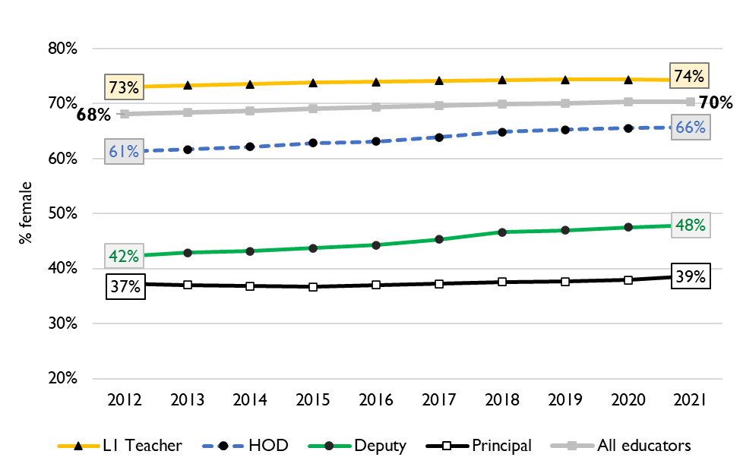
Percentage of educators that are female
9
Percentage of public educators in South Africa that are female, PERSAL (2012-2021)
Nationally, there has been very little transformation in senior school leadership in terms of gender since 2012 and even since 2004 (just 34% of principals were female).
There is better representation at middle-management (HOD) level.
Source: Using anonymised 10-year PERSAL data from 2012 to 2021, only educators of the ranks: level 1 teacher, HOD, deputy principal and principal are considered.

Slide 76
Percentage of educators that are female
9
In GP in 2021, 75% of all educators were female, with 78% of teachers, women.
Women remain underrepresented in senior management positions. Only 52% of deputy principals and 39% of principals were women in 2021.
Source: Using anonymised 10-year PERSAL data from 2012 to 2021, only educators of the ranks: level 1 teacher, HOD, deputy principal and principal are considered.

Slide 77
General questions and discussion
10
Infrastructure: How close is the province to achieving the large growth that is required by 2030? Where is the department regarding moving from learners transport to new schools / classrooms?
Do you track what subjects and phases teachers are needed for:
  Is there a list of the positions requested by principals or positions filled? Or of educators that have left?
What is the process for principal and senior educator mentorship, selection and induction
How much of a concern is gender equity in management in GP

Slide 78
Conclusion
Although the retirement wave will be felt slightly less and later in GP, the province faces a high educator turnover rate, where about 5% of younger educators (50 years and below) leave the schooling system per year, appointments will therefore increase
Due to high predicted population growth rates of school-aged children (~27% from 2021 to 2030), educator numbers (incl. educators in management and leadership positions) will need to rise in GP, and new classrooms and schools will need to be built to respond to the higher enrolment numbers adequately; if the sector does not expand, LE ratios and class sizes will increase even further
The real unit cost for all educators is expected to increase (~1%) slightly in Gauteng over the period 2022-2030; the real unit cost of teachers is projected to increase by (+2%), while the real unit cost of senior educator educators is expected to decline (-3%)

