Slide 1
KwaZulu-Natal Province 23 July 2023
Educator Demand Projections
2021-2030

Slide 2
Introduction (1)
The proportion of educators that are 50 years or older has steadily risen between 2012 to 2021 in South Africa.
⇒ Nationally a wave of educator retirements is expected as older educators reach the standard retirement age of between 60 and 65.

Slide 3
Introduction (2)
National educator age distribution in 2012 & 2021
Peak in age shifted from 46 years to 53 years
Source: Anonymised PERSAL data from 2021, only educators (Rank 60 000 – 69 999) are considered. ECD practitioners, TVET lecturers and ABET teachers were removed.

Slide 4
Introduction (3)
Implications of retirement wave:
Many more appointments: The retirement wave will open up both teaching & school management & leadership positions & other office-based education specialists.
Total compensation of educators: Since older teachers earn more, when retiring they are replaced with younger (less costly) teachers.

Slide 5
Introduction (4)
As retirements increase, the required number of new appointments will need to increase to ensure that total educator numbers (at a minimum) stay at current levels and/or are sufficient to meet learner enrolment growth to prevent deterioration in learner-educator ratios.
Planning will be required to ensure that provinces are ready for the sustained increase in appointments.
If these positions are not filled, this could result in a further deterioration in the learner-educator ratio and lead to further increases in already large class sizes.

Slide 6
Objective
In each province there are some differences in the age profile of teachers, differences in the expected growth of the school-going population and differences in teacher attrition (resignations & retirements).
⇒ The year of the retirement wave peak will differ across provinces.
⇒ Also, some provinces need to accommodate much more growth in
learners than others.
In this presentation, we highlight the situation in KwaZulu-Natal to inform province specific post-provisioning planning.

Slide 8
Overview
Age distributions
Projected retirements & resignations
Provincial population & enrolment trends
Public and independent school growth
Educator growth: Teachers & SMT positions
Appointments in context: LE ratios & class sizes
Expected financial implications to 2030
Movement of educators: Between & within provinces
Gender imbalance
Small schools
Discussion & conclusion

Slide 9
KwaZulu-Natal educator demand summary
1
Age distribution: The age distribution in KN had a peak at around 49 years of age in 2021
Projected resignations and retirements: From 2018 onwards, the majority of educators that exit PERSAL are age-related retirements as opposed to resignations; the number of senior educators (SMT positions and other specialists) that are retiring is expected to increase (65% were 50+ years old in 2021)
Enrolment and population growth: Enrolment in KN ordinary schools grew by 1% from 2012-2021 (~16K learners), and the school-aged population is forecast to decline by 1% (~33K learners) to 2030
School and educator growth: Between 2012 and 2021, the educator number has fallen (-5%), and the number of public schools has also decreased (-3%)
SMT position changes: Alongside falling teacher numbers (-3%), there has been a decline in the number of HODs (-8%) , Deputy Principals (-11%) and Principals (-9%) between 2012 and 2021
Appointments and LE Ratio: Between 2012 and 2021, the LE ratio increased from 28.3 to 29.6. A further deterioration of the LE ratio will drive up class sizes and the number of excessively large classes
Projected educator cost trends: The unit cost of KN’s educators is expected to remain constant (the unit cost of teachers is expected to increase by +1% and decline for senior educators (-3%).
Educator movements: Low movements into (<1%) and out (~2%) of KZN, educators are as likely to move to a different school(~4%) as they are to leave the system (~4%).
2
3
4
5
6
7
8

Slide 10
Age distributions and projected retirements and resignations
1
2
Main highlights:
The age distribution in KZN had a peak at around 49 years of age in 2021 (lower than national peak of 53)
From 2018 onwards, the majority of educators that exit PERSAL are for age-related retirement as opposed to resignations.
The number of senior educators (SMT positions and other specialists) that are retiring is expected to increase (65% were 50+ years old in 2021)

Slide 11
Educator age distribution (2021)
1
A lower proportion of educators are over 50 years old in KwaZulu-Natal than in the rest of the country
Age: 49
Source: Anonymised PERSAL data from 2021, only educators (Rank 60 000 – 69 999) are considered. ECD practitioners, TVET lecturers and ABET teachers were removed.

Slide 12
Percentage of educators aged 50+ in 2021 KZN has relatively fewer older educators, aged 50 years and older in 2021 than the rest of the country, however, retirement and promotion numbers will still rise noticeably
 |  | Percentage of educators aged 50+ in 2021
Province |  | All educators |  | Senior educators (HOD, Dep.- principals, Principals & Other) |  | Primary school educators
EC |  | 51% |  | 71% |  | 58%
FS |  | 43% |  | 65% |  | 49%
GP |  | 41% |  | 65% |  | 42%
KN |  | 39% |  | 65% |  | 44%
LP |  | 58% |  | 81% |  | 63%
MP |  | 50% |  | 73% |  | 55%
NC |  | 43% |  | 69% |  | 44%
NW |  | 47% |  | 70% |  | 52%
WC |  | 42% |  | 73% |  | 40%
SA |  | 46% |  | 69% |  | 49%
1
Source: Anonymised PERSAL data from 2021, only educators (Rank 60 000 – 69 999) are considered. ECD practitioners, TVET lecturers and ABET teachers were removed. The 2021 rankclass file was expanded to include ranks found only in years prior to 2021, used to classify educators by rank. Primary school only includes all educators that are in a component that is classified as a Primary school.

Slide 13
Educator age distribution in 2021 & 2030
1
Assume constant 2021 educator numbers
2021
2030
Source: Anonymised PERSAL data from 2021, only educators (Rank 60 000 – 69 999) are considered. ECD practitioners, TVET lecturers and ABET teachers were removed.

Slide 14
Educator age distribution in 2021 & 2030
1
Assume constant 2021 educator numbers
An even flatter age distribution is expected in 2030, with a higher proportion of younger educators
Age: 49
2021
2030
Source: Anonymised PERSAL data from 2021, only educators (Rank 60 000 – 69 999) are considered. ECD practitioners, TVET lecturers and ABET teachers were removed.

Slide 15
Projected resignation & retirements (KN)
2
Assume constant 2021 educator numbers
Number of retirees (ages 56 to 65) projected to exit PERSAL in KZN is increasing but is similar to the proportion of educators that resign
Large spike in resignations due to the pension reform rumours in 2015
The number of young teachers (ages 21-30) resigning is projected to increase as the number of newly hired young teachers increases.
Percentage of educators resigning or retiring
Projected
% of educators resigning or retiring
Source: Anonymised 10-year PERSAL data, only educators (Rank 60 000 – 69 999) are considered. ECD practitioners, TVET lecturers and ABET teachers were removed. Estimates to 2035 derived from the National and provincial models – assumption of no growth in educator numbers.

Slide 16
Projected resignation & retirements (KN)
2
Assume constant 2021 educator numbers
The number of retirements is projected to increase, peaking in ~2030-31 and then declining again
The number of retirements is projected to increase from about 2,350 in 2022 to about 3,400 in 2030, an increase of about 1,050 retirements annually
Retirement headcount
Projected
Number of retirements
Source: Anonymised 2021 PERSAL data, only educators (Rank 60 000 – 69 999) are considered. ECD practitioners, TVET lecturers and ABET teachers were removed. Estimates to 2035 derived from the National and provincial models – assumption of no growth in educator numbers.

Slide 17
Older leaver trend projections to 2035
2
2
About 43,000
educators estimated to retire by 2035 in KZN
(48% of total educators in 2022)
Assume constant 2021 educator numbers
Source: Anonymised 2021 PERSAL data, only educators (Rank 60 000 – 69 999) are considered. ECD practitioners, TVET lecturers and ABET teachers were removed. Estimates to 2035 derived from the National and provincial models – assumption of no growth in educator numbers.

Slide 18
Projected educators leaving
2
Assume constant 2021 educator numbers
Teachers
(School based teachers)
Senior educators
(HODs, Deputy’s, Principals & Other)
% of teacher resigning & retiring
% of senior educator resigning & retiring
A lower proportion of senior educators leave relative to the SA average, but careful succession planning is still needed, during this period as high numbers of HODs, deputies, and principals leave the system
A similar proportion of teachers are expected to resign and retire in KN as the SA average
Source: Anonymised 2021 PERSAL data, only educators (Rank 60 000 – 69 999) are considered. ECD practitioners, TVET lecturers and ABET teachers were removed. Estimates to 2035 derived from the National and provincial models – assumption of no growth in educator numbers.

Slide 19
Projected increase in appointments
Large increase in expected annual appointments from ~2028 – 2030, mostly due to age-related retirement.
Higher proportions of very young teachers (≤30 years of age)
Must strengthen sourcing & appointment processes
If the province does not keep up with appointments, LE ratios will rise
6
~1 500
Additional educators will
need to be appointed
on average annually
~6 700
educators
5 221
educators
Average number of annual joiners over the period 2012 - 2021
Projected average number of annual joiners needed from 2028 – 2030*
*Assumes that total educator numbers stays constant between 2022 - 2030

Slide 20
Provincial population and enrolment trends
3
Main finding: Enrolment in KZN ordinary schools grew by 1% from 2012-2021 (~16K learners), and the school-aged population is forecast to decline by 1% (~33K learners) to 2030

Slide 21
Actual provincial enrolment trends (2012-2021)
3
High growth
Moderate growth
Stable
Decline
Source: Enrolment numbers taken from School Realities-EMIS (2012 – 2021) released by the DBE, using total numbers for ordinary public and independent schools.

Slide 22
Actual provincial enrolment trends (2012-2021)
3
Enrolment in KZN ordinary schools grew by 1% from 2012 to 2021
… lower growth than national average
Source: Enrolment numbers taken from School Realities-EMIS (2012 – 2021) released by the DBE, using total numbers for ordinary public and independent schools.

Slide 23
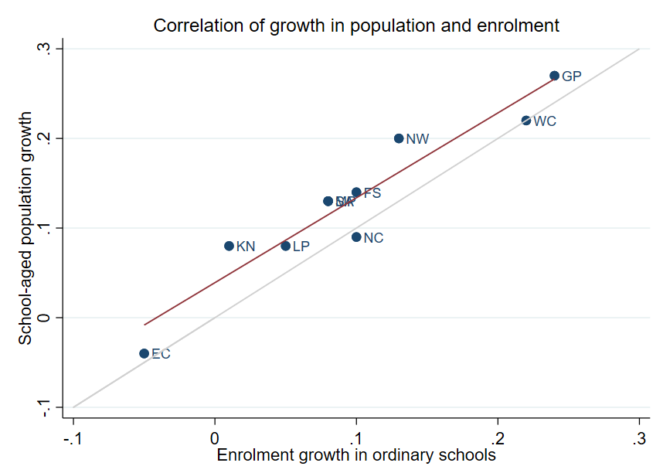
Correlation between population & enrolment growth (2012-2021)
3
R² = 0.9025
Strong positive correlation between population and enrolment growth between 2012 and 2021
45˚
Source: Thembisa age specific data V4.5 for school-aged population (Ages 7-18) estimates and enrolment taken from School Realities-EMIS (2012 – 2021) released by the DBE, for numbers on ordinary public and independent schools (Statistical Publications (education.gov.za))

Slide 24
Projected growth in school-aged
population (2021-2030)
3
Population of children aged 7-18 in KZN is expected to decrease by
~33K children (-1%) from 2021 to 2030

Slide 25
Projected school-aged population: 2021 to 2030
3
 | Number of children Aged 7-18 |  |  |  | Growth '12-21 | Growth '21-30
Province | 2012 | 2021 | 2030E
EC | 1 657 202 | 1 598 475 | 1 361 637 |  | -4% | -15%
FS | 592 445 | 676 489 | 650 820 |  | 14% | -4%
GP | 1 962 793 | 2 498 533 | 3 180 884 |  | 27% | 27%
KN | 2 485 822 | 2 690 378 | 2 657 716 |  | 8% | -1%
LP | 1 395 864 | 1 507 386 | 1 612 125 |  | 8% | 7%
MP | 977 749 | 1 100 594 | 1 165 728 |  | 13% | 6%
NC | 254 075 | 277 560 | 281 208 |  | 9% | 1%
NW | 742 943 | 893 530 | 930 323 |  | 20% | 4%
WC | 1 068 009 | 1 298 801 | 1 496 731 |  | 22% | 15%
Total | 11 136 902 | 12 541 746 | 13 337 172 |  | 13% | 6%
2,49M
2,69M
2,66M
Note: Period 2021 – 2030 is the same timeframe, nine years, as 2012 – 2021.
Source: Thembisa age-specific estimates from the model V4.5 for children aged 7-18 by province

Slide 26
Public & independent school growth (2012-2021)
4
Main highlights: Between 2012 and 2021, educator numbers in KZN fell (-5%), and the number of public schools also decreased (-3%)

Slide 27
Actual school growth from 2012 to 2021
4
2012-2021 in KZN: Decline in public schools (-3%) despite 1% increase in enrolment.
No growth in the number of independent schools in KZN (0%).
EC | FS | GP | KN | LP | MP | NC | NW | WC | SA
% independent schools (2021)
4%
8%
30%
4%
5%
7%
7%
6%
17%
9%
Source: School numbers taken from School Realities-EMIS (2012 – 2021) released by the DBE, for numbers on ordinary public and independent schools (Statistical Publications (education.gov.za))

Slide 28
Actual school growth from 2012 to 2021
School growth from 2012 to 2021
4
School growth was driven by independent school growth (+37%) from 2012 to 2021. In contrast, the number of public schools in SA decreased (-6%)
EC | FS | GP | KN | LP | MP | NC | NW | WC | SA
% independent schools (2021)
4%
8%
30%
4%
5%
7%
7%
6%
17%
9%
Source: School numbers taken from School Realities-EMIS (2012 – 2021) released by the DBE, for numbers on ordinary public and independent schools (Statistical Publications (education.gov.za))

Slide 29
Educator growth: Teachers & SMT positions
5
Main highlight: Declines in educator numbers in KZN from 2012-2021: Falling teacher numbers (-3%), declines in the number of HODs (-8%), Deputy Principals
(-11%) and Principals (-9%).

Slide 30
Changes in teacher and SMT numbers in PERSAL (publicly employed educators)
5
 |  | Teacher |  |  |  |  | HOD |  |  |  |  | Deputy-Principal |  |  |  |  | Principal
Province |  | 2012 | 2021 | Diff | % change |  | 2012 | 2021 | Diff | % change |  | 2012 | 2021 | Diff | % change |  | 2012 | 2021 | Diff | % change
EC |  | 50 295 | 40 115 | -10 180 | -20% |  | 5 870 | 6 196 | 326 | 6% |  | 1 342 | 1 453 | 111 | 8% |  | 5 294 | 4 755 | - 539 | -10%
FS |  | 20 148 | 17 561 | -2 587 | -13% |  | 2 685 | 2 470 | - 215 | -8% |  | 852 | 768 | - 84 | -10% |  | 1 224 | 892 | - 332 | -27%
GP |  | 47 233 | 60 677 | 13 444 | 28% |  | 8 708 | 9 209 | 501 | 6% |  | 2 565 | 2 850 | 285 | 11% |  | 2 162 | 1 959 | - 203 | -9%
KN |  | 73 050 | 71 000 | -2 050 | -3% |  | 11 289 | 10 330 | - 959 | -8% |  | 2 642 | 2 342 | - 300 | -11% |  | 5 584 | 5 055 | - 529 | -9%
LP |  | 44 998 | 44 317 | - 681 | -2% |  | 6 090 | 3 762 | -2 328 | -38% |  | 1 562 | 778 | - 784 | -50% |  | 3 510 | 3 316 | - 194 | -6%
MP |  | 26 127 | 27 857 | 1 730 | 7% |  | 4 047 | 4 055 | 8 | 0% |  | 1 108 | 1 114 | 6 | 1% |  | 1 790 | 1 450 | - 340 | -19%
NC |  | 7 257 | 7 929 | 672 | 9% |  | 1 034 | 1 094 | 60 | 6% |  | 294 | 365 | 71 | 24% |  | 587 | 488 | - 99 | -17%
NW |  | 21 305 | 22 261 | 956 | 4% |  | 2 994 | 3 023 | 29 | 1% |  | 902 | 1 041 | 139 | 15% |  | 1 698 | 1 338 | - 360 | -21%
WC |  | 23 579 | 28 665 | 5 086 | 22% |  | 4 065 | 3 700 | - 365 | -9% |  | 1 334 | 1 297 | - 37 | -3% |  | 1 531 | 1 339 | - 192 | -13%
SA |  | 313 992 | 320 382 | 6 390 | 2% |  | 46 782 | 43 839 | -2 943 | -6% |  | 12 601 | 12 008 | - 593 | -5% |  | 23 380 | 20 592 | -2 788 | -12%
Source: Anonymised PERSAL data from 2012 and 2021, only educators (Rank 60 000 – 69 999) are considered. ECD practitioners, TVET lecturers, and ABET teachers were removed. The 2021 rankclass file was expanded to include ranks found only in years prior to 2021.

Slide 31
Changes in teacher and SMT numbers in PERSAL – key highlights
In KZN between 2012-2021:
Learner enrolment growth of 1% but in PERSAL…
Teacher numbers decline (-3%)
HODs numbers decline (-8%)
Deputy Principals numbers decline (-11%) AND
Principal numbers decline (-9%) > decline in public schools (-3%)
… Are principal posts being filled by “Acting principals”?

Slide 32
Proportional split by educator rank
5
In KZN proportional split remains similar: The proportions of the different educator ranks appear to be roughly in line with the national average in 2021
 | All Educators |  |  | Teacher |  |  | HOD |  |  | Dep-Principal |  |  | Principal |  |  | Other
 | 2012 | 2021 |  | 2012 | 2021 |  | 2012 | 2021 |  | 2012 | 2021 |  | 2012 | 2021 |  | 2012 | 2021
EC | 100% | 100% |  | 78% | 75% |  | 9% | 12% |  | 2.1% | 2.7% |  | 8.2% | 8.8% |  | 2.5% | 2.4%
FS | 100% | 100% |  | 78% | 78% |  | 10% | 11% |  | 3.3% | 3.4% |  | 4.7% | 4.0% |  | 3.7% | 3.3%
GP | 100% | 100% |  | 74% | 79% |  | 14% | 12% |  | 4.0% | 3.7% |  | 3.4% | 2.6% |  | 4.4% | 2.7%
KN | 100% | 100% |  | 77% | 79% |  | 12% | 11% |  | 2.8% | 2.6% |  | 5.9% | 5.6% |  | 2.1% | 1.3%
LP | 100% | 100% |  | 78% | 84% |  | 11% | 7% |  | 2.7% | 1.5% |  | 6.1% | 6.3% |  | 2.1% | 1.5%
MP | 100% | 100% |  | 76% | 79% |  | 12% | 12% |  | 3.2% | 3.2% |  | 5.2% | 4.1% |  | 3.2% | 1.8%
NC | 100% | 100% |  | 75% | 77% |  | 11% | 11% |  | 3.0% | 3.6% |  | 6.1% | 4.8% |  | 5.1% | 3.9%
NW | 100% | 100% |  | 76% | 78% |  | 11% | 11% |  | 3.2% | 3.7% |  | 6.1% | 4.7% |  | 3.7% | 2.6%
WC | 100% | 100% |  | 74% | 80% |  | 13% | 10% |  | 4.2% | 3.6% |  | 4.8% | 3.7% |  | 4.1% | 2.1%
SA | 100% | 100% |  | 77% | 79% |  | 11% | 11% |  | 3.1% | 3.0% |  | 5.7% | 5.1% |  | 3.1% | 2.1%
Source: Anonymised PERSAL data from 2012 and 2021, only educators (Rank 60 000 – 70 000) are considered. ECD practitioners TVET lecturers and ABET teachers were removed. The 2021 rankclass file was expanded to include ranks found only in years prior to 2021. The percentage within each rank is calculated taking the total number of educator in that year for that rank over the total number of educators in that year.

Slide 33
Implications for LE ratios and class sizes
6
Main finding: Between 2012 and 2021, the LE ratio increased from 28.3 to 29.6. A further deterioration of the LE ratio will drive up class sizes and the number of excessively large classes

Slide 34
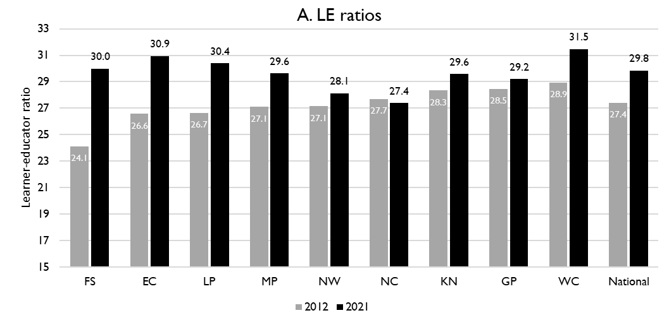
LE ratios between 2012 and 2021
6
KZN:
LE ratio rose from 28.3 learners per educator to 29.6 learners per educator between 2012 and 2021
National and provincial learner-to-public-educator ratios in 2012 and 2021, grades 1 to 12 in public ordinary schools in South Africa
z
Source: Figure 1 in South African teacher shortages as revealed through class sizes and learner-educator ratios: An exploratory analysis by Gabrielle Wills (2023). Estimates from Gustafsson (2022).

Slide 35
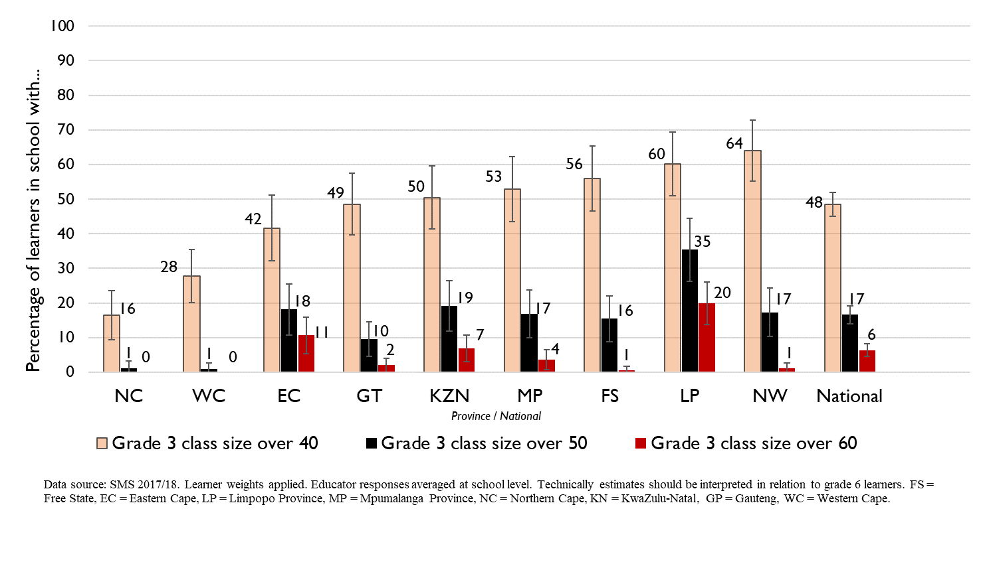
Grade 3 class sizes
(2017/18 School Monitoring Survey)
Post provisioning guidelines - Class sizes should not exceed 35 in Grade 3.
% of learners in grade 3 classes > 40:
48% in SA, 50% in KZN
% of learners in grade 3 classes > 50:
17% in SA, 19% in KZN
% of learners in grade 3 classes > 60:
6% in SA, 7% in KZN
Note: Nationally, grade 3 enrolment numbers had been rising from about 2011 and peaked in 2017 before starting to decline slightly, stabilising at about 1,1 million in 2021 (Gustafsson 2022a, p10-11). Holding other things constant, grade 3 class sizes will be similar or slightly smaller in 2022 than what is seen in these 2017/18 SMS estimates.

Slide 36
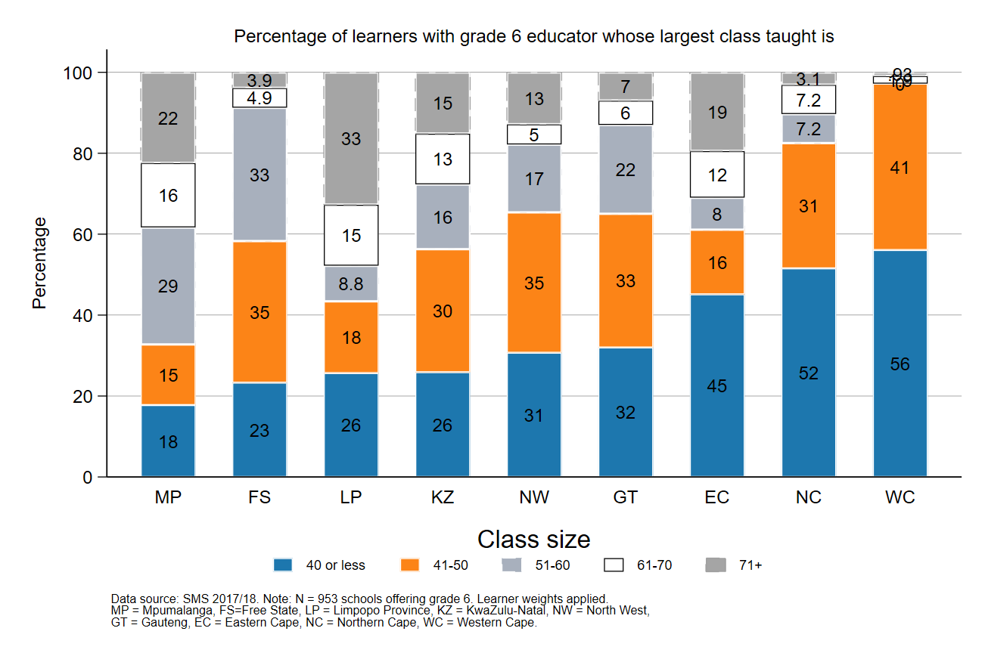
Largest classes - School Monitoring Survey 2017/18
6
In 2017/18, KZN was amongst the top four provinces with the highest percentage of large classes with more than 70 learners
A further deterioration of the LE ratio will drive up class size and the number of excessively large classes, negatively impacting quality and teacher motivation
Percentage of grade 6 learners in schools with an educator reporting that their largest class is in the following class size category, disaggregated by province (SMS 2017/18)
Source: Figure 1 in South African teacher shortages as revealed through class sizes and learner-educator ratios: An exploratory analysis by Gabrielle Wills (2023) using School Monitoring Survey 2017/18 (953 schools, learner weighted).

Slide 37
Projected increase in appointments
Large increase in expected annual appointments from ~2028 – 2030, mostly due to age-related retirement.
Higher proportions of very young teachers (≤30 years of age)
Must strengthen sourcing & appointment processes
If do not keep up with appointments, LE ratios will rise
6
~1 500
Additional educators will
need to be appointed
on average annually
~6 700
educators
5 221
educators
Average number of annual joiners over the period 2012 - 2021
Projected average number of annual joiners needed from 2028 – 2030*
*Assumes that total educator numbers stays constant between 2022 - 2030

Slide 38
Expected financial implications to 2030
7
Projected educator cost trends: The unit cost of KZN’s educators is expected to remain constant (the unit cost of teachers is expected to increase by +1% and decline for senior educators by -3%).

Slide 39
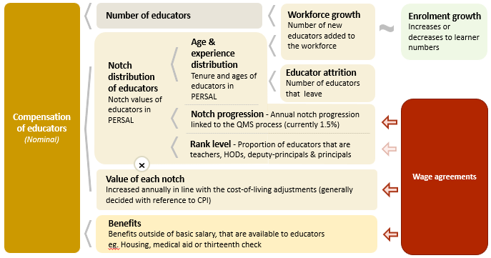
Unit cost drivers
7
Notes:
The cost of educators is determined by the number of educators employed, the notch distribution of these educators, the value assigned to each notch and the benefits packages that educators receive.
The total number of educators should be largely informed by learner enrolment and class size norms however hiring decisions would also be informed and constrained by the available budget.
The distribution of educators across notches is determined by experience – a higher level of experience would lead to higher salaries on average which would drive up the total cost of educators. The average tenure of educators is influenced by attrition rates, especially among younger educators, as well as workforce growth.
How experience is translated into notch level differences is determined by the notch progression percentage – currently 1.5%. A higher notch progression percentage will lead to higher compensation expenditure.
The proportion of educators at each rank will also affect the notch distribution
The notch values are increased according to the cost-of-living adjustments that are the outcome of collective bargaining agreements.

Slide 40
Real and nominal costs
7
Examples:
In 2022 CPI was 7.2%
If nominal wages increase by 7.2%, then real wages increase by 0%
If nominal wages increase by 9%, then real wages increase by 1.8%
If nominal wages increase by 5%, then real wages decrease by 2.2%
A real increase in wages takes place when wages increase above the rate of inflation
Changes to real wages are an indicator of purchasing power

Slide 41
Assumptions for KZN unit cost projections
All of the estimations of unit costs use real 2021 rands.
Two important assumptions:
cost-of-living increases would be equal to, but not exceed consumer price inflation for the years 2022 – 2030
Constant number educators from 2022-2030 ➔ LE ratio unlikely to deteriorate given 1% decline expected in school-aged population in KZN
Province-specific attrition considered
Educators in the model start at their 2021 notch values and these notch values are used to calculate their total compensation for the year. Educators are moved to a higher notch, with a value that is about 1.5% greater on an annual basis (notch progression).

Slide 42
Projected unit costs trends| All educators
7
In constant 2021 rands
The real unit cost of educators in KN is expected to remain constant (0.3%) from 2022 to 2030
Note: Scale not from zero
Source: Own calculations, using the anonymised PERSAL data from 2021, only educators are considered. ECD practitioners and examination reviewers removed. Estimates to 2030 derived from the national and provincial TSD models. Assumption of no growth in educator numbers.

Slide 43
Indexed unit costs trends| All educators
7
In constant 2021 rands
GP: 1% increase
Educator unit cost
(Index in 2022 = 100%)
LP ~1.5% decrease
Note: Scale not from zero
Source: Own calculations, using the anonymised PERSAL data from 2021, only educators are considered. ECD practitioners and examination reviewers removed. Estimates to 2030 derived from the national and provincial TSD models. Assumption of no growth in educator numbers for FS, KN, LP, MP, NC, NW and SA. Assume 20% educator growth for GP, 10% for WC and a decline in 10% of educators in the EC. In LP assume that the proportion of senior educators grows from 16% in 2021 to 21% in 2030.

Slide 44
Indexed unit costs trends| All educators
7
In constant 2021 rands
KN: No significant change in real cost from
2022 - 2030
Educator unit cost
(Index in 2022 = 100%)
Note: Scale not from zero
Source: Own calculations, using the anonymised PERSAL data from 2021, only educators are considered. ECD practitioners and examination reviewers removed. Estimates to 2030 derived from the national and provincial TSD models. Assumption of no growth in educator numbers for FS, KN, LP, MP, NC, NW and SA. Assume 20% educator growth for GP, 10% for WC and a decline in 10% of educators in the EC. In LP assume that the proportion of senior educators grows from 16% in 2021 to 21% in 2030.

Slide 45
Projected unit costs trends| Teachers vs Senior educators
7
In constant 2021 rands
Teachers
(School based teachers)
Senior educators
(HODs, Deputy’s, Principals & Other)
-3%
+1%
Average annual unit cost
(In 2021 Rands)
Note: Scale not from zero
Source: Own calculations, using the anonymised PERSAL data from 2021, only educators are considered. ECD practitioners and examination reviewers removed. Estimates to 2030 derived from the national and provincial TSD models. Assumption of no growth in educator numbers for FS, KN, LP, MP, NC, NW and SA. Assume 20% educator growth for GP, 10% for WC and a decline in 10% of educators in the EC. In LP assume that the proportion of senior educators grows from 16% in 2021 to 21% in 2030.

Slide 46
Movement of educators: Between and within provinces
8
Main findings: Low movements into (<1%) and out (~2%) of KZN, educators are as likely to move to a different school (~4%) as they are to leave the system (~4%).

Slide 47
Inter-provincial educator movement (7-yr)
8
 |  | Province in 2019 |  |  |  |  |  |  |  |  |  |  | Movement out of province
 |  | EC | FS | GP | KN | LP | MP | NC | NW | WC | Total
Province in 2012 | EC | 97.79 | 0.10 | 0.86 | 0.22 | 0.01 | 0.04 | 0.11 | 0.19 | 0.70 | 100 |  | 2.23%
 | FS | 0.35 | 94.25 | 2.76 | 0.10 | 0.07 | 0.23 | 0.41 | 1.56 | 0.26 | 100 |  | 5.74%
 | GP | 0.15 | 0.26 | 96.86 | 0.27 | 0.81 | 0.42 | 0.05 | 0.93 | 0.24 | 100 |  | 3.13%
 | KN | 0.22 | 0.10 | 1.14 | 97.95 | 0.10 | 0.37 | 0.01 | 0.06 | 0.04 | 100 |  | 2.04%
 | LP | 0.02 | 0.02 | 1.72 | 0.02 | 96.80 | 0.80 | 0.05 | 0.56 | 0.02 | 100 |  | 3.21%
 | MP | 0.03 | 0.14 | 2.48 | 0.37 | 1.54 | 94.86 | 0.03 | 0.49 | 0.07 | 100 |  | 5.15%
 | NC | 0.47 | 0.50 | 0.47 | 0.06 | 0.59 | 0.03 | 94.35 | 2.37 | 1.15 | 100 |  | 5.64%
 | NW | 0.06 | 0.59 | 3.84 | 0.03 | 0.65 | 0.34 | 0.75 | 93.60 | 0.14 | 100 |  | 6.40%
 | WC | 0.72 | 0.03 | 0.17 | 0.05 | 0.00 | 0.02 | 0.35 | 0.03 | 98.61 | 100 |  | 1.37%
Source: PERSAL 10-year anonymised dataset, only educators that were in the dataset for 2018 and 2019 are considered here

Slide 48
Inter-provincial educator movement (7-yr)
8
Low level of movement between provinces.
Few KZN teachers leave to go to another province: Only ~2% of KZN teachers in 2012 were teaching in a different province in 2019.
Educators are most likely to move to Gauteng.
 |  | Province in 2019 |  |  |  |  |  |  |  |  |  |  | Movement out of province
 |  | EC | FS | GP | KN | LP | MP | NC | NW | WC | Total
Province in 2012 | EC | 97.79 | 0.10 | 0.86 | 0.22 | 0.01 | 0.04 | 0.11 | 0.19 | 0.70 | 100 |  | 2.23%
 | FS | 0.35 | 94.25 | 2.76 | 0.10 | 0.07 | 0.23 | 0.41 | 1.56 | 0.26 | 100 |  | 5.74%
 | GP | 0.15 | 0.26 | 96.86 | 0.27 | 0.81 | 0.42 | 0.05 | 0.93 | 0.24 | 100 |  | 3.13%
 | KN | 0.22 | 0.10 | 1.14 | 97.95 | 0.10 | 0.37 | 0.01 | 0.06 | 0.04 | 100 |  | 2.04%
 | LP | 0.02 | 0.02 | 1.72 | 0.02 | 96.80 | 0.80 | 0.05 | 0.56 | 0.02 | 100 |  | 3.21%
 | MP | 0.03 | 0.14 | 2.48 | 0.37 | 1.54 | 94.86 | 0.03 | 0.49 | 0.07 | 100 |  | 5.15%
 | NC | 0.47 | 0.50 | 0.47 | 0.06 | 0.59 | 0.03 | 94.35 | 2.37 | 1.15 | 100 |  | 5.64%
 | NW | 0.06 | 0.59 | 3.84 | 0.03 | 0.65 | 0.34 | 0.75 | 93.60 | 0.14 | 100 |  | 6.40%
 | WC | 0.72 | 0.03 | 0.17 | 0.05 | 0.00 | 0.02 | 0.35 | 0.03 | 98.61 | 100 |  | 1.37%
zvc
zvc
Source: PERSAL 10-year anonymised dataset, only educators that were in the dataset for 2018 and 2019 are considered here

Slide 49
Inter-provincial educator movement (7-yr)
8
 |  | Province in 2019
 |  | EC | FS | GP | KN | LP | MP | NC | NW | WC
Province in 2012 | EC | 42 645 | 42 | 373 | 95 | 5 | 16 | 46 | 82 | 304
 | FS | 57 | 15 267 | 447 | 17 | 11 | 38 | 67 | 252 | 42
 | GP | 67 | 117 | 42 770 | 121 | 356 | 187 | 20 | 409 | 108
 | KN | 146 | 67 | 755 | 64 723 | 64 | 247 | 9 | 37 | 26
 | LP | 10 | 10 | 709 | 7 | 39 899 | 328 | 20 | 230 | 7
 | MP | 7 | 34 | 618 | 94 | 385 | 23 644 | 7 | 121 | 17
 | NC | 31 | 33 | 31 | 4 | 39 | 2 | 6 214 | 156 | 76
 | NW | 12 | 111 | 726 | 5 | 123 | 65 | 141 | 17 690 | 27
 | WC | 152 | 7 | 37 | 11 | 0 | 5 | 75 | 6 | 20 858
 | Total 2019 | 43 127 | 15 688 | 46 466 | 65 077 | 40 882 | 24 532 | 6 599 | 18 983 | 21 465
 | Movement into province | 482 | 421 | 3 696 | 354 | 983 | 888 | 385 | 1 293 | 607
 | % movement into province | 1.1% | 2.7% | 8.0% | 0.5% | 2.4% | 3.6% | 5.8% | 6.8% | 2.8%
Source: PERSAL 10-year anonymised dataset, only educators that were in the dataset for 2012 and 2019 are considered here

Slide 50
Inter-provincial educator movement (7-yr)
8
KZN is not attracting many teachers from other provinces.
⇒ Hardly any educators moved to KZN (only 0.5% of educators in 2019 had come from another province)
The provinces that sent the highest number of educators were GP and the EC
 |  | Province in 2019
 |  | EC | FS | GP | KN | LP | MP | NC | NW | WC
Province in 2012 | EC | 42 645 | 42 | 373 | 95 | 5 | 16 | 46 | 82 | 304
 | FS | 57 | 15 267 | 447 | 17 | 11 | 38 | 67 | 252 | 42
 | GP | 67 | 117 | 42 770 | 121 | 356 | 187 | 20 | 409 | 108
 | KN | 146 | 67 | 755 | 64 723 | 64 | 247 | 9 | 37 | 26
 | LP | 10 | 10 | 709 | 7 | 39 899 | 328 | 20 | 230 | 7
 | MP | 7 | 34 | 618 | 94 | 385 | 23 644 | 7 | 121 | 17
 | NC | 31 | 33 | 31 | 4 | 39 | 2 | 6 214 | 156 | 76
 | NW | 12 | 111 | 726 | 5 | 123 | 65 | 141 | 17 690 | 27
 | WC | 152 | 7 | 37 | 11 | 0 | 5 | 75 | 6 | 20 858
 | Total 2019 | 43 127 | 15 688 | 46 466 | 65 077 | 40 882 | 24 532 | 6 599 | 18 983 | 21 465
 | Movement into province | 482 | 421 | 3 696 | 354 | 983 | 888 | 385 | 1 293 | 607
 | % movement into province | 1.1% | 2.7% | 8.0% | 0.5% | 2.4% | 3.6% | 5.8% | 6.8% | 2.8%
zvc
zvc
Source: PERSAL 10-year anonymised dataset, only educators that were in the dataset for 2012 and 2019 are considered here

Slide 51
Educator movement between schools over a year (2018-2019)
8
Fair amount of educator movement between schools (within or across provinces):
⇒ about 4.3% of KZN educators (5.1% nationally) move to a different pay point but stay within PERSAL from 2018-2019
Rate at which KZN educators aged 50 and below (3.7%) leave the system is comparable to the national average (3.8%)
i.e. stay in same school
i.e. move schools
Exit public system
 | Pay point in 2019 (Ordinary schools only)
Province | Same as in 2018 (%) | Different to 2018 (%) | None - left system (%) | Total (%)
EC | 93.25 | 4.61 | 2.14 | 100
FS | 90.54 | 5.54 | 3.93 | 100
GP | 91.08 | 3.95 | 4.97 | 100
KN | 91.99 | 4.31 | 3.70 | 100
LP | 91.04 | 6.95 | 2.00 | 100
MP | 92.02 | 4.66 | 3.32 | 100
NC | 85.44 | 8.39 | 6.18 | 100
NW | 89.42 | 6.30 | 4.28 | 100
WC | 87.27 | 6.09 | 6.64 | 100
Total | 91.11 | 5.05 | 3.83 | 100
Source: PERSAL 10-year anonymised dataset. Only included educators aged 50 years and below, that were in ordinary schools in 2018 (Primary, Secondary, Combined and Intermediate)—excluded all paypoints that did not appear in both years after identifying 103 paypoints where the paypoint number changed.

Slide 52
Gender and promotions
9
Main findings: Significant gender imbalance nationally and in KZN in promotion posts. Very little transformation in senior school leadership positions in more than a decade but improvements at middle-management level.

Slide 53
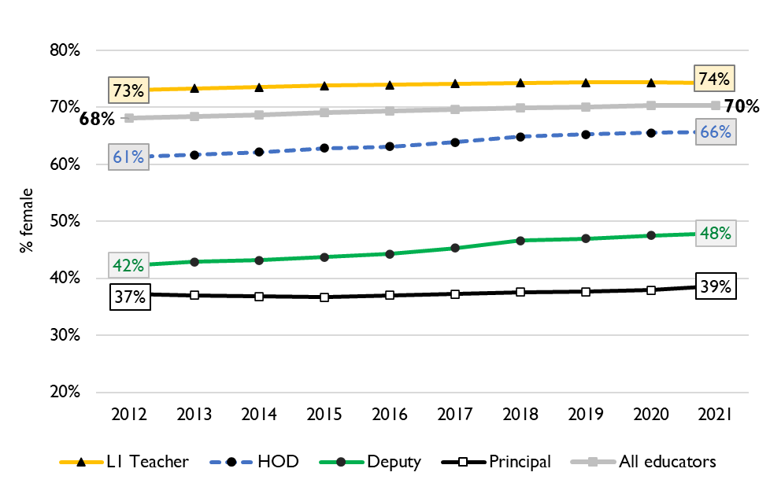
Percentage of educators that are female
Percentage of public educators in South Africa that are female, PERSAL (2012-2021)
Nationally, very little transformation in senior leadership in terms of gender since 2012, and even back to 2004 (just 34% of principals were female).
More transformation at middle-management level.
In KZN in 2021, 72% of all educators are female yet only 45% of deputy principals are female & 40% of principals are female.

Slide 54
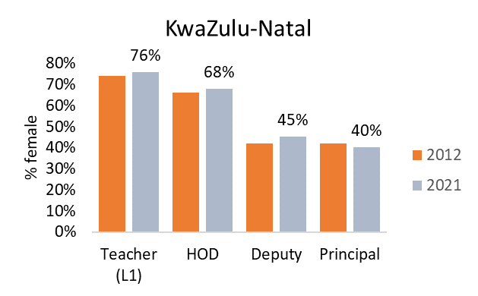
Percentage of educators that are female
9
In KwaZulu-Natal in 2021, 72% of all educators were women.
Women are underrepresented at all levels of management:
68% of HODs are women
45% of Deputies are women
40% of principals are women
Principal gender gap has increased from 28% in 2012 (70-42) to 32% (72-40) in 2021.
Source: Using anonymised 10-year PERSAL data from 2012 to 2021, only educators of the ranks: level 1 teacher, HOD, deputy principal and principal are considered.

Slide 55
Small schools (a brief overview)
10

Slide 56
Small school closures planned in KZN
10
“KwaZulu-Natal’s Department of Education (DoE) plans to shut 255 small and non-viable schools – 70 high schools and 185 primary schools – during the 2023/24 financial year and 967 schools by 2028. These are schools with few learners.”
(10 May 2023)
Head of department Nkosinathi Ngcobo said: “We are looking at progressively closing the small schools. Currently, there are over 900 such schools in the province, starting with those with the lowest enrolment or those which are furthest from the threshold, let say of 135 and 200. …in this financial year, the schools we are targeting have an enrolment of zero already (09 May 2023)
“Schools in urban areas as well as in the townships are much more developed than schools in rural areas. … Some schools have been closed, but this thing of providing transportation has never happened. When they say 255 schools have got five or 10 learners that is not true,” says Khawula.
(08 May 2023)
News articles from: KZN Education Department to close more than 900 schools by 2028 (iol.co.za) ;
KwaZulu-Natal: 900 rural schools are facing closure (sapeople.com) ;
ZN Education Dept plans to close over 900 rural schools - SABC News

Slide 57
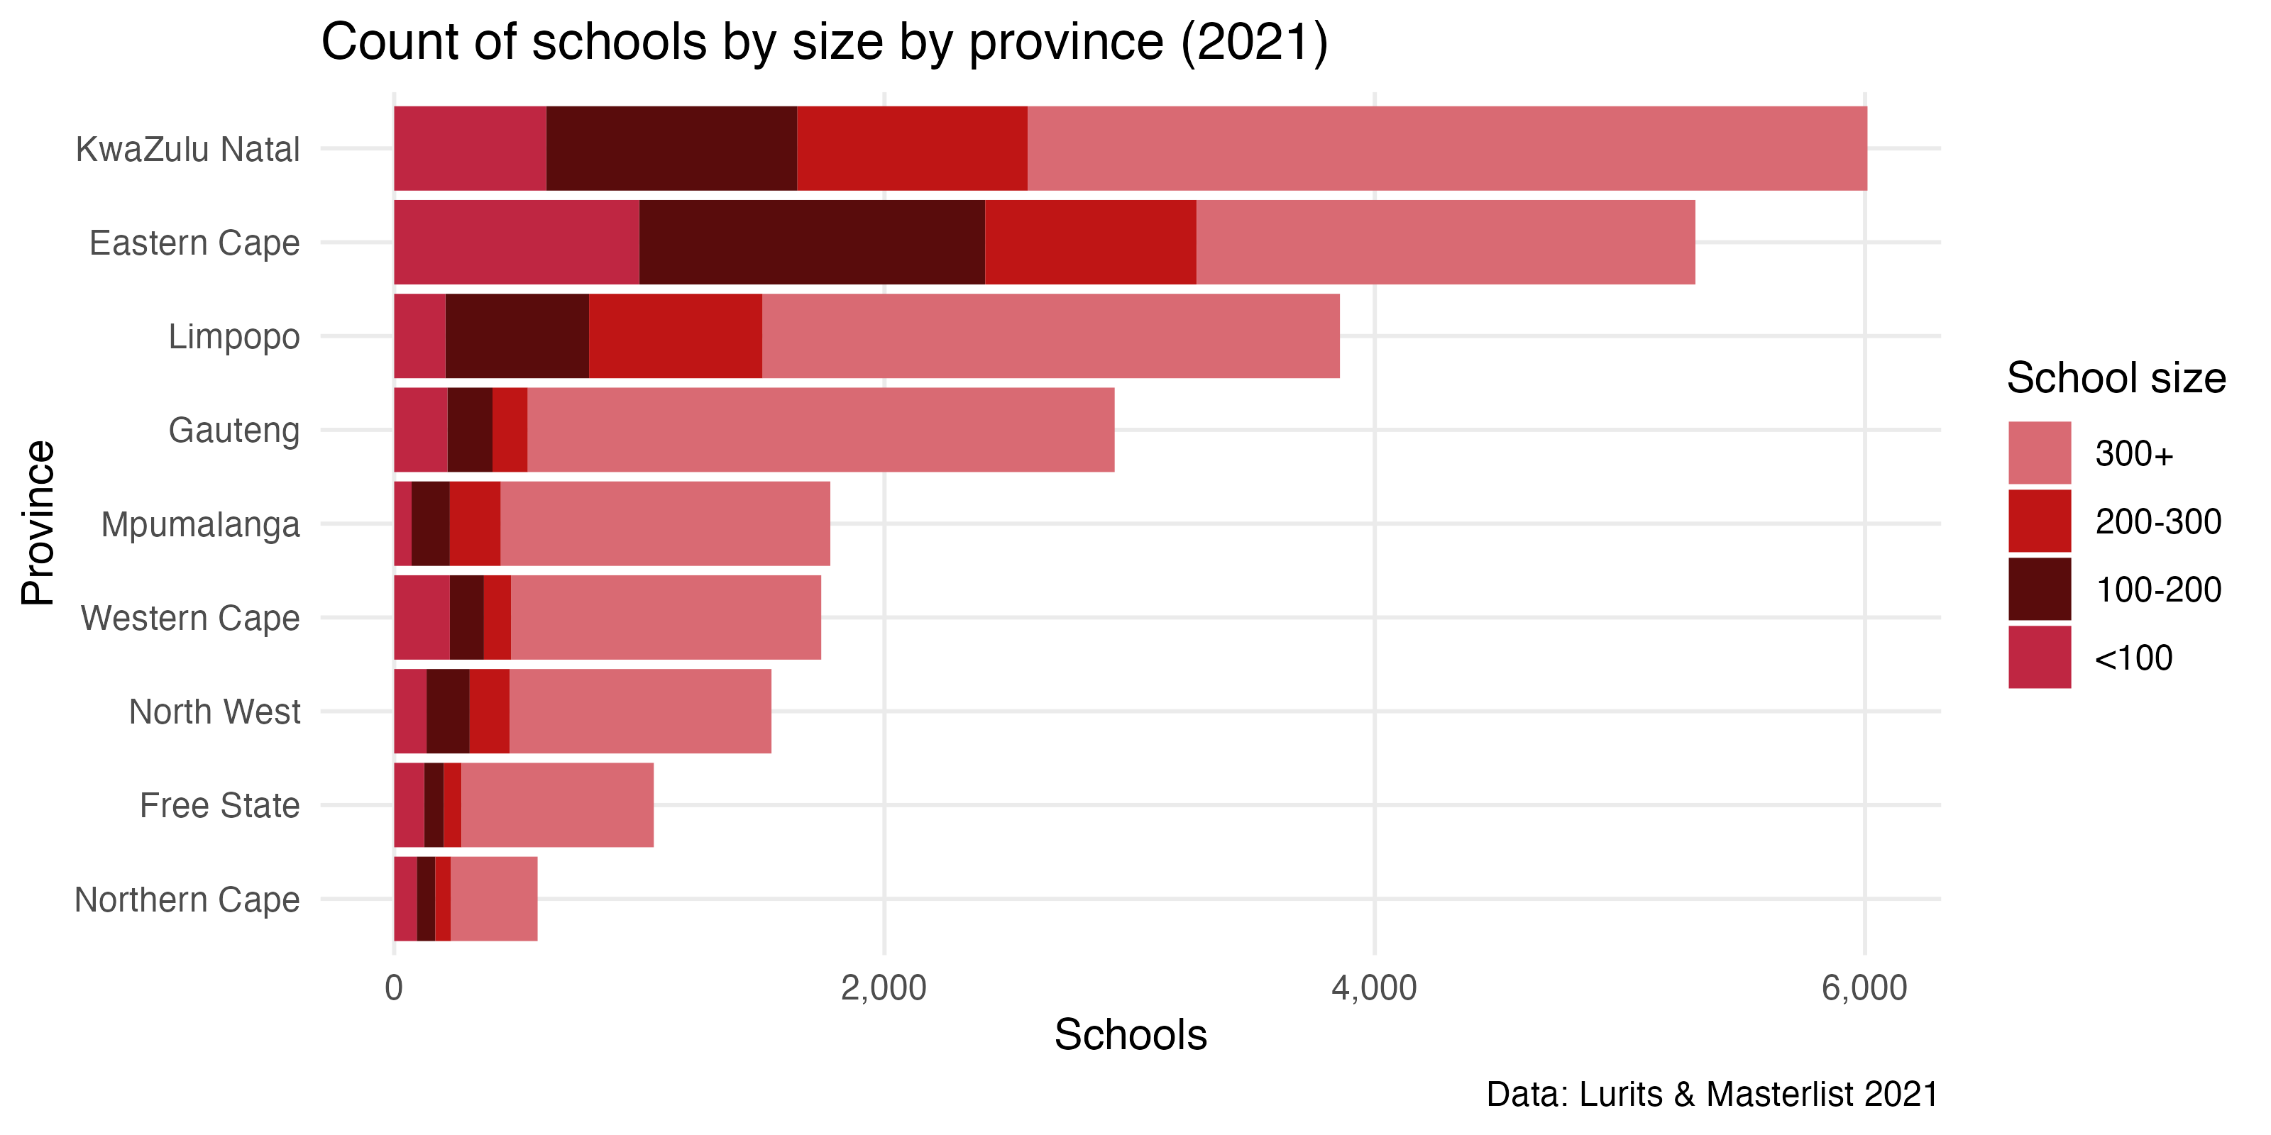
Small schools in KZN
10
620
1025
939
3426
999
1412
863
2034
Between 2009 and 2023, The Free State closed 535 small schools, about a third of schools in the Free State

Slide 58
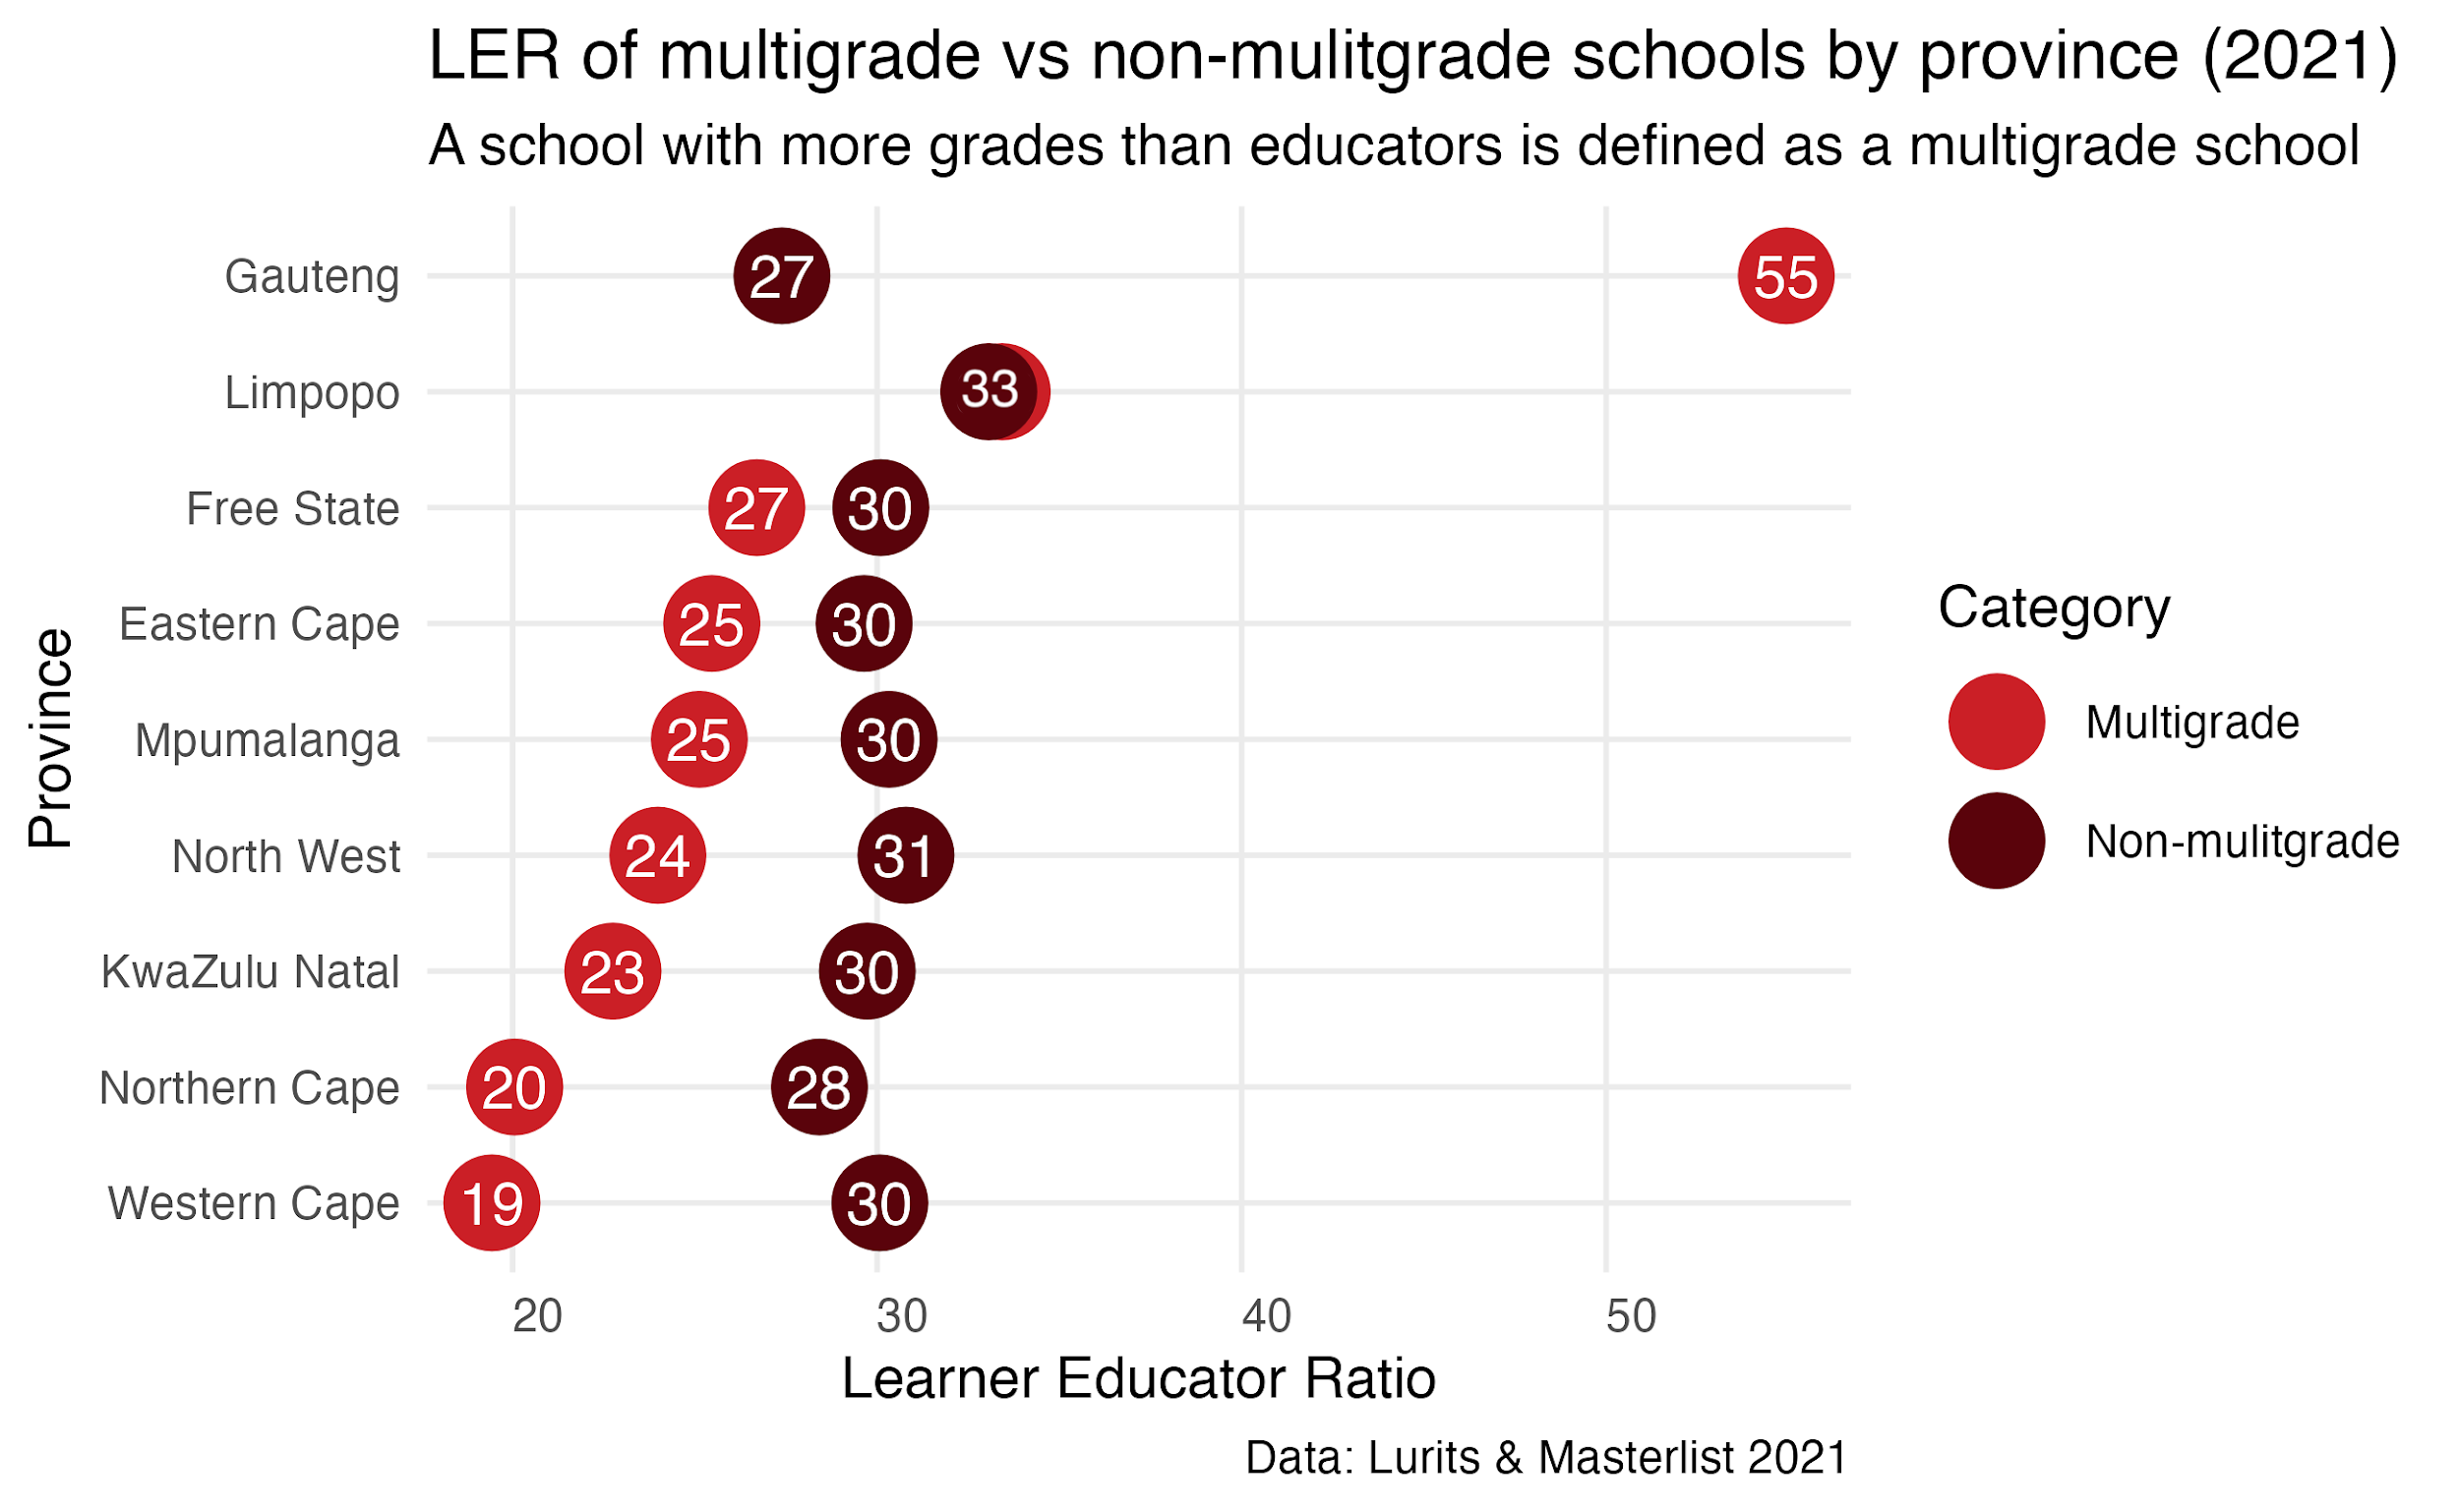
Small schools in KZN
10

Slide 59
Conclusion
11
While KwaZulu-Natal will be relatively less affected by the retirement wave to 2035, the province accounts for a large number of retirees (including a large number of SMT and other specialist educators retiring by 2035)
~65% of SMT( Principals, Deputies and HODs) are over 50 in 2021
Careful succession planning, efficient promotion processes, and good onboarding practices will be required to manage this transition as they retire
KwaZulu-Natal’s enrolment remains stable, with a slight decrease in educator and school-aged population numbers expected
Some school rationalisation may be required in future. Currently planning to close a large number of schools (almost a 1 000) by 2030, this will need to be managed to ensure access is not affected
Unit cost of educators are projected to stay roughly constant between 2022 & 2030

Slide 60
General questions and discussion
11
School rationalisation: What factors influenced & informed the decision-making process and plans for school rationalisation (About 900 schools by 2028 (IOL))?
What explains larger decline in principal numbers than number of schools that closed (2012-2021)?
How did KZN manage the need for many new appointments in 2015 / 16 when there was a sudden spike in resignations due to pension rumors? - (A case study to prepare for 2030/1 peak in expected resignations?)
Has gender equity in school management been a concern for KZN province? What prevents women from applying/being selected into senior management?

Slide 61
Additional slide: Educator, school and enrolment growth
4
 | % growth from 2012 - 2021
Province | Number of educators | Number of teachers |  | Number of public ordinary schools | Enrolment in public ordinary schools | Enrolment in ordinary schools |  | Est. school-aged population
EC | -17% | -20% |  | -8% | -6% | -5% |  | -4%
FS | -13% | -13% |  | -27% | 9% | 10% |  | 14%
GP | 21% | 28% |  | 1% | 20% | 24% |  | 27%
KN | -5% | -3% |  | -3% | 1% | 1% |  | 8%
LP | -8% | -2% |  | -7% | 4% | 5% |  | 8%
MP | 3% | 7% |  | -8% | 7% | 8% |  | 13%
NC | 6% | 9% |  | -3% | 9% | 10% |  | 9%
NW | 2% | 4% |  | -9% | 12% | 13% |  | 20%
WC | 12% | 22% |  | 0% | 21% | 22% |  | 22%
SA | -1% | 2% |  | -6% | 7% | 8% |  | 13%
Source: Educator numbers from anonymised PERSAL data from 2012 and 2021, only educators (Rank 60 000 – 69 999) are considered. Thembisa age specific data V4.5 for school-aged population (Ages 7-18) estimates and enrolment and school numbers taken from School Realities-EMIS (2012 – 2021) released by the DBE, for numbers on ordinary public and independent schools (Statistical Publications (education.gov.za))

Slide 62
Additional slide: Average retirement age across provinces

