Slide 1
Limpopo Province
Oct 2023
Educator Demand Projections
2021-2030

Slide 2
Introduction (1)
The proportion of educators that are 50 years or older has steadily risen between 2012 to 2021 in South Africa.
⇒ Nationally a wave of educator retirements is expected as older educators reach the standard retirement age of between 60 and 65.
Implications:
Many more appointments: The retirement wave will open up both teaching & school management & leadership positions & other office-based education specialists.
Compensation of educators: Since older teachers earn more, when retiring, they are replaced with younger (less costly) teachers, although this overall benefit is offset by shift to 1.5% annual notch progression.

Slide 3
Introduction (2)
Planning will be required to ensure that provinces are ready for the sustained increase in appointments.
As retirements increase, the number of new appointments will need to increase to ensure that total educator numbers (at a minimum) stay at current levels or are sufficient to meet learner enrolment growth.
If these positions are not filled, this could result in a further deterioration in the learner-educator ratio and lead to further increases in already large class sizes.

Slide 4
Objective
In this presentation, we will….
Outline the
National picture
Highlight aspects of
the situation in Limpopo
In each province, there are differences in the age profile of teachers, the expected growth of the school-going population and expected teacher attrition (resignations and retirements).

Slide 5
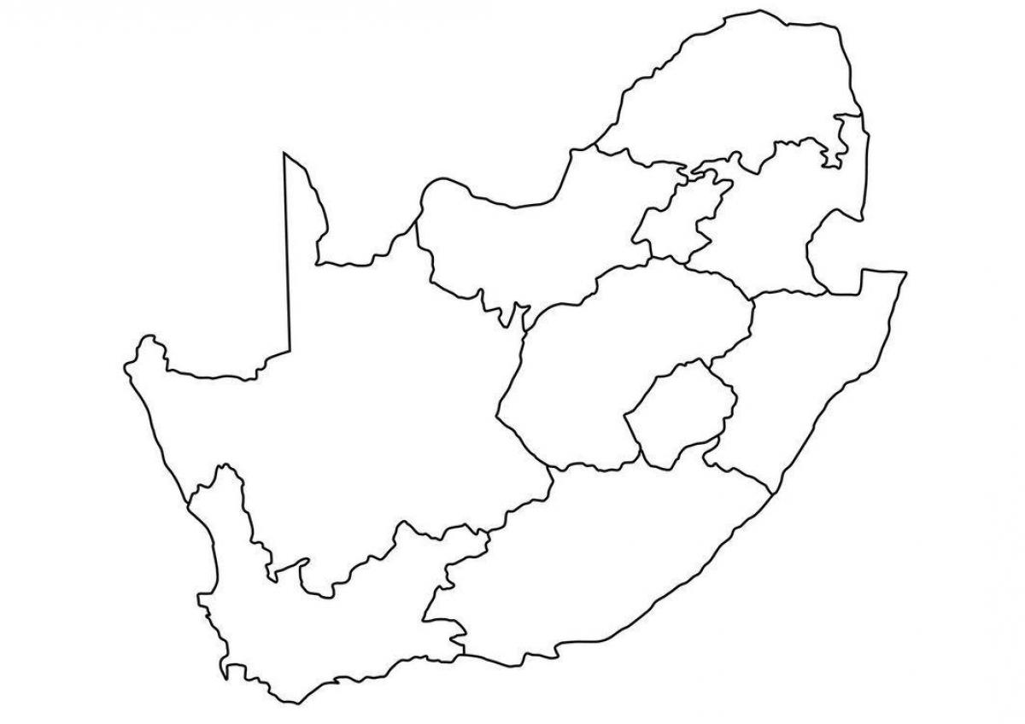
National Background

Slide 6
The ‘main graph’: Focus on the LE ratio
Newly graduated teachers
First-time joiners

Slide 7
The ‘main graph’: Focus on the LE ratio
Newly graduated teachers
20%
First-time joiners
27.4
29.8

Slide 8
The ‘main graph’: Focus on the LE ratio
403 000
467 000
Newly graduated teachers
First-time joiners

Slide 9
The ‘main graph’: Focus on the LE ratio
Newly graduated teachers
20%
First-time joiners
27.4
29.8
27.4

Slide 10
More educators retiring in the coming years
1
Educators aged 56 to 65 leaving
By 2030, 35% would have left due to age
By 2035, 53%

Slide 11
Many more school-age children than we expected
2
Population of children in millions (ages 7-18)
From 2006 projections of UN World Population Prospects (WPP)

Slide 12
Many more school-age children than we expected
2
2022 UN WPP projections
Population of children in millions (ages 7-18)
From 2006 projections of UN World Population Prospects (WPP)

Slide 13
Many more school-age children than we expected
2
2022 UN WPP projections
Stats SA
DBE grades 1 to 12 enrolments
Population of children in millions (ages 7-18)
Thembisa
From 2006 projections of UN World Population Prospects (WPP)

Slide 14
How much will we be able to spend on educators in future?
Schooling provides skills needed to grow the economy
Schooling
Economy
A growing economy means more to spend on schooling, and teachers

Slide 15
Spending on educators, GDP and government non-interest spending
Spending on educators over GDP
Spending on educators over government non-interest spending

Slide 16
Spending on educators, GDP and government non-interest spending
191bn
139bn
Spending on educators over GDP
Spending on educators over government non-interest spending

Slide 17
Spending on educators, GDP and government non-interest spending
38%
(2.1% pa)
191bn
139bn
Spending on educators over GDP
Spending on educators over government non-interest spending

Slide 18
Spending on educators, GDP and government non-interest spending
221bn
38%
(2.1% pa)
191bn
139bn
Spending on educators over GDP
Spending on educators over government non-interest spending

Slide 19
Spending on educators, GDP and government non-interest spending
Older educators (42.8 to 45.1)
Grey part: improvements in purchasing power
Workforce growth
Spending on educators over GDP
Spending on educators over government non-interest spending

Slide 20
Spending on educators, GDP and government non-interest spending
Demographic dividend
(Average age decreases)
Workforce growth
(Around
60 000 additional educators)
Spending on educators over GDP
Spending on educators over government non-interest spending

Slide 21
What an LE ratio increase of 1.0 means
Based on analysis of 2015 to 2018 grades 1 to 3 trends
Average class size | Goes up by 1.2
% of learners in classes over 40 | Rises e.g. from 49% to 55%, so 6 percentage points, pushing some 200,000 grades 1 to 3 learners over the threshold
% of learners in classes over 50 | Rises from e.g. 20% to 23%, so 3 percentage points

Slide 22
Overview
Age distributions
Projected retirements & resignations
Provincial population and enrolment trends
Public and independent school growth
Educator growth: Teachers and SMT positions
The implications for appointments and class sizes
Expected financial implications to 2030
Movement of educators: Between and within provinces
Gender imbalance in school management
Discussion
1
2
3
4
5
6
7
8
9
10

Slide 23
Limpopo educator demand summary
Age distribution: The age distribution in Limpopo has a high peak at around 53 years of age
Projected resignations and retirements: Age-related retirement in Limpopo is expected to peak between 2026 and 2031 (between 2 700 – 2900 leavers a year, 67% of all 2021 educators)
Enrolment and population growth: Enrolment in Limpopo grew by 5% from 2012-2021 (~85K learners), the school-aged population is forecast to grow by a further 7% (~100K learners) to 2030
School and educator growth: Over this same period, the educator number has fallen (-8%), and the number of schools has decreased (-5%), driving up the LE ratio and class sizes.
Senior educator changes: In Limpopo, there has been a substantial decline in the number of HODs and Deputy Principals between 2012 and 2021 (38% of HODs and 50% of Deputy Principals), which puts the province well below the national average of management vs teacher numbers
Appointments and LE Ratio: Significant increases in appointments are needed, otherwise, the LE ratio is in danger of increasing further (dropped from 26.7 to 30.4 from 2012 to 2021)
Projected educator cost trends: Limpopo will experience a small decrease in the average cost of educators (especially for senior educators). This decline in average educator cost should free up some budget to replace and grow the educator workforce or increase the promotion rates
Educator movements: Low movements out of Limpopo, but many educators (~7% annually) appear to move between schools from year-to-year

Slide 24
Age distributions and projected retirements and resignations
1
2

Slide 25
Educator age distribution (2021)
1
Source: Anonymised PERSAL data from 2021, only 405 431 educators (Rank 60 000 – 69 999) are considered. ECD practitioners, TVET lecturers and ABET teachers were removed.

Slide 26
Educator age distribution (2021)
1
A higher proportion of educators are over 50 years old in Limpopo than in the rest of the country
Source: Anonymised PERSAL data from 2021, only 405 431 educators (Rank 60 000 – 69 999) are considered. ECD practitioners, TVET lecturers and ABET teachers were removed.

Slide 27
Educator age distribution in 2021 & 2030
1
Assume constant 2021 educator numbers
2021
2030
Source: Anonymised PERSAL data from 2021, only 405 431 educators (Rank 60 000 – 69 999) are considered. ECD practitioners, TVET lecturers and ABET teachers were removed.

Slide 28
Educator age distribution in 2021 & 2030
1
Assume constant 2021 educator numbers
2021
2030
Source: Anonymised PERSAL data from 2021, only 405 431 educators (Rank 60 000 – 69 999) are considered. ECD practitioners, TVET lecturers and ABET teachers were removed.

Slide 29
Projected resignation & retirements (LP)
2
Assume constant 2021 educator numbers
Proportion of Educators
The majority of educators that exit PERSAL in Limpopo are retirees (ages 56 to 65)
The resignation rate in Limpopo is low. Very few educators opt to leave teaching before retirement
The number of young teachers (ages 21-30) resigning is projected to increase as the number of newly hired young teachers increases.
All educators that leave PERSAL for the province or change to something that is not an educator are classified as having either:
Resigned: Ages 21-55
Retired: Ages 56+
Projected
% of educators resigning or retiring
Source: Anonymised PERSAL data from 2021, only 405 431 educators (Rank 60 000 – 69 999) are considered. ECD practitioners, TVET lecturers and ABET teachers were removed. Estimates to 2035 derived from the National and provincial teacher supply and demand models – assumption of no growth in educator numbers. Note: Retirements refer to all educators, aged 56 to 65, that leave PERSAL in Limpopo, whilst resignations refer to all educators aged 55 and below that leave PERSAL (as educators in Limpopo) for any reason.

Slide 30
Projected resignation & retirements (LP)
2
Assume constant 2021 educator numbers
Retirement headcount
The number of retirements is projected to increase, peaking in ~2028 and then declining again
The number of retirements is projected to increase from about 2,000 in 2022 to about 3,000 in 2028, an increase of about 1,000 retirements annually
Projected
Number of retirements
Source: Anonymised PERSAL data from 2021, only 405 431 educators (Rank 60 000 – 69 999) are considered. ECD practitioners, TVET lecturers and ABET teachers were removed. Estimates to 2035 derived from the National and provincial teacher supply and demand models – assumption of no growth in educator numbers. Note: Retirements refer to all educators, aged 56 to 65, that leave PERSAL in Limpopo, whilst resignations refer to all educators aged 55 and below that leave PERSAL (as educators in Limpopo) for any reason.

Slide 31
Older leaver trend estimates to 2035
2
Assume constant 2021 educator numbers
By 2031, half of the educators from 2021 will have retired
About 36,000
educators estimated to retire by 2035
(67% of total educators in 2021)
50%
Source: Anonymised 2021 PERSAL data, only 405 431 educators (Rank 60 000 – 69 999) are considered. ECD practitioners, TVET lecturers and ABET teachers were removed. Estimates to 2035 derived from the National and provincial models – assumption of no growth in educator numbers.

Slide 32
Provincial population and enrolment trends
3

Slide 33
Provincial enrolment trends (2012-2021)
3
High growth
Moderate growth
Stable
Decline
Source: Enrolment numbers taken from School Realities-EMIS (2012 – 2021) released by the DBE, using total numbers for ordinary public and independent schools.

Slide 34
Provincial enrolment trends (2012-2021)
3
Enrolment in Limpopo ordinary schools
grew by 5% from 2012 to 2021
Source: Enrolment numbers taken from School Realities-EMIS (2012 – 2021) released by the DBE, using total numbers for ordinary public and independent schools.

Slide 35
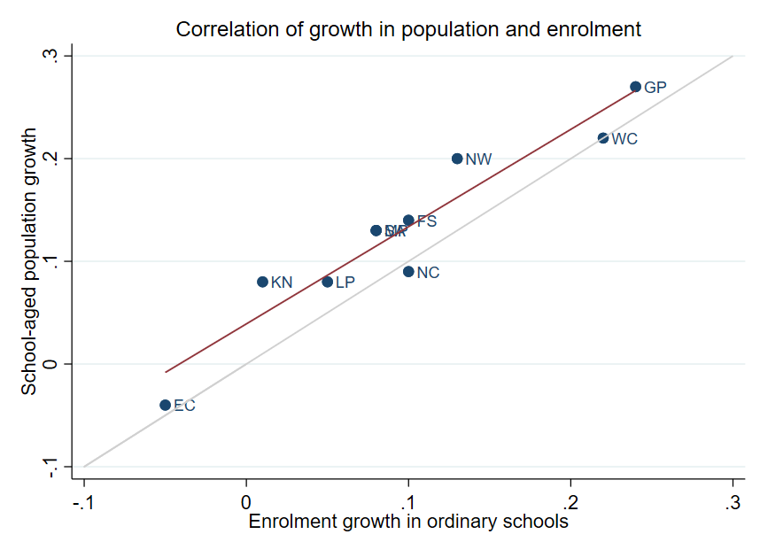
Correlation between population and enrolment growth
(2012-2021)
3
R² = 0.9025
Strong positive correlation between population and enrolment growth between 2012 and 2021
45˚
Source: Thembisa age specific data V4.5 for school-aged population (Ages 7-18) estimates and enrolment taken from School Realities-EMIS (2012 – 2021) released by the DBE, for numbers on ordinary public and independent schools (Statistical Publications (education.gov.za))

Slide 36
Projected growth in school-aged population
3
Population of children aged 7-18 in Limpopo, is expected to grow by
~100K children (7%)
from 2021 to 2030
Note: Period 2021 – 2030 is the same timeframe, nine years, as 2012 – 2021.
Source: Thembisa age-specific estimates from the model V4.5 for children aged 7-18 by province

Slide 37
School aged-population estimates to 2030
3
 | Number of children Aged 7-18 |  |  |  | Growth '12-21 | Growth '21-30
Province | 2012 | 2021 | 2030E
EC | 1 657 202 | 1 598 475 | 1 361 637 |  | -4% | -15%
FS | 592 445 | 676 489 | 650 820 |  | 14% | -4%
GP | 1 962 793 | 2 498 533 | 3 180 884 |  | 27% | 27%
KN | 2 485 822 | 2 690 378 | 2 657 716 |  | 8% | -1%
LP | 1 395 864 | 1 507 386 | 1 612 125 |  | 8% | 7%
MP | 977 749 | 1 100 594 | 1 165 728 |  | 13% | 6%
NC | 254 075 | 277 560 | 281 208 |  | 9% | 1%
NW | 742 943 | 893 530 | 930 323 |  | 20% | 4%
WC | 1 068 009 | 1 298 801 | 1 496 731 |  | 22% | 15%
Total | 11 136 902 | 12 541 746 | 13 337 172 |  | 13% | 6%
1,51M
1.61M
1.40M
Note: Period 2021 – 2030 is the same timeframe, nine years, as 2012 – 2021.
Source: Thembisa age-specific estimates from the model V4.5 for children aged 7-18 by province

Slide 38
Public and independent school growth
4

Slide 39
Educator, school and enrolment growth
4
 | % growth from 2012 - 2021
Province | Number of educators | Number of teachers |  | Number of public ordinary schools | Enrolment in public ordinary schools | Enrolment in ordinary schools |  | Est. school-aged population
EC | -17% | -20% |  | -8% | -6% | -5% |  | -4%
FS | -13% | -13% |  | -27% | 9% | 10% |  | 14%
GP | 21% | 28% |  | 1% | 20% | 24% |  | 27%
KN | -5% | -3% |  | -3% | 1% | 1% |  | 8%
LP | -8% | -2% |  | -7% | 4% | 5% |  | 8%
MP | 3% | 7% |  | -8% | 7% | 8% |  | 13%
NC | 6% | 9% |  | -3% | 9% | 10% |  | 9%
NW | 2% | 4% |  | -9% | 12% | 13% |  | 20%
WC | 12% | 22% |  | 0% | 21% | 22% |  | 22%
SA | -1% | 2% |  | -6% | 7% | 8% |  | 13%
Source: Educator numbers from anonymised PERSAL data from 2012 and 2021, only 405 431 educators (Rank 60 000 – 69 999) are considered. Thembisa age specific data V4.5 for school-aged population (Ages 7-18) estimates and enrolment and school numbers taken from School Realities-EMIS (2012 – 2021) released by the DBE, for numbers on ordinary public and independent schools (Statistical Publications (education.gov.za))

Slide 40
Educator, school and enrolment growth
4
 | % growth from 2012 - 2021
Province | Number of educators | Number of teachers |  | Number of public ordinary schools | Enrolment in public ordinary schools | Enrolment in ordinary schools |  | Est. school-aged population
EC | -17% | -20% |  | -8% | -6% | -5% |  | -4%
FS | -13% | -13% |  | -27% | 9% | 10% |  | 14%
GP | 21% | 28% |  | 1% | 20% | 24% |  | 27%
KN | -5% | -3% |  | -3% | 1% | 1% |  | 8%
LP | -8% | -2% |  | -7% | 4% | 5% |  | 8%
MP | 3% | 7% |  | -8% | 7% | 8% |  | 13%
NC | 6% | 9% |  | -3% | 9% | 10% |  | 9%
NW | 2% | 4% |  | -9% | 12% | 13% |  | 20%
WC | 12% | 22% |  | 0% | 21% | 22% |  | 22%
SA | -1% | 2% |  | -6% | 7% | 8% |  | 13%
z
Total number of educators in Limpopo public schools
decreased from 2012 to 2021….
….despite a growing population and enrolment.
Source: Educator numbers from anonymised PERSAL data from 2012 and 2021, only 405 431 educators (Rank 60 000 – 69 999) are considered. Thembisa age specific data V4.5 for school-aged population (Ages 7-18) estimates and enrolment and school numbers taken from School Realities-EMIS (2012 – 2021) released by the DBE, for numbers on ordinary public and independent schools (Statistical Publications (education.gov.za))

Slide 41
School growth from 2012 to 2021
4
School growth was driven by independent school growth (+37%) from 2012 to 2021. In contrast, the number of public schools in SA decreased (-6%)
The number of independent schools increased by 37 schools (+26%), with enrolment growing from about 50,8K to 75,5K children (+49%)
EC | FS | GP | KN | LP | MP | NC | NW | WC | SA
% independent schools (2021)
4%
8%
30%
4%
5%
7%
7%
6%
17%
9%
Source: School numbers taken from School Realities-EMIS (2012 – 2021) released by the DBE, for numbers on ordinary public and independent schools (Statistical Publications (education.gov.za))
Notes:
Voiceover that decreases in number of schools does not necessarily = bad, it may lead to greater efficiencies in larger schools, but also need to be careful from an overcrowding and access perspective.

Slide 42
Educator growth by teachers and SMT positions
5

Slide 43
Changes in teacher and SMT numbers
5
 |  | Teacher |  |  |  |  | HOD |  |  |  |  | Deputy-Principal |  |  |  |  | Principal
Province |  | 2012 | 2021 | Diff | % change |  | 2012 | 2021 | Diff | % change |  | 2012 | 2021 | Diff | % change |  | 2012 | 2021 | Diff | % change
EC |  | 50 295 | 40 115 | -10 180 | -20% |  | 5 870 | 6 196 | 326 | 6% |  | 1 342 | 1 453 | 111 | 8% |  | 5 294 | 4 755 | - 539 | -10%
FS |  | 20 148 | 17 561 | -2 587 | -13% |  | 2 685 | 2 470 | - 215 | -8% |  | 852 | 768 | - 84 | -10% |  | 1 224 | 892 | - 332 | -27%
GP |  | 47 233 | 60 677 | 13 444 | 28% |  | 8 708 | 9 209 | 501 | 6% |  | 2 565 | 2 850 | 285 | 11% |  | 2 162 | 1 959 | - 203 | -9%
KN |  | 73 050 | 71 000 | -2 050 | -3% |  | 11 289 | 10 330 | - 959 | -8% |  | 2 642 | 2 342 | - 300 | -11% |  | 5 584 | 5 055 | - 529 | -9%
LP |  | 44 998 | 44 317 | - 681 | -2% |  | 6 090 | 3 762 | -2 328 | -38% |  | 1 562 | 778 | - 784 | -50% |  | 3 510 | 3 316 | - 194 | -6%
MP |  | 26 127 | 27 857 | 1 730 | 7% |  | 4 047 | 4 055 | 8 | 0% |  | 1 108 | 1 114 | 6 | 1% |  | 1 790 | 1 450 | - 340 | -19%
NC |  | 7 257 | 7 929 | 672 | 9% |  | 1 034 | 1 094 | 60 | 6% |  | 294 | 365 | 71 | 24% |  | 587 | 488 | - 99 | -17%
NW |  | 21 305 | 22 261 | 956 | 4% |  | 2 994 | 3 023 | 29 | 1% |  | 902 | 1 041 | 139 | 15% |  | 1 698 | 1 338 | - 360 | -21%
WC |  | 23 579 | 28 665 | 5 086 | 22% |  | 4 065 | 3 700 | - 365 | -9% |  | 1 334 | 1 297 | - 37 | -3% |  | 1 531 | 1 339 | - 192 | -13%
SA |  | 313 992 | 320 382 | 6 390 | 2% |  | 46 782 | 43 839 | -2 943 | -6% |  | 12 601 | 12 008 | - 593 | -5% |  | 23 380 | 20 592 | -2 788 | -12%
Source: Anonymised PERSAL data from 2012 and 2021, only 405 431 educators (Rank 60 000 – 69 999) are considered. ECD practitioners, TVET lecturers, and ABET teachers were removed. The 2021 rankclass file was expanded to include ranks found only in years prior to 2021.

Slide 44
Changes in teacher and SMT numbers
5
 |  | Teacher |  |  |  |  | HOD |  |  |  |  | Deputy-Principal |  |  |  |  | Principal
Province |  | 2012 | 2021 | Diff | % change |  | 2012 | 2021 | Diff | % change |  | 2012 | 2021 | Diff | % change |  | 2012 | 2021 | Diff | % change
EC |  | 50 295 | 40 115 | -10 180 | -20% |  | 5 870 | 6 196 | 326 | 6% |  | 1 342 | 1 453 | 111 | 8% |  | 5 294 | 4 755 | - 539 | -10%
FS |  | 20 148 | 17 561 | -2 587 | -13% |  | 2 685 | 2 470 | - 215 | -8% |  | 852 | 768 | - 84 | -10% |  | 1 224 | 892 | - 332 | -27%
GP |  | 47 233 | 60 677 | 13 444 | 28% |  | 8 708 | 9 209 | 501 | 6% |  | 2 565 | 2 850 | 285 | 11% |  | 2 162 | 1 959 | - 203 | -9%
KN |  | 73 050 | 71 000 | -2 050 | -3% |  | 11 289 | 10 330 | - 959 | -8% |  | 2 642 | 2 342 | - 300 | -11% |  | 5 584 | 5 055 | - 529 | -9%
LP |  | 44 998 | 44 317 | - 681 | -2% |  | 6 090 | 3 762 | -2 328 | -38% |  | 1 562 | 778 | - 784 | -50% |  | 3 510 | 3 316 | - 194 | -6%
MP |  | 26 127 | 27 857 | 1 730 | 7% |  | 4 047 | 4 055 | 8 | 0% |  | 1 108 | 1 114 | 6 | 1% |  | 1 790 | 1 450 | - 340 | -19%
NC |  | 7 257 | 7 929 | 672 | 9% |  | 1 034 | 1 094 | 60 | 6% |  | 294 | 365 | 71 | 24% |  | 587 | 488 | - 99 | -17%
NW |  | 21 305 | 22 261 | 956 | 4% |  | 2 994 | 3 023 | 29 | 1% |  | 902 | 1 041 | 139 | 15% |  | 1 698 | 1 338 | - 360 | -21%
WC |  | 23 579 | 28 665 | 5 086 | 22% |  | 4 065 | 3 700 | - 365 | -9% |  | 1 334 | 1 297 | - 37 | -3% |  | 1 531 | 1 339 | - 192 | -13%
SA |  | 313 992 | 320 382 | 6 390 | 2% |  | 46 782 | 43 839 | -2 943 | -6% |  | 12 601 | 12 008 | - 593 | -5% |  | 23 380 | 20 592 | -2 788 | -12%
zvc
Large decline in deputy principal and HOD numbers between 2012 and 2021
vc
Principal number declined roughly in line with the decrease in public schools (-7%)
Source: Anonymised PERSAL data from 2012 and 2021, only 405 431 educators (Rank 60 000 – 69 999) are considered. ECD practitioners, TVET lecturers, and ABET teachers were removed. The 2021 rankclass file was expanded to include ranks found only in years prior to 2021.

Slide 45
Proportional split by educator rank
5
 | All Educators |  |  | Teacher |  |  | HOD |  |  | Dep.-Principal |  |  | Principal |  |  | Other
 | 2012 | 2021 |  | 2012 | 2021 |  | 2012 | 2021 |  | 2012 | 2021 |  | 2012 | 2021 |  | 2012 | 2021
EC | 100% | 100% |  | 78% | 75% |  | 9% | 12% |  | 2.1% | 2.7% |  | 8.2% | 8.8% |  | 2.5% | 2.4%
FS | 100% | 100% |  | 78% | 78% |  | 10% | 11% |  | 3.3% | 3.4% |  | 4.7% | 4.0% |  | 3.7% | 3.3%
GP | 100% | 100% |  | 74% | 79% |  | 14% | 12% |  | 4.0% | 3.7% |  | 3.4% | 2.6% |  | 4.4% | 2.7%
KN | 100% | 100% |  | 77% | 79% |  | 12% | 11% |  | 2.8% | 2.6% |  | 5.9% | 5.6% |  | 2.1% | 1.3%
LP | 100% | 100% |  | 78% | 84% |  | 11% | 7% |  | 2.7% | 1.5% |  | 6.1% | 6.3% |  | 2.1% | 1.5%
MP | 100% | 100% |  | 76% | 79% |  | 12% | 12% |  | 3.2% | 3.2% |  | 5.2% | 4.1% |  | 3.2% | 1.8%
NC | 100% | 100% |  | 75% | 77% |  | 11% | 11% |  | 3.0% | 3.6% |  | 6.1% | 4.8% |  | 5.1% | 3.9%
NW | 100% | 100% |  | 76% | 78% |  | 11% | 11% |  | 3.2% | 3.7% |  | 6.1% | 4.7% |  | 3.7% | 2.6%
WC | 100% | 100% |  | 74% | 80% |  | 13% | 10% |  | 4.2% | 3.6% |  | 4.8% | 3.7% |  | 4.1% | 2.1%
SA | 100% | 100% |  | 77% | 79% |  | 11% | 11% |  | 3.1% | 3.0% |  | 5.7% | 5.1% |  | 3.1% | 2.1%
Source: Anonymised PERSAL data from 2012 and 2021, only educators (Rank 60 000 – 69 999) are considered. ECD practitioners TVET lecturers and ABET teachers were removed. The 2021 rankclass file was expanded to include ranks found only in years prior to 2021. The percentage within each rank is calculated taking the total number of educator in that year for that rank over the total number of educators in that year.

Slide 46
Proportional split by educator rank
5
 | All Educators |  |  | Teacher |  |  | HOD |  |  | Dep.-Principal |  |  | Principal |  |  | Other
 | 2012 | 2021 |  | 2012 | 2021 |  | 2012 | 2021 |  | 2012 | 2021 |  | 2012 | 2021 |  | 2012 | 2021
EC | 100% | 100% |  | 78% | 75% |  | 9% | 12% |  | 2.1% | 2.7% |  | 8.2% | 8.8% |  | 2.5% | 2.4%
FS | 100% | 100% |  | 78% | 78% |  | 10% | 11% |  | 3.3% | 3.4% |  | 4.7% | 4.0% |  | 3.7% | 3.3%
GP | 100% | 100% |  | 74% | 79% |  | 14% | 12% |  | 4.0% | 3.7% |  | 3.4% | 2.6% |  | 4.4% | 2.7%
KN | 100% | 100% |  | 77% | 79% |  | 12% | 11% |  | 2.8% | 2.6% |  | 5.9% | 5.6% |  | 2.1% | 1.3%
LP | 100% | 100% |  | 78% | 84% |  | 11% | 7% |  | 2.7% | 1.5% |  | 6.1% | 6.3% |  | 2.1% | 1.5%
MP | 100% | 100% |  | 76% | 79% |  | 12% | 12% |  | 3.2% | 3.2% |  | 5.2% | 4.1% |  | 3.2% | 1.8%
NC | 100% | 100% |  | 75% | 77% |  | 11% | 11% |  | 3.0% | 3.6% |  | 6.1% | 4.8% |  | 5.1% | 3.9%
NW | 100% | 100% |  | 76% | 78% |  | 11% | 11% |  | 3.2% | 3.7% |  | 6.1% | 4.7% |  | 3.7% | 2.6%
WC | 100% | 100% |  | 74% | 80% |  | 13% | 10% |  | 4.2% | 3.6% |  | 4.8% | 3.7% |  | 4.1% | 2.1%
SA | 100% | 100% |  | 77% | 79% |  | 11% | 11% |  | 3.1% | 3.0% |  | 5.7% | 5.1% |  | 3.1% | 2.1%
zvc
Large increase in the proportion of teachers (78% to 84%) to well above the national average (79%)
Large decrease in the proportion of HODs and deputy principals to well below the national averages
Source: Anonymised PERSAL data from 2012 and 2021, only educators (Rank 60 000 – 69 999) are considered. ECD practitioners TVET lecturers and ABET teachers were removed. The 2021 rankclass file was expanded to include ranks found only in years prior to 2021. The percentage within each rank is calculated taking the total number of educator in that year for that rank over the total number of educators in that year.

Slide 47
Trends in educator numbers (2021-2021)
5
Number of teachers
(Level 1 teachers)
Number of senior educators
(HODs, Deputy’s, Principals & Other)
Source: Anonymised PERSAL data from 2012 and 2021, only 405 431 educators (Rank 60 000 – 69 999) are considered. ECD practitioners, TVET lecturers, and ABET teachers were removed. The 2021 rankclass file was expanded to include ranks found only in years prior to 2021.

Slide 48
Trends in educator numbers (2021-2021)
5
% Headcount growth from 2012 to 2021
Number of teachers
(Level 1 teachers)
Number of senior educators
(HODs, Deputy’s, Principals & Other)
Teachers: -2%
HODs: -38%
Principal: -6%
Deputys: -50%
Source: Anonymised PERSAL data from 2012 and 2021, only 405 431 educators (Rank 60 000 – 69 999) are considered. ECD practitioners, TVET lecturers, and ABET teachers were removed. The 2021 rankclass file was expanded to include ranks found only in years prior to 2021.

Slide 49
Trends in educator numbers (2021-2021)
5
Mean educator age
Number of teachers
(Level 1 teachers)
Number of senior educators
(HODs, Deputy’s, Principals & Other)
46.0 yrs
45.8 yrs
46.5 yrs
46.5 yrs
48.3 yrs
52.9 yrs
51.9 yrs
54.0 yrs
49.1 yrs
54.0 yrs
Source: Anonymised PERSAL data from 2012 and 2021, only 405 431 educators (Rank 60 000 – 69 999) are considered. ECD practitioners, TVET lecturers, and ABET teachers were removed. The 2021 rankclass file was expanded to include ranks found only in years prior to 2021.

Slide 50
Projected educators leaving
5
Teachers
(Level 1 teachers)
Senior educators
(HODs, Deputy’s, Principals & Other)
% of teacher resigning & retiring
% of senior educators resigning & retiring
Careful succession planning is needed, particularly due to low number of HODs and deputies
A higher proportion of teachers are expected to resign and retire in Limpopo relative to SA up to about 2030
Source: Anonymised 2021 PERSAL data, only 405 431 educators (Rank 60 000 – 69 999) are considered. ECD practitioners, TVET lecturers and ABET teachers were removed. Estimates to 2035 derived from the National and provincial models – assumption of no growth in educator numbers.

Slide 51
Implications on appointments and class sizes
6

Slide 52
Projected increase in appointments
6
Large and sustained increase in expected annual appointments over the period of ~2026 - 2031
Sourcing and appointment processes will need strengthening
Alternative sources of teacher supply may need to be considered eg. teachers that would traditionally have sought work in other provinces
~1 200
Additional educators will
need to be appointed
annually
~4 250
educators
3 060
educators
Maximum number of annual joiners over the period 2012 - 2021
Projected mean number of annual leavers from 2028 – 2030

Slide 53
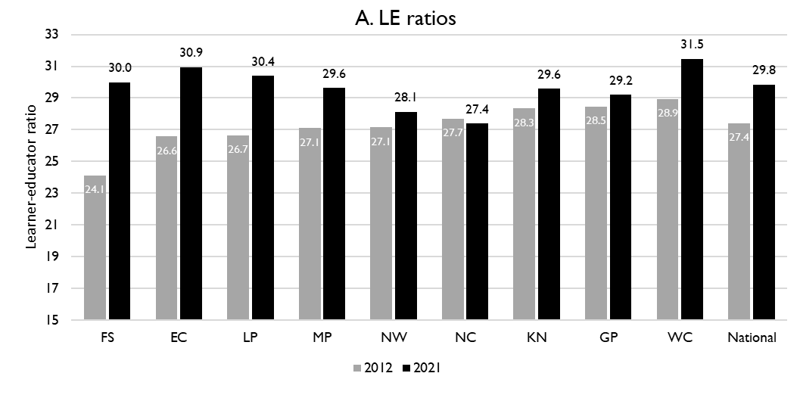
Lerner-public educator ratios (’12 & ‘21)
6
National and provincial learner-to-public-educator ratios in 2012 and 2021, grades 1 to 12 in public ordinary schools in South Africa
z
z
LE ratio rose from 26.7 learners per educator to 30.4 learners per educator in Limpopo, more then the national average
Source: Figure 1 in South African teacher shortages as revealed through class sizes and learner-educator ratios: An exploratory analysis by Gabrielle Wills (2023)

Slide 54
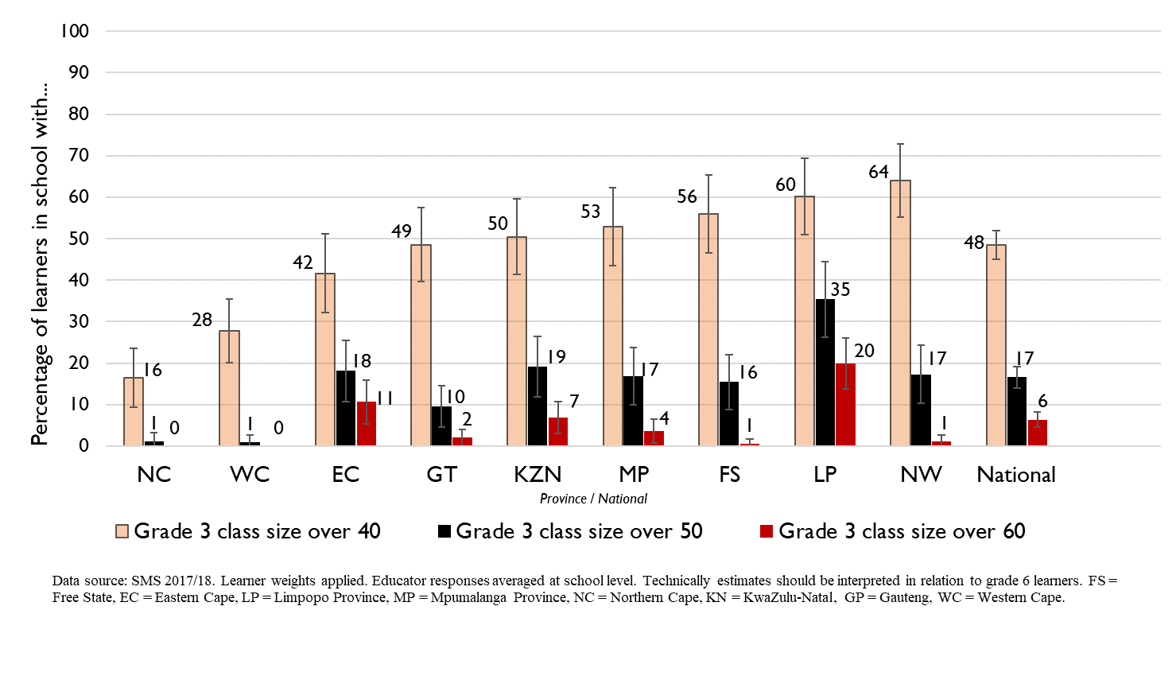
Grade 3 class sizes
(2017/18 School Monitoring Survey)
Post provisioning guidelines - Class sizes should not exceed 35 in Grade 3.
% of learners in grade 3 classes > 40:
48% in SA, 60% in LP
% of learners in grade 3 classes > 50:
17% in SA, 35% in LP
% of learners in grade 3 classes > 60:
6% in SA, 20% in LP
Note: Nationally, grade 3 enrolment numbers had been rising from about 2011 and peaked in 2017 before starting to decline slightly, stabilising at about 1,1 million in 2021 (Gustafsson 2022a, p10-11). Holding other things constant, grade 3 class sizes will be similar or slightly smaller in 2022 than what is seen in these 2017/18 SMS estimates.

Slide 55
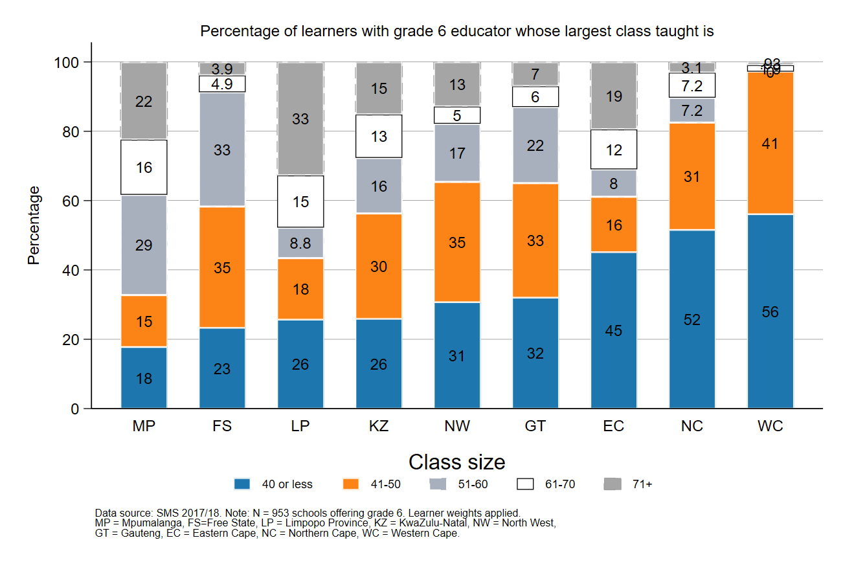
Largest classes - School Monitoring Survey 2017/18
6
6
In 2017/18, Limpopo was the province with the highest percentage of large classes with more than 60 learners
A further deterioration of the LE ratio will drive up class size and the number of excessively large classes, negatively impacting quality and teacher motivation
Percentage of grade 6 learners in schools with an educator reporting that their largest class is in the following class size category, disaggregated by province (SMS 2017/18)
Source: Figure 1 in South African teacher shortages as revealed through class sizes and learner-educator ratios: An exploratory analysis by Gabrielle Wills (2023) using School Monitoring Survey 2017/18 (953 schools, learner weighted).

Slide 56
Expected financial implications to 2030
7

Slide 57
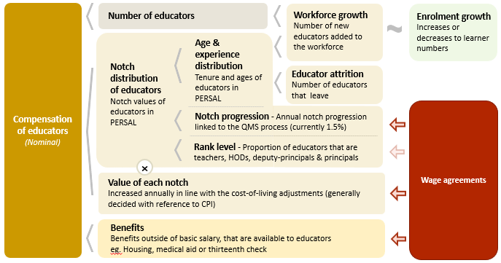
Unit cost drivers
7

Slide 58
Real and nominal costs
7
Examples:
In 2022 CPI was 7.2%
If nominal wages increase by 7.2%, then real wages increase by 0%
If nominal wages increase by 9%, then real wages increase by 1.8%
If nominal wages increase by 5%, then real wages decrease by 2.2%
A real increase in wages takes place when wages increase above the rate of inflation
Changes to real wages are an indicator of purchasing power

Slide 59
Projected unit costs trends| All educators
7
In constant 2021 rands
Note: Scale not from zero
Source: Own calculations, using the anonymised PERSAL data from 2021, only educators are considered. ECD practitioners and examination reviewers removed. Estimates to 2030 derived from the national and provincial TSD models. Assumption of no growth in educator numbers.

Slide 60
Projected unit costs trends| All educators
7
In constant 2021 rands
Some decline in the real unit cost of educators is expected in LP, but it is small, only 1.5% from 2022 to 2030
Note: Scale not from zero
Adjusted the proportion of teachers to total educators from 2021
Assume the teacher proportion of educators returns to 79% by 2030
LP ranks adjusted
Source: Own calculations, using the anonymised PERSAL data from 2021, only educators are considered. ECD practitioners and examination reviewers removed. Estimates to 2030 derived from the national and provincial TSD models. Assumption of no growth in educator numbers for FS, KN, LP, MP, NC, NW and SA. Assume 20% educator growth for GP, 10% for WC and a decline in 10% of educators in the EC. In LP assume that the proportion of senior educators grows from 16% in 2021 to 21% in 2030.

Slide 61
Indexed unit costs trends| All educators
7
In constant 2021 rands
GP: 1% increase
Educator unit cost
(Index in 2022 = 100%)
LP: 1.5% decrease
Note: Scale not from zero
LP ranks adjusted
Source: Own calculations, using the anonymised PERSAL data from 2021, only educators are considered. ECD practitioners and examination reviewers removed. Estimates to 2030 derived from the national and provincial TSD models. Assumption of no growth in educator numbers for FS, KN, LP, MP, NC, NW and SA. Assume 20% educator growth for GP, 10% for WC and a decline in 10% of educators in the EC. In LP assume that the proportion of senior educators grows from 16% in 2021 to 21% in 2030.

Slide 62
Projected unit costs trends| All educators
7
In constant 2021 rands
Teachers
(Level 1 teachers)
Senior educators
(HODs, Deputy’s, Principals & Other)
-1%
-9%
Average annual unit cost
(In 2021 Rands)
Note: Scale not from zero
LP ranks adjusted
Source: Own calculations, using the anonymised PERSAL data from 2021, only educators are considered. ECD practitioners and examination reviewers removed. Estimates to 2030 derived from the national and provincial TSD models. Assumption of no growth in educator numbers for FS, KN, LP, MP, NC, NW and SA. Assume 20% educator growth for GP, 10% for WC and a decline in 10% of educators in the EC. In LP assume that the proportion of senior educators grows from 16% in 2021 to 21% in 2030.

Slide 63
Between and within province movement
8

Slide 64
Inter-provincial educator movement (7-yr)
8
 |  | Province in 2019 |  |  |  |  |  |  |  |  |  |  | Movement out of province
 |  | EC | FS | GP | KN | LP | MP | NC | NW | WC | Total
Province in 2012 | EC | 97.79 | 0.10 | 0.86 | 0.22 | 0.01 | 0.04 | 0.11 | 0.19 | 0.70 | 100 |  | 2.23%
 | FS | 0.35 | 94.25 | 2.76 | 0.10 | 0.07 | 0.23 | 0.41 | 1.56 | 0.26 | 100 |  | 5.74%
 | GP | 0.15 | 0.26 | 96.86 | 0.27 | 0.81 | 0.42 | 0.05 | 0.93 | 0.24 | 100 |  | 3.13%
 | KN | 0.22 | 0.10 | 1.14 | 97.95 | 0.10 | 0.37 | 0.01 | 0.06 | 0.04 | 100 |  | 2.04%
 | LP | 0.02 | 0.02 | 1.72 | 0.02 | 96.80 | 0.80 | 0.05 | 0.56 | 0.02 | 100 |  | 3.21%
 | MP | 0.03 | 0.14 | 2.48 | 0.37 | 1.54 | 94.86 | 0.03 | 0.49 | 0.07 | 100 |  | 5.15%
 | NC | 0.47 | 0.50 | 0.47 | 0.06 | 0.59 | 0.03 | 94.35 | 2.37 | 1.15 | 100 |  | 5.64%
 | NW | 0.06 | 0.59 | 3.84 | 0.03 | 0.65 | 0.34 | 0.75 | 93.60 | 0.14 | 100 |  | 6.40%
 | WC | 0.72 | 0.03 | 0.17 | 0.05 | 0.00 | 0.02 | 0.35 | 0.03 | 98.61 | 100 |  | 1.37%
Low level of movement between provinces – only 3.21% of Limpopo teachers in 2012 are teaching in a different province in 2019
Educators from Limpopo are most likely to move to Gauteng or Mpumalanaga
zvc
vc
Source: PERSAL 10-year anonymised dataset, only educators that were in the dataset for 2012 and 2019 are considered here

Slide 65
Inter-provincial educator movement (7-yr)
8
 |  | Province in 2019
 |  | EC | FS | GP | KN | LP | MP | NC | NW | WC
Province in 2012 | EC | 42 645 | 42 | 373 | 95 | 5 | 16 | 46 | 82 | 304
 | FS | 57 | 15 267 | 447 | 17 | 11 | 38 | 67 | 252 | 42
 | GP | 67 | 117 | 42 770 | 121 | 356 | 187 | 20 | 409 | 108
 | KN | 146 | 67 | 755 | 64 723 | 64 | 247 | 9 | 37 | 26
 | LP | 10 | 10 | 709 | 7 | 39 899 | 328 | 20 | 230 | 7
 | MP | 7 | 34 | 618 | 94 | 385 | 23 644 | 7 | 121 | 17
 | NC | 31 | 33 | 31 | 4 | 39 | 2 | 6 214 | 156 | 76
 | NW | 12 | 111 | 726 | 5 | 123 | 65 | 141 | 17 690 | 27
 | WC | 152 | 7 | 37 | 11 | 0 | 5 | 75 | 6 | 20 858
 | Total 2019 | 43 127 | 15 688 | 46 466 | 65 077 | 40 882 | 24 532 | 6 599 | 18 983 | 21 465
 | Movement into province | 482 | 421 | 3 696 | 354 | 983 | 888 | 385 | 1 293 | 607
 | % movement into province | 1.1% | 2.7% | 8.0% | 0.5% | 2.4% | 3.6% | 5.8% | 6.8% | 2.8%
Few educators moved to LP (2.4% of educators in 2019 had come from another province), the largest numbers came from GP and MP
Neighboring provinces were the most likely source of experienced hires traditionally. (Application process requirements eg. physical CVs)
zvc
vc
Source: PERSAL 10-year anonymised dataset, only educators that were in the dataset for 2012 and 2019 are considered here

Slide 66
Inter-provincial educator movement (7-yr)
8
 |  | Province in 2019
 |  | EC | FS | GP | KN | LP | MP | NC | NW | WC
Province in 2012 | EC | 42 645 | 42 | 373 | 95 | 5 | 16 | 46 | 82 | 304
 | FS | 57 | 15 267 | 447 | 17 | 11 | 38 | 67 | 252 | 42
 | GP | 67 | 117 | 42 770 | 121 | 356 | 187 | 20 | 409 | 108
 | KN | 146 | 67 | 755 | 64 723 | 64 | 247 | 9 | 37 | 26
 | LP | 10 | 10 | 709 | 7 | 39 899 | 328 | 20 | 230 | 7
 | MP | 7 | 34 | 618 | 94 | 385 | 23 644 | 7 | 121 | 17
 | NC | 31 | 33 | 31 | 4 | 39 | 2 | 6 214 | 156 | 76
 | NW | 12 | 111 | 726 | 5 | 123 | 65 | 141 | 17 690 | 27
 | WC | 152 | 7 | 37 | 11 | 0 | 5 | 75 | 6 | 20 858
 | Total 2019 | 43 127 | 15 688 | 46 466 | 65 077 | 40 882 | 24 532 | 6 599 | 18 983 | 21 465
 | Movement into province | 482 | 421 | 3 696 | 354 | 983 | 888 | 385 | 1 293 | 607
 | % movement into province | 1.1% | 2.7% | 8.0% | 0.5% | 2.4% | 3.6% | 5.8% | 6.8% | 2.8%
Movement takes place between provinces – may be near borders. Movement to GP from LP outweighs movement to LP from GP
Source: PERSAL 10-year anonymised dataset, only educators that were in the dataset for 2012 and 2019 are considered here

Slide 67
Educator movement between schools
8
 | Pay point in 2019 (Ordinary schools only)
Province | Same as in 2018 (%) | Different to 2018 (%) | None - left system (%) | Total (%)
EC | 93.25 | 4.61 | 2.14 | 100
FS | 90.54 | 5.54 | 3.93 | 100
GP | 91.08 | 3.95 | 4.97 | 100
KN | 91.99 | 4.31 | 3.70 | 100
LP | 91.04 | 6.95 | 2.00 | 100
MP | 92.02 | 4.66 | 3.32 | 100
NC | 85.44 | 8.39 | 6.18 | 100
NW | 89.42 | 6.30 | 4.28 | 100
WC | 87.27 | 6.09 | 6.64 | 100
Total | 91.11 | 5.05 | 3.83 | 100
About 7% of educators in Limpopo (only 5% nationally) move to a different pay point but stay within PERSAL from 2018-2019
Educators below 50 years in Limpopo are three times more likely to move to a different school than leave the system
Source: PERSAL 10-year anonymised dataset. Only included educators aged 50 years and below, that were in ordinary schools in 2018 (Primary, Secondary, Combined and Intermediate)—excluded all paypoints that did not appear in both years after identifying 103 paypoints where the paypoint number changed.

Slide 68
Gender imbalances in management
9

Slide 69
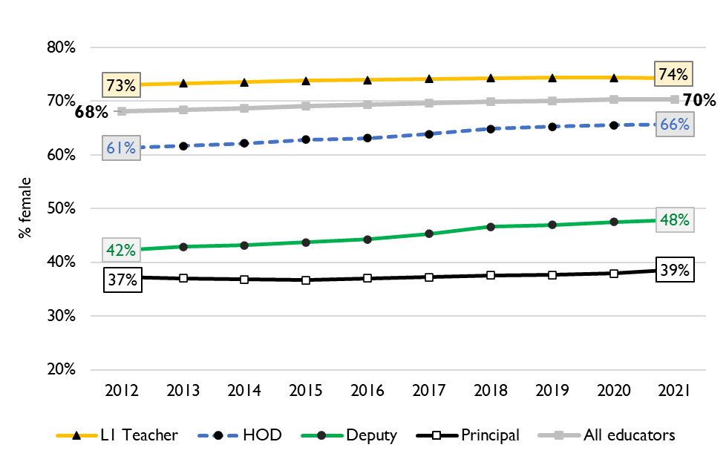
Percentage of educators that are female
9
Percentage of public educators in South Africa that are female, PERSAL (2012-2021)
Nationally, there has been very little transformation in senior school leadership in terms of gender since 2012 and even since 2004 (just 34% of principals were female).
There is better representation at middle-management (HOD) level.
Source: Using anonymised 10-year PERSAL data from 2012 to 2021, only educators of the ranks: level 1 teacher, HOD, deputy principal and principal are considered.

Slide 70
Percentage of educators that are female
9
In Limpopo in 2021, 63% of all educators were women.
Women were underrepresented at all levels of management with 50% of HODs being women. And, only 39% of deputy principals and 41% of principals.
Source: Using anonymised 10-year PERSAL data from 2012 to 2021, only educators of the ranks: level 1 teacher, HOD, deputy principal and principal are considered.

Slide 71
General questions and discussion
10
What are constraints to filling positions?
                What are the highest need subjects and phases?
                Is there a list of the positions requested by principals or positions filled? Or of educators that have left?
                Is there a mismatch of skills between unemployed educators’ skills and those needed? Are these documented?
How are the number of positions in the basket determined?
What is the process for principals and senior educator selection, induction and mentorship?
Has gender equity in school management been a concern for LP province? What prevents women from applying/being selected for senior management?

Slide 72
Conclusion
Limpopo will face an increase in demand for educators at least until 2035
Due to predicted population growth, educator numbers need to rise to keep pace with the demand for schooling, if the sector does not expand, class sizes will likely rise even further
  Increased class sizes will hurt teacher morale and worsen learner outcomes
Dues to the expected shift in age distribution, the cost structure will improve, which should give the province some space in the budget
  Hire more teachers
  Consider addressing the imbalance in management vs teacher numbers
Average appointments per year are likely to rise, sourcing new teachers (incl. graduates) and ensuring retention will become more important

