Slide 1
Mpumalanga Province 27 July 2023
Educator Demand Projections
2021-2030

Slide 2
Introduction (1)
The proportion of educators that are 50 years or older has steadily risen between 2012 to 2021 in South Africa.
⇒ Nationally a wave of educator retirements is expected as older educators reach the standard retirement age of between 60 and 65.
Implications:
Many more appointments: The retirement wave will open up both teaching & school management & leadership positions & other office-based education specialists.
Total compensation of educators: Since older teachers earn more, when retiring they are replaced with younger (less costly) teachers, although this overall benefit is offset by shift to 1.5% annual notch progression.

Slide 3
Introduction (2)
As retirements increase, the required number of new appointments will need to increase to ensure that total educator numbers (at a minimum) stay at current levels and/or are sufficient to meet learner enrolment growth to prevent deterioration in learner-educator ratios.
Planning will be required to ensure that provinces are ready for the sustained increase in appointments.
If these positions are not filled, this could result in a further deterioration in the learner-educator ratio and lead to further increases in already large class sizes.

Slide 4
Introduction (3)
Educator age distribution in 2012 & 2021
Peak in age shifted from 46 years to 53 years
Source: Anonymised PERSAL data from 2021, only educators (Rank 60 000 – 69 999) are considered. ECD practitioners, TVET lecturers and ABET teachers were removed.

Slide 6
Objective
In each province there are some differences in:
the age profile of teachers
the expected growth of the school-going population, and
expected teacher attrition (resignations & retirements)
⇒ The year of the retirement wave peak will differ across provinces.
⇒ Also some provinces need to accommodate much more growth in
learners than others.
In this presentation, we highlight the situation in
Mpumalanga to inform province-specific planning

Slide 7
Overview
Age distributions
Projected retirements & resignations
Provincial population and enrolment trends
Public and independent school growth
Educator growth: Teachers and SMT positions
The implications for appointments and class sizes
Expected financial implications to 2030
Movement of educators: Between and within provinces
Gender imbalance in school management
Discussion
1
2
3
4
5
6
7
8
9
10

Slide 8
Mpumalanga educator demand summary
Age distribution: The age distribution in the MP had a peak at around 53 years of age in 2021
Projected resignations and retirements: Before 2020, the majority of educators that exited PERSAL were resignations (ages 55 and below), whereas from 2020 onwards, the majority are age-related retirements; the number of senior educators (SMT positions and other specialists) that are retiring is expected to increase (73% were 50+ in 2021)
Enrolment and population growth: Enrolment in MP ordinary schools grew by 8% from 2012-2021 (~80K learners), and the school-aged population is forecast to grow by a further 6% (~65K learners) to 2030
School and educator growth: Between 2012 and 2021, the educator number has increased but less than enrolment (+3%), while the number of public schools has decreased (-8%), driving up the LE ratio and class sizes.
SMT position changes: In MP, the number of principals has seen a large decrease (-19%) between 2012 and 2021. Teacher numbers have increased over this period (+7%), the number of HODs has remained constant, while the number of Deputy Principals has increased slightly (+1%).
Appointments and LE Ratio: Increases in appointments are needed in response to enrolment growth; otherwise, the learner public educator ratio is in danger of worsening (increased from 27.1 to from 2012 to 2021 in MP)
Projected educator cost trends: The unit cost of educators is expected to remain constant (the unit cost of teachers is expected to increase by +1% and decline for senior educators (decline of -4%). This should free up some budget to replace and grow the educator workforce or increase the promotion rates
Educator movements: Low-moderate movements in (3.6%) and out (5.2%) of MP; educators are more likely to move to a different school than they are to leave the system.

Slide 9
Age distributions and projected retirements and resignations
1
2

Slide 10
Educator age distribution (2021)
1
Source: Anonymised PERSAL data from 2021, only educators (Rank 60 000 – 69 999) are considered. ECD practitioners, TVET lecturers and ABET teachers were removed.

Slide 11
Educator age distribution (2021)
1
Age: 53
A higher proportion of educators are over 50 years old in the MP than in the rest of the country
Source: Anonymised PERSAL data from 2021, only educators (Rank 60 000 – 69 999) are considered. ECD practitioners, TVET lecturers and ABET teachers were removed.

Slide 12
Older teacher proportions for senior and primary schools educators
1
 |  | Percentage of educators aged 50+ in 2021
Province |  | All educators |  | Senior educators (HOD, Dep.- principals, Principals & Other) |  | Primary school educators
EC |  | 51% |  | 71% |  | 58%
FS |  | 43% |  | 65% |  | 49%
GP |  | 41% |  | 65% |  | 42%
KN |  | 39% |  | 65% |  | 44%
LP |  | 58% |  | 81% |  | 63%
MP |  | 50% |  | 73% |  | 55%
NC |  | 43% |  | 69% |  | 44%
NW |  | 47% |  | 70% |  | 52%
WC |  | 42% |  | 73% |  | 40%
Source: Anonymised PERSAL data from 2021, only educators (Rank 60 000 – 69 999) are considered. ECD practitioners, TVET lecturers and ABET teachers were removed. The 2021 rankclass file was expanded to include ranks found only in years prior to 2021, used to classify educators by rank. Primary school only includes all educators that are in a component that is classified as a Primary school.

Slide 13
Older teacher proportions for senior and primary schools educators
1
 |  | Percentage of educators aged 50+ in 2021
Province |  | All educators |  | Senior educators (HOD, Dep.- principals, Principals & Other) |  | Primary school educators
EC |  | 51% |  | 71% |  | 58%
FS |  | 43% |  | 65% |  | 49%
GP |  | 41% |  | 65% |  | 42%
KN |  | 39% |  | 65% |  | 44%
LP |  | 58% |  | 81% |  | 63%
MP |  | 50% |  | 73% |  | 55%
NC |  | 43% |  | 69% |  | 44%
NW |  | 47% |  | 70% |  | 52%
WC |  | 42% |  | 73% |  | 40%
zvc
Large numbers of senior educator positions (73%) were aged 50 years and older in 2021 in MP
zvc
Source: Anonymised PERSAL data from 2021, only educators (Rank 60 000 – 69 999) are considered. ECD practitioners, TVET lecturers and ABET teachers were removed. The 2021 rankclass file was expanded to include ranks found only in years prior to 2021, used to classify educators by rank. Primary school only includes all educators that are in a component that is classified as a Primary school.

Slide 14
Educator age distribution in 2021 & 2030
1
Assume constant 2021 educator numbers
2021
2030
Source: Anonymised PERSAL data from 2021, only educators (Rank 60 000 – 69 999) are considered. ECD practitioners, TVET lecturers and ABET teachers were removed.

Slide 15
Educator age distribution in 2021 & 2030
1
Assume constant 2021 educator numbers
A flatter age distribution is expected in 2030, with higher proportion of younger educators
2021
2030
Source: Anonymised PERSAL data from 2021, only educators (Rank 60 000 – 69 999) are considered. ECD practitioners, TVET lecturers and ABET teachers were removed.

Slide 16
Projected resignation & retirements (MP)
2
Assume constant 2021 educator numbers
Proportion of Educators
About half of the educators that are projected to exit PERSAL in Mpumalanga are retirees (ages 56 to 65)
The resignation rate in Mpumalanga is low. Few middle-aged educators opt to leave teaching before retirement
The number of young teachers (ages 21-30) resigning is projected to increase slightly as the number of newly hired young teachers increases.
Projected
% of educators resigning or retiring
Source: Anonymised 10-year PERSAL data, only educators (Rank 60 000 – 69 999) are considered. ECD practitioners, TVET lecturers and ABET teachers were removed. Estimates to 2035 derived from the National and provincial models – assumption of no growth in educator numbers.

Slide 17
Projected resignation & retirements (MP)
2
Assume constant 2021 educator numbers
Retirement headcount
The number of retirements is projected to increase, peaking in ~2029 and then declining again
The number of retirements is projected to increase from about 1,150 in 2022 to about 1,650 in 2028, an increase of about 500 retirements annually
Projected
Number of retirements
Source: Anonymised 2021 PERSAL data, only educators (Rank 60 000 – 69 999) are considered. ECD practitioners, TVET lecturers and ABET teachers were removed. Estimates to 2035 derived from the National and provincial models – assumption of no growth in educator numbers.

Slide 18
Older leaver trend estimates to 2035
2
Assume constant 2021 educator numbers
About ~20,000
educators estimated to retire by 2035 in the MP
(57% of total educators in 2021)
Source: Anonymised 2021 PERSAL data, only educators (Rank 60 000 – 69 999) are considered. ECD practitioners, TVET lecturers and ABET teachers were removed. Estimates to 2035 derived from the National and provincial models – assumption of no growth in educator numbers.

Slide 19
Projected educators leaving
2
Assume constant 2021 educator numbers
Teachers
(School based teachers)
Senior educators
(HODs, Deputy’s, Principals & Other)
% of teacher resigning & retiring
% of senior educators resigning & retiring
A similar proportion of teachers are expected to resign and retire in MP as the SA average (~6-7%)
Careful succession planning is needed during this period as high numbers of HODs, deputies and principals will be retiring by 2034
Source: Anonymised 2021 PERSAL data, only educators (Rank 60 000 – 69 999) are considered. ECD practitioners, TVET lecturers and ABET teachers were removed. Estimates to 2035 derived from the National and provincial models – assumption of no growth in educator numbers.

Slide 20
Provincial population and enrolment trends
3

Slide 21
Provincial enrolment trends (2012-2021)
3
High growth
Moderate growth
Stable
Decline
Source: Enrolment numbers taken from School Realities-EMIS (2012 – 2021) released by the DBE, using total numbers for ordinary public and independent schools.

Slide 22
Provincial enrolment trends (2012-2021)
3
Enrolment in Mpumalanga ordinary schools
grew by 8%
from 2012 to 2021
Source: Enrolment numbers taken from School Realities-EMIS (2012 – 2021) released by the DBE, using total numbers for ordinary public and independent schools.

Slide 23
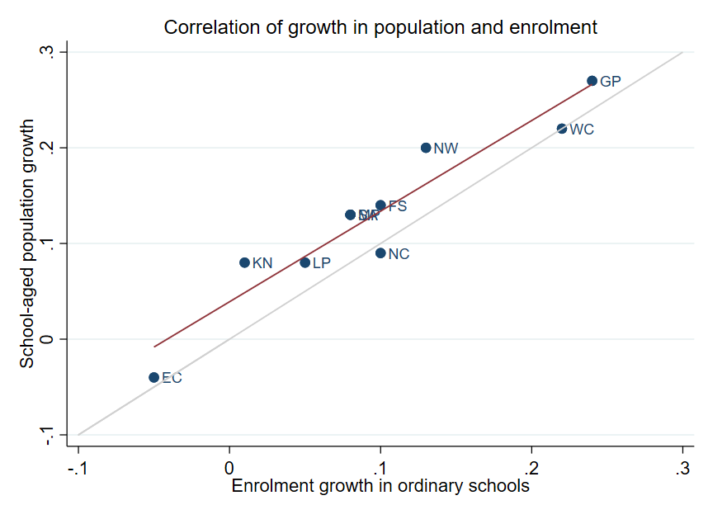
Correlation between population and enrolment growth (2012-2021)
3
R² = 0.9025
Strong positive correlation between population and enrolment growth between 2012 and 2021
45˚
Source: Thembisa age specific data V4.5 for school-aged population (Ages 7-18) estimates and enrolment taken from School Realities-EMIS (2012 – 2021) released by the DBE, for numbers on ordinary public and independent schools (Statistical Publications (education.gov.za))

Slide 24
Projected growth in school-aged population
3
Population of children aged 7-18 in Mpumalang is expected to grow by
~65K children (6%)
from 2021 to 2030
Note: Period 2021 – 2030 is the same timeframe, nine years, as 2012 – 2021.
Source: Thembisa age-specific estimates from the model V4.5 for children aged 7-18 by province

Slide 25
School aged-population estimates to 2030
3
 | Number of children Aged 7-18 |  |  |  | Growth '12-21 | Growth '21-30
Province | 2012 | 2021 | 2030E
EC | 1 657 202 | 1 598 475 | 1 361 637 |  | -4% | -15%
FS | 592 445 | 676 489 | 650 820 |  | 14% | -4%
GP | 1 962 793 | 2 498 533 | 3 180 884 |  | 27% | 27%
KN | 2 485 822 | 2 690 378 | 2 657 716 |  | 8% | -1%
LP | 1 395 864 | 1 507 386 | 1 612 125 |  | 8% | 7%
MP | 977 749 | 1 100 594 | 1 165 728 |  | 13% | 6%
NC | 254 075 | 277 560 | 281 208 |  | 9% | 1%
NW | 742 943 | 893 530 | 930 323 |  | 20% | 4%
WC | 1 068 009 | 1 298 801 | 1 496 731 |  | 22% | 15%
Total | 11 136 902 | 12 541 746 | 13 337 172 |  | 13% | 6%
1,10M
1,17M
0.98M
Note: Period 2021 – 2030 is the same timeframe, nine years, as 2012 – 2021.
Source: Thembisa age-specific estimates from the model V4.5 for children aged 7-18 by province

Slide 26
Public and independent school growth
4

Slide 27
Educator, school and enrolment growth
4
 | % growth from 2012 - 2021
Province | Number of educators | Number of teachers |  | Number of public ordinary schools | Enrolment in public ordinary schools | Enrolment in ordinary schools |  | Est. school-aged population
EC | -17% | -20% |  | -8% | -6% | -5% |  | -4%
FS | -13% | -13% |  | -27% | 9% | 10% |  | 14%
GP | 21% | 28% |  | 1% | 20% | 24% |  | 27%
KN | -5% | -3% |  | -3% | 1% | 1% |  | 8%
LP | -8% | -2% |  | -7% | 4% | 5% |  | 8%
MP | 3% | 7% |  | -8% | 7% | 8% |  | 13%
NC | 6% | 9% |  | -3% | 9% | 10% |  | 9%
NW | 2% | 4% |  | -9% | 12% | 13% |  | 20%
WC | 12% | 22% |  | 0% | 21% | 22% |  | 22%
SA | -1% | 2% |  | -6% | 7% | 8% |  | 13%
Source: Educator numbers from anonymised PERSAL data from 2012 and 2021, only educators (Rank 60 000 – 69 999) are considered. Thembisa age specific data V4.5 for school-aged population (Ages 7-18) estimates and enrolment and school numbers taken from School Realities-EMIS (2012 – 2021) released by the DBE, for numbers on ordinary public and independent schools (Statistical Publications (education.gov.za))

Slide 28
Educator, school and enrolment growth
4
 | % growth from 2012 - 2021
Province | Number of educators | Number of teachers |  | Number of public ordinary schools | Enrolment in public ordinary schools | Enrolment in ordinary schools |  | Est. school-aged population
EC | -17% | -20% |  | -8% | -6% | -5% |  | -4%
FS | -13% | -13% |  | -27% | 9% | 10% |  | 14%
GP | 21% | 28% |  | 1% | 20% | 24% |  | 27%
KN | -5% | -3% |  | -3% | 1% | 1% |  | 8%
LP | -8% | -2% |  | -7% | 4% | 5% |  | 8%
MP | 3% | 7% |  | -8% | 7% | 8% |  | 13%
NC | 6% | 9% |  | -3% | 9% | 10% |  | 9%
NW | 2% | 4% |  | -9% | 12% | 13% |  | 20%
WC | 12% | 22% |  | 0% | 21% | 22% |  | 22%
SA | -1% | 2% |  | -6% | 7% | 8% |  | 13%
z
Enrolment and educator numbers grew in Mpumalanga, whilst the number of public ordinary schools declined….
z
Source: Educator numbers from anonymised PERSAL data from 2012 and 2021, only educators (Rank 60 000 – 69 999) are considered. Thembisa age specific data V4.5 for school-aged population (Ages 7-18) estimates and enrolment and school numbers taken from School Realities-EMIS (2012 – 2021) released by the DBE, for numbers on ordinary public and independent schools (Statistical Publications (education.gov.za))

Slide 29
School growth from 2012 to 2021
4
School growth was driven by independent school growth (+37%) from 2012 to 2021. In contrast, the number of public schools in SA decreased (-6%)
EC | FS | GP | KN | LP | MP | NC | NW | WC | SA
% independent schools (2021)
4%
8%
30%
4%
5%
7%
7%
6%
17%
9%
Source: School numbers taken from School Realities-EMIS (2012 – 2021) released by the DBE, for numbers on ordinary public and independent schools (Statistical Publications (education.gov.za))

Slide 30
School growth from 2012 to 2021
4
Higher growth in the number of independent schools in MP (+16%) vs. public (-8%), with enrolment growing from about 27K to 34K children (+25%)
EC | FS | GP | KN | LP | MP | NC | NW | WC | SA
% independent schools (2021)
4%
8%
30%
4%
5%
7%
7%
6%
17%
9%
Source: School numbers taken from School Realities-EMIS (2012 – 2021) released by the DBE, for numbers on ordinary public and independent schools (Statistical Publications (education.gov.za))

Slide 31
Educator growth by teachers and senior educator positions
5

Slide 32
Changes in teacher and SMT numbers
5
 |  | Teacher |  |  |  |  | HOD |  |  |  |  | Deputy-Principal |  |  |  |  | Principal
Province |  | 2012 | 2021 | Diff | % change |  | 2012 | 2021 | Diff | % change |  | 2012 | 2021 | Diff | % change |  | 2012 | 2021 | Diff | % change
EC |  | 50 295 | 40 115 | -10 180 | -20% |  | 5 870 | 6 196 | 326 | 6% |  | 1 342 | 1 453 | 111 | 8% |  | 5 294 | 4 755 | - 539 | -10%
FS |  | 20 148 | 17 561 | -2 587 | -13% |  | 2 685 | 2 470 | - 215 | -8% |  | 852 | 768 | - 84 | -10% |  | 1 224 | 892 | - 332 | -27%
GP |  | 47 233 | 60 677 | 13 444 | 28% |  | 8 708 | 9 209 | 501 | 6% |  | 2 565 | 2 850 | 285 | 11% |  | 2 162 | 1 959 | - 203 | -9%
KN |  | 73 050 | 71 000 | -2 050 | -3% |  | 11 289 | 10 330 | - 959 | -8% |  | 2 642 | 2 342 | - 300 | -11% |  | 5 584 | 5 055 | - 529 | -9%
LP |  | 44 998 | 44 317 | - 681 | -2% |  | 6 090 | 3 762 | -2 328 | -38% |  | 1 562 | 778 | - 784 | -50% |  | 3 510 | 3 316 | - 194 | -6%
MP |  | 26 127 | 27 857 | 1 730 | 7% |  | 4 047 | 4 055 | 8 | 0% |  | 1 108 | 1 114 | 6 | 1% |  | 1 790 | 1 450 | - 340 | -19%
NC |  | 7 257 | 7 929 | 672 | 9% |  | 1 034 | 1 094 | 60 | 6% |  | 294 | 365 | 71 | 24% |  | 587 | 488 | - 99 | -17%
NW |  | 21 305 | 22 261 | 956 | 4% |  | 2 994 | 3 023 | 29 | 1% |  | 902 | 1 041 | 139 | 15% |  | 1 698 | 1 338 | - 360 | -21%
WC |  | 23 579 | 28 665 | 5 086 | 22% |  | 4 065 | 3 700 | - 365 | -9% |  | 1 334 | 1 297 | - 37 | -3% |  | 1 531 | 1 339 | - 192 | -13%
SA |  | 313 992 | 320 382 | 6 390 | 2% |  | 46 782 | 43 839 | -2 943 | -6% |  | 12 601 | 12 008 | - 593 | -5% |  | 23 380 | 20 592 | -2 788 | -12%
Source: Anonymised PERSAL data from 2012 and 2021, only educators (Rank 60 000 – 69 999) are considered. ECD practitioners, TVET lecturers, and ABET teachers were removed. The 2021 rankclass file was expanded to include ranks found only in years prior to 2021.

Slide 33
Changes in teacher and SMT numbers
5
 |  | Teacher |  |  |  |  | HOD |  |  |  |  | Deputy-Principal |  |  |  |  | Principal
Province |  | 2012 | 2021 | Diff | % change |  | 2012 | 2021 | Diff | % change |  | 2012 | 2021 | Diff | % change |  | 2012 | 2021 | Diff | % change
EC |  | 50 295 | 40 115 | -10 180 | -20% |  | 5 870 | 6 196 | 326 | 6% |  | 1 342 | 1 453 | 111 | 8% |  | 5 294 | 4 755 | - 539 | -10%
FS |  | 20 148 | 17 561 | -2 587 | -13% |  | 2 685 | 2 470 | - 215 | -8% |  | 852 | 768 | - 84 | -10% |  | 1 224 | 892 | - 332 | -27%
GP |  | 47 233 | 60 677 | 13 444 | 28% |  | 8 708 | 9 209 | 501 | 6% |  | 2 565 | 2 850 | 285 | 11% |  | 2 162 | 1 959 | - 203 | -9%
KN |  | 73 050 | 71 000 | -2 050 | -3% |  | 11 289 | 10 330 | - 959 | -8% |  | 2 642 | 2 342 | - 300 | -11% |  | 5 584 | 5 055 | - 529 | -9%
LP |  | 44 998 | 44 317 | - 681 | -2% |  | 6 090 | 3 762 | -2 328 | -38% |  | 1 562 | 778 | - 784 | -50% |  | 3 510 | 3 316 | - 194 | -6%
MP |  | 26 127 | 27 857 | 1 730 | 7% |  | 4 047 | 4 055 | 8 | 0% |  | 1 108 | 1 114 | 6 | 1% |  | 1 790 | 1 450 | - 340 | -19%
NC |  | 7 257 | 7 929 | 672 | 9% |  | 1 034 | 1 094 | 60 | 6% |  | 294 | 365 | 71 | 24% |  | 587 | 488 | - 99 | -17%
NW |  | 21 305 | 22 261 | 956 | 4% |  | 2 994 | 3 023 | 29 | 1% |  | 902 | 1 041 | 139 | 15% |  | 1 698 | 1 338 | - 360 | -21%
WC |  | 23 579 | 28 665 | 5 086 | 22% |  | 4 065 | 3 700 | - 365 | -9% |  | 1 334 | 1 297 | - 37 | -3% |  | 1 531 | 1 339 | - 192 | -13%
SA |  | 313 992 | 320 382 | 6 390 | 2% |  | 46 782 | 43 839 | -2 943 | -6% |  | 12 601 | 12 008 | - 593 | -5% |  | 23 380 | 20 592 | -2 788 | -12%
zvc
Teacher numbers increased by same amount as enrolment growth in public ordinary schools (+7%)
Large decline in principal numbers between 2012 and 2021, compared to public school closures (-8%)
zvc
Source: Anonymised PERSAL data from 2012 and 2021, only educators (Rank 60 000 – 69 999) are considered. ECD practitioners, TVET lecturers, and ABET teachers were removed. The 2021 rankclass file was expanded to include ranks found only in years prior to 2021.

Slide 34
Proportional split by educator rank
5
 | All Educators |  |  | Teacher |  |  | HOD |  |  | Dep.-Principal |  |  | Principal |  |  | Other
 | 2012 | 2021 |  | 2012 | 2021 |  | 2012 | 2021 |  | 2012 | 2021 |  | 2012 | 2021 |  | 2012 | 2021
EC | 100% | 100% |  | 78% | 75% |  | 9% | 12% |  | 2.1% | 2.7% |  | 8.2% | 8.8% |  | 2.5% | 2.4%
FS | 100% | 100% |  | 78% | 78% |  | 10% | 11% |  | 3.3% | 3.4% |  | 4.7% | 4.0% |  | 3.7% | 3.3%
GP | 100% | 100% |  | 74% | 79% |  | 14% | 12% |  | 4.0% | 3.7% |  | 3.4% | 2.6% |  | 4.4% | 2.7%
KN | 100% | 100% |  | 77% | 79% |  | 12% | 11% |  | 2.8% | 2.6% |  | 5.9% | 5.6% |  | 2.1% | 1.3%
LP | 100% | 100% |  | 78% | 84% |  | 11% | 7% |  | 2.7% | 1.5% |  | 6.1% | 6.3% |  | 2.1% | 1.5%
MP | 100% | 100% |  | 76% | 79% |  | 12% | 12% |  | 3.2% | 3.2% |  | 5.2% | 4.1% |  | 3.2% | 1.8%
NC | 100% | 100% |  | 75% | 77% |  | 11% | 11% |  | 3.0% | 3.6% |  | 6.1% | 4.8% |  | 5.1% | 3.9%
NW | 100% | 100% |  | 76% | 78% |  | 11% | 11% |  | 3.2% | 3.7% |  | 6.1% | 4.7% |  | 3.7% | 2.6%
WC | 100% | 100% |  | 74% | 80% |  | 13% | 10% |  | 4.2% | 3.6% |  | 4.8% | 3.7% |  | 4.1% | 2.1%
SA | 100% | 100% |  | 77% | 79% |  | 11% | 11% |  | 3.1% | 3.0% |  | 5.7% | 5.1% |  | 3.1% | 2.1%
Source: Anonymised PERSAL data from 2012 and 2021. Only educators are considered. ECD practitioners, examination reviewers, ABET teachers and TVET lecturers were removed. Arrow shown for teachers and HODs if difference is at least 3 percentage points, for deputy principals if the difference is at least 0.6 percentage points and for principals a difference of at least 0.8 percentage points.

Slide 35
Proportional split by educator rank
5
 | All Educators |  |  | Teacher |  |  | HOD |  |  | Dep.-Principal |  |  | Principal |  |  | Other
 | 2012 | 2021 |  | 2012 | 2021 |  | 2012 | 2021 |  | 2012 | 2021 |  | 2012 | 2021 |  | 2012 | 2021
EC | 100% | 100% |  | 78% | 75% |  | 9% | 12% |  | 2.1% | 2.7% |  | 8.2% | 8.8% |  | 2.5% | 2.4%
FS | 100% | 100% |  | 78% | 78% |  | 10% | 11% |  | 3.3% | 3.4% |  | 4.7% | 4.0% |  | 3.7% | 3.3%
GP | 100% | 100% |  | 74% | 79% |  | 14% | 12% |  | 4.0% | 3.7% |  | 3.4% | 2.6% |  | 4.4% | 2.7%
KN | 100% | 100% |  | 77% | 79% |  | 12% | 11% |  | 2.8% | 2.6% |  | 5.9% | 5.6% |  | 2.1% | 1.3%
LP | 100% | 100% |  | 78% | 84% |  | 11% | 7% |  | 2.7% | 1.5% |  | 6.1% | 6.3% |  | 2.1% | 1.5%
MP | 100% | 100% |  | 76% | 79% |  | 12% | 12% |  | 3.2% | 3.2% |  | 5.2% | 4.1% |  | 3.2% | 1.8%
NC | 100% | 100% |  | 75% | 77% |  | 11% | 11% |  | 3.0% | 3.6% |  | 6.1% | 4.8% |  | 5.1% | 3.9%
NW | 100% | 100% |  | 76% | 78% |  | 11% | 11% |  | 3.2% | 3.7% |  | 6.1% | 4.7% |  | 3.7% | 2.6%
WC | 100% | 100% |  | 74% | 80% |  | 13% | 10% |  | 4.2% | 3.6% |  | 4.8% | 3.7% |  | 4.1% | 2.1%
SA | 100% | 100% |  | 77% | 79% |  | 11% | 11% |  | 3.1% | 3.0% |  | 5.7% | 5.1% |  | 3.1% | 2.1%
zvc
The portions of the different educator ranks in the Mpumalanga appear to be roughly in line with the national average in 2021
zvc
Source: Anonymised PERSAL data from 2012 and 2021. Only educators are considered. ECD practitioners, examination reviewers, ABET teachers and TVET lecturers were removed. Arrow shown for teachers and HODs if difference is at least 3 percentage points, for deputy principals if the difference is at least 0.6 percentage points and for principals a difference of at least 0.8 percentage points.

Slide 36
Implications for appointments and class sizes
6

Slide 37
Projected increase in appointments
6
Increase in expected annual appointments over the period of ~750 from 2028 – 2030, mostly due to an increase in the number of retirements
Alternative sources of teacher supply may need to be considered eg. Working with universities, hiring teachers that would traditionally have sought work in other provinces
~750
Additional educators will
need to be appointed
annually
~2 850
educators
2 079
educators
Mean number of annual joiners over the period 2012 - 2021
Projected mean number of annual leavers from 2028 – 2030

Slide 38
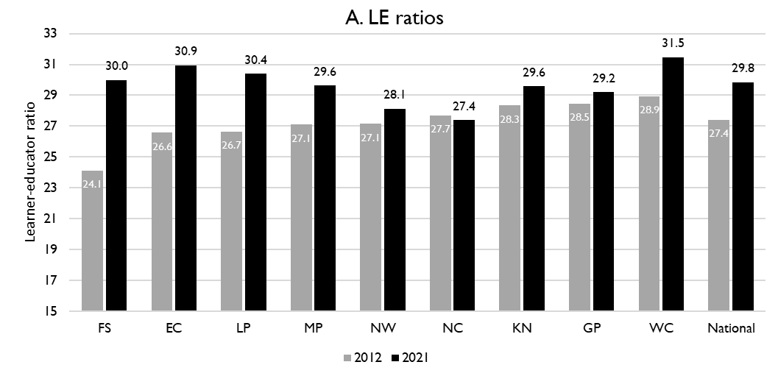
Learner-public educator ratios (‘12 & ’21)
6
National and provincial learner-to-public-educator ratios in 2012 and 2021, grades 1 to 12 in public ordinary schools in South Africa
z
z
LE ratio rose from 27.1 learners per educator to 29.6 learners per educator in Mpumalanga between 2012 and 2021
Excl. SGB teachers
Source: Figure 1 in South African teacher shortages as revealed through class sizes and learner-educator ratios: An exploratory analysis by Gabrielle Wills (2023)

Slide 39
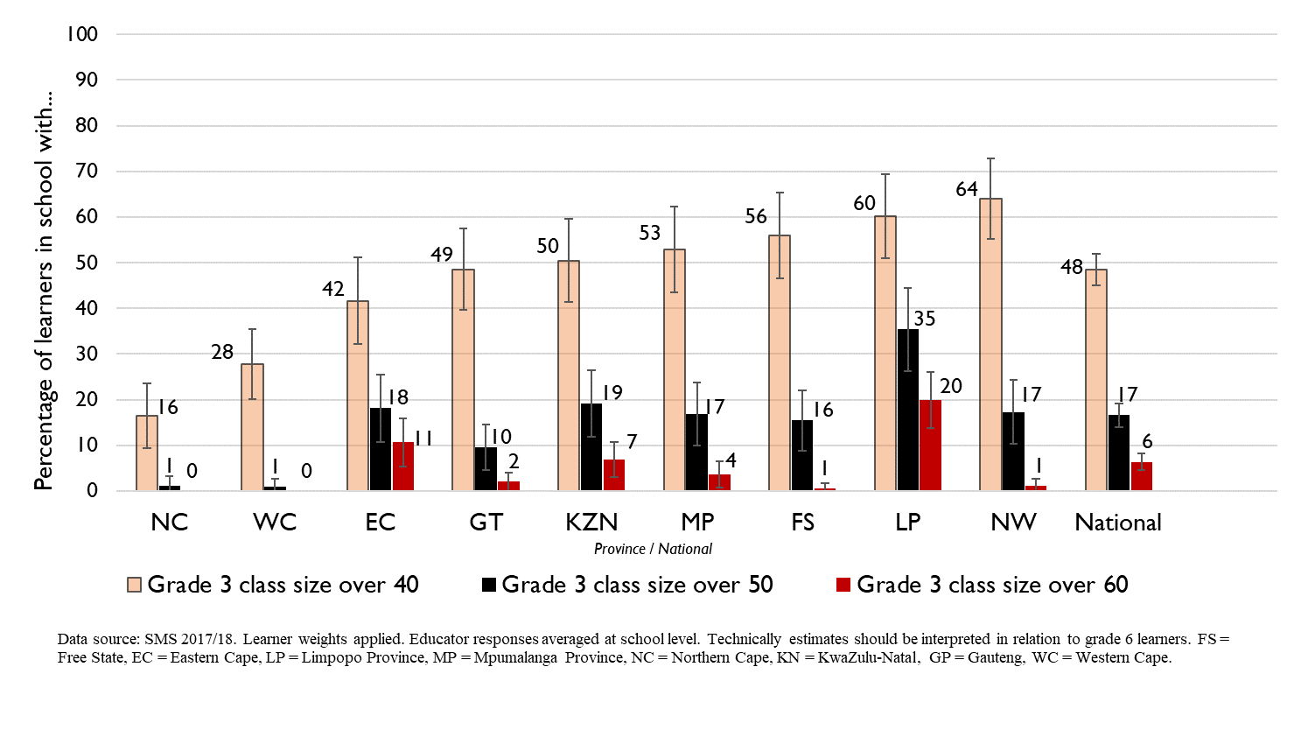
Grade 3 class sizes
(2017/18 School Monitoring Survey)
6
Post-provisioning guidelines - Class sizes should not exceed 35 in Grade 3.
% of learners in grade 3 classes > 40:
48% in SA, 53% in MP
% of learners in grade 3 classes > 50:
17% in SA, ~17% in MP
% of learners in grade 3 classes > 60:
6% in SA, ~4% in MP
Note: Nationally, grade 3 enrolment numbers had been rising from about 2011 and peaked in 2017 before starting to decline slightly, stabilising at about 1,1 million in 2021 (Gustafsson 2022a, p10-11). Holding other things constant, grade 3 class sizes will be similar or slightly smaller in 2022 than what is seen in these 2017/18 SMS estimates.

Slide 40
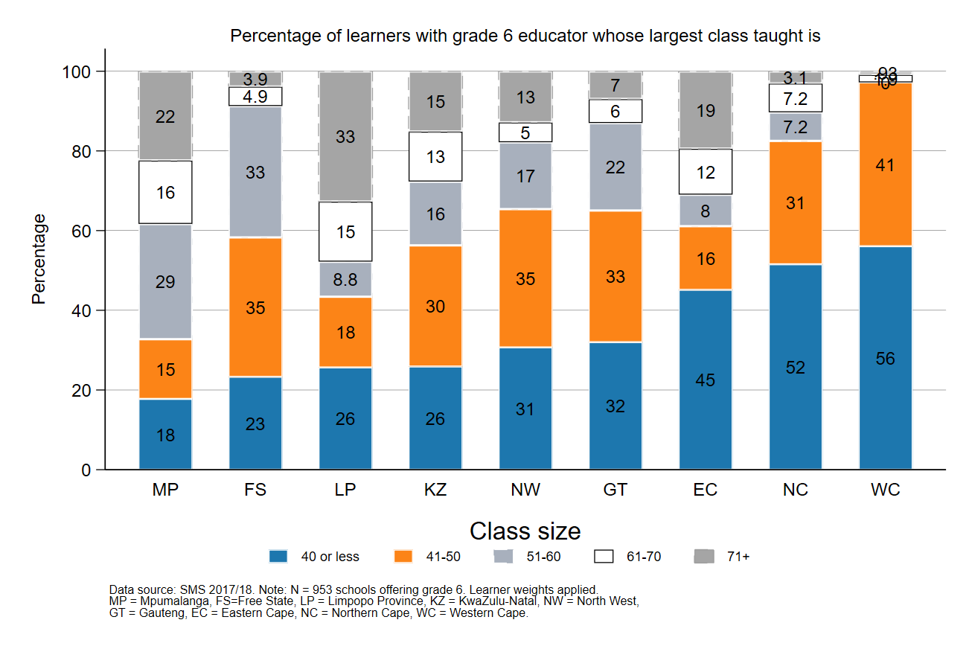
Largest classes - School Monitoring Survey 2017/18
6
In 2017/18, MP was the province with the second highest proportion (38%) of Gr6 learners in schools with very large classes (>60 learners)
A further deterioration of the LE ratio will drive up class size and the number of excessively large classes, negatively impacting quality and teacher motivation
Percentage of grade 6 learners in schools with an educator reporting that their largest class is in the following class size category, disaggregated by province (SMS 2017/18)
Source: Figure 1 in South African teacher shortages as revealed through class sizes and learner-educator ratios: An exploratory analysis by Gabrielle Wills (2023) using School Monitoring Survey 2017/18 (953 schools, learner weighted).

Slide 41
Expected financial implications to 2030
7

Slide 42
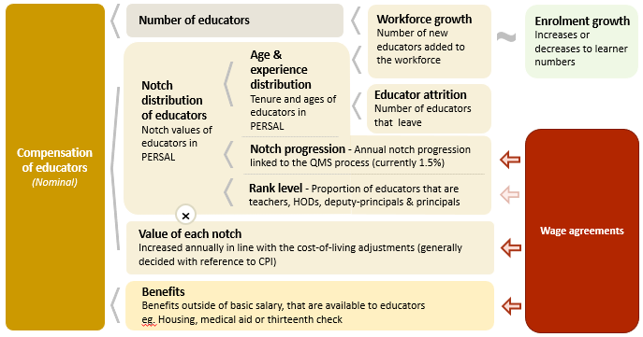
Unit cost drivers
7

Slide 43
Real and nominal costs
7
Examples:
In 2022 CPI was 7.2%
If nominal wages increase by 7.2%, then real wages increase by 0%
If nominal wages increase by 9%, then real wages increase by 1.8%
If nominal wages increase by 5%, then real wages decrease by 2.2%
A real increase in wages takes place when wages increase above the rate of inflation
Changes to real wages are an indicator of purchasing power

Slide 44
Projected unit costs trends| All educators
7
In constant 2021 rands
Note: Scale not from zero
Source: Own calculations, using the anonymised PERSAL data from 2021, only educators are considered. ECD practitioners and examination reviewers removed. Estimates to 2030 derived from the national and provincial TSD models. Assumption of no growth in educator numbers.

Slide 45
Indexed unit costs trends| All educators
7
In constant 2021 rands
GP: 1% increase
Educator unit cost
(Index in 2022 = 100%)
WC: ~1.5% decrease
Note: Scale not from zero
Source: Own calculations, using the anonymised PERSAL data from 2021, only educators are considered. ECD practitioners and examination reviewers removed. Estimates to 2030 derived from the national and provincial TSD models. Assumption of no growth in educator numbers for FS, KN, LP, MP, NC, NW and SA. Assume 20% educator growth for GP, 10% for WC and a decline in 10% of educators in the EC. In LP assume that the proportion of senior educators grows from 16% in 2021 to 21% in 2030.

Slide 46
Indexed unit costs trends| All educators
7
In constant 2021 rands
MP: No change in real cost from
2022 - 2030
Educator unit cost
(Index in 2022 = 100%)
Note: Scale not from zero
Source: Own calculations, using the anonymised PERSAL data from 2021, only educators are considered. ECD practitioners and examination reviewers removed. Estimates to 2030 derived from the national and provincial TSD models. Assumption of no growth in educator numbers for FS, KN, LP, MP, NC, NW and SA. Assume 20% educator growth for GP, 10% for WC and a decline in 10% of educators in the EC. In LP assume that the proportion of senior educators grows from 16% in 2021 to 21% in 2030.

Slide 47
Projected unit costs trends| All educators
7
In constant 2021 rands
Teachers
(School based teachers)
Senior educators
(HODs, Deputy’s, Principals & Other)
-4%
+1%
Average annual unit cost
(In 2021 Rands)
Note: Scale not from zero
Source: Own calculations, using the anonymised PERSAL data from 2021, only educators are considered. ECD practitioners and examination reviewers removed. Estimates to 2030 derived from the national and provincial TSD models. Assumption of no growth in educator numbers for FS, KN, LP, MP, NC, NW and SA. Assume 20% educator growth for GP, 10% for WC and a decline in 10% of educators in the EC. In LP assume that the proportion of senior educators grows from 16% in 2021 to 21% in 2030.

Slide 48
Gender imbalances in management
9

Slide 49
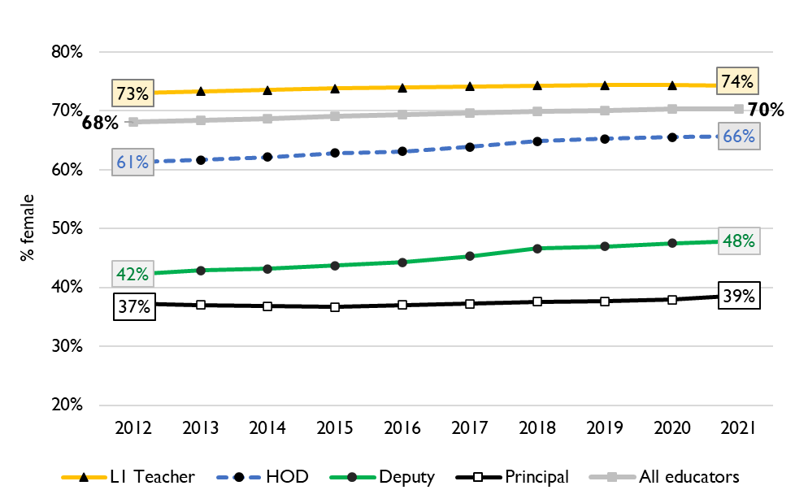
Percentage of educators that are female
9
Percentage of public educators in South Africa that are female, PERSAL (2012-2021)
Nationally, there has been very little transformation in senior school leadership in terms of gender since 2012 and even since 2004 (just 34% of principals were female).
There is better representation at middle-management (HOD) level.
Source: Using anonymised 10-year PERSAL data from 2012 to 2021, only educators of the ranks: level 1 teacher, HOD, deputy principal and principal are considered.

Slide 50
Percentage of educators that are female
9
In Mpumalanga in 2021, 68% of all educators were women. Women were reasonably represented at the HOD level at 60% of HODs.
Yet only 46% of deputy principals and 36% of principals were women.
Source: Using anonymised 10-year PERSAL data from 2012 to 2021, only educators of the ranks: level 1 teacher, HOD, deputy principal and principal are considered.

Slide 51
Between and within province movement
8

Slide 52
Inter-provincial educator movement (7-yr)
8
 |  | Province in 2019 |  |  |  |  |  |  |  |  |  |  | Movement out of province
 |  | EC | FS | GP | KN | LP | MP | NC | NW | WC | Total
Province in 2012 | EC | 97.79 | 0.10 | 0.86 | 0.22 | 0.01 | 0.04 | 0.11 | 0.19 | 0.70 | 100 |  | 2.23%
 | FS | 0.35 | 94.25 | 2.76 | 0.10 | 0.07 | 0.23 | 0.41 | 1.56 | 0.26 | 100 |  | 5.74%
 | GP | 0.15 | 0.26 | 96.86 | 0.27 | 0.81 | 0.42 | 0.05 | 0.93 | 0.24 | 100 |  | 3.13%
 | KN | 0.22 | 0.10 | 1.14 | 97.95 | 0.10 | 0.37 | 0.01 | 0.06 | 0.04 | 100 |  | 2.04%
 | LP | 0.02 | 0.02 | 1.72 | 0.02 | 96.80 | 0.80 | 0.05 | 0.56 | 0.02 | 100 |  | 3.21%
 | MP | 0.03 | 0.14 | 2.48 | 0.37 | 1.54 | 94.86 | 0.03 | 0.49 | 0.07 | 100 |  | 5.15%
 | NC | 0.47 | 0.50 | 0.47 | 0.06 | 0.59 | 0.03 | 94.35 | 2.37 | 1.15 | 100 |  | 5.64%
 | NW | 0.06 | 0.59 | 3.84 | 0.03 | 0.65 | 0.34 | 0.75 | 93.60 | 0.14 | 100 |  | 6.40%
 | WC | 0.72 | 0.03 | 0.17 | 0.05 | 0.00 | 0.02 | 0.35 | 0.03 | 98.61 | 100 |  | 1.37%
Source: PERSAL 10-year anonymised dataset, only educators that were in the dataset for 2012 and 2019 are considered here

Slide 53
Inter-provincial educator movement (7-yr)
8
 |  | Province in 2019 |  |  |  |  |  |  |  |  |  |  | Movement out of province
 |  | EC | FS | GP | KN | LP | MP | NC | NW | WC | Total
Province in 2012 | EC | 97.79 | 0.10 | 0.86 | 0.22 | 0.01 | 0.04 | 0.11 | 0.19 | 0.70 | 100 |  | 2.23%
 | FS | 0.35 | 94.25 | 2.76 | 0.10 | 0.07 | 0.23 | 0.41 | 1.56 | 0.26 | 100 |  | 5.74%
 | GP | 0.15 | 0.26 | 96.86 | 0.27 | 0.81 | 0.42 | 0.05 | 0.93 | 0.24 | 100 |  | 3.13%
 | KN | 0.22 | 0.10 | 1.14 | 97.95 | 0.10 | 0.37 | 0.01 | 0.06 | 0.04 | 100 |  | 2.04%
 | LP | 0.02 | 0.02 | 1.72 | 0.02 | 96.80 | 0.80 | 0.05 | 0.56 | 0.02 | 100 |  | 3.21%
 | MP | 0.03 | 0.14 | 2.48 | 0.37 | 1.54 | 94.86 | 0.03 | 0.49 | 0.07 | 100 |  | 5.15%
 | NC | 0.47 | 0.50 | 0.47 | 0.06 | 0.59 | 0.03 | 94.35 | 2.37 | 1.15 | 100 |  | 5.64%
 | NW | 0.06 | 0.59 | 3.84 | 0.03 | 0.65 | 0.34 | 0.75 | 93.60 | 0.14 | 100 |  | 6.40%
 | WC | 0.72 | 0.03 | 0.17 | 0.05 | 0.00 | 0.02 | 0.35 | 0.03 | 98.61 | 100 |  | 1.37%
Moderate levels of movement out of Mpumalanga – about 5.15% of Mpumalanga teachers in 2012 are teaching in a different province in 2019
Educators are most likely to move to Gauteng and Limpopo
zvc
zvc
Source: PERSAL 10-year anonymised dataset, only educators that were in the dataset for 2012 and 2019 are considered here

Slide 54
Inter-provincial educator movement (7-yr)
8
 |  | Province in 2019
 |  | EC | FS | GP | KN | LP | MP | NC | NW | WC
Province in 2012 | EC | 42 645 | 42 | 373 | 95 | 5 | 16 | 46 | 82 | 304
 | FS | 57 | 15 267 | 447 | 17 | 11 | 38 | 67 | 252 | 42
 | GP | 67 | 117 | 42 770 | 121 | 356 | 187 | 20 | 409 | 108
 | KN | 146 | 67 | 755 | 64 723 | 64 | 247 | 9 | 37 | 26
 | LP | 10 | 10 | 709 | 7 | 39 899 | 328 | 20 | 230 | 7
 | MP | 7 | 34 | 618 | 94 | 385 | 23 644 | 7 | 121 | 17
 | NC | 31 | 33 | 31 | 4 | 39 | 2 | 6 214 | 156 | 76
 | NW | 12 | 111 | 726 | 5 | 123 | 65 | 141 | 17 690 | 27
 | WC | 152 | 7 | 37 | 11 | 0 | 5 | 75 | 6 | 20 858
 | Total 2019 | 43 127 | 15 688 | 46 466 | 65 077 | 40 882 | 24 532 | 6 599 | 18 983 | 21 465
 | Movement into province | 482 | 421 | 3 696 | 354 | 983 | 888 | 385 | 1 293 | 607
 | % movement into province | 1.1% | 2.7% | 8.0% | 0.5% | 2.4% | 3.6% | 5.8% | 6.8% | 2.8%
Source: PERSAL 10-year anonymised dataset, only educators that were in the dataset for 2012 and 2019 are considered here

Slide 55
Inter-provincial educator movement (7-yr)
8
 |  | Province in 2019
 |  | EC | FS | GP | KN | LP | MP | NC | NW | WC
Province in 2012 | EC | 42 645 | 42 | 373 | 95 | 5 | 16 | 46 | 82 | 304
 | FS | 57 | 15 267 | 447 | 17 | 11 | 38 | 67 | 252 | 42
 | GP | 67 | 117 | 42 770 | 121 | 356 | 187 | 20 | 409 | 108
 | KN | 146 | 67 | 755 | 64 723 | 64 | 247 | 9 | 37 | 26
 | LP | 10 | 10 | 709 | 7 | 39 899 | 328 | 20 | 230 | 7
 | MP | 7 | 34 | 618 | 94 | 385 | 23 644 | 7 | 121 | 17
 | NC | 31 | 33 | 31 | 4 | 39 | 2 | 6 214 | 156 | 76
 | NW | 12 | 111 | 726 | 5 | 123 | 65 | 141 | 17 690 | 27
 | WC | 152 | 7 | 37 | 11 | 0 | 5 | 75 | 6 | 20 858
 | Total 2019 | 43 127 | 15 688 | 46 466 | 65 077 | 40 882 | 24 532 | 6 599 | 18 983 | 21 465
 | Movement into province | 482 | 421 | 3 696 | 354 | 983 | 888 | 385 | 1 293 | 607
 | % movement into province | 1.1% | 2.7% | 8.0% | 0.5% | 2.4% | 3.6% | 5.8% | 6.8% | 2.8%
Few educators moved to MP, a total of 3.6% of educators in 2019 had come from another province since 2012
The provinces that sent the highest number of educators to MP were the LP and KN
zvc
zvc
Source: PERSAL 10-year anonymised dataset, only educators that were in the dataset for 2012 and 2019 are considered here

Slide 56
Educator movement between schools
8
Fair amount of movement between schools, about 4.7% of Mpumalanga educators (5.0% nationally) move to a different pay point but stay within PERSAL from 2018-2019
Rate at which MP educators (3.3%) aged 50 and below leave the system is slightly below the national average (3.8%)
 | Pay point in 2019 (Ordinary schools only)
Province | Same as in 2018 (%) | Different to 2018 (%) | None - left system (%) | Total (%)
EC | 93.25 | 4.61 | 2.14 | 100
FS | 90.54 | 5.54 | 3.93 | 100
GP | 91.08 | 3.95 | 4.97 | 100
KN | 91.99 | 4.31 | 3.70 | 100
LP | 91.04 | 6.95 | 2.00 | 100
MP | 92.02 | 4.66 | 3.32 | 100
NC | 85.44 | 8.39 | 6.18 | 100
NW | 89.42 | 6.30 | 4.28 | 100
WC | 87.27 | 6.09 | 6.64 | 100
Total | 91.11 | 5.05 | 3.83 | 100
Source: PERSAL 10-year anonymised dataset. Only included educators aged 50 years and below, that were in ordinary schools in 2018 (Primary, Secondary, Combined and Intermediate)—excluded all paypoints that did not appear in both years after identifying 103 paypoints where the paypoint number changed.

Slide 57
Conclusion
Alongside the coming teacher retirement wave, Mpumalanga will also see a high number of senior educators retiring by 2035. Furthermore, the large decrease of 19% in the number of principals between 2012 and 2021 should be understood.
Careful succession planning, efficient promotion processes, and good onboarding practices will be required to manage this transition as older educators retire.
Due to predicted population growth (+6%), educator numbers need to rise to keep pace with the demand for schooling, if the sector does not expand, class sizes will likely rise even further
Increased class sizes will hurt teacher morale and worsen learner outcomes
The unit cost of educators is predicted to stay constant due to the shift in age profile, which should give the province some space in the budget to hire more teachers and ensure promotions are finalised.

