Slide 1
Northern Cape Province 31 July 2023
Educator Demand Projections
2021-2030

Slide 2
Introduction (1)
The proportion of educators that are 50 years or older has steadily risen between 2012 to 2021 in South Africa.
⇒ Nationally a wave of educator retirements is expected as older educators reach the standard retirement age of between 60 and 65.
Implications:
Many more appointments: The retirement wave will open up both teaching & school management & leadership positions & other office-based education specialists.
Total compensation of educators: Since older teachers earn more, when retiring they are replaced with younger (less costly) teachers, although this overall benefit is offset by shift to 1.5% annual notch progression.

Slide 3
Introduction (2)
As retirements increase, the required number of new appointments will need to increase to ensure that total educator numbers (at a minimum) stay at current levels and/or are sufficient to meet learner enrolment growth to prevent deterioration in learner-educator ratios.
Planning will be required to ensure that provinces are ready for the sustained increase in appointments.
If these positions are not filled, this could result in a further deterioration in the learner-educator ratio and lead to further increases in already large class sizes.

Slide 4
Objective
In each province there are some differences in the age profile of teachers, differences in the expected growth of the school-going population and differences in expected teacher attrition (resignations & retirements).
⇒ The year of the retirement wave peak will differ across provinces.
⇒ Also some provinces need to accommodate much more growth in
learners than others.
In this presentation, we highlight the situation in the
Northern Cape to inform province-specific planning.

Slide 5
Overview
Age distributions
Projected retirements & resignations
Provincial population and enrolment trends
Public and independent school growth
Educator growth: Teachers and senior educators
Expected financial implications to 2030
Movement of educators: Between and within provinces
Gender imbalance in school management
The implications for appointments and class sizes
Discussion
1
2
3
4
5
6
7
8
9
10

Slide 6
Northern Cape educator demand summary
Age distribution: The age distribution in the NC had a peak at around 49-51 years of age in 2021
Projected resignations and retirements: From 2022 onwards, the majority of educators projected to exit PERSAL were younger educators (ages 21 to 55); the number of senior educators (SMT positions and other specialists) that are retiring is expected to increase (69% were 50+ years old in 2021)
Enrolment and population growth: Enrolment in NC ordinary schools increased by 10% from 2012-2021 (~ 27K learners), and the school-aged population is forecast to stay roughly constant to 2030. School rationalization may need to continue in response to this decrease.
School and educator growth: Between 2012 and 2021, the public educator number has increased (+6%), and the number of public ordinary schools has decreased (-3%)
SMT position changes: In NC, there has been a large decline in the number of Principals between 2012 and 2021 (-17%), conversely, the number of deputy principals has increased (+24%). Teacher (+9%) and HOD (+6%) numbers have also increased over this period.
Projected educator cost trends: Educator unit cost to 2030 is projected to remain roughly constant (~+0,5%), mainly as change in age distribution leads to a decrease in senior educators’ unit costs (-6%)
Educator movements: There is high movement out of the NC (~6%) as well as high movement to the NC (~6%) over 7 yrs. More than 8% of educators moved to a different school from 2018 to 2019.
Appointments and LE Ratio: The learner-public educator ratio stayed similar (27.7 to 27.4) between 2012 and 2021. Little change to appointments numbers expected to 2030.

Slide 7
Age distributions and projected retirements and resignations
1
2

Slide 8
Educator age distribution (2021)
1
The NC has a very similar age distribution to the whole of South Africa, with a higher proportion of educators are over 50 years old
Source: Anonymised PERSAL data from 2021, only educators (Rank 60 000 – 69 999) are considered. ECD practitioners, TVET lecturers and ABET teachers were removed.

Slide 9
Older teacher proportions for senior educator and primary schools educators
1
 |  | Percentage of educators aged 50+ in 2021
Province |  | All educators |  | Senior educators (HOD, Dep.- principals, Principals & Other) |  | Primary school educators
EC |  | 51% |  | 71% |  | 58%
FS |  | 43% |  | 65% |  | 49%
GP |  | 41% |  | 65% |  | 42%
KN |  | 39% |  | 65% |  | 44%
LP |  | 58% |  | 81% |  | 63%
MP |  | 50% |  | 73% |  | 55%
NC |  | 43% |  | 69% |  | 44%
NW |  | 47% |  | 70% |  | 52%
WC |  | 42% |  | 73% |  | 40%
SA |  | 46% |  | 69% |  | 49%
Source: Anonymised PERSAL data from 2021, only educators (Rank 60 000 – 69 999) are considered. ECD practitioners, TVET lecturers and ABET teachers were removed. The 2021 rankclass file was expanded to include ranks found only in years prior to 2021, used to classify educators by rank. Primary school only includes all educators that are in a component that is classified as a Primary school.

Slide 10
Older teacher proportions for senior educator and primary schools educators
1
 |  | Percentage of educators aged 50+ in 2021
Province |  | All educators |  | Senior educators (HOD, Dep.- principals, Principals & Other) |  | Primary school educators
EC |  | 51% |  | 71% |  | 58%
FS |  | 43% |  | 65% |  | 49%
GP |  | 41% |  | 65% |  | 42%
KN |  | 39% |  | 65% |  | 44%
LP |  | 58% |  | 81% |  | 63%
MP |  | 50% |  | 73% |  | 55%
NC |  | 43% |  | 69% |  | 44%
NW |  | 47% |  | 70% |  | 52%
WC |  | 42% |  | 73% |  | 40%
SA |  | 46% |  | 69% |  | 49%
zvc
Almost 70% of senior educators were aged 50 years and older in 2021 in the NC
zvc
Source: Anonymised PERSAL data from 2021, only educators (Rank 60 000 – 69 999) are considered. ECD practitioners, TVET lecturers and ABET teachers were removed. The 2021 rankclass file was expanded to include ranks found only in years prior to 2021, used to classify educators by rank. Primary school only includes all educators that are in a component that is classified as a Primary school.

Slide 11
Educator age distribution in 2021 & 2030
1
Assume constant 2021 educator numbers
~Age 49-52
2021
2030
Source: Anonymised PERSAL data from 2021, only educators (Rank 60 000 – 69 999) are considered. ECD practitioners, TVET lecturers and ABET teachers were removed.

Slide 12
Educator age distribution in 2021 & 2030
1
Assume constant 2021 educator numbers
A peak of younger educators (below age 32) is expected to develop by 2030
~Age 49-52
2021
2030
Source: Anonymised PERSAL data from 2021, only educators (Rank 60 000 – 69 999) are considered. ECD practitioners, TVET lecturers and ABET teachers were removed.

Slide 13
Projected resignation & retirements (NC)
2
Assume constant 2021 educator numbers
Proportion of Educators
The majority of educators that exit PERSAL in the NC are resignations (ages 21 to 55), not retirements
Large spike in resignations and retirements in 2021 in the NC, perhaps due to COVID? And also, in 2015, due to pension reform rumours
The number of young teachers (ages 21-30) resigning is projected to increase
Projected
% of educators resigning or retiring
Source: Anonymised PERSAL data from 2021, only educators (Rank 60 000 – 69 999) are considered. ECD practitioners, TVET lecturers and ABET teachers were removed. Estimates to 2035 derived from the National and provincial teacher supply and demand models – assumption of no growth in educator numbers. Note: Retirements refer to all educators, aged 56 to 65, that leave PERSAL, whilst resignations refer to all educators aged 55 and below that leave PERSAL (as educators) for any reason.

Slide 14
Projected retirements (NC)
2
Assume constant 2021 educator numbers
Retirement headcount
The number of retirements is projected to increase slightly, peaking in ~2029 & 2032 and then declining
The number of retirements is projected to increase slightly from about 300 in 2022 to about 375 in 2030-32, an increase of about 75 retirements annually, a small change relative to total resignations and spike in 2020 and 2021
Projected
Number of retirements
Source: Anonymised PERSAL data from 2021, only educators (Rank 60 000 – 69 999) are considered. ECD practitioners, TVET lecturers and ABET teachers were removed. Estimates to 2035 derived from the National and provincial teacher supply and demand models – assumption of no growth in educator numbers. Note: Retirements refer to all educators, aged 56 to 65, that leave PERSAL, whilst resignations refer to all educators aged 55 and below that leave PERSAL (as educators) for any reason.

Slide 15
Projected resignations (NC)
2
Assume constant 2021 educator numbers
Resignation headcount
The number of resignations of 21 to 30 year-olds is projected to increase, almost doubling from 2022 to 2030, but numbers for 31 to 55 year olds is projected to remain relatively constant.
There were two large spikes in resignations of educator aged 31-55. One in 2014 to 2015 (retirement fund rumours) and another from 2020 to 2021 (COVID?), such a spike is not observed elsewhere in SA
Projected
Number of resignations
Source: Anonymised PERSAL data from 2021, only educators (Rank 60 000 – 69 999) are considered. ECD practitioners, TVET lecturers and ABET teachers were removed. Estimates to 2035 derived from the National and provincial teacher supply and demand models – assumption of no growth in educator numbers. Note: Retirements refer to all educators, aged 56 to 65, that leave PERSAL, whilst resignations refer to all educators aged 55 and below that leave PERSAL (as educators) for any reason.

Slide 16
Older leaver trend estimates to 2035
2
Assume constant 2021 educator numbers
About 5,000
educators estimated to retire by 2035 in the EC
(48% of total educators in 2021)
Source: Anonymised 2021 PERSAL data, only educators (Rank 60 000 – 69 999) are considered. ECD practitioners, TVET lecturers and ABET teachers were removed. Estimates to 2035 derived from the National and provincial models – assumption of no growth in educator numbers.

Slide 17
Projected educators leaving
2
Assume constant 2021 educator numbers
Teachers
(School based teachers)
Senior educators
(HODs, Deputy’s, Principals & Other)
% of teacher resigning & retiring
% of senior educators resigning & retiring
A very high proportion of teachers are expected to resign and retire in the NC – much of this is due to high proportions of younger teachers leaving
Careful succession planning is needed during this period as high numbers of HODs, deputies, and principals will be retiring
Source: Anonymised 2021 PERSAL data, only educators (Rank 60 000 – 69 999) are considered. ECD practitioners, TVET lecturers and ABET teachers were removed. Estimates to 2035 derived from the National and provincial models – assumption of no growth in educator numbers.

Slide 18
Provincial population and enrolment trends
3

Slide 19
Provincial enrolment trends (2012-2021)
3
High growth
Moderate growth
Stable
Decline
Source: Enrolment numbers taken from School Realities-EMIS (2012 – 2021) released by the DBE, using total numbers for ordinary public and independent schools.

Slide 20
Provincial enrolment trends (2012-2021)
3
Enrolment in Northern Cape ordinary schools
increased by 10%
from 2012 to 2021
Source: Enrolment numbers taken from School Realities-EMIS (2012 – 2021) released by the DBE, using total numbers for ordinary public and independent schools.

Slide 21
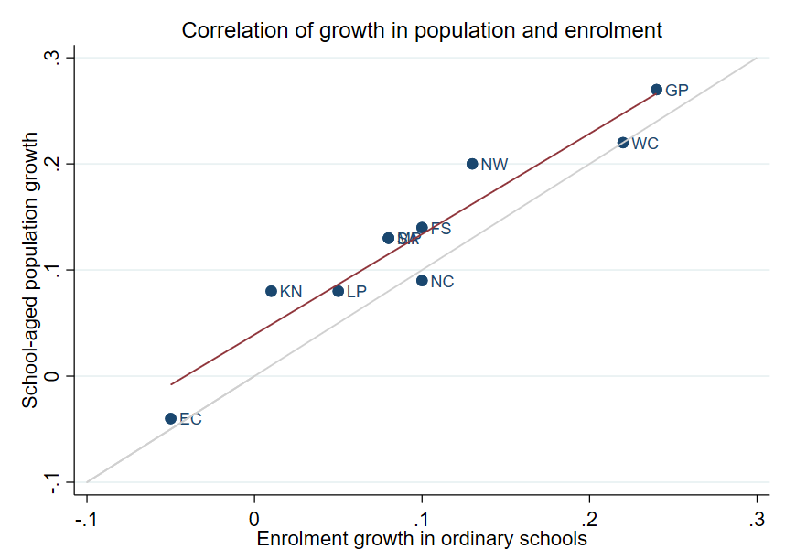
Correlation between population and enrolment growth (2012-2021)
3
R² = 0.9025
Strong positive correlation between population and enrolment growth between 2012 and 2021
45˚
Source: Thembisa age specific data V4.5 for school-aged population (Ages 7-18) estimates and enrolment taken from School Realities-EMIS (2012 – 2021) released by the DBE, for numbers on ordinary public and independent schools (Statistical Publications (education.gov.za))

Slide 22
Projected growth in school-aged population
3
Population of children aged 7-18 in the Northern Cape, is expected to stay roughly constant, with a small increase of
~3,5K children (+1%)
from 2021 to 2030
Note: Period 2021 – 2030 is the same timeframe, nine years, as 2012 – 2021.
Source: Thembisa age-specific estimates from the model V4.5 for children aged 7-18 by province

Slide 23
School aged-population estimates to 2030
3
 | Number of children Aged 7-18 |  |  |  | Growth '12-21 | Growth '21-30
Province | 2012 | 2021 | 2030E |  | Growth '12-21 | Growth '21-30
EC | 1 657 202 | 1 598 475 | 1 361 637 |  | -4% | -15%
FS | 592 445 | 676 489 | 650 820 |  | 14% | -4%
GP | 1 962 793 | 2 498 533 | 3 180 884 |  | 27% | 27%
KN | 2 485 822 | 2 690 378 | 2 657 716 |  | 8% | -1%
LP | 1 395 864 | 1 507 386 | 1 612 125 |  | 8% | 7%
MP | 977 749 | 1 100 594 | 1 165 728 |  | 13% | 6%
NC | 254 075 | 277 560 | 281 208 |  | 9% | 1%
NW | 742 943 | 893 530 | 930 323 |  | 20% | 4%
WC | 1 068 009 | 1 298 801 | 1 496 731 |  | 22% | 15%
Total | 11 136 902 | 12 541 746 | 13 337 172 |  | 13% | 6%
278K
281K
254K
Note: Period 2021 – 2030 is the same timeframe, nine years, as 2012 – 2021.
Source: Thembisa age-specific estimates from the model V4.5 for children aged 7-18 by province

Slide 24
Public and independent school & educator growth
4

Slide 25
Educator, school and enrolment growth
4
 | % growth from 2012 - 2021
Province | Number of educators | Number of teachers |  | Number of public ordinary schools | Enrolment in public ordinary schools | Enrolment in ordinary schools |  | Est. school-aged population
EC | -17% | -20% |  | -8% | -6% | -5% |  | -4%
FS | -13% | -13% |  | -27% | 9% | 10% |  | 14%
GP | 21% | 28% |  | 1% | 20% | 24% |  | 27%
KN | -5% | -3% |  | -3% | 1% | 1% |  | 8%
LP | -8% | -2% |  | -7% | 4% | 5% |  | 8%
MP | 3% | 7% |  | -8% | 7% | 8% |  | 13%
NC | 6% | 9% |  | -3% | 9% | 10% |  | 9%
NW | 2% | 4% |  | -9% | 12% | 13% |  | 20%
WC | 12% | 22% |  | 0% | 21% | 22% |  | 22%
SA | -1% | 2% |  | -6% | 7% | 8% |  | 13%
Source: Educator numbers from anonymised PERSAL data from 2012 and 2021, only educators (Rank 60 000 – 69 999) are considered. Thembisa age specific data V4.5 for school-aged population (Ages 7-18) estimates and enrolment and school numbers taken from School Realities-EMIS (2012 – 2021) released by the DBE, for numbers on ordinary public and independent schools (Statistical Publications (education.gov.za))

Slide 26
Educator, school and enrolment growth
4
 | % growth from 2012 - 2021
Province | Number of educators | Number of teachers |  | Number of public ordinary schools | Enrolment in public ordinary schools | Enrolment in ordinary schools |  | Est. school-aged population
EC | -17% | -20% |  | -8% | -6% | -5% |  | -4%
FS | -13% | -13% |  | -27% | 9% | 10% |  | 14%
GP | 21% | 28% |  | 1% | 20% | 24% |  | 27%
KN | -5% | -3% |  | -3% | 1% | 1% |  | 8%
LP | -8% | -2% |  | -7% | 4% | 5% |  | 8%
MP | 3% | 7% |  | -8% | 7% | 8% |  | 13%
NC | 6% | 9% |  | -3% | 9% | 10% |  | 9%
NW | 2% | 4% |  | -9% | 12% | 13% |  | 20%
WC | 12% | 22% |  | 0% | 21% | 22% |  | 22%
SA | -1% | 2% |  | -6% | 7% | 8% |  | 13%
z
Enrolment and educator numbers increased somewhat in line with each other in the Northern Cape, however, the number of public ordinary schools declined slightly
z
Source: Educator numbers from anonymised PERSAL data from 2012 and 2021, only educators (Rank 60 000 – 69 999) are considered. Thembisa age specific data V4.5 for school-aged population (Ages 7-18) estimates and enrolment and school numbers taken from School Realities-EMIS (2012 – 2021) released by the DBE, for numbers on ordinary public and independent schools (Statistical Publications (education.gov.za))

Slide 27
School growth from 2012 to 2021
4
School growth was driven by independent school growth (+37%) from 2012 to 2021. In contrast, the number of public schools in SA decreased (-6%)
EC | FS | GP | KN | LP | MP | NC | NW | WC | SA
% independent schools (2021)
4%
8%
30%
4%
5%
7%
7%
6%
17%
9%
Source: School numbers taken from School Realities-EMIS (2012 – 2021) released by the DBE, for numbers on ordinary public and independent schools (Statistical Publications (education.gov.za))

Slide 28
School growth from 2012 to 2021
4
The number of independent schools in the NC doubled (+100%) vs. public schools (-3%) off of a very low base of 20 schools. Independent school enrolment grew from about 9,6K to 24,5K children (+65%)
EC | FS | GP | KN | LP | MP | NC | NW | WC | SA
% independent schools (2021)
4%
8%
30%
4%
5%
7%
7%
6%
17%
9%
Source: School numbers taken from School Realities-EMIS (2012 – 2021) released by the DBE, for numbers on ordinary public and independent schools (Statistical Publications (education.gov.za))

Slide 29
Educator growth by teachers and senior educators
5

Slide 30
Changes in teacher and SMT numbers
5
 |  | Teacher |  |  |  |  | HOD |  |  |  |  | Deputy-Principal |  |  |  |  | Principal
Province |  | 2012 | 2021 | Diff | % change |  | 2012 | 2021 | Diff | % change |  | 2012 | 2021 | Diff | % change |  | 2012 | 2021 | Diff | % change
EC |  | 50 295 | 40 115 | -10 180 | -20% |  | 5 870 | 6 196 | 326 | 6% |  | 1 342 | 1 453 | 111 | 8% |  | 5 294 | 4 755 | - 539 | -10%
FS |  | 20 148 | 17 561 | -2 587 | -13% |  | 2 685 | 2 470 | - 215 | -8% |  | 852 | 768 | - 84 | -10% |  | 1 224 | 892 | - 332 | -27%
GP |  | 47 233 | 60 677 | 13 444 | 28% |  | 8 708 | 9 209 | 501 | 6% |  | 2 565 | 2 850 | 285 | 11% |  | 2 162 | 1 959 | - 203 | -9%
KN |  | 73 050 | 71 000 | -2 050 | -3% |  | 11 289 | 10 330 | - 959 | -8% |  | 2 642 | 2 342 | - 300 | -11% |  | 5 584 | 5 055 | - 529 | -9%
LP |  | 44 998 | 44 317 | - 681 | -2% |  | 6 090 | 3 762 | -2 328 | -38% |  | 1 562 | 778 | - 784 | -50% |  | 3 510 | 3 316 | - 194 | -6%
MP |  | 26 127 | 27 857 | 1 730 | 7% |  | 4 047 | 4 055 | 8 | 0% |  | 1 108 | 1 114 | 6 | 1% |  | 1 790 | 1 450 | - 340 | -19%
NC |  | 7 257 | 7 929 | 672 | 9% |  | 1 034 | 1 094 | 60 | 6% |  | 294 | 365 | 71 | 24% |  | 587 | 488 | - 99 | -17%
NW |  | 21 305 | 22 261 | 956 | 4% |  | 2 994 | 3 023 | 29 | 1% |  | 902 | 1 041 | 139 | 15% |  | 1 698 | 1 338 | - 360 | -21%
WC |  | 23 579 | 28 665 | 5 086 | 22% |  | 4 065 | 3 700 | - 365 | -9% |  | 1 334 | 1 297 | - 37 | -3% |  | 1 531 | 1 339 | - 192 | -13%
SA |  | 313 992 | 320 382 | 6 390 | 2% |  | 46 782 | 43 839 | -2 943 | -6% |  | 12 601 | 12 008 | - 593 | -5% |  | 23 380 | 20 592 | -2 788 | -12%
Source: Anonymised PERSAL data from 2012 and 2021, only educators (Rank 60 000 – 69 999) are considered. ECD practitioners, TVET lecturers, and ABET teachers were removed. The 2021 rankclass file was expanded to include ranks found only in years prior to 2021.

Slide 31
Changes in teacher and SMT numbers
5
 |  | Teacher |  |  |  |  | HOD |  |  |  |  | Deputy-Principal |  |  |  |  | Principal
Province |  | 2012 | 2021 | Diff | % change |  | 2012 | 2021 | Diff | % change |  | 2012 | 2021 | Diff | % change |  | 2012 | 2021 | Diff | % change
EC |  | 50 295 | 40 115 | -10 180 | -20% |  | 5 870 | 6 196 | 326 | 6% |  | 1 342 | 1 453 | 111 | 8% |  | 5 294 | 4 755 | - 539 | -10%
FS |  | 20 148 | 17 561 | -2 587 | -13% |  | 2 685 | 2 470 | - 215 | -8% |  | 852 | 768 | - 84 | -10% |  | 1 224 | 892 | - 332 | -27%
GP |  | 47 233 | 60 677 | 13 444 | 28% |  | 8 708 | 9 209 | 501 | 6% |  | 2 565 | 2 850 | 285 | 11% |  | 2 162 | 1 959 | - 203 | -9%
KN |  | 73 050 | 71 000 | -2 050 | -3% |  | 11 289 | 10 330 | - 959 | -8% |  | 2 642 | 2 342 | - 300 | -11% |  | 5 584 | 5 055 | - 529 | -9%
LP |  | 44 998 | 44 317 | - 681 | -2% |  | 6 090 | 3 762 | -2 328 | -38% |  | 1 562 | 778 | - 784 | -50% |  | 3 510 | 3 316 | - 194 | -6%
MP |  | 26 127 | 27 857 | 1 730 | 7% |  | 4 047 | 4 055 | 8 | 0% |  | 1 108 | 1 114 | 6 | 1% |  | 1 790 | 1 450 | - 340 | -19%
NC |  | 7 257 | 7 929 | 672 | 9% |  | 1 034 | 1 094 | 60 | 6% |  | 294 | 365 | 71 | 24% |  | 587 | 488 | - 99 | -17%
NW |  | 21 305 | 22 261 | 956 | 4% |  | 2 994 | 3 023 | 29 | 1% |  | 902 | 1 041 | 139 | 15% |  | 1 698 | 1 338 | - 360 | -21%
WC |  | 23 579 | 28 665 | 5 086 | 22% |  | 4 065 | 3 700 | - 365 | -9% |  | 1 334 | 1 297 | - 37 | -3% |  | 1 531 | 1 339 | - 192 | -13%
SA |  | 313 992 | 320 382 | 6 390 | 2% |  | 46 782 | 43 839 | -2 943 | -6% |  | 12 601 | 12 008 | - 593 | -5% |  | 23 380 | 20 592 | -2 788 | -12%
zvcd
Large decline in principal numbers between 2012 and 2021, relative to the decrease in public schools of -3%, and even larger increase in deputy principal numbers (+24%)
(principal appointments potentially delayed by COVID)
zvcd
Source: Anonymised PERSAL data from 2012 and 2021, only educators (Rank 60 000 – 69 999) are considered. ECD practitioners, TVET lecturers, and ABET teachers were removed. The 2021 rankclass file was expanded to include ranks found only in years prior to 2021.

Slide 32
Proportional split by educator rank
5
 | All Educators |  |  | Teacher |  |  | HOD |  |  | Dep.-Principal |  |  | Principal |  |  | Other
 | 2012 | 2021 |  | 2012 | 2021 |  | 2012 | 2021 |  | 2012 | 2021 |  | 2012 | 2021 |  | 2012 | 2021
EC | 100% | 100% |  | 78% | 75% |  | 9% | 12% |  | 2.1% | 2.7% |  | 8.2% | 8.8% |  | 2.5% | 2.4%
FS | 100% | 100% |  | 78% | 78% |  | 10% | 11% |  | 3.3% | 3.4% |  | 4.7% | 4.0% |  | 3.7% | 3.3%
GP | 100% | 100% |  | 74% | 79% |  | 14% | 12% |  | 4.0% | 3.7% |  | 3.4% | 2.6% |  | 4.4% | 2.7%
KN | 100% | 100% |  | 77% | 79% |  | 12% | 11% |  | 2.8% | 2.6% |  | 5.9% | 5.6% |  | 2.1% | 1.3%
LP | 100% | 100% |  | 78% | 84% |  | 11% | 7% |  | 2.7% | 1.5% |  | 6.1% | 6.3% |  | 2.1% | 1.5%
MP | 100% | 100% |  | 76% | 79% |  | 12% | 12% |  | 3.2% | 3.2% |  | 5.2% | 4.1% |  | 3.2% | 1.8%
NC | 100% | 100% |  | 75% | 77% |  | 11% | 11% |  | 3.0% | 3.6% |  | 6.1% | 4.8% |  | 5.1% | 3.9%
NW | 100% | 100% |  | 76% | 78% |  | 11% | 11% |  | 3.2% | 3.7% |  | 6.1% | 4.7% |  | 3.7% | 2.6%
WC | 100% | 100% |  | 74% | 80% |  | 13% | 10% |  | 4.2% | 3.6% |  | 4.8% | 3.7% |  | 4.1% | 2.1%
SA | 100% | 100% |  | 77% | 79% |  | 11% | 11% |  | 3.1% | 3.0% |  | 5.7% | 5.1% |  | 3.1% | 2.1%
Source: Anonymised PERSAL data from 2012 and 2021. Only educators are considered. ECD practitioners, examination reviewers, ABET teachers and TVET lecturers were removed. Arrow shown for teachers and HODs if difference is at least 3 percentage points, for deputy principals if the difference is at least 0.6 percentage points and for principals a difference of at least 0.8 percentage points.

Slide 33
Proportional split by educator rank
5
 | All Educators |  |  | Teacher |  |  | HOD |  |  | Dep.-Principal |  |  | Principal |  |  | Other
 | 2012 | 2021 |  | 2012 | 2021 |  | 2012 | 2021 |  | 2012 | 2021 |  | 2012 | 2021 |  | 2012 | 2021
EC | 100% | 100% |  | 78% | 75% |  | 9% | 12% |  | 2.1% | 2.7% |  | 8.2% | 8.8% |  | 2.5% | 2.4%
FS | 100% | 100% |  | 78% | 78% |  | 10% | 11% |  | 3.3% | 3.4% |  | 4.7% | 4.0% |  | 3.7% | 3.3%
GP | 100% | 100% |  | 74% | 79% |  | 14% | 12% |  | 4.0% | 3.7% |  | 3.4% | 2.6% |  | 4.4% | 2.7%
KN | 100% | 100% |  | 77% | 79% |  | 12% | 11% |  | 2.8% | 2.6% |  | 5.9% | 5.6% |  | 2.1% | 1.3%
LP | 100% | 100% |  | 78% | 84% |  | 11% | 7% |  | 2.7% | 1.5% |  | 6.1% | 6.3% |  | 2.1% | 1.5%
MP | 100% | 100% |  | 76% | 79% |  | 12% | 12% |  | 3.2% | 3.2% |  | 5.2% | 4.1% |  | 3.2% | 1.8%
NC | 100% | 100% |  | 75% | 77% |  | 11% | 11% |  | 3.0% | 3.6% |  | 6.1% | 4.8% |  | 5.1% | 3.9%
NW | 100% | 100% |  | 76% | 78% |  | 11% | 11% |  | 3.2% | 3.7% |  | 6.1% | 4.7% |  | 3.7% | 2.6%
WC | 100% | 100% |  | 74% | 80% |  | 13% | 10% |  | 4.2% | 3.6% |  | 4.8% | 3.7% |  | 4.1% | 2.1%
SA | 100% | 100% |  | 77% | 79% |  | 11% | 11% |  | 3.1% | 3.0% |  | 5.7% | 5.1% |  | 3.1% | 2.1%
zvc
zvc
There was a significant decline in the proportion of principals and the opposite for deputy principals, Teacher and HOD proportions are similar to the national averages
zvc
Source: Anonymised PERSAL data from 2012 and 2021. Only educators are considered. ECD practitioners, examination reviewers, ABET teachers and TVET lecturers were removed. Arrow shown for teachers and HODs if difference is at least 3 percentage points, for deputy principals if the difference is at least 0.6 percentage points and for principals a difference of at least 0.8 percentage points.

Slide 34
Expected financial implications to 2030
6

Slide 35
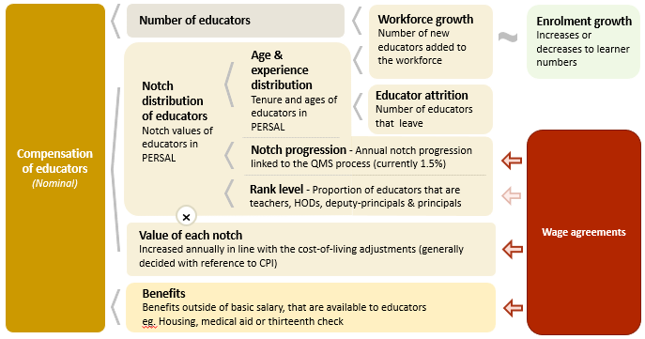
Unit cost drivers
6

Slide 36
Real and nominal costs
6
Examples:
In 2022 CPI was 7.2%
If nominal wages increase by 7.2%, then real wages increase by 0%
If nominal wages increase by 9%, then real wages increase by 1.8%
If nominal wages increase by 5%, then real wages decrease by 2.2%
A real increase in wages takes place when wages increase above the rate of inflation
Changes to real wages are an indicator of purchasing power

Slide 37
Projected unit costs trends| All educators
6
In constant 2021 rands
NC has a somewhat lower unit costs per educator than other provinces. Lower proportions of older educators and higher attrition levels among younger educators contribute to this lower unit cost.
Note: Scale not from zero
Source: Own calculations, using the anonymised PERSAL data from 2021, only educators are considered. ECD practitioners and examination reviewers removed. Estimates to 2030 derived from the national and provincial TSD models. Assumption of no growth in educator numbers.

Slide 38
Indexed unit costs trends| All educators
6
In constant 2021 rands
GP: ~1% increase
Educator unit cost
(Index in 2022 = 100%)
WC: ~1.5% decrease
Note: Scale not from zero
Source: Own calculations, using the anonymised PERSAL data from 2021, only educators are considered. ECD practitioners and examination reviewers removed. Estimates to 2030 derived from the national and provincial TSD models. Assumption of no growth in educator numbers for FS, KN, LP, MP, NC, NW and SA. Assume 20% educator growth for GP, 10% for WC and a decline in 10% of educators in the EC. In LP assume that the proportion of senior educators grows from 16% in 2021 to 21% in 2030.

Slide 39
Indexed unit costs trends| All educators
6
In constant 2021 rands
NC: Very slight (~+0,5%) increase in real cost from
2022 - 2030
Educator unit cost
(Index in 2022 = 100%)
Note: Scale not from zero
Source: Own calculations, using the anonymised PERSAL data from 2021, only educators are considered. ECD practitioners and examination reviewers removed. Estimates to 2030 derived from the national and provincial TSD models. Assumption of no growth in educator numbers for FS, KN, LP, MP, NC, NW and SA. Assume 20% educator growth for GP, 10% for WC and a decline in 10% of educators in the EC. In LP assume that the proportion of senior educators grows from 16% in 2021 to 21% in 2030.

Slide 40
Projected unit costs trends| All educators
6
In constant 2021 rands
Teachers
(School based teachers)
Senior educators
(HODs, Deputy’s, Principals & Other)
-6%
Average annual unit cost
(In 2021 Rands)
+3%
Note: Scale not from zero
Source: Own calculations, using the anonymised PERSAL data from 2021, only educators are considered. ECD practitioners and examination reviewers removed. Estimates to 2030 derived from the national and provincial TSD models. Assumption of no growth in educator numbers for FS, KN, LP, MP, NC, NW and SA. Assume 20% educator growth for GP, 10% for WC and a decline in 10% of educators in the EC. In LP assume that the proportion of senior educators grows from 16% in 2021 to 21% in 2030.

Slide 41
Between and within province movement
7

Slide 42
Inter-provincial educator movement (7-yr)
7
 |  | Province in 2019 |  |  |  |  |  |  |  |  |  |  | Movement out of province
 |  | EC | FS | GP | KN | LP | MP | NC | NW | WC | Total
Province in 2012 | EC | 97.79 | 0.10 | 0.86 | 0.22 | 0.01 | 0.04 | 0.11 | 0.19 | 0.70 | 100 |  | 2.23%
 | FS | 0.35 | 94.25 | 2.76 | 0.10 | 0.07 | 0.23 | 0.41 | 1.56 | 0.26 | 100 |  | 5.74%
 | GP | 0.15 | 0.26 | 96.86 | 0.27 | 0.81 | 0.42 | 0.05 | 0.93 | 0.24 | 100 |  | 3.13%
 | KN | 0.22 | 0.10 | 1.14 | 97.95 | 0.10 | 0.37 | 0.01 | 0.06 | 0.04 | 100 |  | 2.04%
 | LP | 0.02 | 0.02 | 1.72 | 0.02 | 96.80 | 0.80 | 0.05 | 0.56 | 0.02 | 100 |  | 3.21%
 | MP | 0.03 | 0.14 | 2.48 | 0.37 | 1.54 | 94.86 | 0.03 | 0.49 | 0.07 | 100 |  | 5.15%
 | NC | 0.47 | 0.50 | 0.47 | 0.06 | 0.59 | 0.03 | 94.35 | 2.37 | 1.15 | 100 |  | 5.64%
 | NW | 0.06 | 0.59 | 3.84 | 0.03 | 0.65 | 0.34 | 0.75 | 93.60 | 0.14 | 100 |  | 6.40%
 | WC | 0.72 | 0.03 | 0.17 | 0.05 | 0.00 | 0.02 | 0.35 | 0.03 | 98.61 | 100 |  | 1.37%
Source: PERSAL 10-year anonymised dataset, only educators that were in the dataset for 2012 and 2019 are considered here

Slide 43
Inter-provincial educator movement (7-yr)
7
 |  | Province in 2019 |  |  |  |  |  |  |  |  |  |  | Movement out of province
 |  | EC | FS | GP | KN | LP | MP | NC | NW | WC | Total
Province in 2012 | EC | 97.79 | 0.10 | 0.86 | 0.22 | 0.01 | 0.04 | 0.11 | 0.19 | 0.70 | 100 |  | 2.23%
 | FS | 0.35 | 94.25 | 2.76 | 0.10 | 0.07 | 0.23 | 0.41 | 1.56 | 0.26 | 100 |  | 5.74%
 | GP | 0.15 | 0.26 | 96.86 | 0.27 | 0.81 | 0.42 | 0.05 | 0.93 | 0.24 | 100 |  | 3.13%
 | KN | 0.22 | 0.10 | 1.14 | 97.95 | 0.10 | 0.37 | 0.01 | 0.06 | 0.04 | 100 |  | 2.04%
 | LP | 0.02 | 0.02 | 1.72 | 0.02 | 96.80 | 0.80 | 0.05 | 0.56 | 0.02 | 100 |  | 3.21%
 | MP | 0.03 | 0.14 | 2.48 | 0.37 | 1.54 | 94.86 | 0.03 | 0.49 | 0.07 | 100 |  | 5.15%
 | NC | 0.47 | 0.50 | 0.47 | 0.06 | 0.59 | 0.03 | 94.35 | 2.37 | 1.15 | 100 |  | 5.64%
 | NW | 0.06 | 0.59 | 3.84 | 0.03 | 0.65 | 0.34 | 0.75 | 93.60 | 0.14 | 100 |  | 6.40%
 | WC | 0.72 | 0.03 | 0.17 | 0.05 | 0.00 | 0.02 | 0.35 | 0.03 | 98.61 | 100 |  | 1.37%
High level of movement between provinces – about 5.6% of Northern Cape teachers in 2012 are teaching in a different province in 2019
Educators are most likely to move to the North West or Western Cape
zvc
zvc
Source: PERSAL 10-year anonymised dataset, only educators that were in the dataset for 2012 and 2019 are considered here

Slide 44
Inter-provincial educator movement (7-yr)
7
 |  | Province in 2019
 |  | EC | FS | GP | KN | LP | MP | NC | NW | WC
Province in 2012 | EC | 42 645 | 42 | 373 | 95 | 5 | 16 | 46 | 82 | 304
 | FS | 57 | 15 267 | 447 | 17 | 11 | 38 | 67 | 252 | 42
 | GP | 67 | 117 | 42 770 | 121 | 356 | 187 | 20 | 409 | 108
 | KN | 146 | 67 | 755 | 64 723 | 64 | 247 | 9 | 37 | 26
 | LP | 10 | 10 | 709 | 7 | 39 899 | 328 | 20 | 230 | 7
 | MP | 7 | 34 | 618 | 94 | 385 | 23 644 | 7 | 121 | 17
 | NC | 31 | 33 | 31 | 4 | 39 | 2 | 6 214 | 156 | 76
 | NW | 12 | 111 | 726 | 5 | 123 | 65 | 141 | 17 690 | 27
 | WC | 152 | 7 | 37 | 11 | 0 | 5 | 75 | 6 | 20 858
 | Total 2019 | 43 127 | 15 688 | 46 466 | 65 077 | 40 882 | 24 532 | 6 599 | 18 983 | 21 465
 | Movement into province | 482 | 421 | 3 696 | 354 | 983 | 888 | 385 | 1 293 | 607
 | % movement into province | 1.1% | 2.7% | 8.0% | 0.5% | 2.4% | 3.6% | 5.8% | 6.8% | 2.8%
Source: PERSAL 10-year anonymised dataset, only educators that were in the dataset for 2012 and 2019 are considered here

Slide 45
Inter-provincial educator movement (7-yr)
7
 |  | Province in 2019
 |  | EC | FS | GP | KN | LP | MP | NC | NW | WC
Province in 2012 | EC | 42 645 | 42 | 373 | 95 | 5 | 16 | 46 | 82 | 304
 | FS | 57 | 15 267 | 447 | 17 | 11 | 38 | 67 | 252 | 42
 | GP | 67 | 117 | 42 770 | 121 | 356 | 187 | 20 | 409 | 108
 | KN | 146 | 67 | 755 | 64 723 | 64 | 247 | 9 | 37 | 26
 | LP | 10 | 10 | 709 | 7 | 39 899 | 328 | 20 | 230 | 7
 | MP | 7 | 34 | 618 | 94 | 385 | 23 644 | 7 | 121 | 17
 | NC | 31 | 33 | 31 | 4 | 39 | 2 | 6 214 | 156 | 76
 | NW | 12 | 111 | 726 | 5 | 123 | 65 | 141 | 17 690 | 27
 | WC | 152 | 7 | 37 | 11 | 0 | 5 | 75 | 6 | 20 858
 | Total 2019 | 43 127 | 15 688 | 46 466 | 65 077 | 40 882 | 24 532 | 6 599 | 18 983 | 21 465
 | Movement into province | 482 | 421 | 3 696 | 354 | 983 | 888 | 385 | 1 293 | 607
 | % movement into province | 1.1% | 2.7% | 8.0% | 0.5% | 2.4% | 3.6% | 5.8% | 6.8% | 2.8%
High movement into the NC, a total of 5.8% of educators in 2019that were teaching in 2012, had come from another province since 2012
The province that sent the highest number of educators to the NC was the NW
zvc
zvc
Source: PERSAL 10-year anonymised dataset, only educators that were in the dataset for 2012 and 2019 are considered here

Slide 46
Educator movement between schools
7
Large amount of movement between schools, about 8.4% of NC educators (vs 5% nationally) move to a different pay point but stay within PERSAL from 2018-2019
Rate at which NC educators aged 50 and below (6.2%) leave the system is much higher than the national average (3.8%)
 | Pay point in 2019 (Ordinary schools only)
Province | Same as in 2018 (%) | Different to 2018 (%) | None - left system (%) | Total (%)
EC | 93.25 | 4.61 | 2.14 | 100
FS | 90.54 | 5.54 | 3.93 | 100
GP | 91.08 | 3.95 | 4.97 | 100
KN | 91.99 | 4.31 | 3.70 | 100
LP | 91.04 | 6.95 | 2.00 | 100
MP | 92.02 | 4.66 | 3.32 | 100
NC | 85.44 | 8.39 | 6.18 | 100
NW | 89.42 | 6.30 | 4.28 | 100
WC | 87.27 | 6.09 | 6.64 | 100
Total | 91.11 | 5.05 | 3.83 | 100
Source: PERSAL 10-year anonymised dataset. Only included educators aged 50 years and below, that were in ordinary schools in 2018 (Primary, Secondary, Combined and Intermediate)—excluded all paypoints that did not appear in both years after identifying 103 paypoints where the paypoint number changed.

Slide 47
Gender imbalances in management
8

Slide 48
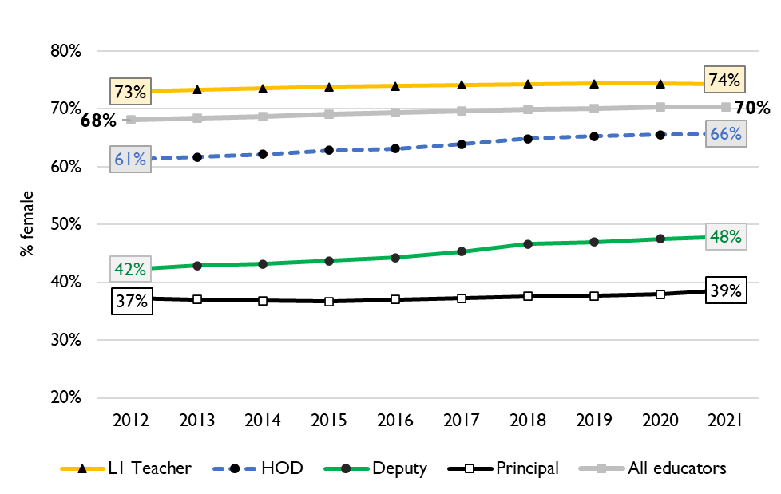
Percentage of educators that are female
8
Percentage of public educators in South Africa that are female, PERSAL (2012-2021)
Nationally, there has been very little transformation in senior school leadership in terms of gender since 2012 and even since 2004 (just 34% of principals were female).
There is better representation at middle-management (HOD) level.
Source: Using anonymised 10-year PERSAL data from 2012 to 2021, only educators of the ranks: level 1 teacher, HOD, deputy principal and principal are considered.

Slide 49
Percentage of educators that are female
8
In the Northern Cape in 2021, 69% of all educators were women. Women were well represented at the HOD level at 67% of HODs.
Yet only 50% of deputy principals and 36% of principals were women.
Source: Using anonymised 10-year PERSAL data from 2012 to 2021, only educators of the ranks: level 1 teacher, HOD, deputy principal and principal are considered.

Slide 50
Implications on appointments, class sizes and small schools
9

Slide 51
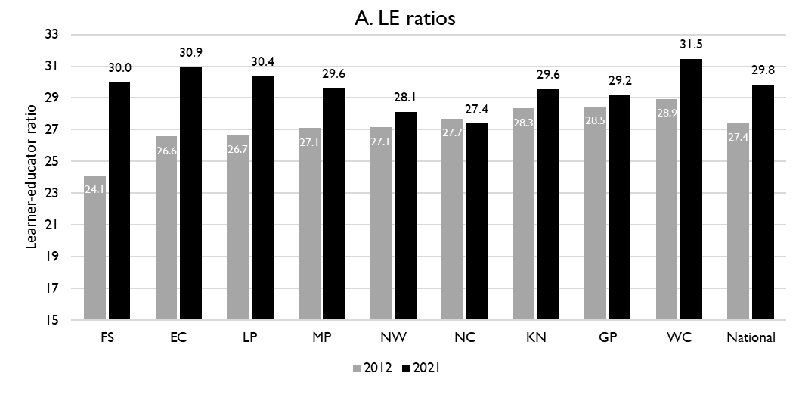
Learner-public educator ratios (‘12 & ’21)
9
National and provincial learner-to-public-educator ratios in 2012 and 2021, grades 1 to 12 in public ordinary schools in South Africa
Learner-public educator ratio decreased from 27.7 learners per educator to 27.4 learners per educator in the NC between 2012 & 2021.
NC was the only province that experienced an improvement
z
z
Source: Figure 1 in South African teacher shortages as revealed through class sizes and learner-educator ratios: An exploratory analysis by Gabrielle Wills (2023)

Slide 52
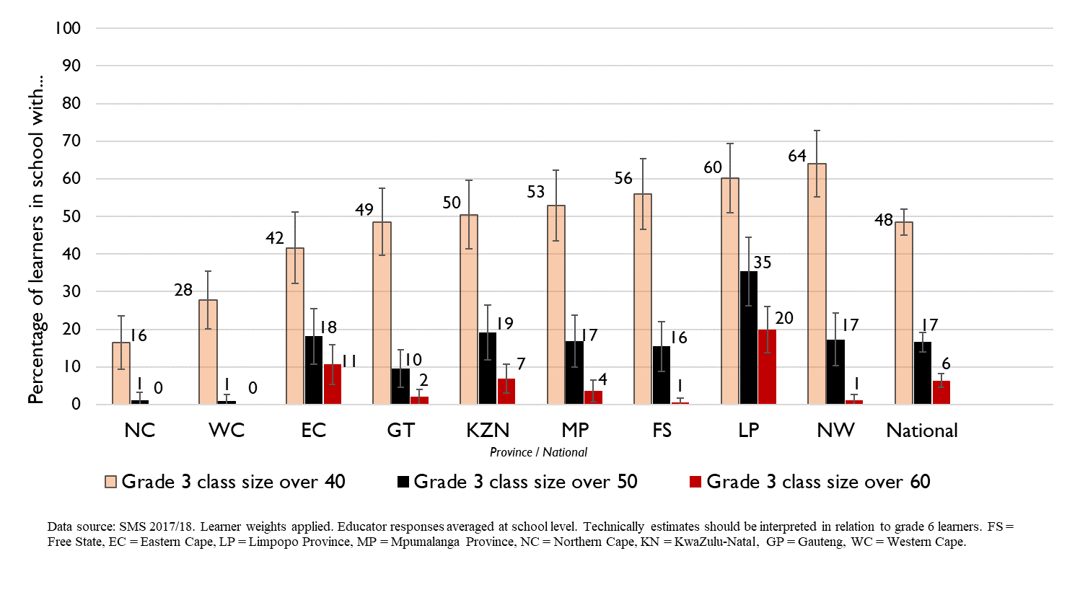
Grade 3 class sizes
(2017/18 School Monitoring Survey)
9
Post-provisioning guidelines - Class sizes should not exceed 35 in Grade 3.
% of learners in grade 3 classes > 40:
48% in SA, 16% in NC
% of learners in grade 3 classes > 50:
17% in SA, ~1% in NC
% of learners in grade 3 classes > 60:
6% in SA, ~0% in NC
Note: Nationally, grade 3 enrolment numbers had been rising from about 2011 and peaked in 2017 before starting to decline slightly, stabilising at about 1,1 million in 2021 (Gustafsson 2022a, p10-11). Holding other things constant, grade 3 class sizes will be similar or slightly smaller in 2022 than what is seen in these 2017/18 SMS estimates.
Large class sizes in Foundation phase is less of an issue in the Northern Cape

Slide 53
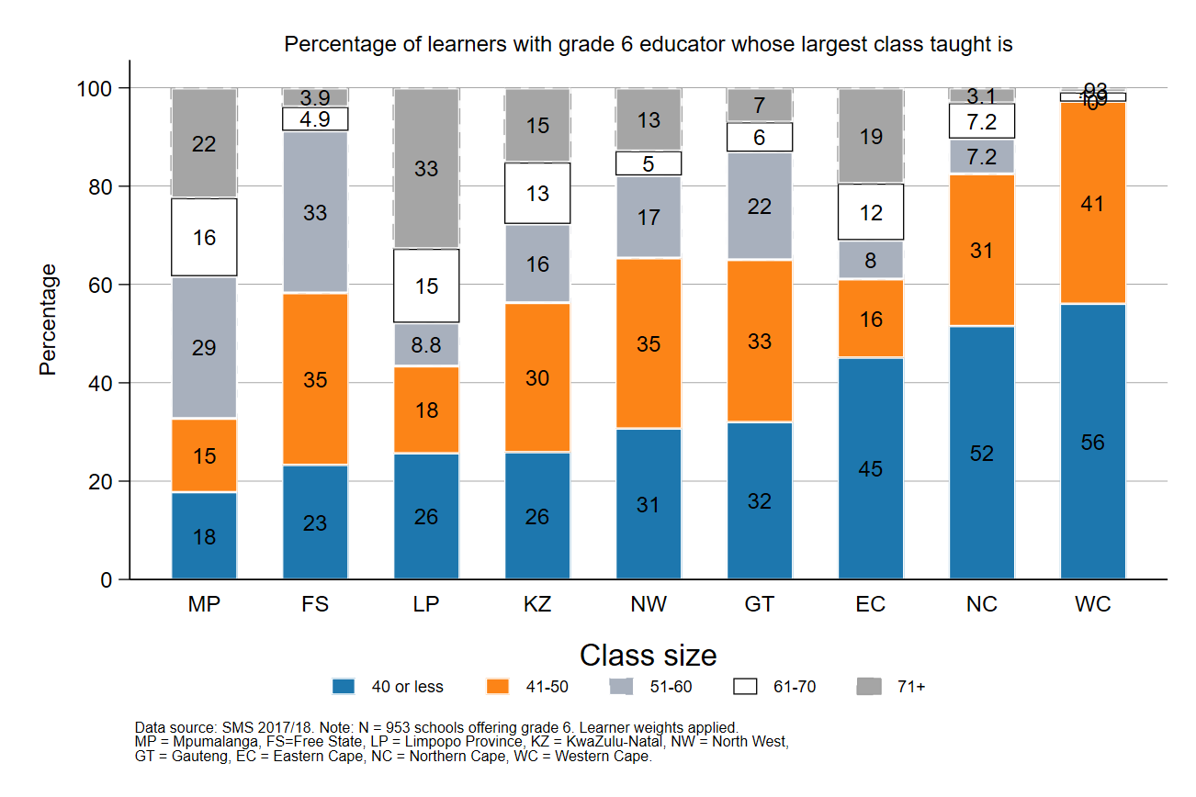
Largest classes - School Monitoring Survey 2017/18
9
In 2017/18, the Northern Cape had less than 20% of Gr6 learners in schools with large classes (>50 learners)
A further deterioration of the LE ratio will drive up class size and the number of excessively large classes, negatively impacting quality and teacher motivation
Percentage of grade 6 learners in schools with an educator reporting that their largest class is in the following class size category, disaggregated by province (SMS 2017/18)
Source: Figure 1 in South African teacher shortages as revealed through class sizes and learner-educator ratios: An exploratory analysis by Gabrielle Wills (2023) using School Monitoring Survey 2017/18 (953 schools, learner weighted).

Slide 54
Projections of promotions and appointments
9
Promotions
High proportions of promotions expected rising from ~8% to 12% of senior educators between 2022 and 2030). Deliberate, careful succession planning will be needed along with resources and processes to make and implement promotion decisions
Appointments
Limited increase to already high new appointments in NC (~10% of teachers). Movement into and out of province is high? Depending on the nature of the movement this might be a sign of efficiency or cause for concern? Needs to be monitored.

Slide 55
Conclusion
10
In the NC, retirements are not expected to increase leaver numbers significantly – about 42% of educators were 50 years or older in 2021, however, a high proportion of senior educators (69%) were over 50. Will need to manage succession well.
School-aged population and enrolment projected to stay roughly constant to 2030
The unit cost of educators is predicted to stay roughly constant.
The NC faces high levels of movement of educators
Year-to-year movement between schools and out of PERSAL is much higher than the national average
The movement out of the NC to other provinces and into the Northern Cape from other provinces is high – mostly to neighbouring provinces North West and the Western Cape

Slide 56
General questions and discussion
10
What is the process for principals and senior educator mentorship, selection and induction?
Is the retention of younger educators a concern in the Northern Cape?
How did the NC manage the need for new appointments in 2015?
What caused the spike in resignations in 2021?
How much of a concern is gender equity in senior management in NC?
Do you track what subjects and phases teachers are needed:
Is there a list of the positions requested by principals or positions filled? Or of educators that have left?

