Slide 1
North West Province 11 Sep 2023
Educator Demand Projections
2021-2030

Slide 2
Introduction (1)
The proportion of educators that are 50 years or older has steadily risen between 2012 to 2021 in South Africa.
⇒ Nationally a wave of educator retirements is expected as older educators reach the standard retirement age of between 60 and 65.
Implications:
Many more appointments: The retirement wave will open up both teaching & school management & leadership positions & other office-based education specialists.
Total compensation of educators: Since older teachers earn more, when retiring they are replaced with younger (less costly) teachers.

Slide 3
Introduction (2)
As retirements increase, the required number of new appointments will need to increase to ensure that total educator numbers (at a minimum) stay at current levels and/or are sufficient to meet learner enrolment growth to prevent deterioration in learner-educator ratios.
Planning will be required to ensure that provinces are ready for the sustained increase in appointments.
If these positions are not filled, this could result in a further deterioration in the learner-educator ratio and lead to further increases in already large class sizes.

Slide 4
Introduction (3)
Educator age distribution in 2012 & 2021 in SA
Peak in age shifted from 46 years to 53 years
Source: Anonymised PERSAL data from 2021, only educators (Rank 60 000 – 69 999) are considered. ECD practitioners, TVET lecturers and ABET teachers were removed.

Slide 6
Objective
In each province there are some differences in the age profile of teachers, differences in the expected growth of the school-going population and differences in expected teacher attrition (resignations & retirements).
⇒ The year of the retirement wave peak will differ across provinces.
⇒ Also some provinces need to accommodate much more growth in
learners than others.
In this presentation, we highlight the situation in
North West to inform province-specific planning

Slide 7
Overview
Age distributions
Projected retirements & resignations
Provincial population and enrolment trends
Public and independent school growth
Educator growth: Teachers and senior educators
The implications for appointments and class sizes
Expected financial implications to 2030
Movement of educators: Between and within provinces
Gender imbalance in school management
Discussion
1
2
3
4
5
6
7
8
9
10

Slide 8
North West educator demand summary
Age distribution: The age distribution in the NW had a peak at around 53 years of age in 2021
Projected resignations and retirements: NW will see high rates of resignations for younger educators (aged 55 and below)-this is mainly driven by younger educators resigning as the proportion of newly hired younger educators increases; the number of senior educators (SMT positions and other specialists) that are retiring is expected to increase (70% were 50+ years old in 2021)
Enrolment and population growth: Enrolment in NW ordinary schools grew by +13% from 2012-2021 (~97K learners), and the school-aged population is forecast to grow by +4% (~37K learners) to 2030
School and educator growth: From 2012 to 2021, the educator number in public schools increased but less than enrolment (+2%); school numbers declined (-9%), driving up the LE ratio and class sizes.
SMT position changes: In the NW, the number of HODs remained almost constant (+1%), while deputy principal numbers increased (+15%), and principal numbers declined significantly (-21%) from 2012 to 2021
Appointments and LE Ratio: Increases in appointments are needed in response to enrolment growth; otherwise, the LE ratio will increase further (inc. from 27.1 to 28.1 from 2012 to 2021)
Projected educator cost trends: NW will experience a slight increase in the real average cost of educators (<1%); the real unit cost of teachers will increase by (+2%), and the real unit cost of senior educator educators will decrease by (-3%)
Educator movements: High levels of educator movement out of NW(~6%) and into the province (~7%) over a 7-year period. Educators are more likely to move to a different school than they are to leave the system.

Slide 9
Educator age distribution (2021)
1
Source: Anonymised PERSAL data from 2021, only 405 413 educators (Rank 60 000 – 69 999) are considered. ECD practitioners, TVET lecturers and ABET teachers were removed.

Slide 10
Educator age distribution (2021)
1
A high concentration of educators are over 50 years old in NW, peak at age 53
Age: 53
A slightly higher proportion of young educators under 30 years in NW than in the country
Source: Anonymised PERSAL data from 2021, only 405 413 educators (Rank 60 000 – 69 999) are considered. ECD practitioners, TVET lecturers and ABET teachers were removed.

Slide 11
Older teacher proportions for senior educator and primary schools educators
1
 |  | Percentage of educators aged 50+ in 2021
Province |  | All educators |  | Senior educators (HOD, Dep.- principals, Principals & Other) |  | Primary school educators
EC |  | 51% |  | 71% |  | 58%
FS |  | 43% |  | 65% |  | 49%
GP |  | 41% |  | 65% |  | 42%
KN |  | 39% |  | 65% |  | 44%
LP |  | 58% |  | 81% |  | 63%
MP |  | 50% |  | 73% |  | 55%
NC |  | 43% |  | 69% |  | 44%
NW |  | 47% |  | 70% |  | 52%
WC |  | 42% |  | 73% |  | 40%
SA |  | 46% |  | 69% |  | 49%
Source: Anonymised PERSAL data from 2021, only 405 413 educators (Rank 60 000 – 69 999) are considered. ECD practitioners, TVET lecturers and ABET teachers were removed. The 2021 rankclass file was expanded to include ranks found only in years prior to 2021, used to classify educators by rank. Primary school only includes all educators that are in a component that is classified as a Primary school.

Slide 12
Older teacher proportions for senior educator and primary schools educators
1
 |  | Percentage of educators aged 50+ in 2021
Province |  | All educators |  | Senior educators (HOD, Dep.- principals, Principals & Other) |  | Primary school educators
EC |  | 51% |  | 71% |  | 58%
FS |  | 43% |  | 65% |  | 49%
GP |  | 41% |  | 65% |  | 42%
KN |  | 39% |  | 65% |  | 44%
LP |  | 58% |  | 81% |  | 63%
MP |  | 50% |  | 73% |  | 55%
NC |  | 43% |  | 69% |  | 44%
NW |  | 47% |  | 70% |  | 52%
WC |  | 42% |  | 73% |  | 40%
SA |  | 46% |  | 69% |  | 49%
zvc
A large number of senior educators (70%) and primary school educators (52%) were aged 50 years and older in 2021 in the NW
zvc
Source: Anonymised PERSAL data from 2021, only 405 413 educators (Rank 60 000 – 69 999) are considered. ECD practitioners, TVET lecturers and ABET teachers were removed. The 2021 rankclass file was expanded to include ranks found only in years prior to 2021, used to classify educators by rank. Primary school only includes all educators that are in a component that is classified as a Primary school.

Slide 13
Educator age distribution in 2021 & 2030
1
Assume constant 2021 educator numbers
Age: 53
2021
2030
Source: Anonymised PERSAL data from 2021, only 405 413 educators (Rank 60 000 – 69 999) are considered. ECD practitioners, TVET lecturers and ABET teachers were removed. Estimates to 2035 derived from the National and provincial teacher supply and demand models – assumption of no growth in educator numbers.

Slide 14
Projected resignation & retirements (NW)
2
Assume constant 2021 educator numbers
Proportion of Educators
More than half of the educators that are projected to exit PERSAL in the NW are resignations (ages 21 to 55)
The resignation rate is relatively high, with a large spike due to the pension reform rumours in 2015
The number of young teachers (ages 21-30) resigning is projected to increase as the number of newly hired young teachers increases.
Projected
% of educators resigning or retiring
Source: Anonymised PERSAL data from 2021, only 405 413 educators (Rank 60 000 – 69 999) are considered. ECD practitioners, TVET lecturers and ABET teachers were removed. Estimates to 2035 derived from the National and provincial teacher supply and demand models – assumption of no growth in educator numbers. Note: Retirements refer to all educators, aged 56 to 65, that leave PERSAL, whilst resignations refer to all educators aged 55 and below that leave PERSAL (as educators) for any reason.

Slide 15
Projected resignation & retirements (NW)
2
Assume constant 2021 educator numbers
Retirement headcount
The number of retirements is projected to increase, peaking in ~2029 & 2030 and then declining again
The number of retirements is projected to increase from about 900 in 2022 to about 1,250 in 2029 & 2030, an increase of about 350 retirements annually
Projected
Number of retirements
Source: Anonymised PERSAL data from 2021, only 405 413 educators (Rank 60 000 – 69 999) are considered. ECD practitioners, TVET lecturers and ABET teachers were removed. Estimates to 2035 derived from the National and provincial teacher supply and demand models – assumption of no growth in educator numbers. Note: Retirements refer to all educators, aged 56 to 65, that leave PERSAL, whilst resignations refer to all educators aged 55 and below that leave PERSAL (as educators) for any reason.

Slide 16
Older leaver trend estimates to 2035
2
Assume constant 2021 educator numbers
About 15,600
educators estimated to retire by 2035 in the NW
(55% of total educators in 2021)
Source: Anonymised 2021 PERSAL data, only 405 413 educators (Rank 60 000 – 69 999) are considered. ECD practitioners, TVET lecturers and ABET teachers were removed. Estimates to 2035 derived from the National and provincial models – assumption of no growth in educator numbers.

Slide 17
Projected educators leaving by ranks
2
Assume constant 2021 educator numbers
L1 Teachers
(School based teachers)
Senior educators
(HODs, Deputy’s, Principals & Other)
% of teacher resigning & retiring
% of senior educator resigning & retiring
Careful succession planning is needed from 2027 onwards as ~10% of HODs, deputies and principals are projected to leave annually
A high proportion of teachers are expected to resign and retire in NW relative to SA; many of them are younger educators
Source: Anonymised 2021 PERSAL data, only 405 413 educators (Rank 60 000 – 69 999) are considered. ECD practitioners, TVET lecturers and ABET teachers were removed. Estimates to 2035 derived from the National and provincial models – assumption of no growth in educator numbers.

Slide 18
Provincial population and enrolment trends
3

Slide 19
Provincial enrolment trends (2012-2021)
3
High growth
Moderate growth
Stable
Decline
Source: Enrolment numbers taken from School Realities-EMIS (2012 – 2021) released by the DBE, using total numbers for ordinary public and independent schools.

Slide 20
Provincial enrolment trends (2012-2021)
3
Enrolment in North West ordinary schools
grew by 13%
from 2012 to 2021
Source: Enrolment numbers taken from School Realities-EMIS (2012 – 2021) released by the DBE, using total numbers for ordinary public and independent schools.

Slide 21
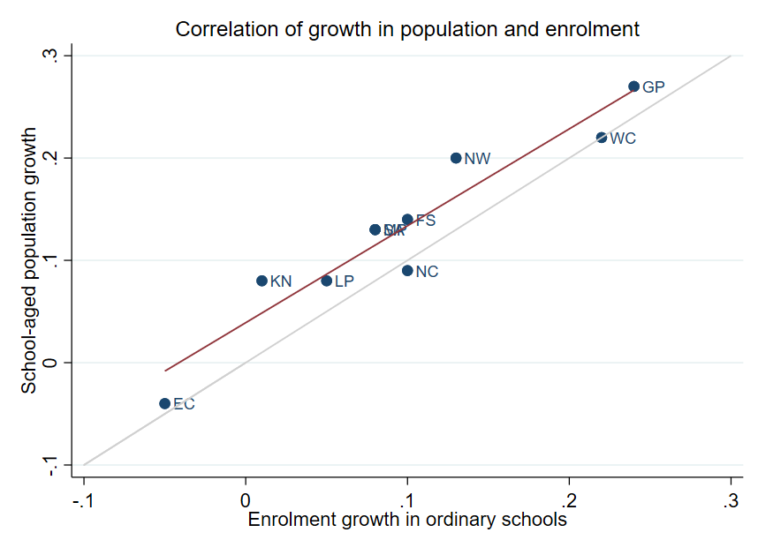
Correlation between population and enrolment growth (2012-2021)
3
R² = 0.9025
Strong positive correlation between population and enrolment growth between 2012 and 2021
45˚
Source: Thembisa age specific data V4.5 for school-aged population (Ages 7-18) estimates and enrolment taken from School Realities-EMIS (2012 – 2021) released by the DBE, for numbers on ordinary public and independent schools (Statistical Publications (education.gov.za))

Slide 22
Projected growth in school-aged population
3
Population of children aged 7-18 in the North West is expected to grow by
~37 000 children (+4%)
from 2021 to 2030
Note: Period 2021 – 2030 is the same timeframe, nine years, as 2012 – 2021.
Source: Thembisa age-specific estimates from the model V4.5 for children aged 7-18 by province

Slide 23
School aged-population estimates to 2030
3
 | Number of children Aged 7-18 |  |  |  | Growth '12-21 | Growth '21-30
Province | 2012 | 2021 | 2030E
EC | 1 657 202 | 1 598 475 | 1 361 637 |  | -4% | -15%
FS | 592 445 | 676 489 | 650 820 |  | 14% | -4%
GP | 1 962 793 | 2 498 533 | 3 180 884 |  | 27% | 27%
KN | 2 485 822 | 2 690 378 | 2 657 716 |  | 8% | -1%
LP | 1 395 864 | 1 507 386 | 1 612 125 |  | 8% | 7%
MP | 977 749 | 1 100 594 | 1 165 728 |  | 13% | 6%
NC | 254 075 | 277 560 | 281 208 |  | 9% | 1%
NW | 742 943 | 893 530 | 930 323 |  | 20% | 4%
WC | 1 068 009 | 1 298 801 | 1 496 731 |  | 22% | 15%
Total | 11 136 902 | 12 541 746 | 13 337 172 |  | 13% | 6%
930K
894K
743K
Note: Period 2021 – 2030 is the same timeframe, nine years, as 2012 – 2021.
Source: Thembisa age-specific estimates from the model V4.5 for children aged 7-18 by province

Slide 24
Public and independent school growth
4

Slide 25
Educator, school and enrolment growth
4
 | % growth from 2012 - 2021
Province | Number of educators | Number of teachers |  | Number of public ordinary schools | Enrolment in public ordinary schools | Enrolment in ordinary schools |  | Est. school-aged population
EC | -17% | -20% |  | -8% | -6% | -5% |  | -4%
FS | -13% | -13% |  | -27% | 9% | 10% |  | 14%
GP | 21% | 28% |  | 1% | 20% | 24% |  | 27%
KN | -5% | -3% |  | -3% | 1% | 1% |  | 8%
LP | -8% | -2% |  | -7% | 4% | 5% |  | 8%
MP | 3% | 7% |  | -8% | 7% | 8% |  | 13%
NC | 6% | 9% |  | -3% | 9% | 10% |  | 9%
NW | 2% | 4% |  | -9% | 12% | 13% |  | 20%
WC | 12% | 22% |  | 0% | 21% | 22% |  | 22%
SA | -1% | 2% |  | -6% | 7% | 8% |  | 13%
Source: Educator numbers from anonymised PERSAL data from 2012 and 2021, only educators (Rank 60 000 – 69 999) are considered. Thembisa age specific data V4.5 for school-aged population (Ages 7-18) estimates and enrolment and school numbers taken from School Realities-EMIS (2012 – 2021) released by the DBE, for numbers on ordinary public and independent schools (Statistical Publications (education.gov.za))

Slide 26
Educator, school and enrolment growth
4
 | % growth from 2012 - 2021
Province | Number of educators | Number of teachers |  | Number of public ordinary schools | Enrolment in public ordinary schools | Enrolment in ordinary schools |  | Est. school-aged population
EC | -17% | -20% |  | -8% | -6% | -5% |  | -4%
FS | -13% | -13% |  | -27% | 9% | 10% |  | 14%
GP | 21% | 28% |  | 1% | 20% | 24% |  | 27%
KN | -5% | -3% |  | -3% | 1% | 1% |  | 8%
LP | -8% | -2% |  | -7% | 4% | 5% |  | 8%
MP | 3% | 7% |  | -8% | 7% | 8% |  | 13%
NC | 6% | 9% |  | -3% | 9% | 10% |  | 9%
NW | 2% | 4% |  | -9% | 12% | 13% |  | 20%
WC | 12% | 22% |  | 0% | 21% | 22% |  | 22%
SA | -1% | 2% |  | -6% | 7% | 8% |  | 13%
z
Enrolment and educator numbers grew in the North West, whilst the number of public ordinary schools decreased....
z
Source: Educator numbers from anonymised PERSAL data from 2012 and 2021, only educators (Rank 60 000 – 69 999) are considered. Thembisa age specific data V4.5 for school-aged population (Ages 7-18) estimates and enrolment and school numbers taken from School Realities-EMIS (2012 – 2021) released by the DBE, for numbers on ordinary public and independent schools (Statistical Publications (education.gov.za))

Slide 27
School growth from 2012 to 2021
4
School growth was driven by independent school growth (+37%) from 2012 to 2021. In contrast, the number of public schools in SA decreased (-6%)
EC | FS | GP | KN | LP | MP | NC | NW | WC | SA
% independent schools (2021)
4%
8%
30%
4%
5%
7%
7%
6%
17%
9%
Source: School numbers taken from School Realities-EMIS (2012 – 2021) released by the DBE, for numbers on ordinary public and independent schools (Statistical Publications (education.gov.za))

Slide 28
School growth from 2012 to 2021
4
High growth in the number of independent schools in the NW (+65%), with enrolment growing from about 15K to 25K children (+65%)
EC | FS | GP | KN | LP | MP | NC | NW | WC | SA
% independent schools (2021)
4%
8%
30%
4%
5%
7%
7%
6%
17%
9%
Source: School numbers taken from School Realities-EMIS (2012 – 2021) released by the DBE, for numbers on ordinary public and independent schools (Statistical Publications (education.gov.za))

Slide 29
Educator growth by teachers and senior educator positions
5

Slide 30
Changes in teacher and SMT numbers
5
 |  | Teacher |  |  |  |  | HOD |  |  |  |  | Deputy-Principal |  |  |  |  | Principal
Province |  | 2012 | 2021 | Diff | % change |  | 2012 | 2021 | Diff | % change |  | 2012 | 2021 | Diff | % change |  | 2012 | 2021 | Diff | % change
EC |  | 50 295 | 40 115 | -10 180 | -20% |  | 5 870 | 6 196 | 326 | 6% |  | 1 342 | 1 453 | 111 | 8% |  | 5 294 | 4 755 | - 539 | -10%
FS |  | 20 148 | 17 561 | -2 587 | -13% |  | 2 685 | 2 470 | - 215 | -8% |  | 852 | 768 | - 84 | -10% |  | 1 224 | 892 | - 332 | -27%
GP |  | 47 233 | 60 677 | 13 444 | 28% |  | 8 708 | 9 209 | 501 | 6% |  | 2 565 | 2 850 | 285 | 11% |  | 2 162 | 1 959 | - 203 | -9%
KN |  | 73 050 | 71 000 | -2 050 | -3% |  | 11 289 | 10 330 | - 959 | -8% |  | 2 642 | 2 342 | - 300 | -11% |  | 5 584 | 5 055 | - 529 | -9%
LP |  | 44 998 | 44 317 | - 681 | -2% |  | 6 090 | 3 762 | -2 328 | -38% |  | 1 562 | 778 | - 784 | -50% |  | 3 510 | 3 316 | - 194 | -6%
MP |  | 26 127 | 27 857 | 1 730 | 7% |  | 4 047 | 4 055 | 8 | 0% |  | 1 108 | 1 114 | 6 | 1% |  | 1 790 | 1 450 | - 340 | -19%
NC |  | 7 257 | 7 929 | 672 | 9% |  | 1 034 | 1 094 | 60 | 6% |  | 294 | 365 | 71 | 24% |  | 587 | 488 | - 99 | -17%
NW |  | 21 305 | 22 261 | 956 | 4% |  | 2 994 | 3 023 | 29 | 1% |  | 902 | 1 041 | 139 | 15% |  | 1 698 | 1 338 | - 360 | -21%
WC |  | 23 579 | 28 665 | 5 086 | 22% |  | 4 065 | 3 700 | - 365 | -9% |  | 1 334 | 1 297 | - 37 | -3% |  | 1 531 | 1 339 | - 192 | -13%
SA |  | 313 992 | 320 382 | 6 390 | 2% |  | 46 782 | 43 839 | -2 943 | -6% |  | 12 601 | 12 008 | - 593 | -5% |  | 23 380 | 20 592 | -2 788 | -12%
Source: Anonymised PERSAL data from 2012 and 2021, only educators (Rank 60 000 – 69 999) are considered. ECD practitioners, TVET lecturers, and ABET teachers were removed. The 2021 rankclass file was expanded to include ranks found only in years prior to 2021.

Slide 31
Changes in teacher and SMT numbers
5
 |  | Teacher |  |  |  |  | HOD |  |  |  |  | Deputy-Principal |  |  |  |  | Principal
Province |  | 2012 | 2021 | Diff | % change |  | 2012 | 2021 | Diff | % change |  | 2012 | 2021 | Diff | % change |  | 2012 | 2021 | Diff | % change
EC |  | 50 295 | 40 115 | -10 180 | -20% |  | 5 870 | 6 196 | 326 | 6% |  | 1 342 | 1 453 | 111 | 8% |  | 5 294 | 4 755 | - 539 | -10%
FS |  | 20 148 | 17 561 | -2 587 | -13% |  | 2 685 | 2 470 | - 215 | -8% |  | 852 | 768 | - 84 | -10% |  | 1 224 | 892 | - 332 | -27%
GP |  | 47 233 | 60 677 | 13 444 | 28% |  | 8 708 | 9 209 | 501 | 6% |  | 2 565 | 2 850 | 285 | 11% |  | 2 162 | 1 959 | - 203 | -9%
KN |  | 73 050 | 71 000 | -2 050 | -3% |  | 11 289 | 10 330 | - 959 | -8% |  | 2 642 | 2 342 | - 300 | -11% |  | 5 584 | 5 055 | - 529 | -9%
LP |  | 44 998 | 44 317 | - 681 | -2% |  | 6 090 | 3 762 | -2 328 | -38% |  | 1 562 | 778 | - 784 | -50% |  | 3 510 | 3 316 | - 194 | -6%
MP |  | 26 127 | 27 857 | 1 730 | 7% |  | 4 047 | 4 055 | 8 | 0% |  | 1 108 | 1 114 | 6 | 1% |  | 1 790 | 1 450 | - 340 | -19%
NC |  | 7 257 | 7 929 | 672 | 9% |  | 1 034 | 1 094 | 60 | 6% |  | 294 | 365 | 71 | 24% |  | 587 | 488 | - 99 | -17%
NW |  | 21 305 | 22 261 | 956 | 4% |  | 2 994 | 3 023 | 29 | 1% |  | 902 | 1 041 | 139 | 15% |  | 1 698 | 1 338 | - 360 | -21%
WC |  | 23 579 | 28 665 | 5 086 | 22% |  | 4 065 | 3 700 | - 365 | -9% |  | 1 334 | 1 297 | - 37 | -3% |  | 1 531 | 1 339 | - 192 | -13%
SA |  | 313 992 | 320 382 | 6 390 | 2% |  | 46 782 | 43 839 | -2 943 | -6% |  | 12 601 | 12 008 | - 593 | -5% |  | 23 380 | 20 592 | -2 788 | -12%
zvc
Teacher numbers (+4%) lag behind enrolment growth (+12%) in public ordinary schools
Large decline in principal numbers between 2012 and 2021
(principal appointments potentially delayed by COVID)
zvc
Source: Anonymised PERSAL data from 2012 and 2021, only educators (Rank 60 000 – 69 999) are considered. ECD practitioners, TVET lecturers, and ABET teachers were removed. The 2021 rankclass file was expanded to include ranks found only in years prior to 2021.

Slide 32
Changes in teacher and SMT numbers
5
 |  | Teacher |  |  |  |  | HOD |  |  |  |  | Deputy-Principal |  |  |  |  | Principal
Province |  | 2012 | 2021 | Diff | % change |  | 2012 | 2021 | Diff | % change |  | 2012 | 2021 | Diff | % change |  | 2012 | 2021 | Diff | % change
EC |  | 50 295 | 40 115 | -10 180 | -20% |  | 5 870 | 6 196 | 326 | 6% |  | 1 342 | 1 453 | 111 | 8% |  | 5 294 | 4 755 | - 539 | -10%
FS |  | 20 148 | 17 561 | -2 587 | -13% |  | 2 685 | 2 470 | - 215 | -8% |  | 852 | 768 | - 84 | -10% |  | 1 224 | 892 | - 332 | -27%
GP |  | 47 233 | 60 677 | 13 444 | 28% |  | 8 708 | 9 209 | 501 | 6% |  | 2 565 | 2 850 | 285 | 11% |  | 2 162 | 1 959 | - 203 | -9%
KN |  | 73 050 | 71 000 | -2 050 | -3% |  | 11 289 | 10 330 | - 959 | -8% |  | 2 642 | 2 342 | - 300 | -11% |  | 5 584 | 5 055 | - 529 | -9%
LP |  | 44 998 | 44 317 | - 681 | -2% |  | 6 090 | 3 762 | -2 328 | -38% |  | 1 562 | 778 | - 784 | -50% |  | 3 510 | 3 316 | - 194 | -6%
MP |  | 26 127 | 27 857 | 1 730 | 7% |  | 4 047 | 4 055 | 8 | 0% |  | 1 108 | 1 114 | 6 | 1% |  | 1 790 | 1 450 | - 340 | -19%
NC |  | 7 257 | 7 929 | 672 | 9% |  | 1 034 | 1 094 | 60 | 6% |  | 294 | 365 | 71 | 24% |  | 587 | 488 | - 99 | -17%
NW |  | 21 305 | 22 261 | 956 | 4% |  | 2 994 | 3 023 | 29 | 1% |  | 902 | 1 041 | 139 | 15% |  | 1 698 | 1 338 | - 360 | -21%
WC |  | 23 579 | 28 665 | 5 086 | 22% |  | 4 065 | 3 700 | - 365 | -9% |  | 1 334 | 1 297 | - 37 | -3% |  | 1 531 | 1 339 | - 192 | -13%
SA |  | 313 992 | 320 382 | 6 390 | 2% |  | 46 782 | 43 839 | -2 943 | -6% |  | 12 601 | 12 008 | - 593 | -5% |  | 23 380 | 20 592 | -2 788 | -12%
zvc
Increase in HOD and deputy principal numbers between 2012 and 2021
zvc
Source: Anonymised PERSAL data from 2012 and 2021, only educators (Rank 60 000 – 69 999) are considered. ECD practitioners, TVET lecturers, and ABET teachers were removed. The 2021 rankclass file was expanded to include ranks found only in years prior to 2021.

Slide 33
Proportional split by educator rank
5
 | All Educators |  |  | Teacher |  |  | HOD |  |  | Dep.-Principal |  |  | Principal |  |  | Other
 | 2012 | 2021 |  | 2012 | 2021 |  | 2012 | 2021 |  | 2012 | 2021 |  | 2012 | 2021 |  | 2012 | 2021
EC | 100% | 100% |  | 78% | 75% |  | 9% | 12% |  | 2.1% | 2.7% |  | 8.2% | 8.8% |  | 2.5% | 2.4%
FS | 100% | 100% |  | 78% | 78% |  | 10% | 11% |  | 3.3% | 3.4% |  | 4.7% | 4.0% |  | 3.7% | 3.3%
GP | 100% | 100% |  | 74% | 79% |  | 14% | 12% |  | 4.0% | 3.7% |  | 3.4% | 2.6% |  | 4.4% | 2.7%
KN | 100% | 100% |  | 77% | 79% |  | 12% | 11% |  | 2.8% | 2.6% |  | 5.9% | 5.6% |  | 2.1% | 1.3%
LP | 100% | 100% |  | 78% | 84% |  | 11% | 7% |  | 2.7% | 1.5% |  | 6.1% | 6.3% |  | 2.1% | 1.5%
MP | 100% | 100% |  | 76% | 79% |  | 12% | 12% |  | 3.2% | 3.2% |  | 5.2% | 4.1% |  | 3.2% | 1.8%
NC | 100% | 100% |  | 75% | 77% |  | 11% | 11% |  | 3.0% | 3.6% |  | 6.1% | 4.8% |  | 5.1% | 3.9%
NW | 100% | 100% |  | 76% | 78% |  | 11% | 11% |  | 3.2% | 3.7% |  | 6.1% | 4.7% |  | 3.7% | 2.6%
WC | 100% | 100% |  | 74% | 80% |  | 13% | 10% |  | 4.2% | 3.6% |  | 4.8% | 3.7% |  | 4.1% | 2.1%
SA | 100% | 100% |  | 77% | 79% |  | 11% | 11% |  | 3.1% | 3.0% |  | 5.7% | 5.1% |  | 3.1% | 2.1%
Source: Anonymised PERSAL data from 2012 and 2021, only educators (Rank 60 000 – 70 000) are considered. ECD practitioners TVET lecturers and ABET teachers were removed. The 2021 rankclass file was expanded to include ranks found only in years prior to 2021. The percentage within each rank is calculated taking the total number of educator in that year for that rank over the total number of educators in that year.

Slide 34
Proportional split by educator rank
5
 | All Educators |  |  | Teacher |  |  | HOD |  |  | Dep.-Principal |  |  | Principal |  |  | Other
 | 2012 | 2021 |  | 2012 | 2021 |  | 2012 | 2021 |  | 2012 | 2021 |  | 2012 | 2021 |  | 2012 | 2021
EC | 100% | 100% |  | 78% | 75% |  | 9% | 12% |  | 2.1% | 2.7% |  | 8.2% | 8.8% |  | 2.5% | 2.4%
FS | 100% | 100% |  | 78% | 78% |  | 10% | 11% |  | 3.3% | 3.4% |  | 4.7% | 4.0% |  | 3.7% | 3.3%
GP | 100% | 100% |  | 74% | 79% |  | 14% | 12% |  | 4.0% | 3.7% |  | 3.4% | 2.6% |  | 4.4% | 2.7%
KN | 100% | 100% |  | 77% | 79% |  | 12% | 11% |  | 2.8% | 2.6% |  | 5.9% | 5.6% |  | 2.1% | 1.3%
LP | 100% | 100% |  | 78% | 84% |  | 11% | 7% |  | 2.7% | 1.5% |  | 6.1% | 6.3% |  | 2.1% | 1.5%
MP | 100% | 100% |  | 76% | 79% |  | 12% | 12% |  | 3.2% | 3.2% |  | 5.2% | 4.1% |  | 3.2% | 1.8%
NC | 100% | 100% |  | 75% | 77% |  | 11% | 11% |  | 3.0% | 3.6% |  | 6.1% | 4.8% |  | 5.1% | 3.9%
NW | 100% | 100% |  | 76% | 78% |  | 11% | 11% |  | 3.2% | 3.7% |  | 6.1% | 4.7% |  | 3.7% | 2.6%
WC | 100% | 100% |  | 74% | 80% |  | 13% | 10% |  | 4.2% | 3.6% |  | 4.8% | 3.7% |  | 4.1% | 2.1%
SA | 100% | 100% |  | 77% | 79% |  | 11% | 11% |  | 3.1% | 3.0% |  | 5.7% | 5.1% |  | 3.1% | 2.1%
zvc
Proportions of the different educator ranks in the North West appear to be roughly in line with the national average in 2021. There was a significant decline in principal proportion between 2012 and 2021
zvc
Source: Anonymised PERSAL data from 2012 and 2021, only educators (Rank 60 000 – 70 000) are considered. ECD practitioners TVET lecturers and ABET teachers were removed. The 2021 rankclass file was expanded to include ranks found only in years prior to 2021. The percentage within each rank is calculated taking the total number of educator in that year for that rank over the total number of educators in that year.

Slide 35
Implications for appointments and class sizes
6

Slide 36
Projected increase in appointments
6
Increase in expected annual appointments over the period of ~550 in 2028 – 2030, mostly due to an increase in the number of retirement
Appointment and promotion processes will need to be strengthened, and careful succession planning will be required
Alternative sources of Careful succession planning will also need to be implemented due to higher numbers of senior educators leaving
~550
Additional educators will
need to be appointed
annually
~2 750
educators
2 198
educators
Mean number of annual joiners over the period 2012 - 2021
Projected mean number of annual joiners needed from 2028 – 2030
*Assumes that total educator numbers stays constant between 2022 - 2030

Slide 37
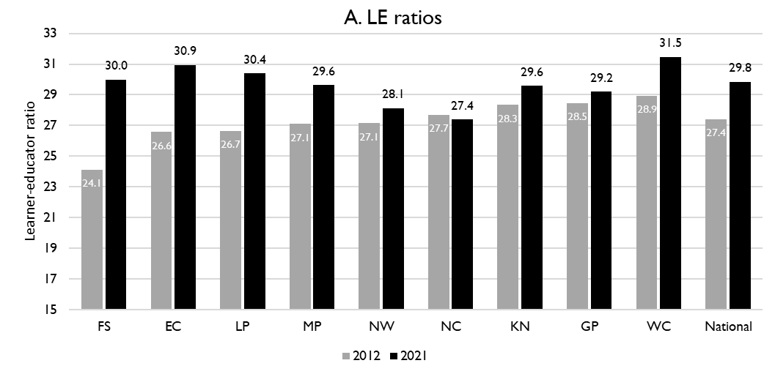
Learner-public educator ratio in ‘12 & ‘21
6
National and provincial learner-to-public-educator ratios in 2012 and 2021, grades 1 to 12 in public ordinary schools in South Africa
z
z
LE ratio rose from 27.1 learners per educator to 28.1 learners per educator in the North West between 2012 and 2021
Excl. SGB teachers
Source: Figure 1 in South African teacher shortages as revealed through class sizes and learner-educator ratios: An exploratory analysis by Gabrielle Wills (2023)

Slide 38
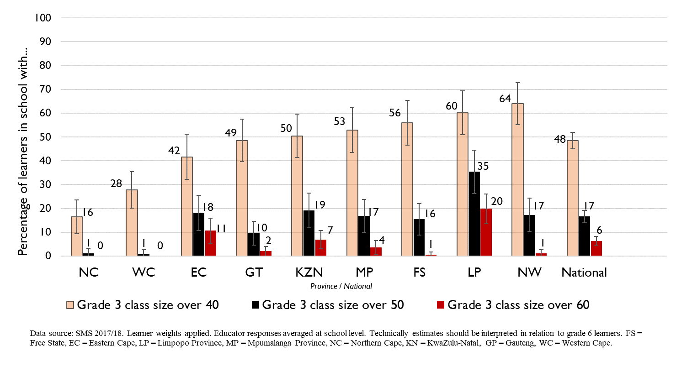
Grade 3 class sizes
(2017/18 School Monitoring Survey)
6
Post-provisioning guidelines - Class sizes should not exceed 35 in Grade 3.
% of learners in grade 3 classes > 40:
48% in SA, 64% in NW
% of learners in grade 3 classes > 50:
17% in SA, ~17% in NW
% of learners in grade 3 classes > 60:
6% in SA, ~1% in NW
Note: Nationally, grade 3 enrolment numbers had been rising from about 2011 and peaked in 2017 before starting to decline slightly, stabilising at about 1,1 million in 2021 (Gustafsson 2022a, p10-11). Holding other things constant, grade 3 class sizes will be similar or slightly smaller in 2022 than what is seen in these 2017/18 SMS estimates.

Slide 39
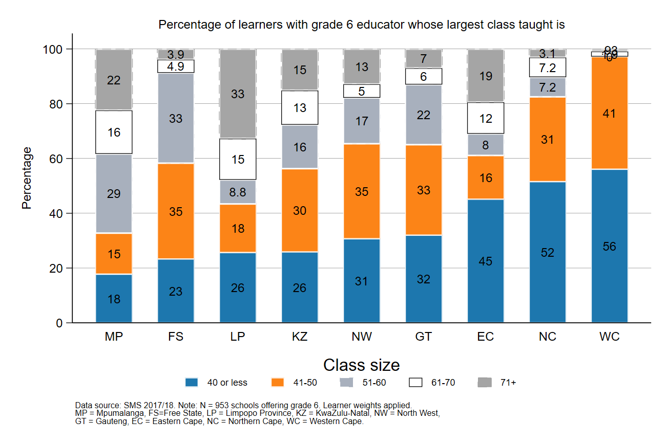
Largest classes - School Monitoring Survey 2017/18
6
In 2017/18, the North West had less than 35% of Gr6 learners in schools with large classes (>50 learners)
A further deterioration of the LE ratio will drive up class size and the number of excessively large classes, negatively impacting quality and teacher motivation
Percentage of grade 6 learners in schools with an educator reporting that their largest class is in the following class size category, disaggregated by province (SMS 2017/18)
Source: Figure 1 in South African teacher shortages as revealed through class sizes and learner-educator ratios: An exploratory analysis by Gabrielle Wills (2023) using School Monitoring Survey 2017/18 (953 schools, learner weighted).

Slide 40
Expected financial implications to 2030
7

Slide 41
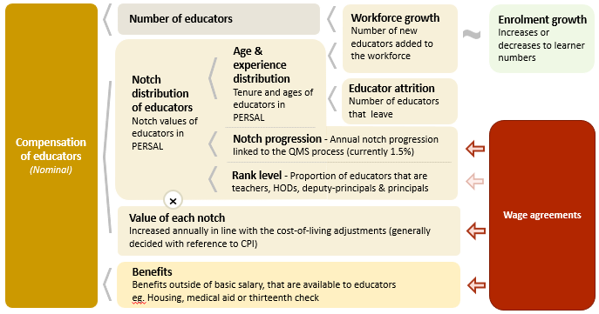
Unit cost drivers
7

Slide 42
Real and nominal costs
7
Examples:
In 2022 CPI was 7.2%
If nominal wages increase by 7.2%, then real wages increase by 0%
If nominal wages increase by 9%, then real wages increase by 1.8%
If nominal wages increase by 5%, then real wages decrease by 2.2%
A real increase in wages takes place when wages increase above the rate of inflation
Changes to real wages are an indicator of purchasing power

Slide 43
Projected unit costs trends| All educators
7
In constant 2021 rands
Note: Scale not from zero
Source: Own calculations, using the anonymised PERSAL data from 2021, only 405 413 educators are considered. ECD practitioners and examination reviewers removed. Estimates to 2030 derived from the national and provincial TSD models. Assumption of no growth in educator numbers.

Slide 44
Indexed unit costs trends| All educators
7
In constant 2021 rands
GP: 1% increase
Educator unit cost
(Index in 2022 = 100%)
WC: <1.5% decrease
Note: Scale not from zero
WC growth adjusted
Source: Own calculations, using the anonymised PERSAL data from 2021, only 405 413 educators are considered. ECD practitioners and examination reviewers removed. Estimates to 2030 derived from the national and provincial TSD models. Assumption of no growth in educator numbers for FS, KN, LP, MP, NC, NW and SA. Assume 20% educator growth for GP, 10% for WC and a decline in 10% of educators in the EC. In LP assume that the proportion of senior educators grows from 16% in 2021 to 21% in 2030.

Slide 45
Indexed unit costs trends| All educators
7
In constant 2021 rands
NW: ~0,5% increase to 2030
Educator unit cost
(Index in 2022 = 100%)
Note: Scale not from zero
WC growth adjusted
Source: Own calculations, using the anonymised PERSAL data from 2021, only 405 413 educators are considered. ECD practitioners and examination reviewers removed. Estimates to 2030 derived from the national and provincial TSD models. Assumption of no growth in educator numbers for FS, KN, LP, MP, NC, NW and SA. Assume 20% educator growth for GP, 10% for WC and a decline in 10% of educators in the EC. In LP assume that the proportion of senior educators grows from 16% in 2021 to 21% in 2030.

Slide 46
Projected unit costs trends| All educators
7
In constant 2021 rands
L1 Teachers
(School based teachers)
Senior educators
(HODs, Deputy’s, Principals & Other)
-3%
Average annual unit cost
(In 2021 Rands)
+2%
Note: Scale not from zero
GP growth adjusted
Source: Own calculations, using the anonymised PERSAL data from 2021, only 405 413 educators are considered. ECD practitioners and examination reviewers removed. Estimates to 2030 derived from the national and provincial TSD models. Assumption of no growth in educator numbers for FS, KN, LP, MP, NC, NW and SA. Assume 20% educator growth for GP, 10% for WC and a decline in 10% of educators in the EC. In LP assume that the proportion of non-teachers grows from 16% in 2021 to 21% in 2030.

Slide 47
Between and within province movement
8

Slide 48
Inter-provincial educator movement (7-yr)
8
 |  | Province in 2019 |  |  |  |  |  |  |  |  |  |  | Movement out of province
 |  | EC | FS | GP | KN | LP | MP | NC | NW | WC | Total
Province in 2012 | EC | 97.79 | 0.10 | 0.86 | 0.22 | 0.01 | 0.04 | 0.11 | 0.19 | 0.70 | 100 |  | 2.23%
 | FS | 0.35 | 94.25 | 2.76 | 0.10 | 0.07 | 0.23 | 0.41 | 1.56 | 0.26 | 100 |  | 5.74%
 | GP | 0.15 | 0.26 | 96.86 | 0.27 | 0.81 | 0.42 | 0.05 | 0.93 | 0.24 | 100 |  | 3.13%
 | KN | 0.22 | 0.10 | 1.14 | 97.95 | 0.10 | 0.37 | 0.01 | 0.06 | 0.04 | 100 |  | 2.04%
 | LP | 0.02 | 0.02 | 1.72 | 0.02 | 96.80 | 0.80 | 0.05 | 0.56 | 0.02 | 100 |  | 3.21%
 | MP | 0.03 | 0.14 | 2.48 | 0.37 | 1.54 | 94.86 | 0.03 | 0.49 | 0.07 | 100 |  | 5.15%
 | NC | 0.47 | 0.50 | 0.47 | 0.06 | 0.59 | 0.03 | 94.35 | 2.37 | 1.15 | 100 |  | 5.64%
 | NW | 0.06 | 0.59 | 3.84 | 0.03 | 0.65 | 0.34 | 0.75 | 93.60 | 0.14 | 100 |  | 6.40%
 | WC | 0.72 | 0.03 | 0.17 | 0.05 | 0.00 | 0.02 | 0.35 | 0.03 | 98.61 | 100 |  | 1.37%
Source: PERSAL 10-year anonymised dataset, only educators that were in the dataset for 2012 and 2019 are considered here

Slide 49
Inter-provincial educator movement (7-yr)
8
 |  | Province in 2019 |  |  |  |  |  |  |  |  |  |  | Movement out of province
 |  | EC | FS | GP | KN | LP | MP | NC | NW | WC | Total
Province in 2012 | EC | 97.79 | 0.10 | 0.86 | 0.22 | 0.01 | 0.04 | 0.11 | 0.19 | 0.70 | 100 |  | 2.23%
 | FS | 0.35 | 94.25 | 2.76 | 0.10 | 0.07 | 0.23 | 0.41 | 1.56 | 0.26 | 100 |  | 5.74%
 | GP | 0.15 | 0.26 | 96.86 | 0.27 | 0.81 | 0.42 | 0.05 | 0.93 | 0.24 | 100 |  | 3.13%
 | KN | 0.22 | 0.10 | 1.14 | 97.95 | 0.10 | 0.37 | 0.01 | 0.06 | 0.04 | 100 |  | 2.04%
 | LP | 0.02 | 0.02 | 1.72 | 0.02 | 96.80 | 0.80 | 0.05 | 0.56 | 0.02 | 100 |  | 3.21%
 | MP | 0.03 | 0.14 | 2.48 | 0.37 | 1.54 | 94.86 | 0.03 | 0.49 | 0.07 | 100 |  | 5.15%
 | NC | 0.47 | 0.50 | 0.47 | 0.06 | 0.59 | 0.03 | 94.35 | 2.37 | 1.15 | 100 |  | 5.64%
 | NW | 0.06 | 0.59 | 3.84 | 0.03 | 0.65 | 0.34 | 0.75 | 93.60 | 0.14 | 100 |  | 6.40%
 | WC | 0.72 | 0.03 | 0.17 | 0.05 | 0.00 | 0.02 | 0.35 | 0.03 | 98.61 | 100 |  | 1.37%
NW had the highest level of interprovincial movement– about 6.4% of NW teachers from 2012 are teaching in a different province in 2019
Educators are most likely to move to Gauteng
zvc
zvc
Source: PERSAL 10-year anonymised dataset, only educators that were in the dataset for 2012 and 2019 are considered here

Slide 50
Inter-provincial educator movement (7-yr)
8
 |  | Province in 2019
 |  | EC | FS | GP | KN | LP | MP | NC | NW | WC
Province in 2012 | EC | 42 645 | 42 | 373 | 95 | 5 | 16 | 46 | 82 | 304
 | FS | 57 | 15 267 | 447 | 17 | 11 | 38 | 67 | 252 | 42
 | GP | 67 | 117 | 42 770 | 121 | 356 | 187 | 20 | 409 | 108
 | KN | 146 | 67 | 755 | 64 723 | 64 | 247 | 9 | 37 | 26
 | LP | 10 | 10 | 709 | 7 | 39 899 | 328 | 20 | 230 | 7
 | MP | 7 | 34 | 618 | 94 | 385 | 23 644 | 7 | 121 | 17
 | NC | 31 | 33 | 31 | 4 | 39 | 2 | 6 214 | 156 | 76
 | NW | 12 | 111 | 726 | 5 | 123 | 65 | 141 | 17 690 | 27
 | WC | 152 | 7 | 37 | 11 | 0 | 5 | 75 | 6 | 20 858
 | Total 2019 | 43 127 | 15 688 | 46 466 | 65 077 | 40 882 | 24 532 | 6 599 | 18 983 | 21 465
 | Movement into province | 482 | 421 | 3 696 | 354 | 983 | 888 | 385 | 1 293 | 607
 | % movement into province | 1.1% | 2.7% | 8.0% | 0.5% | 2.4% | 3.6% | 5.8% | 6.8% | 2.8%
Source: PERSAL 10-year anonymised dataset, only educators that were in the dataset for 2012 and 2019 are considered here

Slide 51
Inter-provincial educator movement (7-yr)
8
Many educators moved to NW- about 7% of educators in 2019 (that were educators in 2012 already) had come from another province
Most educators came from GP, FS, LP & NC. The provinces from which there is little movement to NW is the WC and the KN
 |  | Province in 2019
 |  | EC | FS | GP | KN | LP | MP | NC | NW | WC
Province in 2012 | EC | 42 645 | 42 | 373 | 95 | 5 | 16 | 46 | 82 | 304
 | FS | 57 | 15 267 | 447 | 17 | 11 | 38 | 67 | 252 | 42
 | GP | 67 | 117 | 42 770 | 121 | 356 | 187 | 20 | 409 | 108
 | KN | 146 | 67 | 755 | 64 723 | 64 | 247 | 9 | 37 | 26
 | LP | 10 | 10 | 709 | 7 | 39 899 | 328 | 20 | 230 | 7
 | MP | 7 | 34 | 618 | 94 | 385 | 23 644 | 7 | 121 | 17
 | NC | 31 | 33 | 31 | 4 | 39 | 2 | 6 214 | 156 | 76
 | NW | 12 | 111 | 726 | 5 | 123 | 65 | 141 | 17 690 | 27
 | WC | 152 | 7 | 37 | 11 | 0 | 5 | 75 | 6 | 20 858
 | Total 2019 | 43 127 | 15 688 | 46 466 | 65 077 | 40 882 | 24 532 | 6 599 | 18 983 | 21 465
 | Movement into province | 482 | 421 | 3 696 | 354 | 983 | 888 | 385 | 1 293 | 607
 | % movement into province | 1.1% | 2.7% | 8.0% | 0.5% | 2.4% | 3.6% | 5.8% | 6.8% | 2.8%
zvc
zvc
Source: PERSAL 10-year anonymised dataset, only educators that were in the dataset for 2012 and 2019 are considered here

Slide 52
Educator movement between schools
8
Fair amount of movement between schools; about 6% of North West educators (5% nationally) move to a different pay point but stay within PERSAL from 2018-2019
Rate at which educators aged 50 and below leave the system is comparable with the national average of ~4%
 | Pay point in 2019 (Ordinary schools only)
Province | Same as in 2018 (%) | Different to 2018 (%) | None - left system (%) | Total (%)
EC | 93.25 | 4.61 | 2.14 | 100
FS | 90.54 | 5.54 | 3.93 | 100
GP | 91.08 | 3.95 | 4.97 | 100
KN | 91.99 | 4.31 | 3.70 | 100
LP | 91.04 | 6.95 | 2.00 | 100
MP | 92.02 | 4.66 | 3.32 | 100
NC | 85.44 | 8.39 | 6.18 | 100
NW | 89.42 | 6.30 | 4.28 | 100
WC | 87.27 | 6.09 | 6.64 | 100
Total | 91.11 | 5.05 | 3.83 | 100
Source: PERSAL 10-year anonymised dataset. Only included educators aged 50 years and below, that were in ordinary schools in 2018 (Primary, Secondary, Combined and Intermediate)—excluded all paypoints that did not appear in both years after identifying 103 paypoints where the paypoint number changed.

Slide 53
Gender imbalances in management
9

Slide 54
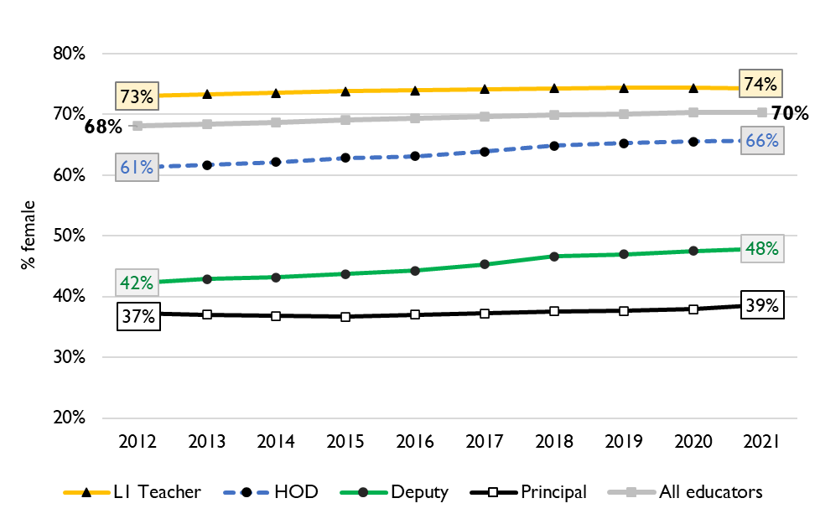
Percentage of educators that are female
9
Percentage of public educators in South Africa that are female, PERSAL (2012-2021)
Nationally, there has been very little transformation in senior school leadership in terms of gender since 2012 and even since 2004 (just 34% of principals were female).
There is better representation at middle-management (HOD) level.
Source: Using anonymised 10-year PERSAL data from 2012 to 2021, only educators of the ranks: level 1 teacher, HOD, deputy principal and principal are considered.

Slide 55
Percentage of educators that are female
9
In North West in 2021, 71% of all educators were women. Women were reasonably well represented at the HOD level at 69% of HODs.
Yet only 52% of deputy principals and 41% of principals were women.
Source: Using anonymised 10-year PERSAL data from 2012 to 2021, only educators of the ranks: level 1 teacher, HOD, deputy principal and principal are considered.

Slide 56
General questions and discussion
10
Does NW keep a database of unemployed teachers? If so, who is the contact person?
Do you track what subjects and phases teachers are needed?
What is the process for principals and senior educator mentorship, selection and induction
Is gender equity in management a concern in NW
Is there any concern about retention in the province
How did the NW manage the sudden spike in resignations in 2015 due to the rumours of pension reform?

Slide 57
Conclusion
Alongside the coming age-related teacher retirements, North West will also see a high number of senior educators (Principals, Deputies, HODs and other education specialists) retiring.
70% of senior educators and other education specialists were 50 or older in 2021
Careful succession planning, efficient promotion processes, and good onboarding practices will be required to manage this transition as they retire
School-aged population and enrolment are projected to increase. Educator numbers are also expected to increase, but they lag behind growth in enrolment in public ordinary schools
To ensure LE ratios and class sizes do not worsen, educator numbers need to rise to respond to the higher enrolment adequately
North West has high levels of educator movement within and out of the province
The real unit cost for all educators is expected to increase (<1%) slightly in the North West over the period 2022-2030

