Slide 1
Western Cape Province 3 August 2023
Educator Demand Projections
2021-2030

Slide 2
Introduction (1)
The proportion of educators that are 50 years or older has steadily risen between 2012 to 2021 in South Africa.
⇒ Nationally a wave of educator retirements is expected as older educators reach the standard retirement age of between 60 and 65.
Implications:
Many more appointments: The retirement wave will open up both teaching & school management & leadership positions & other office-based education specialists.
Total compensation of educators: Since older teachers earn more, when retiring they are replaced with younger (less costly) teachers, although this overall benefit is offset by shift to 1.5% annual notch progression.

Slide 3
Introduction (2)
As retirements increase, the required number of new appointments will need to increase to ensure that total educator numbers (at a minimum) stay at current levels and/or are sufficient to meet learner enrolment growth to prevent deterioration in learner-educator ratios.
Planning will be required to ensure that provinces are ready for the sustained increase in appointments.
If these positions are not filled, this could result in a further deterioration in the learner-educator ratio and lead to further increases in already large class sizes.

Slide 4
Introduction (3)
Educator age distribution in 2012 & 2021 in SA
Peak in age shifted from 46 years to 53 years
Source: Anonymised PERSAL data from 2021, only educators (Rank 60 000 – 69 999) are considered. ECD practitioners, TVET lecturers and ABET teachers were removed.

Slide 5
Objective
In each province there are some differences in the age profile of teachers, differences in the expected growth of the school-going population and differences in expected teacher attrition (resignations & retirements).
⇒ The year of the retirement wave peak will differ across provinces.
⇒ Also some provinces need to accommodate much more growth in
learners than others.
In this presentation, we highlight the situation in Western Cape to
inform province-specific planning.

Slide 6
Overview
Age distributions
Projected retirements & resignations
Provincial population and enrolment trends
Public and independent school growth
Educator growth: Teachers and SMT positions
The implications for appointments and class sizes
Expected financial implications to 2030
Movement of educators: Between and within provinces
Gender imbalance in school management
Discussion
1
2
3
4
5
6
7
8
9
10

Slide 7
Western Cape educator demand summary
Age distribution: The age distribution in the Western had a peak at around 55 years of age in 2021
Projected resignations and retirements: Age-related retirement in the WC has already been high since about 2015; the number of senior educators (SMT positions and other specialists) that are retiring is expected to increase (73% were 50+ years old in 2021)
Enrolment and population growth: Enrolment in WC ordinary schools grew by 22% from 2012 to 2021 (~230K learners), the school-aged population is forecast to grow by 15% (~200K learners) to 2030
School and educator growth: From 2012 to 2021, the educator number in public schools increased but less than enrolment (+12%), increasing the LE ratio (excl. SGB). School numbers stayed constant.
SMT position changes: In the WC, there has been a decline in the number of HODs (-9%), deputy principals (-3%), and principals (-13%) from 2012 to 2021, but teacher numbers increased (+22%)
Appointments and LE Ratio: Increases in appointments are needed in response to enrolment growth; otherwise, the LE ratio will increase further (it rose from 28.9 to 31.5 from 2012 to 2021)
Projected educator cost trends: WC will experience a fall in average cost of educators (especially for senior educators, real decline of ~7%). The decrease in educator unit cost should free up some budget to replace and grow the educator workforce, increase promotion rates or other spending
Educator movements: Low movements into and out of the Western Cape, but the attrition rate of younger educators (aged 50 and below) is relatively high, about 6.5%.

Slide 8
Age distributions and projected retirements and resignations
1
2

Slide 9
Educator age distribution (2021)
1
Source: Anonymised PERSAL data from 2021, only educators (Rank 60 000 – 69 999) are considered. ECD practitioners, TVET lecturers and ABET teachers were removed.

Slide 10
Educator age distribution (2021)
1
A lower proportion of educators are over 50 years old in the Western Cape than in the rest of the country.
A higher proportion of young educators under 35 years in the WC
Age: 55
Source: Anonymised PERSAL data from 2021, only educators (Rank 60 000 – 69 999) are considered. ECD practitioners, TVET lecturers and ABET teachers were removed.

Slide 11
Older teacher proportions for senior educator and primary schools educators
1
 |  | Percentage of educators aged 50+ in 2021
Province |  | All educators |  | Senior educators (HOD, Dep.- principals, Principals & Other) |  | Primary school educators
EC |  | 51% |  | 71% |  | 58%
FS |  | 43% |  | 65% |  | 49%
GP |  | 41% |  | 65% |  | 42%
KN |  | 39% |  | 65% |  | 44%
LP |  | 58% |  | 81% |  | 63%
MP |  | 50% |  | 73% |  | 55%
NC |  | 43% |  | 69% |  | 44%
NW |  | 47% |  | 70% |  | 52%
WC |  | 42% |  | 73% |  | 40%
Source: Anonymised PERSAL data from 2021, only educators (Rank 60 000 – 69 999) are considered. ECD practitioners, TVET lecturers and ABET teachers were removed. The 2021 rankclass file was expanded to include ranks found only in years prior to 2021, used to classify educators by rank. Primary school only includes all educators that are in a component that is classified as a Primary school.

Slide 12
Older teacher proportions for senior educator and primary schools educators
1
 |  | Percentage of educators aged 50+ in 2021
Province |  | All educators |  | Senior educators (HOD, Dep.- principals, Principals & Other) |  | Primary school educators
EC |  | 51% |  | 71% |  | 58%
FS |  | 43% |  | 65% |  | 49%
GP |  | 41% |  | 65% |  | 42%
KN |  | 39% |  | 65% |  | 44%
LP |  | 58% |  | 81% |  | 63%
MP |  | 50% |  | 73% |  | 55%
NC |  | 43% |  | 69% |  | 44%
NW |  | 47% |  | 70% |  | 52%
WC |  | 42% |  | 73% |  | 40%
zvc
Large numbers of SMT positions and education specialists were aged 50 years and older in 2021 in the WC
Source: Anonymised PERSAL data from 2021, only educators (Rank 60 000 – 69 999) are considered. ECD practitioners, TVET lecturers and ABET teachers were removed. The 2021 rankclass file was expanded to include ranks found only in years prior to 2021, used to classify educators by rank. Primary school only includes all educators that are in a component that is classified as a Primary school.

Slide 13
Educator age distribution 2012, 2021 & 2030
1
Assume constant 2021 educator numbers
Source: Anonymised PERSAL data from 2021, only educators (Rank 60 000 – 69 999) are considered. ECD practitioners, TVET lecturers and ABET teachers were removed.

Slide 14
Educator age distribution 2012, 2021 & 2030
1
Assume constant 2021 educator numbers
Source: Anonymised PERSAL data from 2021, only educators (Rank 60 000 – 69 999) are considered. ECD practitioners, TVET lecturers and ABET teachers were removed.

Slide 15
Educator age distribution 2012, 2021 & 2030
1
Assume constant 2021 educator numbers
Source: Anonymised PERSAL data from 2021, only educators (Rank 60 000 – 69 999) are considered. ECD practitioners, TVET lecturers and ABET teachers were removed.

Slide 16
Educator age distribution 2012, 2021 & 2030
1
Assume constant 2021 educator numbers
A flatter age distribution is expected in 2030, with higher proportion of younger educators
WC already had a high proportion of educators age 50+ in 2012
Source: Anonymised PERSAL data from 2021, only educators (Rank 60 000 – 69 999) are considered. ECD practitioners, TVET lecturers and ABET teachers were removed.

Slide 17
Projected resignation & retirements (WC)
2
Assume constant 2021 educator numbers
Proportion of Educators
The majority of educators that exit PERSAL in the Western Cape are aged 55 and below
The number of young teachers (ages 21-30) resigning is projected to increase as the number of newly hired young teachers increases
The proportion of retirements of total leavers is expected to decline from 2022 to 2030
Projected
% of educators resigning or retiring
Source: Anonymised 10-year PERSAL data, only educators (Rank 60 000 – 69 999) are considered. ECD practitioners, TVET lecturers and ABET teachers were removed. Estimates to 2035 derived from the National and provincial models – assumption of no growth in educator numbers.

Slide 18
Projected resignation & retirements (WC)
2
Assume constant 2021 educator numbers
Retirement headcount
Projected
The number of retirements in the Western Cape is roughly at its peak in about 2022-2025
The number of retirements is projected to decrease from about 1,400 in 2022 to about 900 in 2035
Number of retirements
Source: Anonymised 2021 PERSAL data, only educators (Rank 60 000 – 69 999) are considered. ECD practitioners, TVET lecturers and ABET teachers were removed. Estimates to 2035 derived from the National and provincial models – assumption of no growth in educator numbers.

Slide 19
Older leaver trend estimates to 2035
2
Assume constant 2021 educator numbers
About 17,000
educators estimated to retire by 2035 in the WC
(48% of total educators in 2021)
Source: Anonymised 2021 PERSAL data, only educators (Rank 60 000 – 69 999) are considered. ECD practitioners, TVET lecturers and ABET teachers were removed. Estimates to 2035 derived from the National and provincial models – assumption of no growth in educator numbers.

Slide 20
Projected educators leaving
2
Assume constant 2021 educator numbers
Teachers
(School-based teachers)
Senior educator
(HODs, Deputy’s, Principals & Other)
% of teacher resigning & retiring
% of senior educators resigning & retiring
A higher proportion of teachers are expected to resign and retire in WC relative to SA; many of them are younger educators
Careful succession planning is needed over the next ten years as high numbers of HODs, deputies and principals are projected to leave
Source: Anonymised 2021 PERSAL data, only educators (Rank 60 000 – 69 999) are considered. ECD practitioners, TVET lecturers and ABET teachers were removed. Estimates to 2035 derived from the National and provincial models – assumption of no growth in educator numbers.

Slide 21
Provincial population and enrolment trends
3

Slide 22
Provincial enrolment trends (2012-2021)
3
High growth
Moderate growth
Stable
Decline
Source: Enrolment numbers taken from School Realities-EMIS (2012 – 2021) released by the DBE, using total numbers for ordinary public and independent schools.

Slide 23
Provincial enrolment trends (2012-2021)
3
Enrolment in Western Cape ordinary schools
grew by 22%
from 2012 to 2021
Source: Enrolment numbers taken from School Realities-EMIS (2012 – 2021) released by the DBE, using total numbers for ordinary public and independent schools.

Slide 24
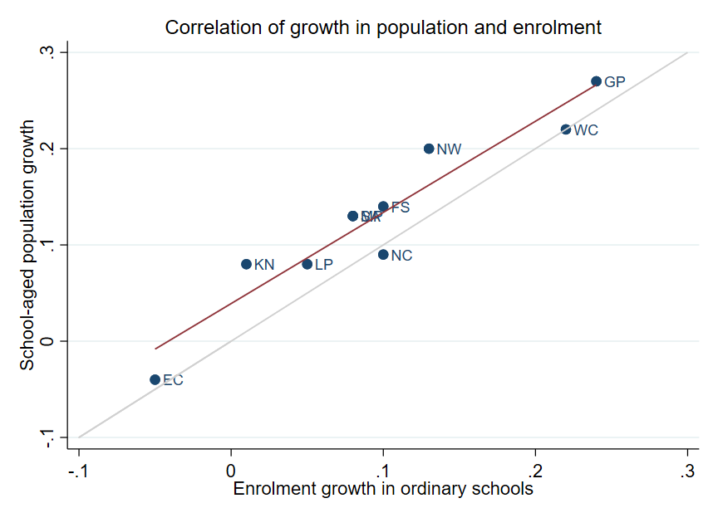
Correlation between population and enrolment growth (2012-2021)
3
R² = 0.9025
Strong positive correlation between population and enrolment growth between 2012 and 2021
45˚
Source: Thembisa age specific data V4.5 for school-aged population (Ages 7-18) estimates and enrolment taken from School Realities-EMIS (2012 – 2021) released by the DBE, for numbers on ordinary public and independent schools (Statistical Publications (education.gov.za))

Slide 25
Projected growth in school-aged population
3
Population of children aged 7-18 in the Western Cape is expected to grow by
~200K children (15%)
from 2021 to 2030
Note: Period 2021 – 2030 is the same timeframe, nine years, as 2012 – 2021.
Source: Thembisa age-specific estimates from the model V4.5 for children aged 7-18 by province

Slide 26
School aged-population estimates to 2030
3
 | Number of children Aged 7-18 |  |  |  | Growth '12-21 | Growth '21-30
Province | 2012 | 2021 | 2030E
EC | 1 657 202 | 1 598 475 | 1 361 637 |  | -4% | -15%
FS | 592 445 | 676 489 | 650 820 |  | 14% | -4%
GP | 1 962 793 | 2 498 533 | 3 180 884 |  | 27% | 27%
KN | 2 485 822 | 2 690 378 | 2 657 716 |  | 8% | -1%
LP | 1 395 864 | 1 507 386 | 1 612 125 |  | 8% | 7%
MP | 977 749 | 1 100 594 | 1 165 728 |  | 13% | 6%
NC | 254 075 | 277 560 | 281 208 |  | 9% | 1%
NW | 742 943 | 893 530 | 930 323 |  | 20% | 4%
WC | 1 068 009 | 1 298 801 | 1 496 731 |  | 22% | 15%
Total | 11 136 902 | 12 541 746 | 13 337 172 |  | 13% | 6%
1.50M
1.30M
1.07M
Note: Period 2021 – 2030 is the same timeframe, nine years, as 2012 – 2021.
Source: Thembisa age-specific estimates from the model V4.5 for children aged 7-18 by province

Slide 27
Public and independent school growth
4

Slide 28
Educator, school and enrolment growth
4
 | % growth from 2012 - 2021
Province | Number of educators | Number of teachers |  | Number of public ordinary schools | Enrolment in public ordinary schools | Enrolment in ordinary schools |  | Est. school-aged population
EC | -17% | -20% |  | -8% | -6% | -5% |  | -4%
FS | -13% | -13% |  | -27% | 9% | 10% |  | 14%
GP | 21% | 28% |  | 1% | 20% | 24% |  | 27%
KN | -5% | -3% |  | -3% | 1% | 1% |  | 8%
LP | -8% | -2% |  | -7% | 4% | 5% |  | 8%
MP | 3% | 7% |  | -8% | 7% | 8% |  | 13%
NC | 6% | 9% |  | -3% | 9% | 10% |  | 9%
NW | 2% | 4% |  | -9% | 12% | 13% |  | 20%
WC | 12% | 22% |  | 0% | 21% | 22% |  | 22%
SA | -1% | 2% |  | -6% | 7% | 8% |  | 13%
Source: Educator numbers from anonymised PERSAL data from 2012 and 2021, only educators (Rank 60 000 – 69 999) are considered. Thembisa age specific data V4.5 for school-aged population (Ages 7-18) estimates and enrolment and school numbers taken from School Realities-EMIS (2012 – 2021) released by the DBE, for numbers on ordinary public and independent schools (Statistical Publications (education.gov.za))

Slide 29
Educator, school and enrolment growth
4
 | % growth from 2012 - 2021
Province | Number of educators | Number of teachers |  | Number of public ordinary schools | Enrolment in public ordinary schools | Enrolment in ordinary schools |  | Est. school-aged population
EC | -17% | -20% |  | -8% | -6% | -5% |  | -4%
FS | -13% | -13% |  | -27% | 9% | 10% |  | 14%
GP | 21% | 28% |  | 1% | 20% | 24% |  | 27%
KN | -5% | -3% |  | -3% | 1% | 1% |  | 8%
LP | -8% | -2% |  | -7% | 4% | 5% |  | 8%
MP | 3% | 7% |  | -8% | 7% | 8% |  | 13%
NC | 6% | 9% |  | -3% | 9% | 10% |  | 9%
NW | 2% | 4% |  | -9% | 12% | 13% |  | 20%
WC | 12% | 22% |  | 0% | 21% | 22% |  | 22%
SA | -1% | 2% |  | -6% | 7% | 8% |  | 13%
z
The increase in the number of all publicly paid educators in the Western Cape is much lower then the growth in enrolment….
Source: Educator numbers from anonymised PERSAL data from 2012 and 2021, only educators (Rank 60 000 – 69 999) are considered. Thembisa age specific data V4.5 for school-aged population (Ages 7-18) estimates and enrolment and school numbers taken from School Realities-EMIS (2012 – 2021) released by the DBE, for numbers on ordinary public and independent schools (Statistical Publications (education.gov.za))

Slide 30
Educator, school and enrolment growth
4
 | % growth from 2012 - 2021
Province | Number of educators | Number of teachers |  | Number of public ordinary schools | Enrolment in public ordinary schools | Enrolment in ordinary schools |  | Est. school-aged population
EC | -17% | -20% |  | -8% | -6% | -5% |  | -4%
FS | -13% | -13% |  | -27% | 9% | 10% |  | 14%
GP | 21% | 28% |  | 1% | 20% | 24% |  | 27%
KN | -5% | -3% |  | -3% | 1% | 1% |  | 8%
LP | -8% | -2% |  | -7% | 4% | 5% |  | 8%
MP | 3% | 7% |  | -8% | 7% | 8% |  | 13%
NC | 6% | 9% |  | -3% | 9% | 10% |  | 9%
NW | 2% | 4% |  | -9% | 12% | 13% |  | 20%
WC | 12% | 22% |  | 0% | 21% | 22% |  | 22%
SA | -1% | 2% |  | -6% | 7% | 8% |  | 13%
z
The increase in the number of L1 teachers in the Western Cape appears to be more responsive to growth in enrolment….
Source: Educator numbers from anonymised PERSAL data from 2012 and 2021, only educators (Rank 60 000 – 69 999) are considered. Thembisa age specific data V4.5 for school-aged population (Ages 7-18) estimates and enrolment and school numbers taken from School Realities-EMIS (2012 – 2021) released by the DBE, for numbers on ordinary public and independent schools (Statistical Publications (education.gov.za))

Slide 31
Educator, school and enrolment growth
4
 | % growth from 2012 - 2021
Province | Number of educators | Number of teachers |  | Number of public ordinary schools | Enrolment in public ordinary schools | Enrolment in ordinary schools |  | Est. school-aged population
EC | -17% | -20% |  | -8% | -6% | -5% |  | -4%
FS | -13% | -13% |  | -27% | 9% | 10% |  | 14%
GP | 21% | 28% |  | 1% | 20% | 24% |  | 27%
KN | -5% | -3% |  | -3% | 1% | 1% |  | 8%
LP | -8% | -2% |  | -7% | 4% | 5% |  | 8%
MP | 3% | 7% |  | -8% | 7% | 8% |  | 13%
NC | 6% | 9% |  | -3% | 9% | 10% |  | 9%
NW | 2% | 4% |  | -9% | 12% | 13% |  | 20%
WC | 12% | 22% |  | 0% | 21% | 22% |  | 22%
SA | -1% | 2% |  | -6% | 7% | 8% |  | 13%
z
Enrolment and educator numbers grew in the Western Cape, whilst the number of public ordinary schools remained constant....
Source: Educator numbers from anonymised PERSAL data from 2012 and 2021, only educators (Rank 60 000 – 69 999) are considered. Thembisa age specific data V4.5 for school-aged population (Ages 7-18) estimates and enrolment and school numbers taken from School Realities-EMIS (2012 – 2021) released by the DBE, for numbers on ordinary public and independent schools (Statistical Publications (education.gov.za))

Slide 32
School growth from 2012 to 2021
4
School growth was driven by independent school growth (+37%) from 2012 to 2021. In contrast, the number of public schools in SA decreased (-6%)
EC | FS | GP | KN | LP | MP | NC | NW | WC | SA
% independent schools (2021)
4%
8%
30%
4%
5%
7%
7%
6%
17%
9%
Source: School numbers taken from School Realities-EMIS (2012 – 2021) released by the DBE, for numbers on ordinary public and independent schools (Statistical Publications (education.gov.za))

Slide 33
School growth from 2012 to 2021
4
High growth in the number of independent schools in the WC (+61%), with enrolment growing from about 46K to 68K children (+46%)
EC | FS | GP | KN | LP | MP | NC | NW | WC | SA
% independent schools (2021)
4%
8%
30%
4%
5%
7%
7%
6%
17%
30%
17%
9%
Source: School numbers taken from School Realities-EMIS (2012 – 2021) released by the DBE, for numbers on ordinary public and independent schools (Statistical Publications (education.gov.za))

Slide 34
Educator growth by teachers and SMT positions
5

Slide 35
Changes in teacher and SMT numbers
5
 |  | Teacher |  |  |  |  | HOD |  |  |  |  | Deputy-Principal |  |  |  |  | Principal
Province |  | 2012 | 2021 | Diff | % change |  | 2012 | 2021 | Diff | % change |  | 2012 | 2021 | Diff | % change |  | 2012 | 2021 | Diff | % change
EC |  | 50 295 | 40 115 | -10 180 | -20% |  | 5 870 | 6 196 | 326 | 6% |  | 1 342 | 1 453 | 111 | 8% |  | 5 294 | 4 755 | - 539 | -10%
FS |  | 20 148 | 17 561 | -2 587 | -13% |  | 2 685 | 2 470 | - 215 | -8% |  | 852 | 768 | - 84 | -10% |  | 1 224 | 892 | - 332 | -27%
GP |  | 47 233 | 60 677 | 13 444 | 28% |  | 8 708 | 9 209 | 501 | 6% |  | 2 565 | 2 850 | 285 | 11% |  | 2 162 | 1 959 | - 203 | -9%
KN |  | 73 050 | 71 000 | -2 050 | -3% |  | 11 289 | 10 330 | - 959 | -8% |  | 2 642 | 2 342 | - 300 | -11% |  | 5 584 | 5 055 | - 529 | -9%
LP |  | 44 998 | 44 317 | - 681 | -2% |  | 6 090 | 3 762 | -2 328 | -38% |  | 1 562 | 778 | - 784 | -50% |  | 3 510 | 3 316 | - 194 | -6%
MP |  | 26 127 | 27 857 | 1 730 | 7% |  | 4 047 | 4 055 | 8 | 0% |  | 1 108 | 1 114 | 6 | 1% |  | 1 790 | 1 450 | - 340 | -19%
NC |  | 7 257 | 7 929 | 672 | 9% |  | 1 034 | 1 094 | 60 | 6% |  | 294 | 365 | 71 | 24% |  | 587 | 488 | - 99 | -17%
NW |  | 21 305 | 22 261 | 956 | 4% |  | 2 994 | 3 023 | 29 | 1% |  | 902 | 1 041 | 139 | 15% |  | 1 698 | 1 338 | - 360 | -21%
WC |  | 23 579 | 28 665 | 5 086 | 22% |  | 4 065 | 3 700 | - 365 | -9% |  | 1 334 | 1 297 | - 37 | -3% |  | 1 531 | 1 339 | - 192 | -13%
SA |  | 313 992 | 320 382 | 6 390 | 2% |  | 46 782 | 43 839 | -2 943 | -6% |  | 12 601 | 12 008 | - 593 | -5% |  | 23 380 | 20 592 | -2 788 | -12%
Source: Anonymised PERSAL data from 2012 and 2021, only educators (Rank 60 000 – 69 999) are considered. ECD practitioners, TVET lecturers, and ABET teachers were removed. The 2021 rankclass file was expanded to include ranks found only in years prior to 2021.

Slide 36
Changes in teacher and SMT numbers
5
 |  | Teacher |  |  |  |  | HOD |  |  |  |  | Deputy-Principal |  |  |  |  | Principal
Province |  | 2012 | 2021 | Diff | % change |  | 2012 | 2021 | Diff | % change |  | 2012 | 2021 | Diff | % change |  | 2012 | 2021 | Diff | % change
EC |  | 50 295 | 40 115 | -10 180 | -20% |  | 5 870 | 6 196 | 326 | 6% |  | 1 342 | 1 453 | 111 | 8% |  | 5 294 | 4 755 | - 539 | -10%
FS |  | 20 148 | 17 561 | -2 587 | -13% |  | 2 685 | 2 470 | - 215 | -8% |  | 852 | 768 | - 84 | -10% |  | 1 224 | 892 | - 332 | -27%
GP |  | 47 233 | 60 677 | 13 444 | 28% |  | 8 708 | 9 209 | 501 | 6% |  | 2 565 | 2 850 | 285 | 11% |  | 2 162 | 1 959 | - 203 | -9%
KN |  | 73 050 | 71 000 | -2 050 | -3% |  | 11 289 | 10 330 | - 959 | -8% |  | 2 642 | 2 342 | - 300 | -11% |  | 5 584 | 5 055 | - 529 | -9%
LP |  | 44 998 | 44 317 | - 681 | -2% |  | 6 090 | 3 762 | -2 328 | -38% |  | 1 562 | 778 | - 784 | -50% |  | 3 510 | 3 316 | - 194 | -6%
MP |  | 26 127 | 27 857 | 1 730 | 7% |  | 4 047 | 4 055 | 8 | 0% |  | 1 108 | 1 114 | 6 | 1% |  | 1 790 | 1 450 | - 340 | -19%
NC |  | 7 257 | 7 929 | 672 | 9% |  | 1 034 | 1 094 | 60 | 6% |  | 294 | 365 | 71 | 24% |  | 587 | 488 | - 99 | -17%
NW |  | 21 305 | 22 261 | 956 | 4% |  | 2 994 | 3 023 | 29 | 1% |  | 902 | 1 041 | 139 | 15% |  | 1 698 | 1 338 | - 360 | -21%
WC |  | 23 579 | 28 665 | 5 086 | 22% |  | 4 065 | 3 700 | - 365 | -9% |  | 1 334 | 1 297 | - 37 | -3% |  | 1 531 | 1 339 | - 192 | -13%
SA |  | 313 992 | 320 382 | 6 390 | 2% |  | 46 782 | 43 839 | -2 943 | -6% |  | 12 601 | 12 008 | - 593 | -5% |  | 23 380 | 20 592 | -2 788 | -12%
zvc
Large decline in principal numbers between 2012 and 2021
(principal appointments still in progress, potentially delayed by COVID)
Source: Anonymised PERSAL data from 2012 and 2021, only educators (Rank 60 000 – 69 999) are considered. ECD practitioners, TVET lecturers, and ABET teachers were removed. The 2021 rankclass file was expanded to include ranks found only in years prior to 2021.

Slide 37
Changes in teacher and SMT numbers
5
 |  | Teacher |  |  |  |  | HOD |  |  |  |  | Deputy-Principal |  |  |  |  | Principal
Province |  | 2012 | 2021 | Diff | % change |  | 2012 | 2021 | Diff | % change |  | 2012 | 2021 | Diff | % change |  | 2012 | 2021 | Diff | % change
EC |  | 50 295 | 40 115 | -10 180 | -20% |  | 5 870 | 6 196 | 326 | 6% |  | 1 342 | 1 453 | 111 | 8% |  | 5 294 | 4 755 | - 539 | -10%
FS |  | 20 148 | 17 561 | -2 587 | -13% |  | 2 685 | 2 470 | - 215 | -8% |  | 852 | 768 | - 84 | -10% |  | 1 224 | 892 | - 332 | -27%
GP |  | 47 233 | 60 677 | 13 444 | 28% |  | 8 708 | 9 209 | 501 | 6% |  | 2 565 | 2 850 | 285 | 11% |  | 2 162 | 1 959 | - 203 | -9%
KN |  | 73 050 | 71 000 | -2 050 | -3% |  | 11 289 | 10 330 | - 959 | -8% |  | 2 642 | 2 342 | - 300 | -11% |  | 5 584 | 5 055 | - 529 | -9%
LP |  | 44 998 | 44 317 | - 681 | -2% |  | 6 090 | 3 762 | -2 328 | -38% |  | 1 562 | 778 | - 784 | -50% |  | 3 510 | 3 316 | - 194 | -6%
MP |  | 26 127 | 27 857 | 1 730 | 7% |  | 4 047 | 4 055 | 8 | 0% |  | 1 108 | 1 114 | 6 | 1% |  | 1 790 | 1 450 | - 340 | -19%
NC |  | 7 257 | 7 929 | 672 | 9% |  | 1 034 | 1 094 | 60 | 6% |  | 294 | 365 | 71 | 24% |  | 587 | 488 | - 99 | -17%
NW |  | 21 305 | 22 261 | 956 | 4% |  | 2 994 | 3 023 | 29 | 1% |  | 902 | 1 041 | 139 | 15% |  | 1 698 | 1 338 | - 360 | -21%
WC |  | 23 579 | 28 665 | 5 086 | 22% |  | 4 065 | 3 700 | - 365 | -9% |  | 1 334 | 1 297 | - 37 | -3% |  | 1 531 | 1 339 | - 192 | -13%
SA |  | 313 992 | 320 382 | 6 390 | 2% |  | 46 782 | 43 839 | -2 943 | -6% |  | 12 601 | 12 008 | - 593 | -5% |  | 23 380 | 20 592 | -2 788 | -12%
zvc
Decline in HOD and deputy principal numbers between 2012 and 2021, possibly due to budget constraints
Source: Anonymised PERSAL data from 2012 and 2021, only educators (Rank 60 000 – 69 999) are considered. ECD practitioners, TVET lecturers, and ABET teachers were removed. The 2021 rankclass file was expanded to include ranks found only in years prior to 2021.

Slide 38
Proportional split by educator rank
5
 | All Educators |  |  | Teacher |  |  | HOD |  |  | Dep.-Principal |  |  | Principal |  |  | Other
 | 2012 | 2021 |  | 2012 | 2021 |  | 2012 | 2021 |  | 2012 | 2021 |  | 2012 | 2021 |  | 2012 | 2021
EC | 100% | 100% |  | 78% | 75% |  | 9% | 12% |  | 2.1% | 2.7% |  | 8.2% | 8.8% |  | 2.5% | 2.4%
FS | 100% | 100% |  | 78% | 78% |  | 10% | 11% |  | 3.3% | 3.4% |  | 4.7% | 4.0% |  | 3.7% | 3.3%
GP | 100% | 100% |  | 74% | 79% |  | 14% | 12% |  | 4.0% | 3.7% |  | 3.4% | 2.6% |  | 4.4% | 2.7%
KN | 100% | 100% |  | 77% | 79% |  | 12% | 11% |  | 2.8% | 2.6% |  | 5.9% | 5.6% |  | 2.1% | 1.3%
LP | 100% | 100% |  | 78% | 84% |  | 11% | 7% |  | 2.7% | 1.5% |  | 6.1% | 6.3% |  | 2.1% | 1.5%
MP | 100% | 100% |  | 76% | 79% |  | 12% | 12% |  | 3.2% | 3.2% |  | 5.2% | 4.1% |  | 3.2% | 1.8%
NC | 100% | 100% |  | 75% | 77% |  | 11% | 11% |  | 3.0% | 3.6% |  | 6.1% | 4.8% |  | 5.1% | 3.9%
NW | 100% | 100% |  | 76% | 78% |  | 11% | 11% |  | 3.2% | 3.7% |  | 6.1% | 4.7% |  | 3.7% | 2.6%
WC | 100% | 100% |  | 74% | 80% |  | 13% | 10% |  | 4.2% | 3.6% |  | 4.8% | 3.7% |  | 4.1% | 2.1%
SA | 100% | 100% |  | 77% | 79% |  | 11% | 11% |  | 3.1% | 3.0% |  | 5.7% | 5.1% |  | 3.1% | 2.1%
Source: Anonymised PERSAL data from 2012 and 2021, only educators (Rank 60 000 – 69 999) are considered. ECD practitioners TVET lecturers and ABET teachers were removed. The 2021 rankclass file was expanded to include ranks found only in years prior to 2021. The percentage within each rank is calculated taking the total number of educator in that year for that rank over the total number of educators in that year.

Slide 39
Proportional split by educator rank
5
 | All Educators |  |  | Teacher |  |  | HOD |  |  | Dep.-Principal |  |  | Principal |  |  | Other
 | 2012 | 2021 |  | 2012 | 2021 |  | 2012 | 2021 |  | 2012 | 2021 |  | 2012 | 2021 |  | 2012 | 2021
EC | 100% | 100% |  | 78% | 75% |  | 9% | 12% |  | 2.1% | 2.7% |  | 8.2% | 8.8% |  | 2.5% | 2.4%
FS | 100% | 100% |  | 78% | 78% |  | 10% | 11% |  | 3.3% | 3.4% |  | 4.7% | 4.0% |  | 3.7% | 3.3%
GP | 100% | 100% |  | 74% | 79% |  | 14% | 12% |  | 4.0% | 3.7% |  | 3.4% | 2.6% |  | 4.4% | 2.7%
KN | 100% | 100% |  | 77% | 79% |  | 12% | 11% |  | 2.8% | 2.6% |  | 5.9% | 5.6% |  | 2.1% | 1.3%
LP | 100% | 100% |  | 78% | 84% |  | 11% | 7% |  | 2.7% | 1.5% |  | 6.1% | 6.3% |  | 2.1% | 1.5%
MP | 100% | 100% |  | 76% | 79% |  | 12% | 12% |  | 3.2% | 3.2% |  | 5.2% | 4.1% |  | 3.2% | 1.8%
NC | 100% | 100% |  | 75% | 77% |  | 11% | 11% |  | 3.0% | 3.6% |  | 6.1% | 4.8% |  | 5.1% | 3.9%
NW | 100% | 100% |  | 76% | 78% |  | 11% | 11% |  | 3.2% | 3.7% |  | 6.1% | 4.7% |  | 3.7% | 2.6%
WC | 100% | 100% |  | 74% | 80% |  | 13% | 10% |  | 4.2% | 3.6% |  | 4.8% | 3.7% |  | 4.1% | 2.1%
SA | 100% | 100% |  | 77% | 79% |  | 11% | 11% |  | 3.1% | 3.0% |  | 5.7% | 5.1% |  | 3.1% | 2.1%
zvc
The portions of the different educator ranks in the Western Cape appear to be roughly in line with the national average in 2021
Source: Anonymised PERSAL data from 2012 and 2021, only educators (Rank 60 000 – 69 999) are considered. ECD practitioners TVET lecturers and ABET teachers were removed. The 2021 rankclass file was expanded to include ranks found only in years prior to 2021. The percentage within each rank is calculated taking the total number of educator in that year for that rank over the total number of educators in that year.

Slide 40
Implications for appointments, class sizes and infrastructure
6

Slide 41
Projected increase in appointments & promotions
6
Increase in expected annual over the period 2026 to 2030 relative to 2012 to 2021, if growth in the workforce (~+10%) is assumed
Appointment processes will need to be strengthened
~850
additional educators will
need to be appointed
annually
~4 000
educators
3 145
educators
Mean number of annual joiners over the period 2012 - 2021
Projected mean number of annual leavers from 2026 – 2030, plus educators needed to grow workforce by 10%* to 2030
*Assumes total educator numbers increase by ~400 educators annually between 2022 - 2030

Slide 42
Projected increase in appointments & promotions
6
Increase in expected annual promotions over the period 2026 to 2030 relative to 2012 to 2021 of about 45%.
Promotion processes will need to be strengthened, and careful succession planning will be required
~200 - 250
Additional promotion posts will be vacated annually
~740
educators
510
educators
Mean number of senior educators that left annually over the period 2012 - 2021
Projected number of senior educators that leave annually over the period 2026 – 2030, assuming 0% growth* in promotion positions
*A conservative estimate, as this assumes only existing posts will be filled, no new posts created

Slide 43
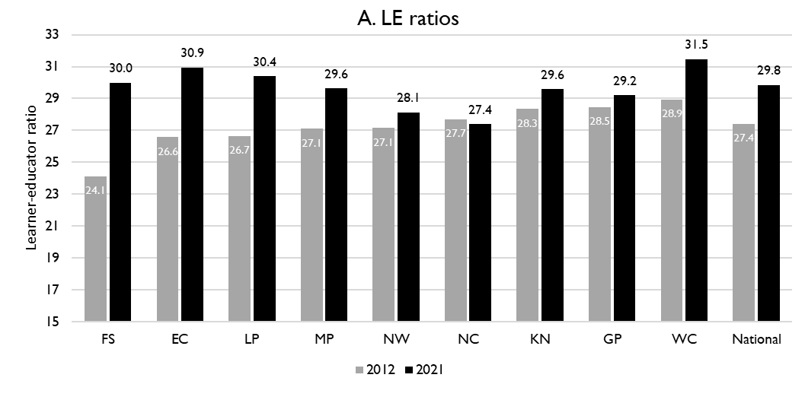
Learner-public educator ratios (‘12 & ’21)
6
National and provincial learner-to-public-educator ratios in 2012 and 2021, grades 1 to 12 in public ordinary schools in South Africa
z
LE ratio rose from 28.9 learners per educator to 31.5 learners per educator in Western Cape, more than the national average.
However, some of this is offset by SGB positions.
Excl. SGB teachers
Source: Figure 1 in South African teacher shortages as revealed through class sizes and learner-educator ratios: An exploratory analysis by Gabrielle Wills (2023)

Slide 44
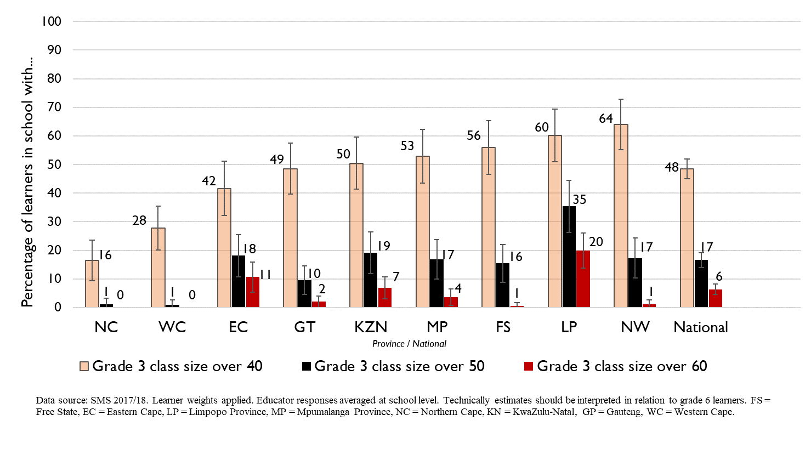
Grade 3 class sizes
(2017/18 School Monitoring Survey)
Post-provisioning guidelines - Class sizes should not exceed 35 in Grade 3.
% of learners in grade 3 classes > 40:
48% in SA, 28% in WC
% of learners in grade 3 classes > 50:
17% in SA, ~1% in WC
% of learners in grade 3 classes > 60:
6% in SA, ~0% in WC
Note: Nationally, grade 3 enrolment numbers had been rising from about 2011 and peaked in 2017 before starting to decline slightly, stabilising at about 1,1 million in 2021 (Gustafsson 2022a, p10-11). Holding other things constant, grade 3 class sizes will be similar or slightly smaller in 2022 than what is seen in these 2017/18 SMS estimates.

Slide 45
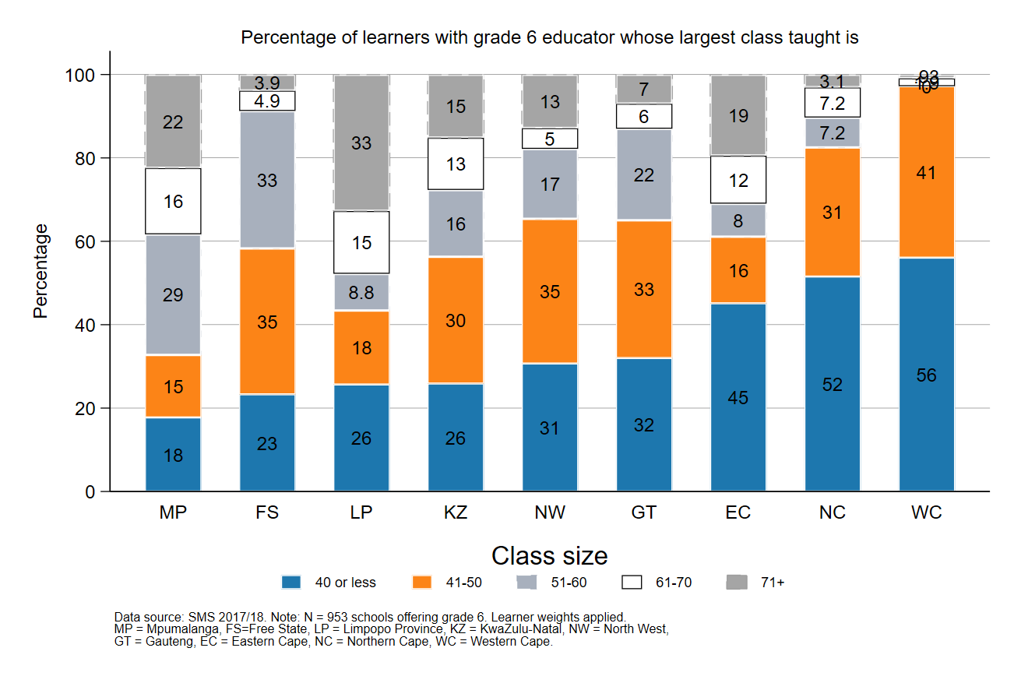
Largest classes - School Monitoring Survey 2017/18
6
In 2017/18, the Western Cape was the province with the lowest percentage of large classes with more than 50 learners (~3%)
A further deterioration of the LE ratio will drive up class size and the number of excessively large classes, negatively impacting quality and teacher motivation
Percentage of grade 6 learners in schools with an educator reporting that their largest class is in the following class size category, disaggregated by province (SMS 2017/18)
Source: Figure 1 in South African teacher shortages as revealed through class sizes and learner-educator ratios: An exploratory analysis by Gabrielle Wills (2023) using School Monitoring Survey 2017/18 (953 schools, learner weighted).

Slide 46
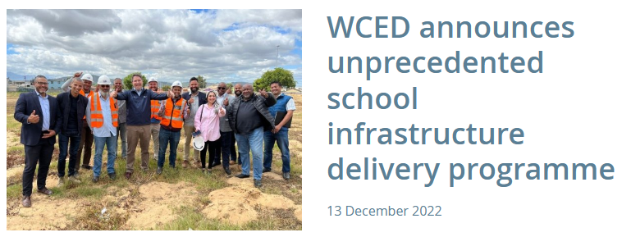
Western Cape school infrastructure plans
6
Programme looks positive
What are the plans for the coming years?
To be completed by March 2023
Source: WCED website https://wcedonline.westerncape.gov.za/news/wced-announces-unprecedented-school-infrastructure-delivery-programme

Slide 47
Expected financial implications to 2030
7

Slide 48
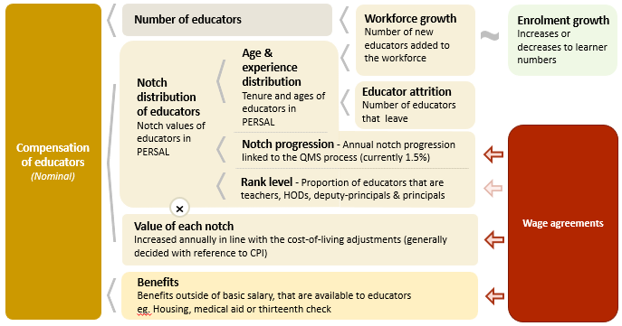
Unit cost drivers
7

Slide 49
Real and nominal costs
7
Examples:
In 2022 CPI was 7.2%
If nominal wages increase by 7.2%, then real wages increase by 0%
If nominal wages increase by 9%, then real wages increase by 1.8%
If nominal wages increase by 5%, then real wages decrease by 2.2%
A real increase in wages takes place when wages increase above the rate of inflation
Changes to real wages are an indicator of purchasing power

Slide 50
Projected unit costs trends| All educators
7
In constant 2021 rands
Note: Scale not from zero
Source: Own calculations, using the anonymised PERSAL data from 2021, only educators are considered. ECD practitioners and examination reviewers removed. Estimates to 2030 derived from the national and provincial TSD models. Assumption of no growth in educator numbers.

Slide 51
Projected unit costs trends| All educators
7
In constant 2021 rands
Some decline in the real unit cost of educators is expected in the WC (<1.5%) from 2022 to 2030
Note: Scale not from zero
Adjusted the expected growth in educator numbers
Assume 10% growth in educators from 2021 to 2030 in the WC
WC growth adjusted
Source: Own calculations, using the anonymised PERSAL data from 2021, only educators are considered. ECD practitioners and examination reviewers removed. Estimates to 2030 derived from the national and provincial TSD models. Assumption of no growth in educator numbers for FS, KN, LP, MP, NC, NW and SA. Assume 20% educator growth for GP, 10% for WC and a decline in 10% of educators in the EC. In LP assume that the proportion of senior educators grows from 16% in 2021 to 21% in 2030.

Slide 52
Indexed unit costs trends| All educators
7
In constant 2021 rands
GP: 1% increase
Educator unit cost
(Index in 2022 = 100%)
WC: <1.5% decrease
Note: Scale not from zero
WC growth adjusted
Source: Own calculations, using the anonymised PERSAL data from 2021, only educators are considered. ECD practitioners and examination reviewers removed. Estimates to 2030 derived from the national and provincial TSD models. Assumption of no growth in educator numbers for FS, KN, LP, MP, NC, NW and SA. Assume 20% educator growth for GP, 10% for WC and a decline in 10% of educators in the EC. In LP assume that the proportion of senior educators grows from 16% in 2021 to 21% in 2030.

Slide 53
Projected unit costs trends| All educators
7
In constant 2021 rands
Teachers
(School-based teachers)
Senior educators
(HODs, Deputy’s, Principals & Other)
-7%
+1%
Average annual unit cost
(In 2021 Rands)
Note: Scale not from zero
WC growth adjusted
Source: Own calculations, using the anonymised PERSAL data from 2021, only educators are considered. ECD practitioners and examination reviewers removed. Estimates to 2030 derived from the national and provincial TSD models. Assumption of no growth in educator numbers for FS, KN, LP, MP, NC, NW and SA. Assume 20% educator growth for GP, 10% for WC and a decline in 10% of educators in the EC. In LP assume that the proportion of senior educators grows from 16% in 2021 to 21% in 2030.

Slide 54
Gender imbalances in management
9

Slide 55
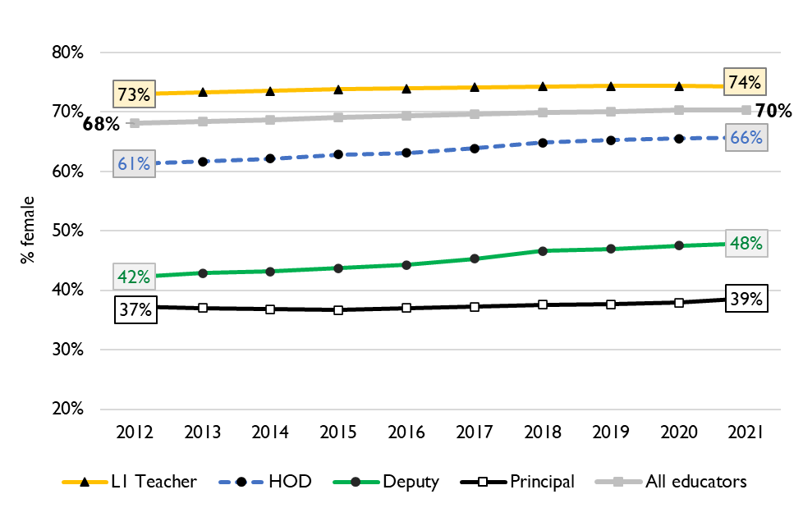
Percentage of educators that are female
9
Percentage of public educators in South Africa that are female, PERSAL (2012-2021)
Nationally, there has been very little transformation in senior school leadership in terms of gender since 2012 and even since 2004 (just 34% of principals were female).
There is better representation at middle-management (HOD) level.
Source: Using anonymised 10-year PERSAL data from 2012 to 2021, only educators of the ranks: level 1 teacher, HOD, deputy principal and principal are considered.

Slide 56
Percentage of educators that are female
9
In the Western Cape in 2021, 72% of all educators were women, yet only 47% of deputy principals and 32% of principals were women.
Source: Using anonymised 10-year PERSAL data from 2012 to 2021, only educators of the ranks: level 1 teacher, HOD, deputy principal and principal are considered.

Slide 57
Between and within province movement
8

Slide 58
Inter-provincial educator movement (7-yr)
8
 |  | Province in 2019 |  |  |  |  |  |  |  |  |  |  | Movement out of province
 |  | EC | FS | GP | KN | LP | MP | NC | NW | WC | Total
Province in 2012 | EC | 97.79 | 0.10 | 0.86 | 0.22 | 0.01 | 0.04 | 0.11 | 0.19 | 0.70 | 100 |  | 2.23%
 | FS | 0.35 | 94.25 | 2.76 | 0.10 | 0.07 | 0.23 | 0.41 | 1.56 | 0.26 | 100 |  | 5.74%
 | GP | 0.15 | 0.26 | 96.86 | 0.27 | 0.81 | 0.42 | 0.05 | 0.93 | 0.24 | 100 |  | 3.13%
 | KN | 0.22 | 0.10 | 1.14 | 97.95 | 0.10 | 0.37 | 0.01 | 0.06 | 0.04 | 100 |  | 2.04%
 | LP | 0.02 | 0.02 | 1.72 | 0.02 | 96.80 | 0.80 | 0.05 | 0.56 | 0.02 | 100 |  | 3.21%
 | MP | 0.03 | 0.14 | 2.48 | 0.37 | 1.54 | 94.86 | 0.03 | 0.49 | 0.07 | 100 |  | 5.15%
 | NC | 0.47 | 0.50 | 0.47 | 0.06 | 0.59 | 0.03 | 94.35 | 2.37 | 1.15 | 100 |  | 5.64%
 | NW | 0.06 | 0.59 | 3.84 | 0.03 | 0.65 | 0.34 | 0.75 | 93.60 | 0.14 | 100 |  | 6.40%
 | WC | 0.72 | 0.03 | 0.17 | 0.05 | 0.00 | 0.02 | 0.35 | 0.03 | 98.61 | 100 |  | 1.37%
Source: PERSAL 10-year anonymised dataset, only educators that were in the dataset for 2018 and 2019 are considered here

Slide 59
Inter-provincial educator movement (7-yr)
8
 |  | Province in 2019 |  |  |  |  |  |  |  |  |  |  | Movement out of province
 |  | EC | FS | GP | KN | LP | MP | NC | NW | WC | Total
Province in 2012 | EC | 97.79 | 0.10 | 0.86 | 0.22 | 0.01 | 0.04 | 0.11 | 0.19 | 0.70 | 100 |  | 2.23%
 | FS | 0.35 | 94.25 | 2.76 | 0.10 | 0.07 | 0.23 | 0.41 | 1.56 | 0.26 | 100 |  | 5.74%
 | GP | 0.15 | 0.26 | 96.86 | 0.27 | 0.81 | 0.42 | 0.05 | 0.93 | 0.24 | 100 |  | 3.13%
 | KN | 0.22 | 0.10 | 1.14 | 97.95 | 0.10 | 0.37 | 0.01 | 0.06 | 0.04 | 100 |  | 2.04%
 | LP | 0.02 | 0.02 | 1.72 | 0.02 | 96.80 | 0.80 | 0.05 | 0.56 | 0.02 | 100 |  | 3.21%
 | MP | 0.03 | 0.14 | 2.48 | 0.37 | 1.54 | 94.86 | 0.03 | 0.49 | 0.07 | 100 |  | 5.15%
 | NC | 0.47 | 0.50 | 0.47 | 0.06 | 0.59 | 0.03 | 94.35 | 2.37 | 1.15 | 100 |  | 5.64%
 | NW | 0.06 | 0.59 | 3.84 | 0.03 | 0.65 | 0.34 | 0.75 | 93.60 | 0.14 | 100 |  | 6.40%
 | WC | 0.72 | 0.03 | 0.17 | 0.05 | 0.00 | 0.02 | 0.35 | 0.03 | 98.61 | 100 |  | 1.37%
Very low level of movement between provinces – only 1.37% of Western Cape teachers from 2012 are teaching in a different province in 2019
Educators are most likely to move to the Eastern Cape
zvc
Source: PERSAL 10-year anonymised dataset, only educators that were in the dataset for 2018 and 2019 are considered here

Slide 60
Inter-provincial educator movement (7-yr)
8
 |  | Province in 2019
 |  | EC | FS | GP | KN | LP | MP | NC | NW | WC
Province in 2012 | EC | 42 645 | 42 | 373 | 95 | 5 | 16 | 46 | 82 | 304
 | FS | 57 | 15 267 | 447 | 17 | 11 | 38 | 67 | 252 | 42
 | GP | 67 | 117 | 42 770 | 121 | 356 | 187 | 20 | 409 | 108
 | KN | 146 | 67 | 755 | 64 723 | 64 | 247 | 9 | 37 | 26
 | LP | 10 | 10 | 709 | 7 | 39 899 | 328 | 20 | 230 | 7
 | MP | 7 | 34 | 618 | 94 | 385 | 23 644 | 7 | 121 | 17
 | NC | 31 | 33 | 31 | 4 | 39 | 2 | 6 214 | 156 | 76
 | NW | 12 | 111 | 726 | 5 | 123 | 65 | 141 | 17 690 | 27
 | WC | 152 | 7 | 37 | 11 | 0 | 5 | 75 | 6 | 20 858
 | Total 2019 | 43 127 | 15 688 | 46 466 | 65 077 | 40 882 | 24 532 | 6 599 | 18 983 | 21 465
 | Movement into province | 482 | 421 | 3 696 | 354 | 983 | 888 | 385 | 1 293 | 607
 | % movement into province | 1.1% | 2.7% | 8.0% | 0.5% | 2.4% | 3.6% | 5.8% | 6.8% | 2.8%
Source: PERSAL 10-year anonymised dataset, only educators that were in the dataset for 2012 and 2019 are considered here

Slide 61
Inter-provincial educator movement (7-yr)
8
 |  | Province in 2019
 |  | EC | FS | GP | KN | LP | MP | NC | NW | WC
Province in 2012 | EC | 42 645 | 42 | 373 | 95 | 5 | 16 | 46 | 82 | 304
 | FS | 57 | 15 267 | 447 | 17 | 11 | 38 | 67 | 252 | 42
 | GP | 67 | 117 | 42 770 | 121 | 356 | 187 | 20 | 409 | 108
 | KN | 146 | 67 | 755 | 64 723 | 64 | 247 | 9 | 37 | 26
 | LP | 10 | 10 | 709 | 7 | 39 899 | 328 | 20 | 230 | 7
 | MP | 7 | 34 | 618 | 94 | 385 | 23 644 | 7 | 121 | 17
 | NC | 31 | 33 | 31 | 4 | 39 | 2 | 6 214 | 156 | 76
 | NW | 12 | 111 | 726 | 5 | 123 | 65 | 141 | 17 690 | 27
 | WC | 152 | 7 | 37 | 11 | 0 | 5 | 75 | 6 | 20 858
 | Total 2019 | 43 127 | 15 688 | 46 466 | 65 077 | 40 882 | 24 532 | 6 599 | 18 983 | 21 465
 | Movement into province | 482 | 421 | 3 696 | 354 | 983 | 888 | 385 | 1 293 | 607
 | % movement into province | 1.1% | 2.7% | 8.0% | 0.5% | 2.4% | 3.6% | 5.8% | 6.8% | 2.8%
Few educators moved to WC, only 2.8% of educators in 2019 had come from another province between 2012 to 2019
The provinces that sent the highest number of educators were the EC and GP
zvc
Source: PERSAL 10-year anonymised dataset, only educators that were in the dataset for 2012 and 2019 are considered here

Slide 62
Educator movement between schools
8
Fair amount of movement between schools, about 6% of Western Cape educators (5% nationally) move to a different paypoint but stay within PERSAL from 2018-2019
Rate at which educators aged 50 and below leave the system is much higher in the Western Cape (6.6%) than the national average (3.8%)
 | Paypoint in 2019 (Ordinary schools only)
Province | Same as in 2018 (%) | Different to 2018 (%) | None - left system (%) | Total (%)
EC | 93.25 | 4.61 | 2.14 | 100
FS | 90.54 | 5.54 | 3.93 | 100
GP | 91.08 | 3.95 | 4.97 | 100
KN | 91.99 | 4.31 | 3.70 | 100
LP | 91.04 | 6.95 | 2.00 | 100
MP | 92.02 | 4.66 | 3.32 | 100
NC | 85.44 | 8.39 | 6.18 | 100
NW | 89.42 | 6.30 | 4.28 | 100
WC | 87.27 | 6.09 | 6.64 | 100
Total | 91.11 | 5.05 | 3.83 | 100
Source: PERSAL 10-year anonymised dataset. Only included educators aged 50 years and below, that were in ordinary schools in 2018 (Primary, Secondary, Combined and Intermediate)—excluded all paypoints that did not appear in both years after identifying 103 paypoints where the paypoint number changed.

Slide 63
Conclusion
10
The Western Cape faces a relatively high rate of replacement, with about 9% of educators forecast to leave PERSAL annually to 2030, driven by a high proportion of younger educators (aged 55 and below) resigning
A high proportion of SMT (Principals, Deputies and HODs) and other education specialists (73%) are over 50. Careful succession planning, efficient promotion processes, and good on-boarding practices will be required to manage this transition as they retire.
Due to predicted population growth (~15% from 2021 to 2030), educator numbers will need to rise in the WC to keep pace with the demand for schooling; if employment does not expand, LE ratios and class sizes will increase even further
The cost structure will improve due to the shift in age profile, which should give the province some space in the budget to hire more teachers, ensure promotions are finalised or to expand other spending.

Slide 64
General questions and discussion
10
Infrastructure: How close is the province to achieving the large growth that is required by 2030?
What is the process for principals and senior educator mentorship, selection and induction?
How much of a concern is gender equity in management in WC?
Do you track what subjects and phases teachers are needed:
Is there a list of the positions requested by principals or positions filled? Or of educators that have left?

